Slide 1
German Credit Dataset
David de Vega Martin
Notes:
© Copyright PresentationGO.com – Free Templates & Infographics for PowerPoint and Google Slides

Slide 2
German Credit Data
Objective of the study I
The objective of this study is to address a credit quality assessment problem.
The analysis will focus on the variable "default", a qualitative, dichotomous variable where:
1 indicates good credit quality.
2 indicates poor credit quality.
By comparing the "default" variable, we will evaluate each associated variable, grouping them into several categories to improve overall comprehension.
Credit Profile Objectives
Goal: Obtain a profile of the types of loans granted by the bank.
Key Variables:
Default: Credit quality.
Duration in months: Length of the loan in months.
Credit Amount: Loan amount.
Purpose: Reason for financing.
Number of existing credits at this bank: Number of other loans at the bank.
.

Slide 3
German Credit Data
Objective of the study II
Client Profile Objectives
Goal: Create a profile of the bank's clients.
Approach: Evaluate from three perspectives: Personal, Asset, and Financial.
Personal Profile Variables
To assess the client's personal situation, we use the following variables:
Personal status and sex: Gender and marital status.
Age: Age of the client.
Job: Type of job.
Present employment since: Duration of current employment.
Foreign worker: Nationality or foreign status.
Dependents: Number of dependents.
Telephone: Whether the client has a telephone.
Asset Profile Variables
For the asset profile, the following variables will be analyzed:
Housing: Type of housing tenure.
Property: Type of property owned.
Present residence since: Duration of stay at current residence.

Slide 4
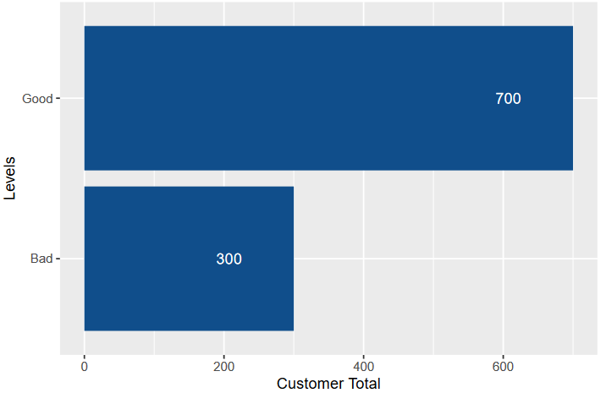
German Credit Data
Objective of the study III
Financial Profile Variables
To establish a credit profile of the client, we examine:
Status of existing checking account: Balance of the client’s bank account.
Credit History: Credit history.
Saving account: Savings account balance.
Installment rate as a percentage of disposable income: Leverage based on client’s income.
Other debtors: Any additional debts.
Other installment plans: Other installment-based purchases.
In figure we can see proportion of credits

Slide 5
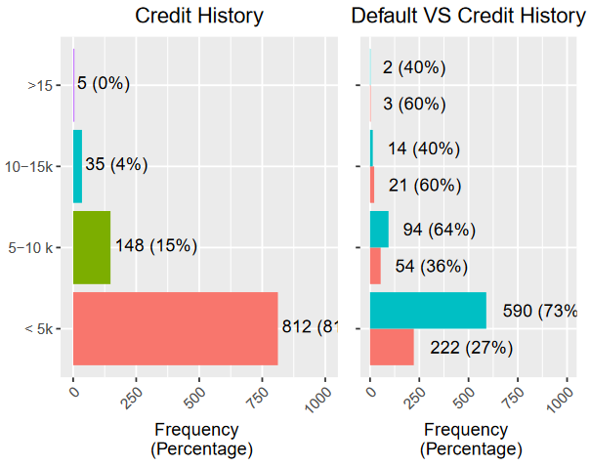
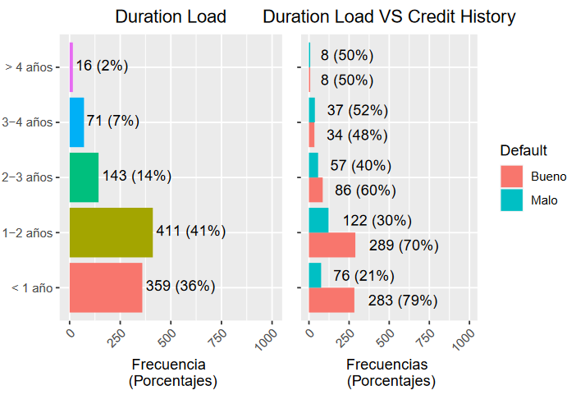
German Credit Data
Credit Profile Objectives I:
Credit Quantity
Credit Duration

Slide 6
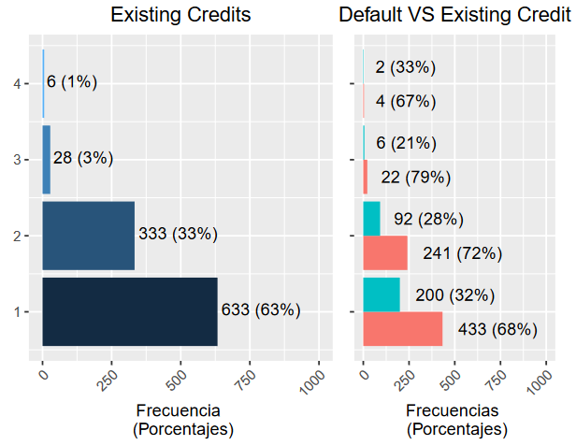
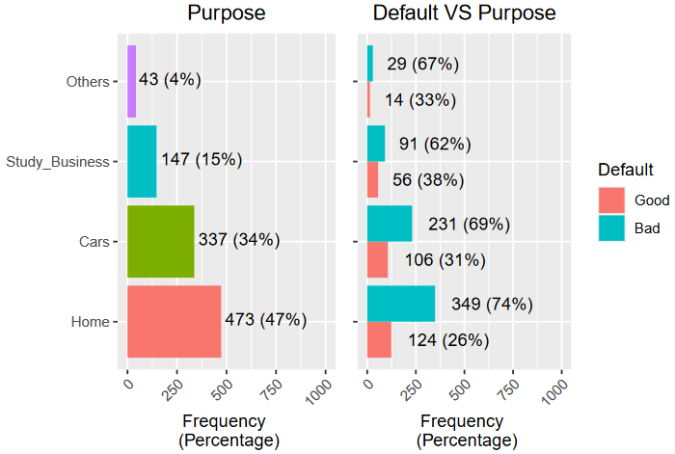
German Credit Data
Credit Profile Objectives II:
Number of Credit
Credit Purpose

Slide 7
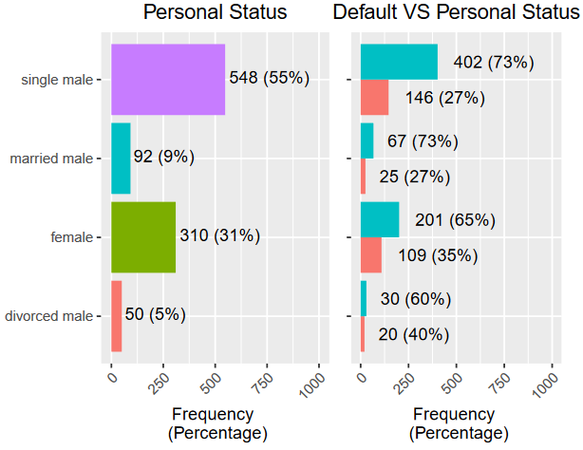
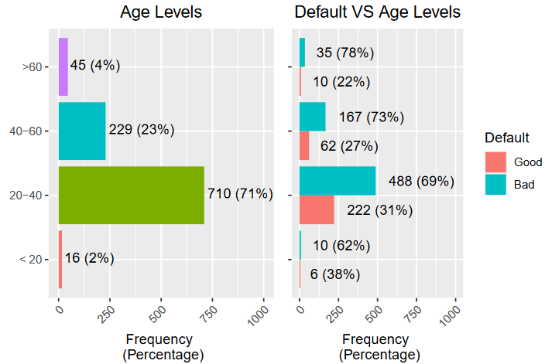
German Credit Data
Personal Profile Variables I
Personal Status
Age

Slide 8
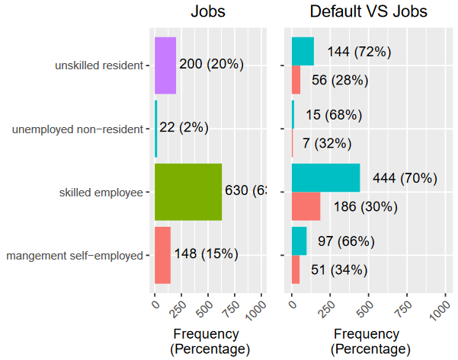
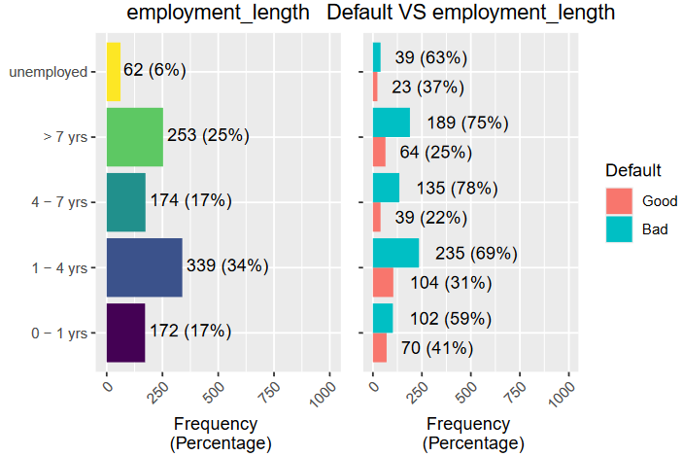
German Credit Data
Personal Profile Variables II
Type Job
Years in same employee

Slide 9
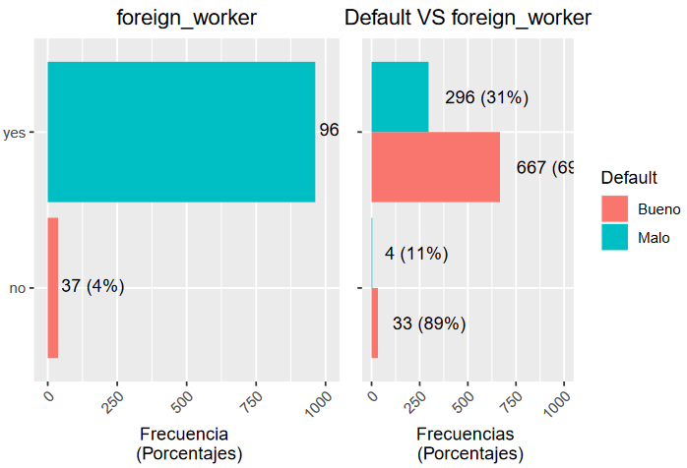
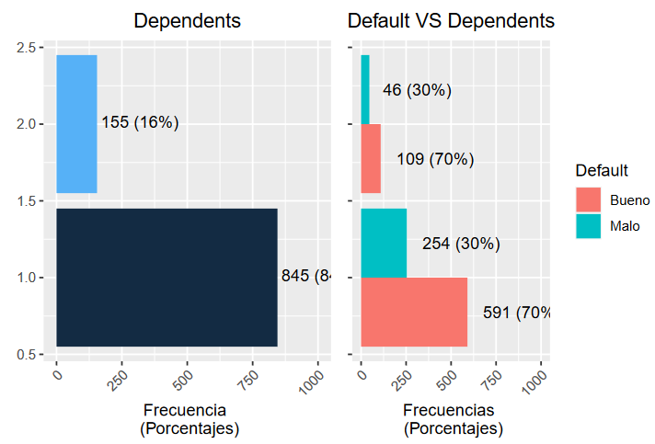
German Credit Data
Personal Profile Variables III
Foreign Worker?
Dependents?

Slide 10
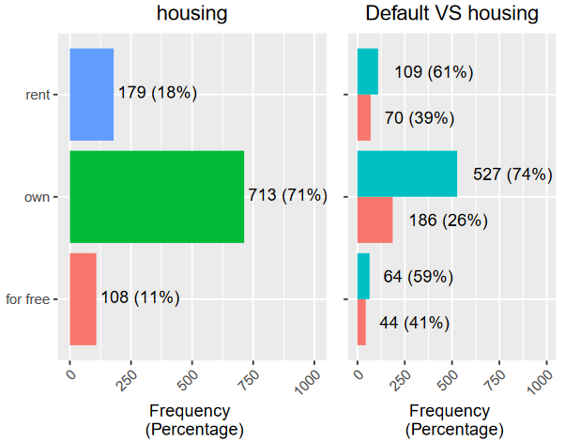
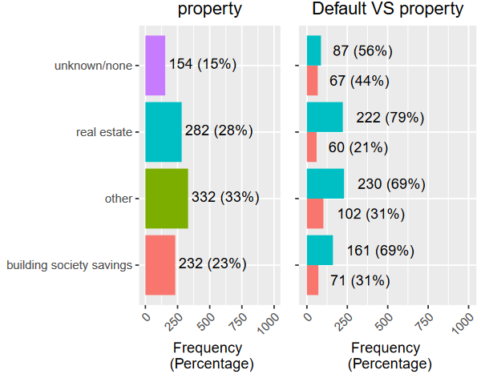
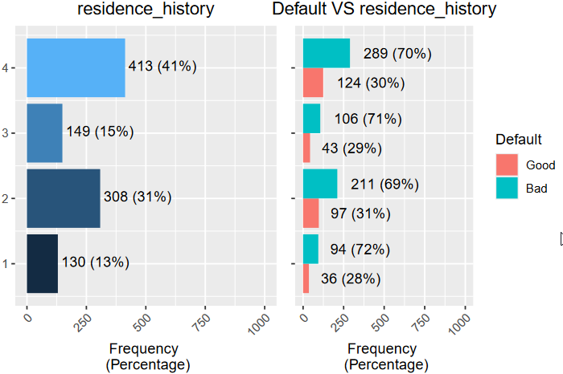
German Credit Data
Asset Profile Variables
Housing
Property
Residence History

Slide 11
German Credit Data
Asset Profile Variables
Housing
Property
Residence History

Slide 12
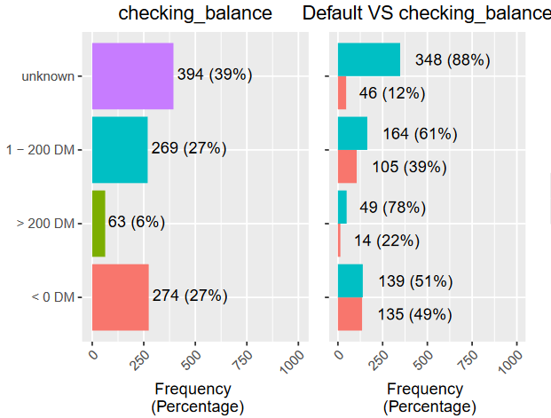
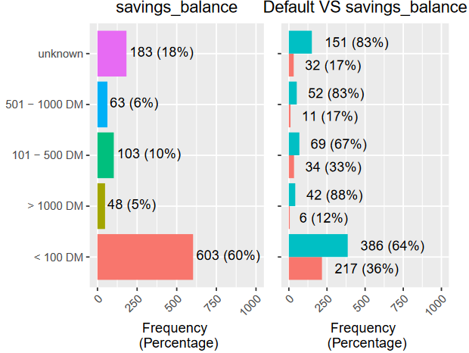
German Credit Data
Finance Profile Variables I
Checking Balance
Saving Balance

Slide 13
German Credit Data
EDA Conclusions
Credit Typology
The bank primarily offers consumer credit, with 81% focused on financing:
Cars (both new and used).
Household goods (such as furniture and TV/radio).
Credit Quality:
Good credits: 70% (solvent).
Bad credits: 30% (non-solvent).
Loan Amounts: 95% are for amounts up to 5,000 DM.
Loan Duration: 77% of loans have a maximum term of 2 years.
Leverage: High or very high in 64% of cases, with clients often having up to two additional credits.
Client Profile
Typical Client: A single, foreign male, aged 20-40 years, with at least one dependent.
Employment Status: 83% are employed with a minimum of 4 years at their current job.
Client's Asset Profile
Home Ownership: 71% own property, acquired through savings and/or mortgage.
Residence Duration: Clients typically apply for credit after at least 3 years at their current residence.

Slide 14
German Credit Data
EDA Conclusions II
Client's Financial Situation
Account Balance: 60% have a balance of up to 100 DM.
Credit Card Balance:
Unknown for 40% of clients (notably the most solvent, with 88% classified as good credits).
Of the remaining clients, 50% have a credit card balance of up to 200 DM, with the percentage of good credits dropping to 60%.
Other Payment Plans: 80% have no additional installment plans.
External Debts: 90% have no debts with other financial institutions.
Overall Financial Summary
Generally, clients hold low-amount loans with high leverage relative to income.
Clients typically have consistent assets in the form of their primary residence, which they are still paying off, and maintain low cash balances in their accounts.

Slide 15
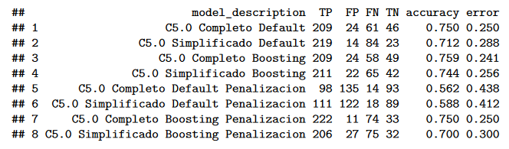
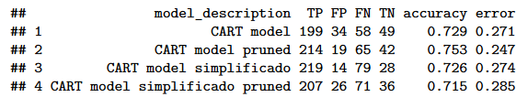
German Credit Data
Tree Models
Best Models Identified
The top models identified are:
CART Model (Pruned)
C5.0 Simplified Boosting
Model Performance Comparison
The results are very similar between these two models.
A different subset of variables or variable discretization could potentially highlight more differences.
Model Selection
With the selected data, the CART Model (Pruned) provides the simplest possible tree.
Predictive Power: Minimal differences in predictive power were observed between models.
Final Choice: Given the simplicity and comparable predictive performance, the recommended model is CART Model (Pruned).
Model C 5.0
Model CART

Slide 16
Notes:
© Copyright PresentationGO.com – Free Templates & Infographics for PowerPoint and Google Slides

