Slide 1
B2LLVM
Translation rules

Slide 2
Outline
B Implementation and LLVM constructs
Examples
Modularity
Data aspects
Conclusions and future work

Slide 3
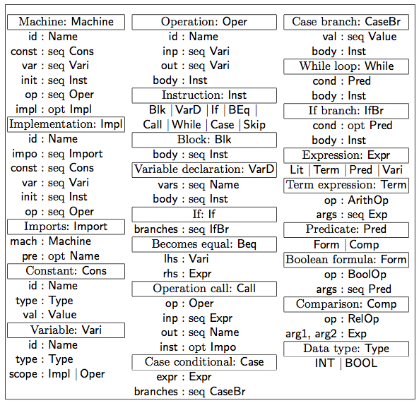
Subset of B Implementation AST - Source
Only arithmetic and Boolean operations
seq – Sequence
opt - Optional

Slide 4
Target LLVM - declarations
It is a single-static assembly (SSA): a variable may only be assigned once
A module contains
declarations of external entities (types, functions and constants)
@max = external constant i32
internal definitions (types, functions, variables and constants)
%T1 = type {i32, i32} %T2 = type {%T1 *, %T1 *}
Identifiers declarations starts with @ when global % when local
For instance, declare void @inc(i32*) declares a global function having as parameter a pointer to an integer and void as a return type.
Declaring global variables
@count = common global i32 zeroinitializer
Notes:
the variable is merged with other of the same name
The scope

Slide 5
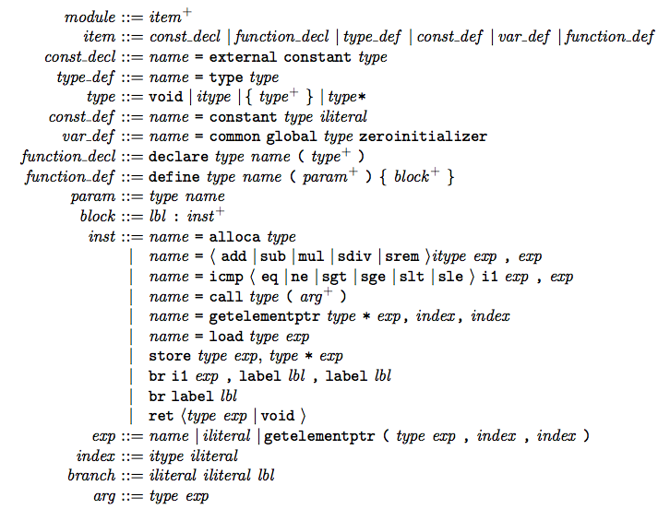
Target LLVM - AST

Slide 6
Translation - a global picture Requirements:
Memory allocated statically
No dynamic memory allocation library is required
Safety critical system use of this facility
Code generator features with independent compilation
A change in a component does not require compilation of the dependent components
This condition is important for larger, distributed projects

Slide 7
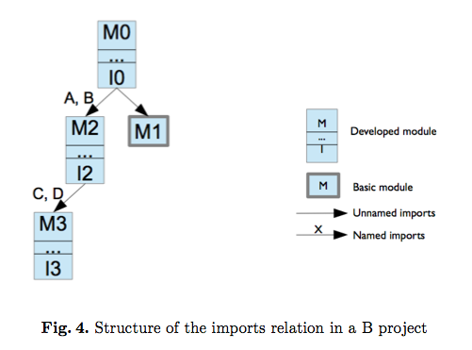
Translation – modes for code generation
COMP (Component)
Classified at:
(a) The module is basic, and only declarations need to be emitted.
(b) The module is developed, and declarations and definitions are produced.
It is independent for each component.
PROJ (Project)
Its responsibility the static allocation of instances and to perform the proper bindings between the actual and formal instances in the generated code.
Must identify all the transitively imported module instances.

Slide 8
Translation - PROJ mode
%M$state$ is a structure type that the elements represent the variables and the instances of imported modules.
%M$ref$ denote the type pointer to %M$state$.
to pass the address of the instance encoding structure associated with that operation.
@M$op defines a function translated from an operation
@M$init defines a function translated from an initialization

Slide 9
What is the function of each file extension?
Scaffold* .llvm - It provides an environment for (test) execution and developed manually by designer
*.bxml – It is the source code of B0 Implementation
*.llvm – It is the code generated by b2llvm
*.bc - It is the binary code generated from llvm-ir

Slide 10
Steps of translation, compilation and execution
Generating the LLVM code with B2LLVM.py and its parameters:
This is executed for each component: $python3 b2llvm timer timer.llvm bxml project.xml
<component name without extension >, <generated LLVM file>, <source folder>, <project name>
Generating the binary code:
This is executed for each component:
$llvm-as-mp-3.1 timer.llvm -o timer.bc
Linking the components:
$llvm-link-mp-3.1 timer.bc counter.bc init-timer.bc scaffold-timer.bc -o run-timer.bc
Executing the main file
$lli-mp-3.1 run-timer.bc

Slide 11
Example of B Machine
5 MACHINE 6 counter 7 VARIABLES 8 value, overflow 9 INVARIANT 10 value: INT & overflow: BOOL & 11 0 <= value & value <= MAXINT & 12 ((overflow = TRUE) => (value = MAXINT)) 13 INITIALISATION 14 value := 0 || overflow := FALSE 15 OPERATIONS 16 zero = 17 BEGIN 18 value := 0 || overflow := FALSE 19 END; 20 inc = 21 PRE 22 value <= MAXINT 23 THEN 24 IF value < MAXINT THEN 25 value := value + 1 26 ELSE 27 overflow := TRUE 28 END 29 END; 30 res <-- get =
res := value 31 END

Slide 12
Example of B implementation
1 IMPLEMENTATION
2 timer_i
3 REFINES
4 timer_r
5 IMPORTS
6 hh.counter, mm.counter, ss.counter
7 VALUES
8 capacity = (24 * 60 * 60) - 1
9 CONCRETE_VARIABLES
10 is_running, overflow
11 INVARIANT
12 is_running : BOOL & overflow : BOOL &
13 ((state = running) <=> (is_running = TRUE)) &
14 count = (hh.value * 3600 + mm.value * 60 + ss.value)
15
16 INITIALISATION
17 is_running := FALSE;
18 overflow := FALSE
19
20

Slide 13
Example of B implementation
20 OPERATIONS
21 tick =
22 IF ( is_running = TRUE ) & ( overflow = FALSE )
23 THEN
24 VAR hours, minutes, seconds IN
25 hours <-- hh.get;
26 minutes <-- mm.get;
27 seconds <-- ss.get;
28 IF (seconds < 59) THEN
29 ss.inc
30 ELSE
31 BEGIN
32 ss.zero;
33 IF (minutes < 59) THEN
34 mm.inc
35 ELSE
36 BEGIN
37 mm.zero;
38 hh.inc
39 END
40 END
41 END
42 END
43 END
44 END
45 ;

Slide 14
Example timer LLVM- Comp
6 %counter$state$ = type opaque
7 %counter$ref$ = type %counter$state$*
8 declare void @counter$init$(%counter$ref$)
9 declare void @counter$zero(%counter$ref$)
10 declare void @counter$inc(%counter$ref$)
11 declare void @counter$get(%counter$ref$, i32*)
12 %timer$state$ = type {%counter$ref$, %counter$ref$, %counter$ref$, i1, i1}
13 %timer$ref$ = type %timer$state$*
14 define void @timer$init$(%timer$ref$ %self$, %counter$ref$ %arg0$,
%counter$ref$ %arg1$, %counter$ref$ %arg2$){
15 entry:
16 %0 = getelementptr %timer$ref$ %self$, i32 0, i32 0
17 store %counter$ref$ %arg0$, %counter$ref$* %0
18 %1 = getelementptr %timer$ref$ %self$, i32 0, i32 1
19 store %counter$ref$ %arg1$, %counter$ref$* %1
20 %2 = getelementptr %timer$ref$ %self$, i32 0, i32 2
21 store %counter$ref$ %arg2$, %counter$ref$* %2
22 call void @counter$init$(%counter$ref$ %arg0$)
23 call void @counter$init$(%counter$ref$ %arg1$)
24 call void @counter$init$(%counter$ref$ %arg2$)
25 %3 = getelementptr %timer$ref$ %self$, i32 0, i32 3
26 store i1 0, i1* %3
27 %4 = getelementptr %timer$ref$ %self$, i32 0, i32 4
28 store i1 0, i1* %4
29 br label %exit
30 exit:
31 ret void
32 }

Slide 15
Example counter LLVM Comp
6 %counter$state$ = type {i32, i1}
7 %counter$ref$ = type %counter$state$*
8 define void @counter$init$(%counter$ref$ %self$){
9 entry:
10 %0 = getelementptr %counter$ref$ %self$, i32 0, i32 0
11 store i32 0, i32* %0
12 %1 = getelementptr %counter$ref$ %self$, i32 0, i32 1
13 store i1 0, i1* %1
14 br label %exit
15 exit:
16 ret void
17 }
18 define void @counter$zero(%counter$ref$ %self$){
19 entry:
20 %0 = getelementptr %counter$ref$ %self$, i32 0, i32 0
21 store i32 0, i32* %0
22 %1 = getelementptr %counter$ref$ %self$, i32 0, i32 1
23 store i1 0, i1* %1
24 br label %exit
25 exit:
26 ret void
27 }

Slide 16
Example init-timer LLVM PROJ
%counter$state$ = type {i32, i1}
7 %counter$ref$ = type %counter$state$*
8 %timer$state$ = type {%counter$ref$, %counter$ref$, %counter$ref$, i1, i1}
9 %timer$ref$ = type %timer$state$*
10 @$timer = common global %timer$state$ zeroinitializer
11 @hh$counter = common global %counter$state$ zeroinitializer
12 @mm$counter = common global %counter$state$ zeroinitializer
13 @ss$counter = common global %counter$state$ zeroinitializer
14 declare void @timer$init$(%timer$ref$, %counter$ref$, %counter$ref$, %counter$ref$)
15 declare void @timer$tick(%timer$ref$)
16 declare void @timer$reset(%timer$ref$)
17 declare void @timer$stop(%timer$ref$)
18 declare void @timer$start(%timer$ref$)
19 declare void @timer$elapsed(%timer$ref$, i32*, i32*, i32*)
20 declare void @timer$has_overflown(%timer$ref$, i1*)
21 define void @$init$() {
22 entry:
23 call void @timer$init$(%timer$ref$ @$timer, %counter$ref$ @hh$counter, %counter$ref$ @mm$counter, %counter$ref$ @ss$counter)
24 ret void
25 }

Slide 17
First idea to support arrays
Requirements:
It must be generic to any type
It cannot use dynamic allocation
Challenge:
It is not possible to generate the BXML with out parser XML

Slide 18
Conclusions
Impressions about translation
difficult to understand the translation
Maybe because:
It is under construction
Only yesterday, I get an executable version
It is really big and complex
Next tasks:
Create examples with this
Extend the example with array and integrated with the approach for modularization (separated compilation)

