Slide 1


Project 2
Reinforcement learning for path finding
Central European University
David Diestre Rubio • Juan Roset Moreno
DNDS5019 • Machine Learning (Advanced) | Winter 2026 | Nysret Musliu
Notes:
1

Slide 2



Presentation Overview
Our Algorithm
Path Finding
Results & Discussion
Repository organization
Monte Carlo Control
On-policy first-visit
3 Different Grids
1 Target
Obstacles and walls
Overall Results
Found paths and Runtimes
Discussion & Lessons learned
DNDS5019 • Machine Learning (Advanced)
1
Notes:
2

Slide 3

Section I: Our algorithm
Repository, approach and RL model used
DNDS5019 • Machine Learning (Advanced)
2
Notes:
3

Slide 4

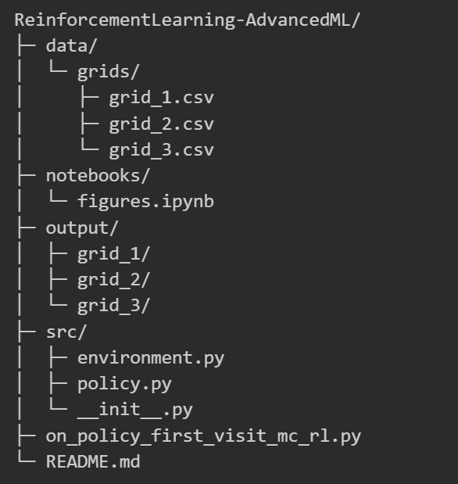
GitHub Repository
Workflow
data/grids/
on_policy_first_visit_mc_rl.py
environment.py
policy.py
output/
figures.ipynb
state & reward
step
DNDS5019 • Machine Learning (Advanced)
3
Notes:
9

Slide 5
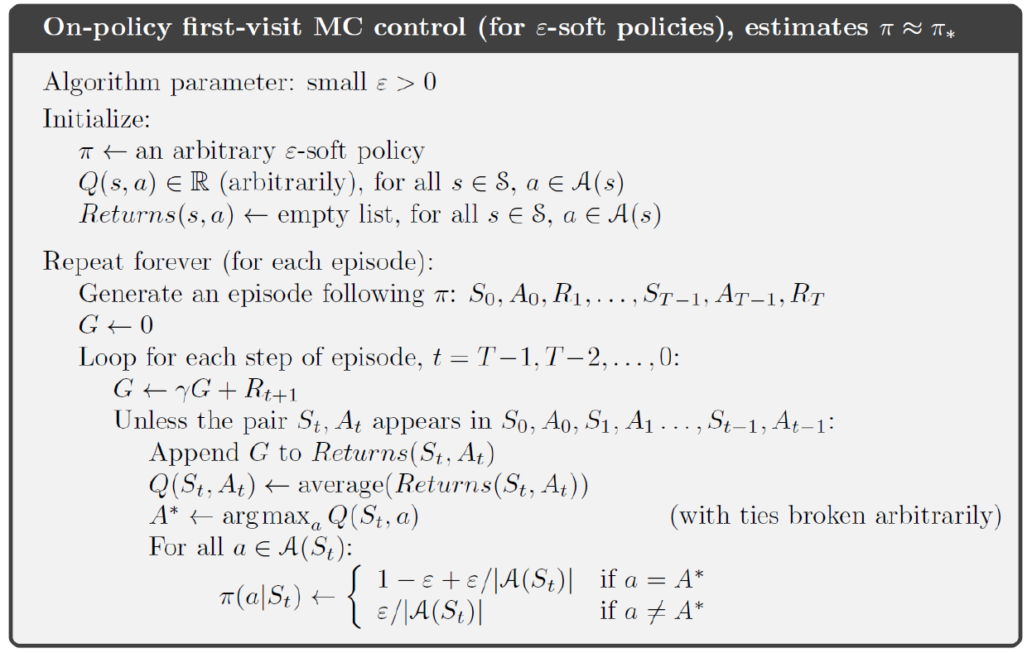
DNDS5019 • Machine Learning (Advanced)
4
Notes:
5

Slide 6
Our approach
Problem Formulation
We first define the environment as a Markov Decision Process, specifying states, actions, rewards and episode dynamics.
State S: (x,y,vx​,vy​) position + velocity
Action A: matrix of 9 possible discrete accelerations
Rewards R: -1 for each step until target
G total reward: sequence that acumulates the rewards for each state in one episode
DNDS5019 • Machine Learning (Advanced)
5
Notes:
5

Slide 7
Our approach
Problem Formulation
Policy & exploration
We first define the environment as a Markov Decision Process, specifying states, actions, rewards and episode dynamics.
State S: (x,y,vx​,vy​) position + velocity
Action A: matrix of 9 possible discrete accelerations
Rewards R: -1 for each step until target
G total reward: sequence that acumulates the rewards for each state in one episode
The policy is ε-greedy with respect to Q, allowing a balance between exploration and exploitation, with a decaying ε over time.
Policy π: ε-greedy, implicit and not stored
Exploration vs Explotation: ε controls randomness and it decreases through episodes
Solution
DNDS5019 • Machine Learning (Advanced)
6
Notes:
5

Slide 8
Our approach
Problem Formulation
Policy & exploration
Learning Mechanism
We first define the environment as a Markov Decision Process, specifying states, actions, rewards and episode dynamics.
State S: (x,y,vx​,vy​) position + velocity
Action A: matrix of 9 possible discrete accelerations
Rewards R: -1 for each step until target
G total reward: sequence that acumulates the rewards for each state in one episode
The policy is ε-greedy with respect to Q, allowing a balance between exploration and exploitation, with a decaying ε over time.
Policy π: ε-greedy, implicit and not stored
Exploration vs Explotation: ε controls randomness and it decreases through episodes
We estimate the action-value function using first-visit Monte Carlo, averaging returns for each state-action pair.
Q-function Q(s,a): Tabular representation, we initialize its value to 0
Returns Estimation: First-visit Monte Carlo and avg of the returns
Return G: Computes G from time 1 to time t -1 with discount γ.
Solution
DNDS5019 • Machine Learning (Advanced)
7
Notes:
5

Slide 9
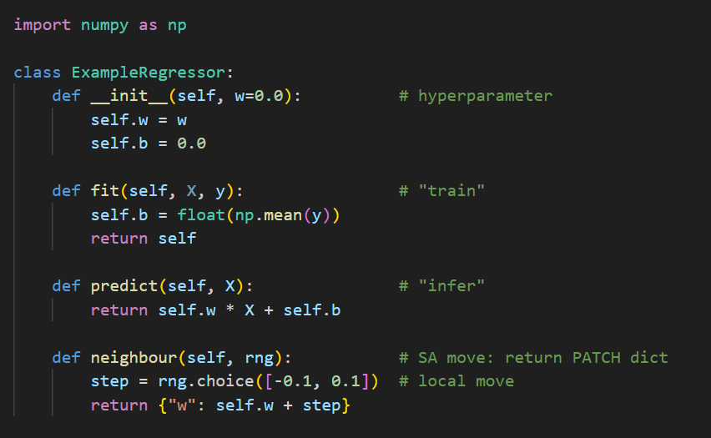
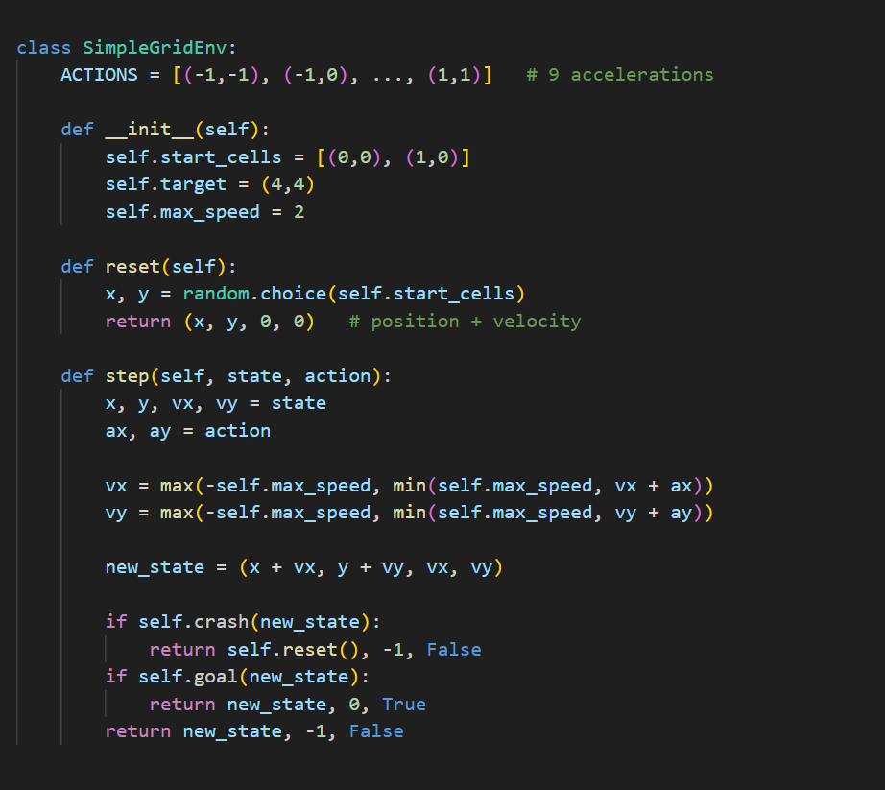
Core idea of the Environment algorithm
State Representation
The agent state is not only where the robot is, but also how fast it is moving.
Transition dynamics
Actions do not move the robot directly, they modify its velocity, and velocity determines the next position.
Environment rules and reward logic
The environment penalizes every step, so the agent is encouraged to reach the goal as quickly as possible while avoiding collisions.
DNDS5019 • Machine Learning (Advanced)
8
Notes:
8

Slide 10
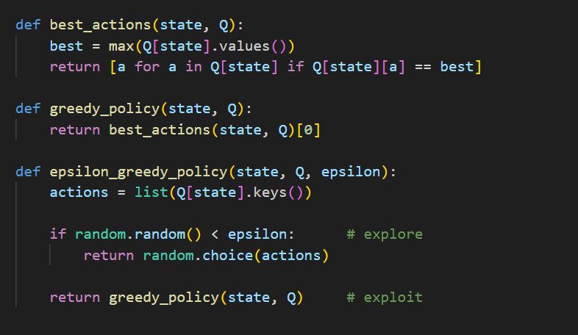
Core idea of the Policy algorithm
Best action selection
The policy uses the current Q-values to identify the best available actions.
Greedy decision
In greedy mode, the agent follows the action that currently looks best.
Exploration vs Exploitation
The policy balances exploration and exploitation by occasionally trying random actions.
DNDS5019 • Machine Learning (Advanced)
9
Notes:
8

Slide 11
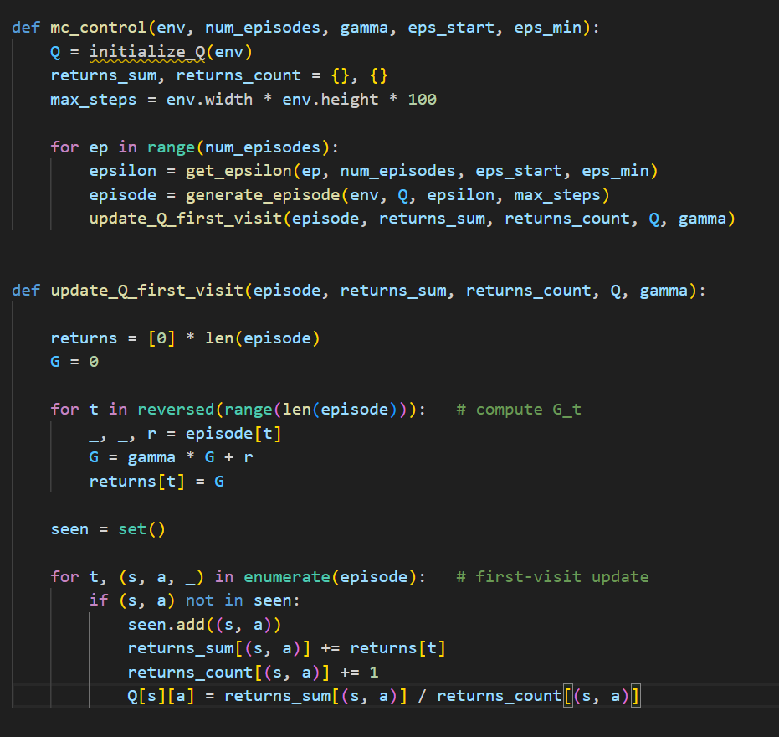
Core idea of the MC control algorithm
Episode-based learning
Learning is based on complete episodes, not single-step updates.
Monte Carlo return computation
Returns are computed backwards to estimate the future reward from each time step.
First-visit Q update with decaying exploration
Q-values are updated from first-visit returns, while epsilon gradually shifts behaviour from exploration to exploitation.
DNDS5019 • Machine Learning (Advanced)
10
Notes:
8

Slide 12

Section II: The 3 Grids
Creation of maps: Progressively more complex testing grounds
DNDS5019 • Machine Learning (Advanced)
11
Notes:
3

Slide 13
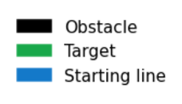
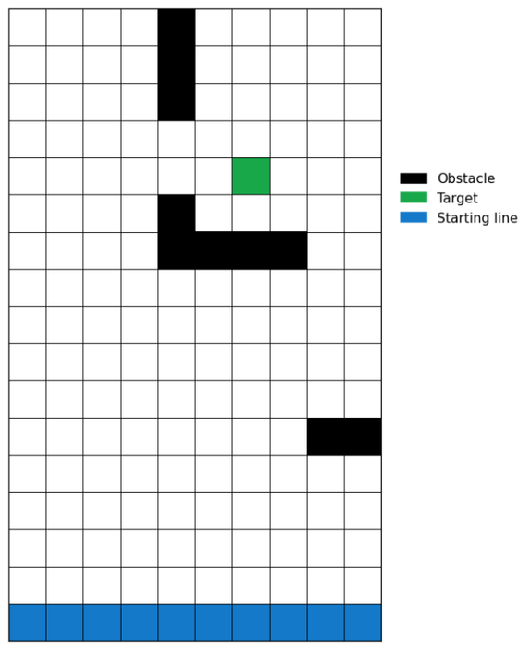
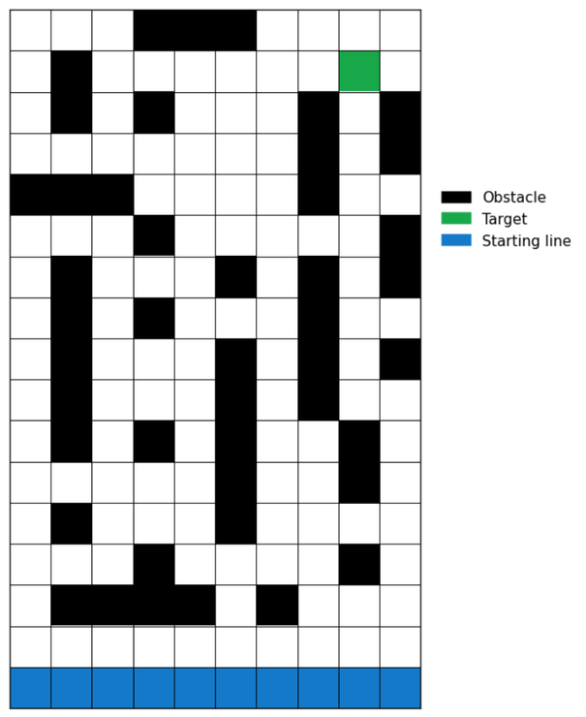
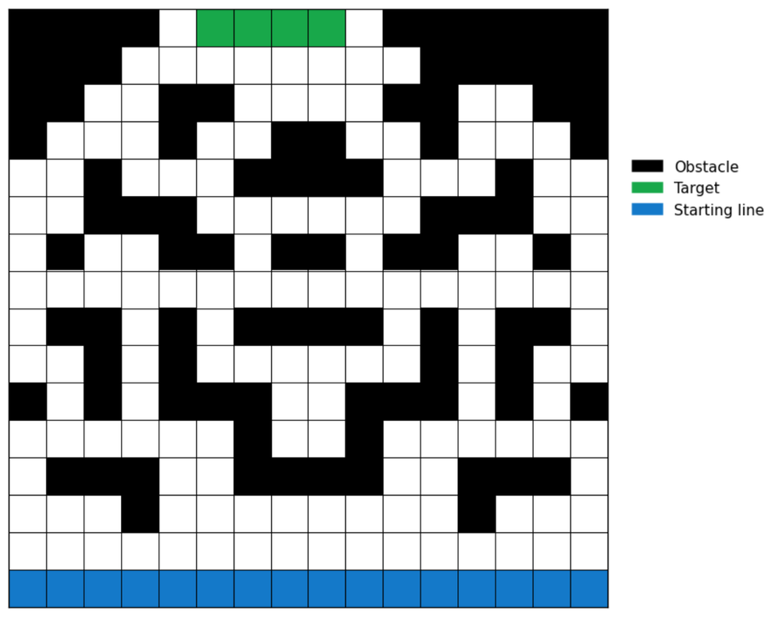
The 3 Grids
Level 1
Level 2
Level 3
DNDS5019 • Machine Learning (Advanced)
12
Notes:
4

Slide 14

Section III: Results & Discussion
How did we perform? Results, Comparisons and Conclusions
DNDS5019 • Machine Learning (Advanced)
13
Notes:
3

Slide 15
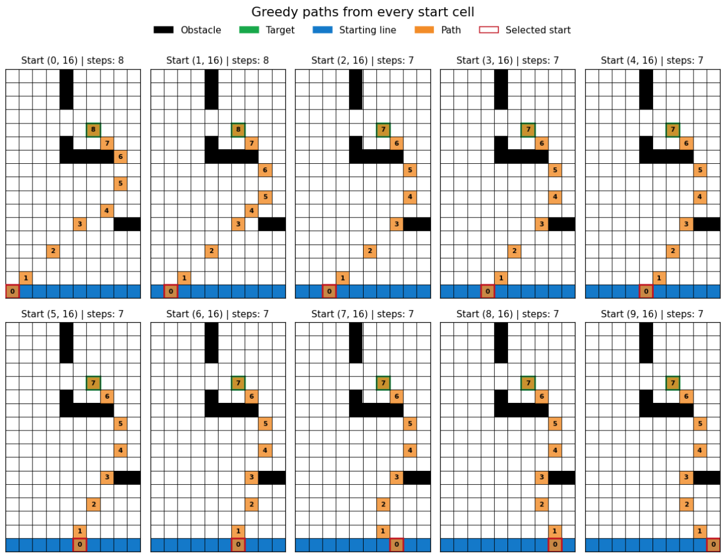
Results Grid 1
1 000 000 episodes, ε from 0.4 ⟶ 0.01
7 -8 Steps for starting point
137.79 seconds of runtime
The agent finds near-optimal paths from any point
Effective learning from the environment
Good estimation of the Q function
Fast Convergence
Stable and short paths
11
Notes:
4

Slide 16
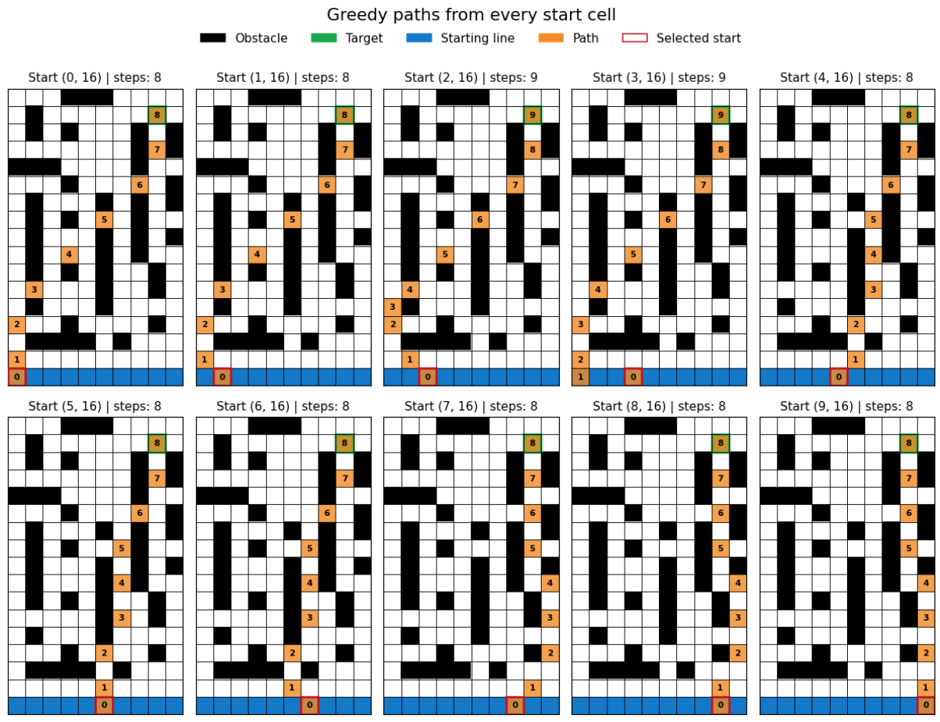
Results Grid 2
1 000 000 episodes, ε from 0.4 ⟶ 0.01
8 - 9 Steps for starting point
190.77 seconds of runtime
The agent finds valid paths from all starting positions
Paths are slightly longer due to increased obstacle complexity
The agent successfully navigates through narrow corridors
Stable policy despite a more complex environment
Moderate convergence time
11
Notes:
4

Slide 17
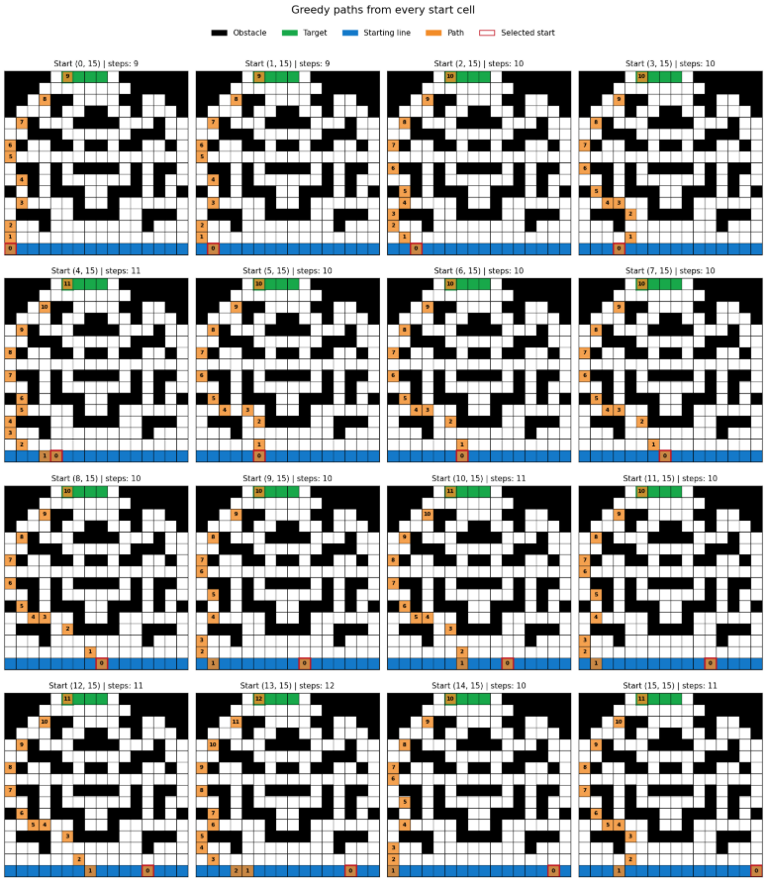
Results Grid 3
1 000 000 episodes, ε from 0.4 ⟶ 0.01
9 -12 Steps for starting point
322.42 seconds of runtime
The agent finds valid paths from all starting positions
Navigation is more constrained due to high obstacle density
The agent must follow narrow and complex corridors
Slow convergence
More variability in paths (calculated risk restart: model gambles)
Overall Conclusion of Results
Monte Carlo control successfully learns near-optimal policies in all environments, but its efficiency decreases as the environment becomes more complex, leading to longer paths and higher computational cost.
Notes:
4

Slide 18

Discussion
Conclusions & observations
Difficulties
Monte Carlo control successfully learned valid policies in all three grids.
The agent reached the target from every starting position.
As grid complexity increased, paths became longer and runtime increased significantly.
Overall, the method is robust, but its efficiency decreases as obstacle density grows.
When faced against harder, less optimized starting positions, sometimes the model performs a calculated-risk restart, gambling to respawn on a better starting position by sacrificing a move.
Tuning ε to balance exploration and exploitation across each grid.
Modifying the code to make the check of a state being the first-visit more efficient.
We ended up opting to compute the G vector separately and then apply it from 0 to T to first-visited states.
DNDS5019 • Machine Learning (Advanced)
17
Notes:
11

