Slide 1
Alexa trifft LEGO
by Patrick Loh, Sascha Potesil, David Dittmann, Benjamin Klaasen

Slide 2
Index
What is our project?
How far have we come?
How does it work?
Lessons Learned
Effort

Slide 3
What is our project?
Connect Alexa with roboter
Create Alexa Skills
Use build in Amazon functions
Controlled by voice command
Making a step by step guide

Slide 4
How far have we come?

Slide 5
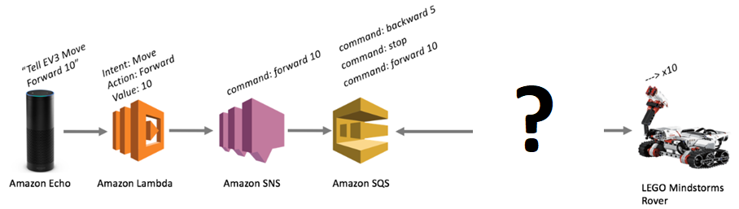
How does it not work?

Slide 6
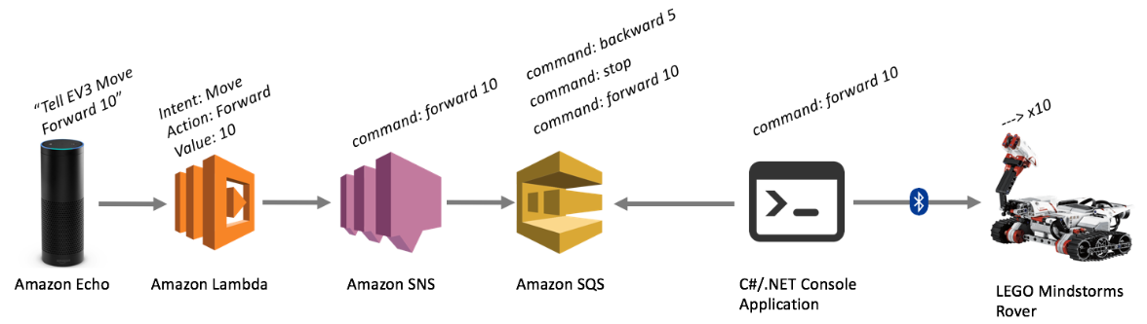
How does it work?
simplified

Slide 7
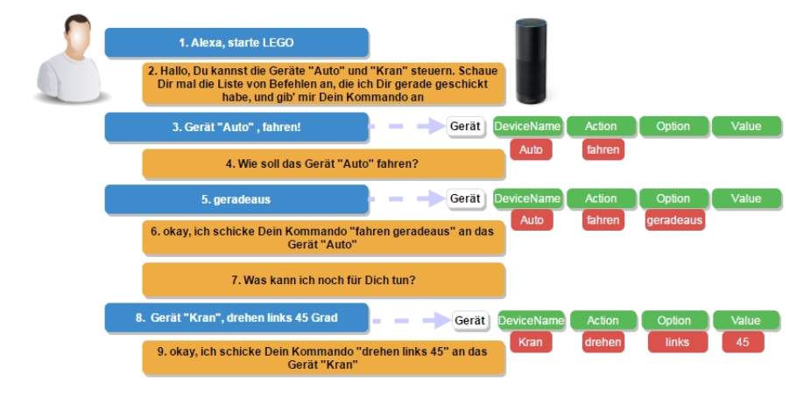
How does it work? - Skills

Slide 8
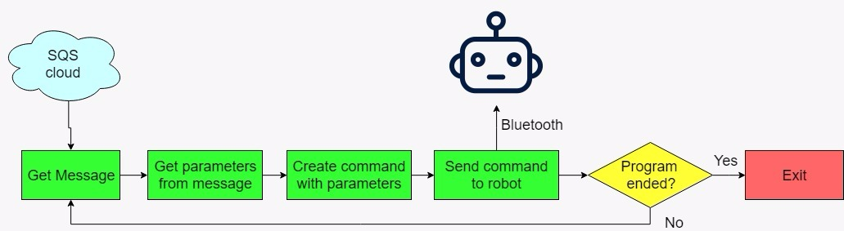
How does it work? - C#

Slide 9
Lessons Learned
Developing Amazon Services
Skills, SQS, SNS, Lambda
New programming languages
C#
JavaScript
Interface Communication
Projectmanagement

Slide 10
Effort

Slide 11
Sources:
http://blog.jimdrewes.com/controlling-a-mindstorms-ev3-with-amazon-echo/
https://jaxenter.de/alexa-skills-entwickeln-64751

