Slide 1
Progress Presentation
Teresa Steiner, David Nyrnberg & Martin Djurhuus

Slide 2
Motivation
The backbone of a lot of medical and social studies is the access and use of personal data from the participants in the study. But for people to be willing to participate in these studies their privacy should be ensured. The privacy here is the individual privacy defined as information that can be used to identify an individual in the study.
The traditional approach is to simply remove from the database any information which obviously identifies an individual. This approach isn’t always a good idea. Even if the remaining fields don’t provide enough information on their own to identify an individual, together they might give too much information when combined. Examples of this has been seen.
Therefore differential privacy is useful as it allows for the release of test results pertaining to the population without revealing information about an individual. The idea is that the outcome of any analysis should essentially be equally likely, independent of whether any individual joins, or refrains from joining, the dataset.

Slide 3
Overview
Theory
Differential Privacy
Rasch model
Metods
Functional Mechanism
???
Data sets
Results
Implementation of Functional Mechanism for linear regression
Implementation of ??? for logistic regression
Implementation of Non-private rasch model

Slide 4
Overview
Theory
Differential Privacy
Rasch model
Metods
Functional Mechanism
???
Data sets
Results
Implementation of Functional Mechanism for linear regression
Implementation of ??? for logistic regression
Implementation of Non-private rasch model

Slide 5
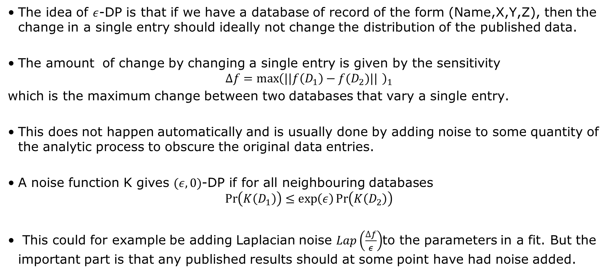
Differential Privacy
The idea of $ε$-DP is that if we have a database of record of the form (Name,X,Y,Z), then the change in a single entry should ideally not change the distribution of the published data.
The amount of change by changing a single entry is given by the sensitivity
$$Δf={\max\left(||f\left(D_{1}\right)−f(D_{2})|| \right)}_{1}$$
which is the maximum change between two databases that vary a single entry.
This does not happen automatically and is usually done by adding noise to some quantity of the analytic process to obscure the original data entries.
A noise function K gives $(ε,0)$-DP if for all neighbouring databases
$$\operatorname{Pr}\left(K\left(D_{1}\right)\right)≤\exp\left(ε\right)\operatorname{Pr}\left(K\left(D_{2}\right)\right)$$
This could for example be adding Laplacian noise $Lap\left(\frac{Δf}{ε}\right)$to the parameters in a fit. But the important part is that any published results should at some point have had noise added.

Slide 6
Differential Privacy
Of course the addition of noise is normally not a good idea but since it distribution of the population and not individuals we are concerned with and the noise amount is small. This is not a big deal, but of course accuracy will be reduced a bit.

Slide 7
Rasch model

Slide 8
Overview
Theory
Differential Privacy
Rasch model
Metods
Functional Mechanism
???
Data sets
Results
Implementation of Functional Mechanism for linear regression
Implementation of ??? for logistic regression
Implementation of Non-private rasch model

Slide 9
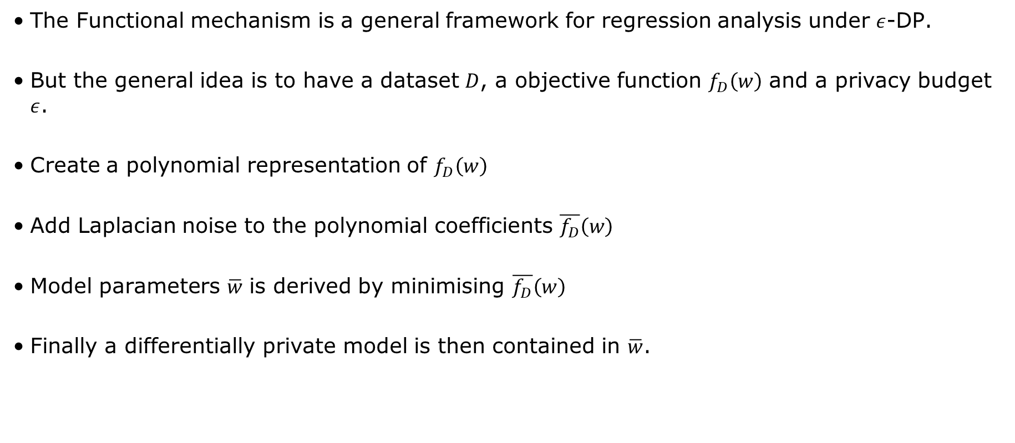
Functional Mechanism
The Functional mechanism is a general framework for regression analysis under $ε$-DP.
But the general idea is to have a dataset $D$, a objective function $f_{D}\left(w\right)$ and a privacy budget $ε$.
Create a polynomial representation of $f_{D}\left(w\right)$
Add Laplacian noise to the polynomial coefficients $\overline{f_{D}}\left(w\right)$
Model parameters $\overline{w}$ is derived by minimising $\overline{f_{D}}\left(w\right)$
Finally a differentially private model is then contained in $\overline{w}$.

Slide 10
???

Slide 11
Data sets
Linear regression
Simulated data from a linear system with added noise.
Logistic regression
mnist or fashion
Rasch model
???

Slide 12
Overview
Theory
Differential Privacy
Rasch model
Metods
Functional Mechanism
???
Data sets
Results
Implementation of Functional Mechanism for linear regression
Implementation of ??? for logistic regression
Implementation of Non-private rasch model

Slide 13
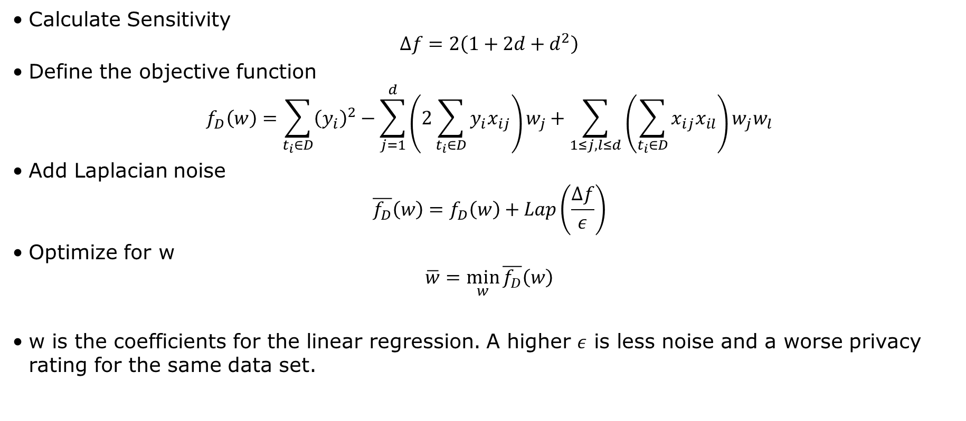
Implementation of Functional Mechanism for linear regression
Calculate Sensitivity
$$Δf=2\left(1+2d+d^{2}\right)$$
Define the objective function
$$f_{D}\left(w\right)=\sum_{t_{i}∈D}{{\left(y_{i}\right)}^{2}}−\sum_{j=1}^{d}{\left(2\sum_{t_{i}∈D}{y_{i}x_{ij}}\right)}w_{j}+\sum_{1≤j,l≤d}{\left(\sum_{t_{i}∈D}{x_{ij}x_{il}}\right)}w_{j}w_{l}$$
Add Laplacian noise
$$\overline{f_{D}}\left(w\right)=f_{D}\left(w\right)+Lap\left(\frac{Δf}{ε}\right)$$
Optimize for w
$$\overline{w}=\min_{w}{\overline{f_{D}}\left(w\right)}$$
w is the coefficients for the linear regression. A higher $ε$ is less noise and a worse privacy rating for the same data set.

Slide 14
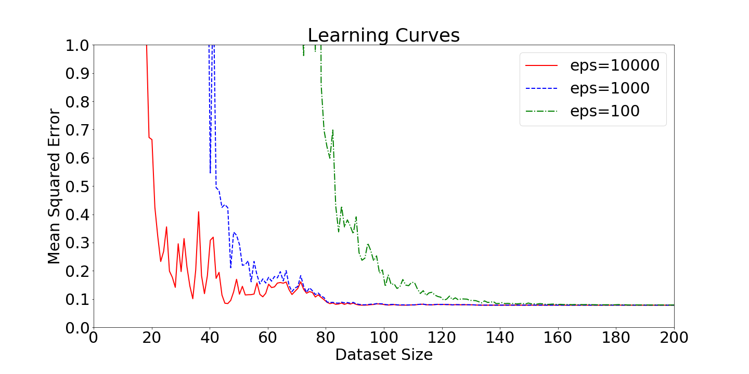
Implementation of Functional Mechanism for linear regression

Slide 15
Implementation of ??? for logistic regression

Slide 16
Implementation of Non-private rasch model

