Slide 1


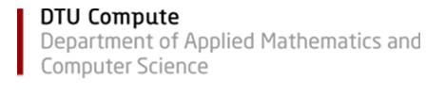
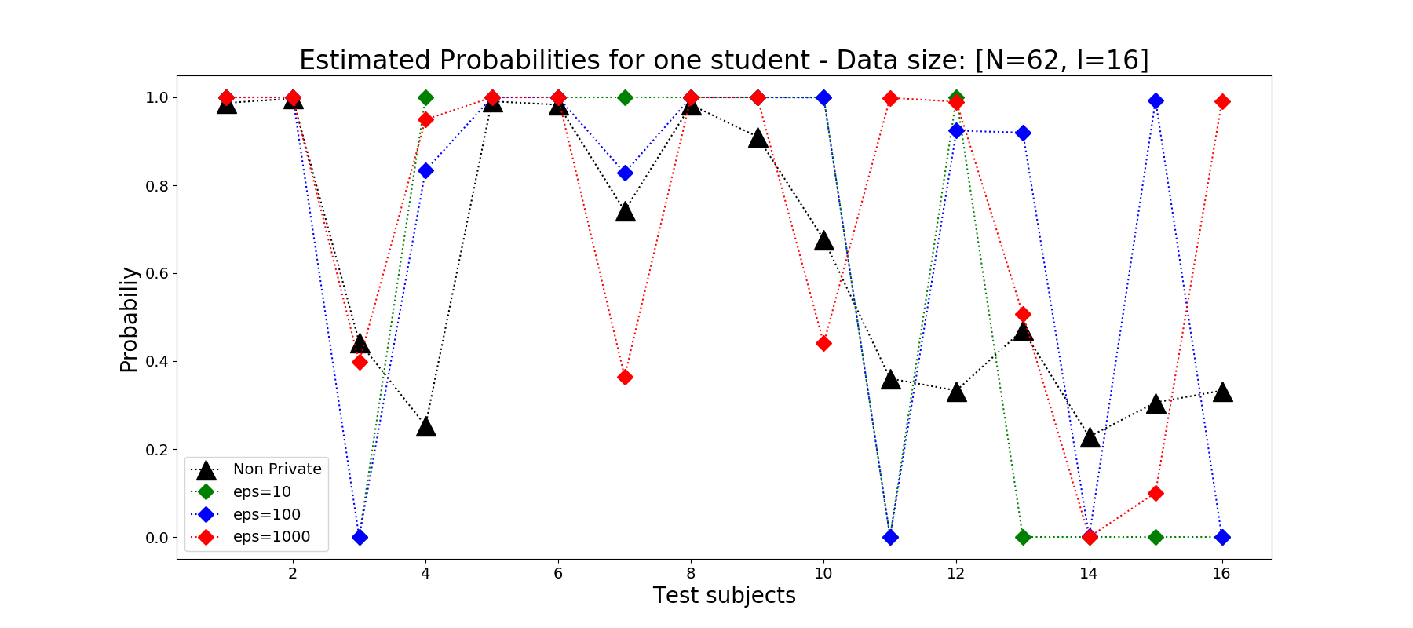
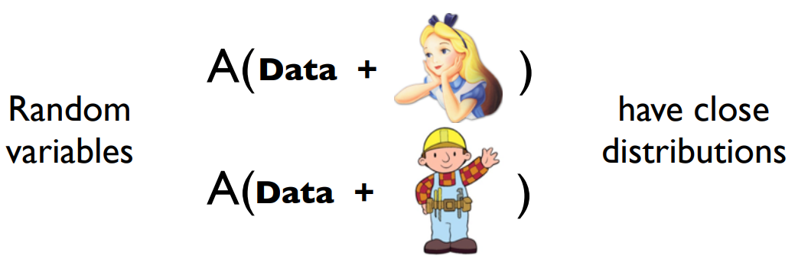
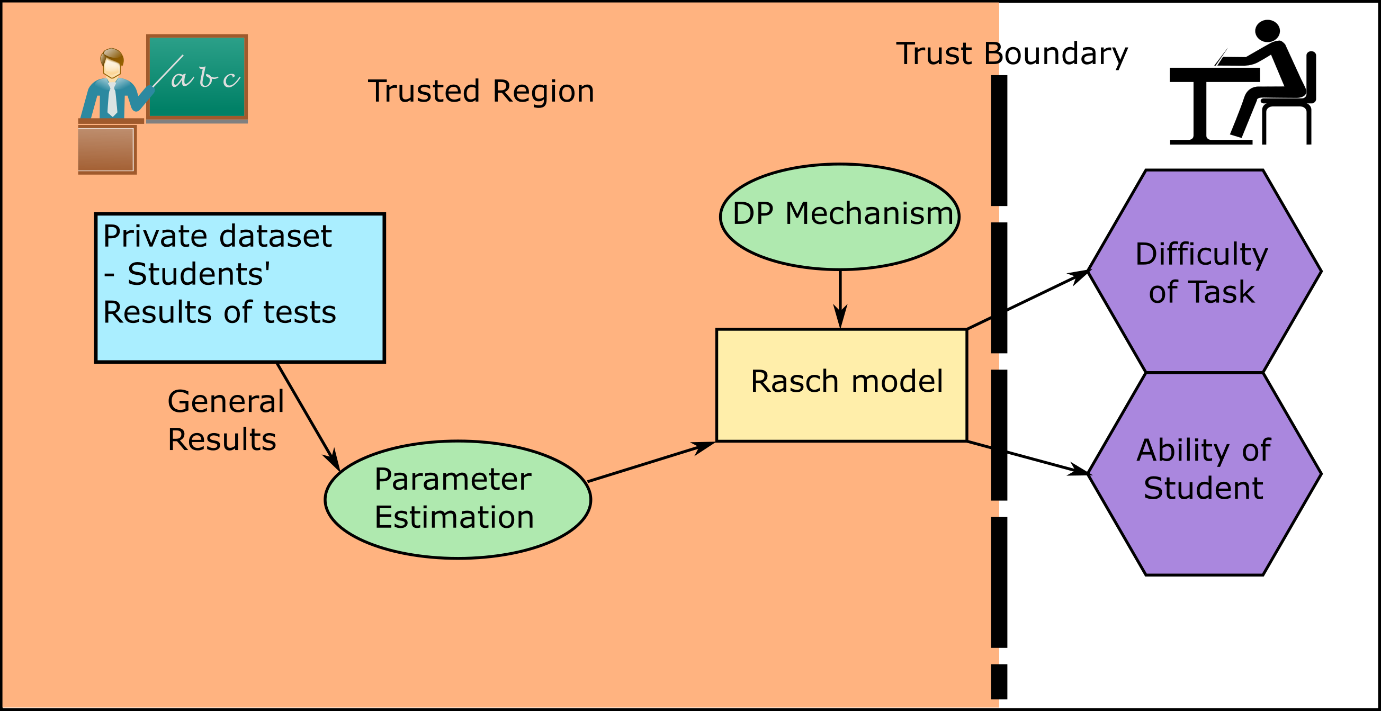
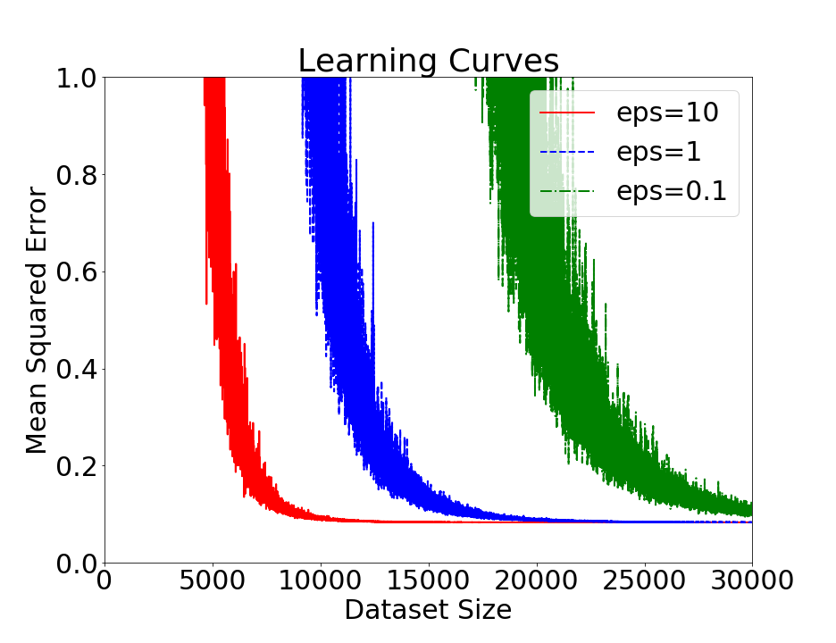
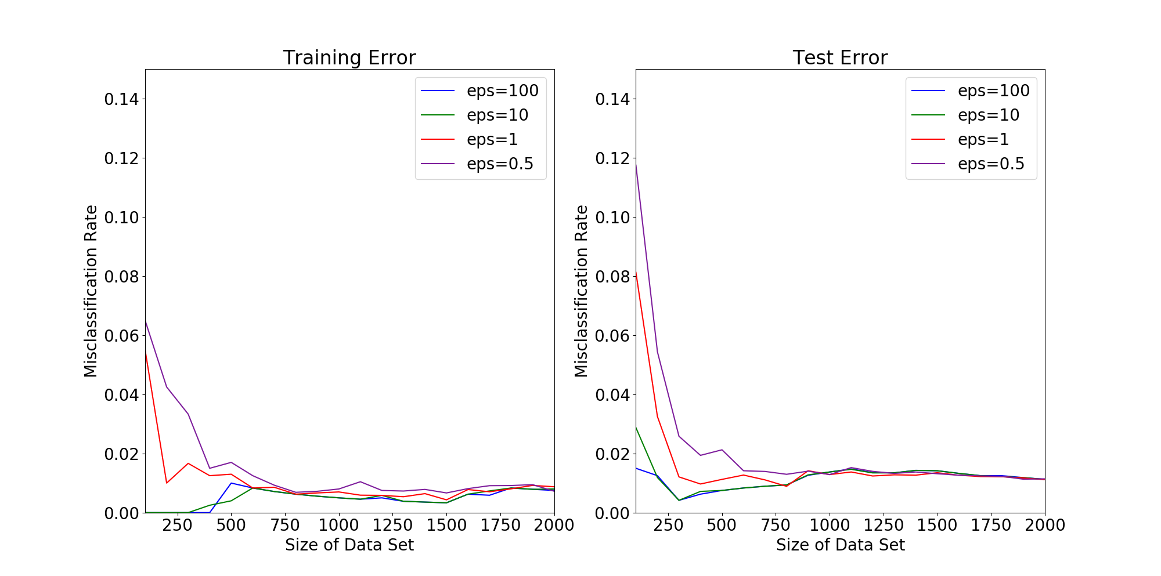
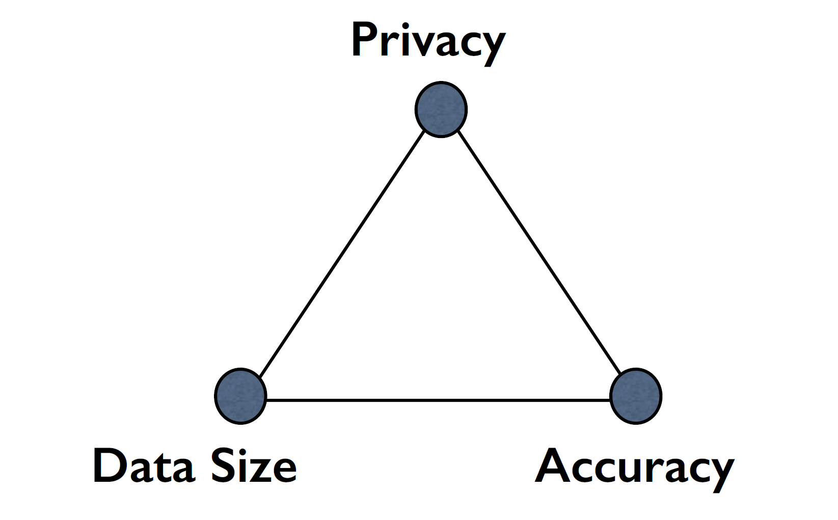
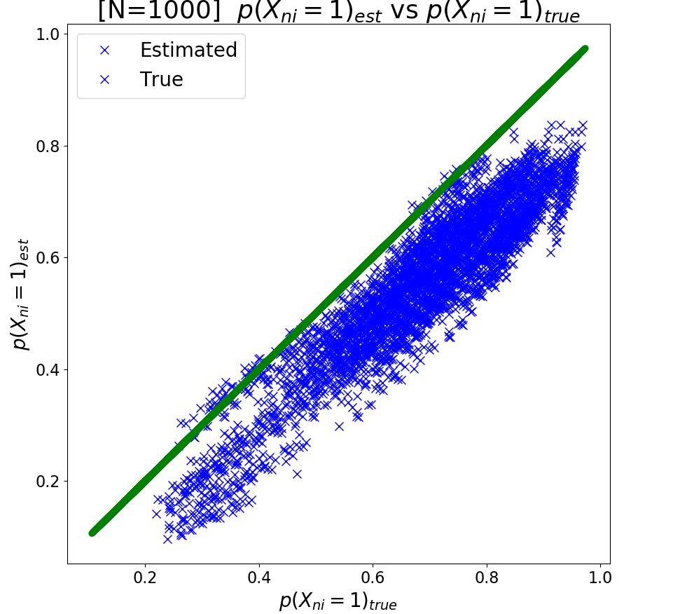
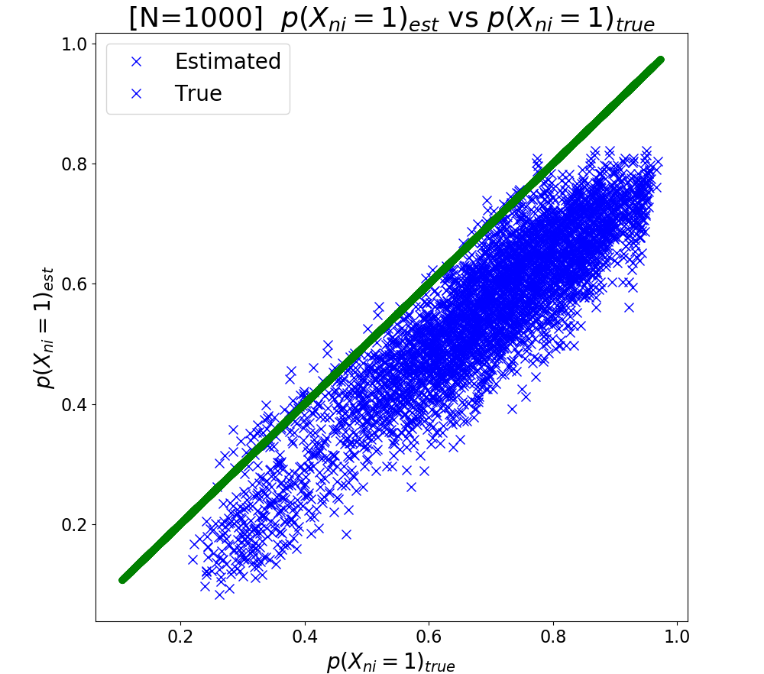



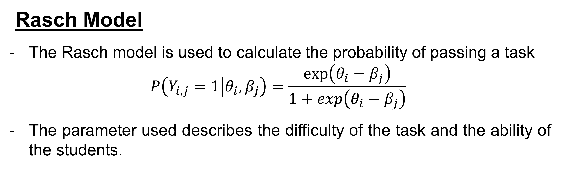
Differentially Private Rasch Model
Teresa Steiner¹, David Nyrnberg¹ and Martin Djurhuus²
¹DTU Compute, Technical University of Denmark, Kgs. Lyngby, Denmark
²DTU Fotonik, Technical University of Denmark, Kgs. Lyngby, Denmark
Introduction
The backbone of medical and social studies is the access and use of personal data.
As an incentive privacy should be ensured.
The traditional approach is to anonymize the data.
But this is not always enough.
$ε$-Differential privacy is a tool that allows for the release of test results without revealing information about any participant.
Is it possible to develop a differentially private feedback system for
students?
Differential privacy
Differential privacy is based around a privacy parameter $ε$.
$$p\left[A\left(D_{1}\right)\right]≤p\left[A\left(D_{2}\right)\right] exp⁡(ε)$$
Done by incorporating randomness e.g. through the addition of noise that is scaled $Δf/ε$.
Sensitivity is how sensitive a function is to the change of a single entry in the data set.
$$Δf=max⁡||f\left(D_{1}\right)−f\left(D_{2}\right)||$$
Results – Real Data
[NIPSKA17]
Discussion
Differential private Rasch model is possible and yields good results on simulated data
Large data set sizes are necessary (f.e. N=1000, I=40)
Real data results here are unusable because of very small class size (i.e. N=62)
Tradeoff!
Results – Simulated Data
Linear Regression with FM / Logistic Regression with OP: Rasch Model Non Private / Private with $ε=10$
Figure 1: Concept of the differentially private Rasch model and its use in teaching.
[NIPSKA17]
Rasch Model
The Rasch model is used to calculate the probability of passing a task
$$P\left(Y_{i,j}=1 | θ_{i},β_{j}\right)=\frac{\exp\left(θ_{i}−β_{j}\right)}{1+\exp\left(θ_{i}−β_{j}\right)}$$
The parameter used describes the difficulty of the task and the ability of the students.
References
Zhanglong Ji, Zachary C. Lipton, Charles Elkan, “Differential Privacy and Machine Learning: a Survey and Review,” arXiv (2014).
Jun Zhang, Zhenjie Zhang, Xiaokui Xiao, Ying Yan, Marianne Winslett, ”Functional mechanism: Regrassion analysis under differential privacy”, International Conferance on very large data bases pages 1364-1375, 2012
Kamalika Chaudhuri and Claire Monteleoni. Privacy-preserving logistic regression. In Proceed-
ings of the 21st International Conference on Neural Information Processing Systems, NIPS'08,
pages 289{296, USA, 2008. Curran Associates Inc.
[NIPSKA17]: Kamalika Chaudhuri and Anand D. Sarwate's tutorial on Differentially Private Machine Learning: Theory, Algorithms, and Applications from NIPS 2017
02460 Advanced Machine Learning
May 16th , 2018

