Slide 1



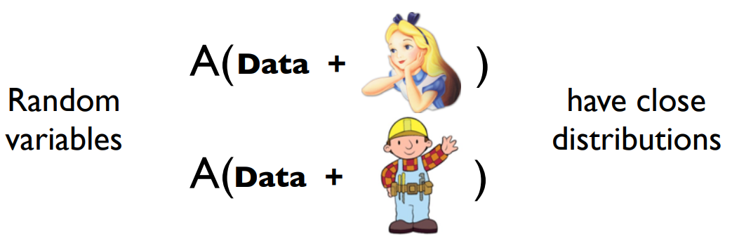
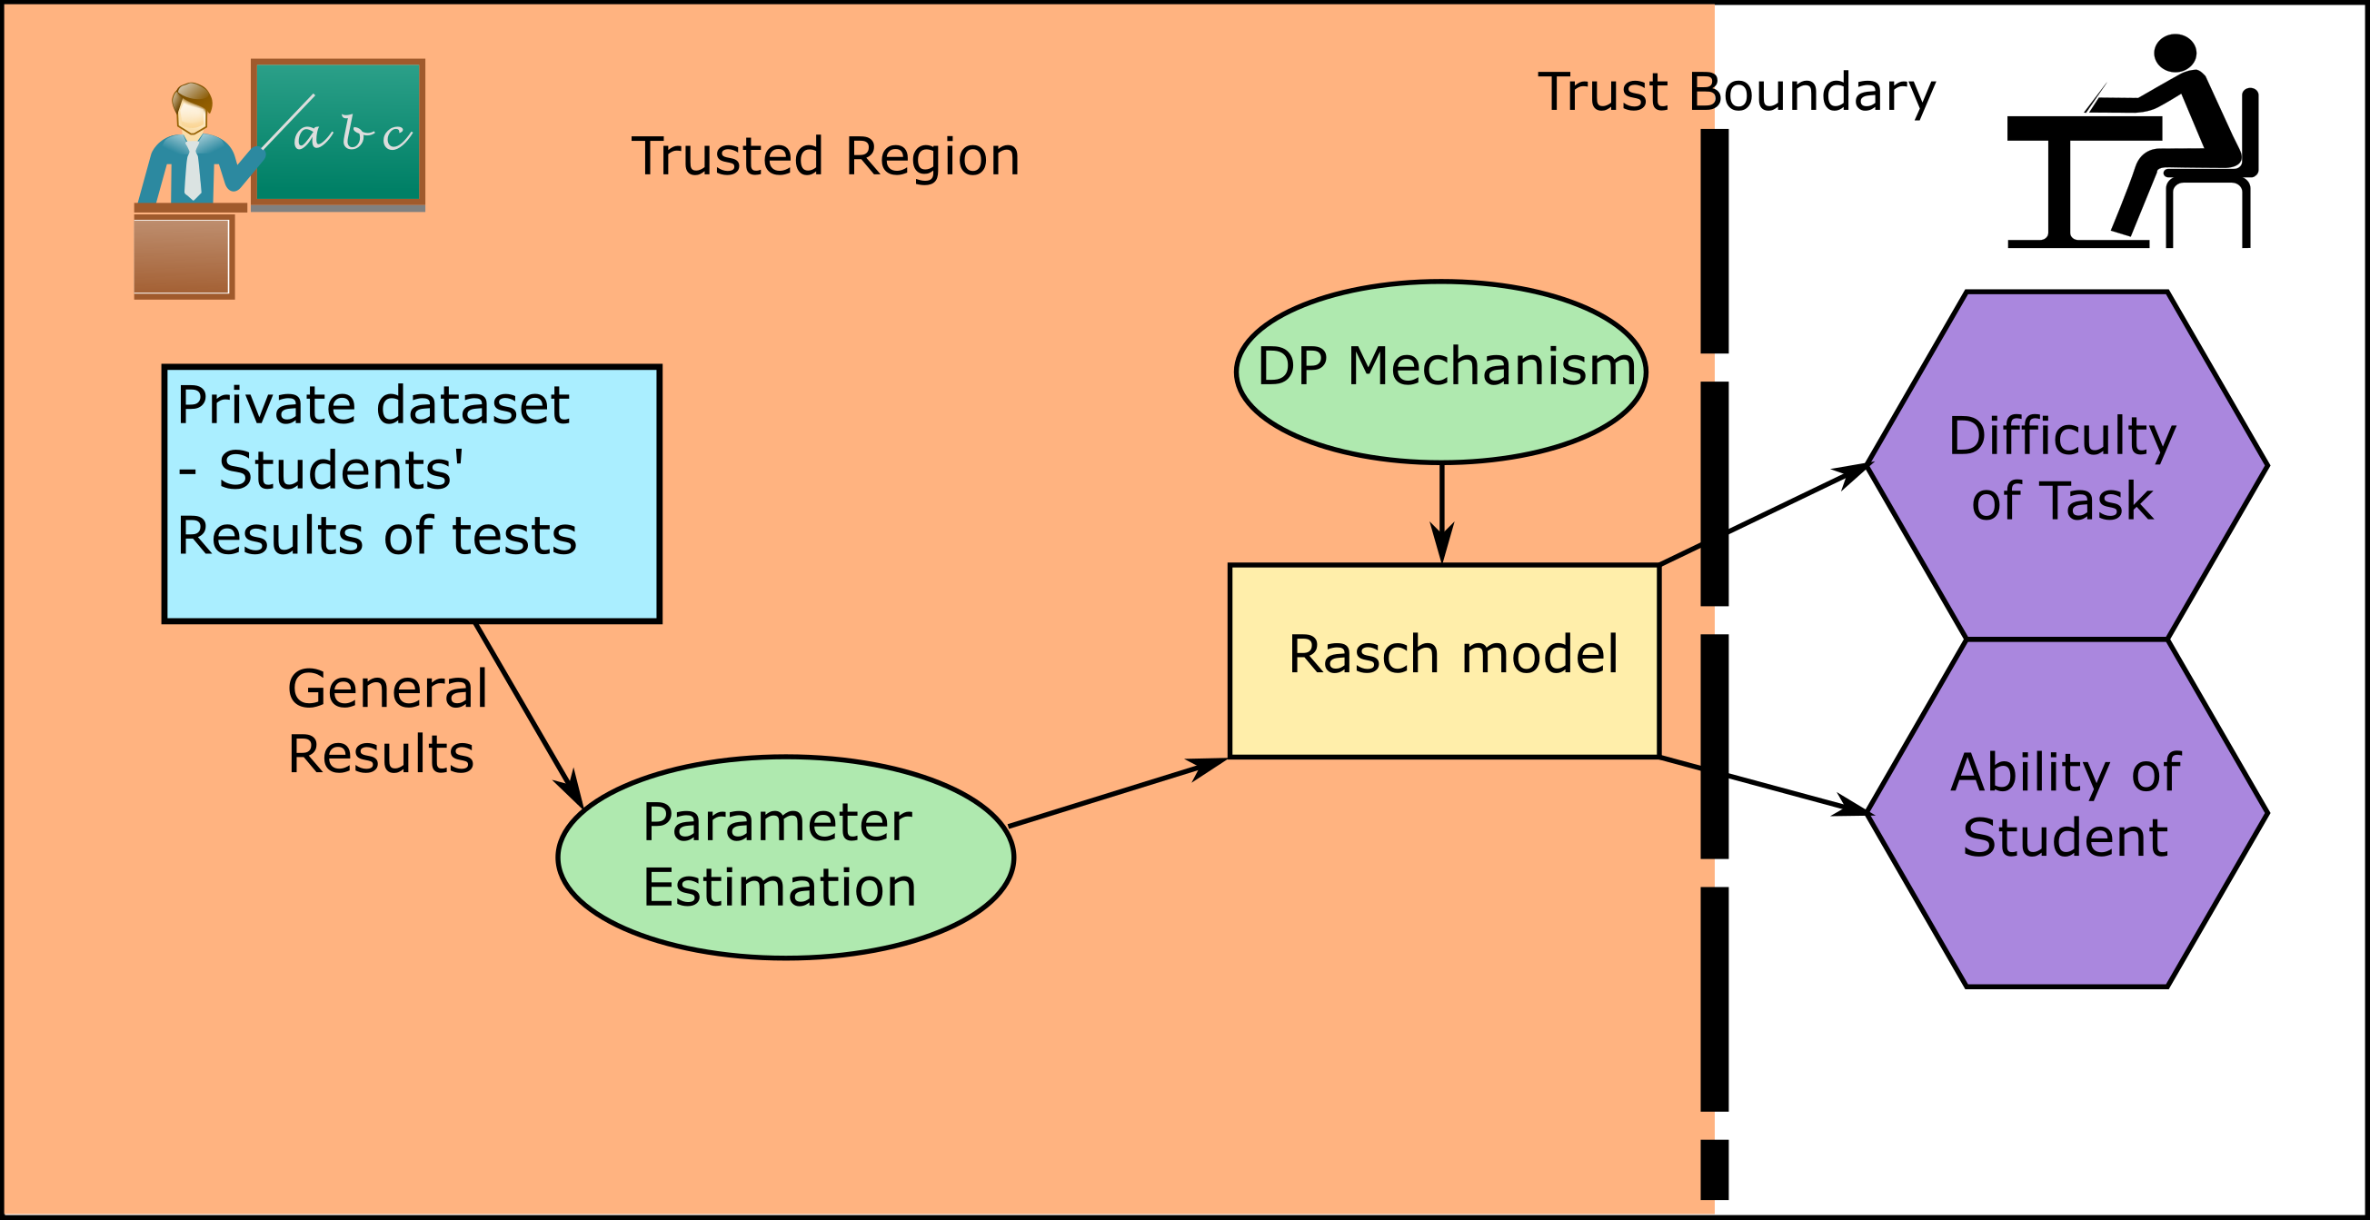
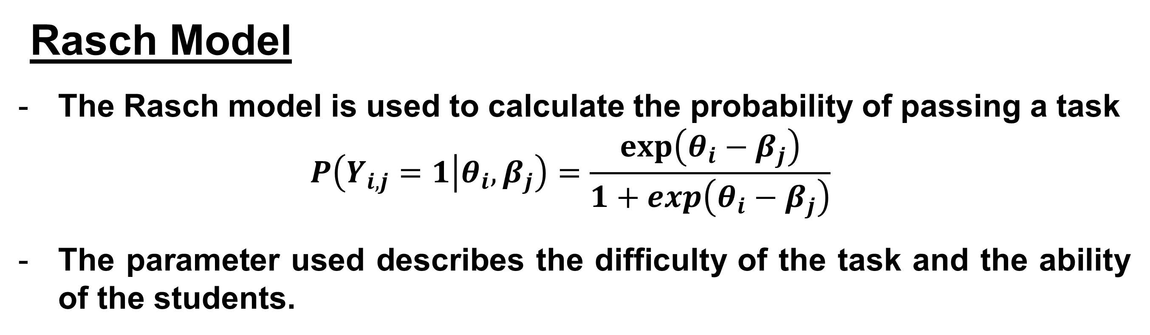


Differentially Private Rasch Model
Teresa Steiner¹, David Nyrnberg¹ and Martin Djurhuus²
¹DTU Compute, Technical University of Denmark, Kgs. Lyngby, Denmark
²DTU Fotonik, Technical University of Denmark, Kgs. Lyngby, Denmark
Introduction
The backbone of medical and social studies the access and use of personal data.
As an incentive privacy should be ensured.
The traditional approach is to ananomize the data.
But this is not always enough.
$ε$-Differential privacy is a tool that allows for the release of test results without revealing information about any participant.
Is it possible to develop a differentially private feedback system for
students?
Differential privacy
Differential privacy is based around a privacy parameter $ε$.
$$p\left[A\left(D_{1}\right)\right]≤p\left[A\left(D_{2}\right)\right] exp⁡(ε)$$
Done by incorporating randomness e.g. through the addition of noise that is scaled $Δf/ε$.
Sensitivity is how sensitive a function is to the change of a single entry in the data set.
$$Δf=max⁡||f\left(D_{1}\right)−f\left(D_{2}\right)||$$
Real Illustrations
Simulated illustrations
Discussion
A strong conclusion that is to the point
?
?
?
?
?
?
?
Figure 1: Concept of the differentially private Rasch model and its use in teaching.
Rasch Model
The Rasch model is used to calculate the probability of passing a task
$$P\left(Y_{i,j}=1 | θ_{i},β_{j}\right)=\frac{\exp\left(θ_{i}−β_{j}\right)}{1+\exp\left(θ_{i}−β_{j}\right)}$$
The parameter used describes the difficulty of the task and the ability of the students.
References
Zhanglong Ji, Zachary C. Lipton, Charles Elkan, “Differential Privacy and Machine Learning: a Survey and Review,” arXiv (2014).
Jun Zhang, Zhenjie Zhang, Xiaokui Xiao, Ying Yan, Marianne Winslett, ”Functional mechanism: Regrassion analysis under differential privacy”, International Conferance on very large data bases pages 1364-1375, 2012
?
???
???

Slide 2
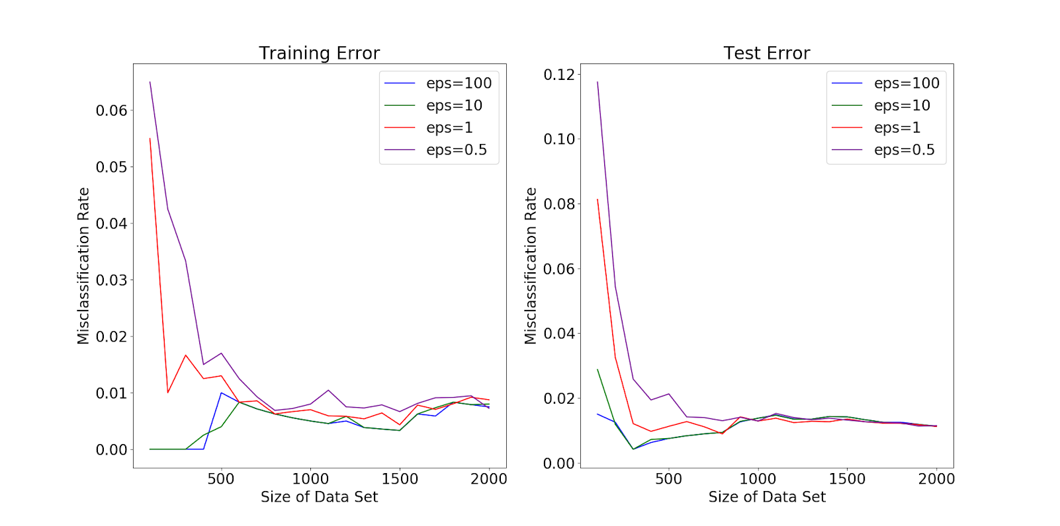
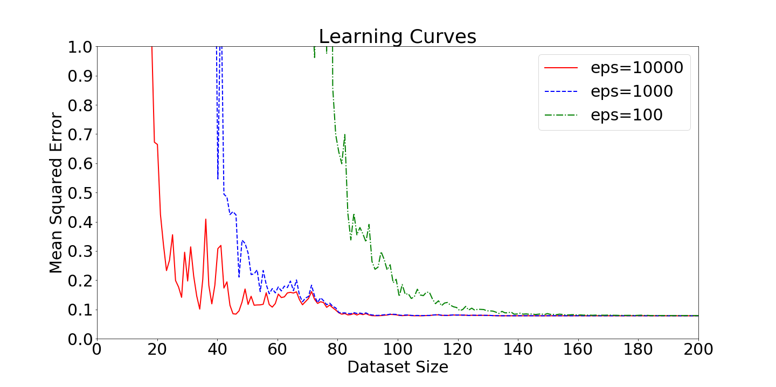
Add if needed

