Slide 1


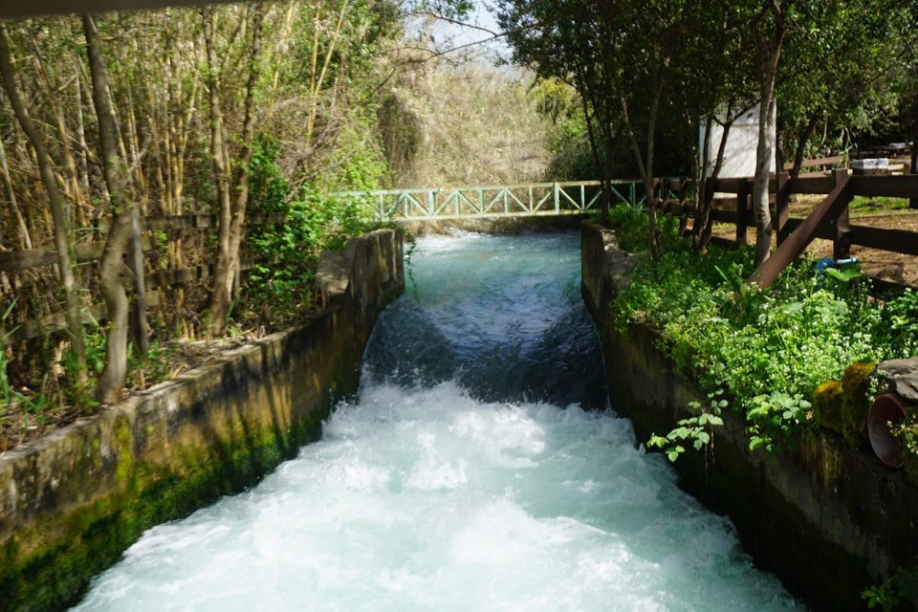
login
sign up
Welcome to vacapp!

Slide 2
login
sign up
Welcome to vacapp!
Sign up
Name:
Email:
דexample@mail.com
Password:
Sign up
or
Continue with google

Slide 3
login
sign up
Welcome to vacapp!
Login
Email:
דexample@mail.com
Password:
Login
or
Continue with google

Slide 4

logout
Your profile
country:
Year of birth:
Status:
save
Notes:
Status, country, religion, gender, kosher, nagish

Slide 5

logout
My posts Add post logout
Hello someone
Find vacation
Advanced
a
Vac type
from
to
Country

Slide 6
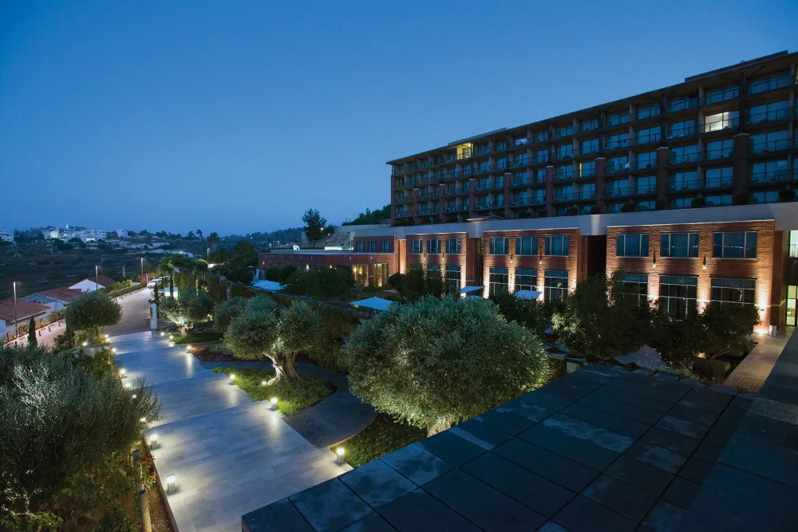
logout
Hello someone
Find vacation
Advanced
Hotel blabla
Hotel blabla
Hotel blabla
Details for example….
Details for example….
Details for example….
4.5 (123)
4.5 (123)
4.5 (123)

Slide 7
logout
Hotel blabla
Details for example….
4.5 (123)
Add comment/grade
View comments

Slide 8
logout
Hotel blabla
Details for example….
4.5 (123)
Grade:
comment
save
cancel

Slide 9
logout
My posts
Hotel blabla
Hotel blabla
Hotel blabla
Details for example….
Details for example….
Details for example….
4.5 (123)
4.5 (123)
4.5 (123)

Slide 10


logout
Hotel blabla
Details for example….
4.5 (123)

Slide 11
logout
Update post
Hotel blabla
Details for example….
4.5 (123)
save
cancel

Slide 12
logout
Hello someone

