Slide 1
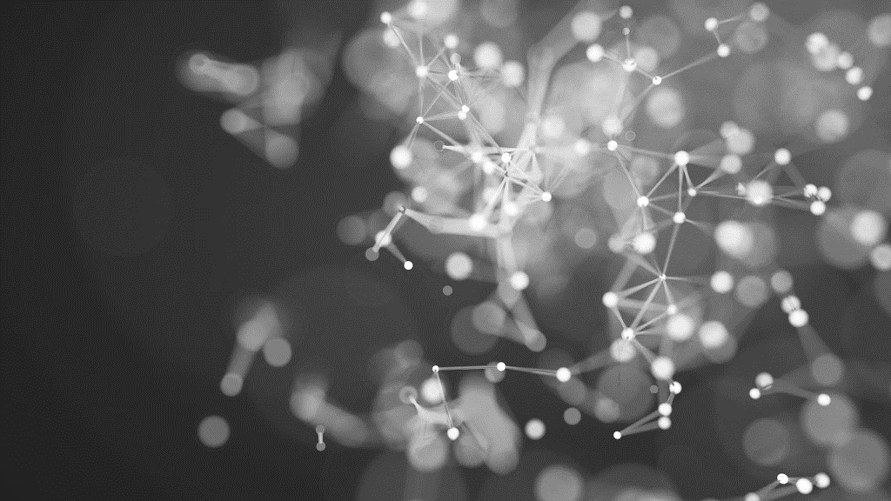

CNN Feature Visualisation and DEEP DREAM
David Farrugia

Slide 2
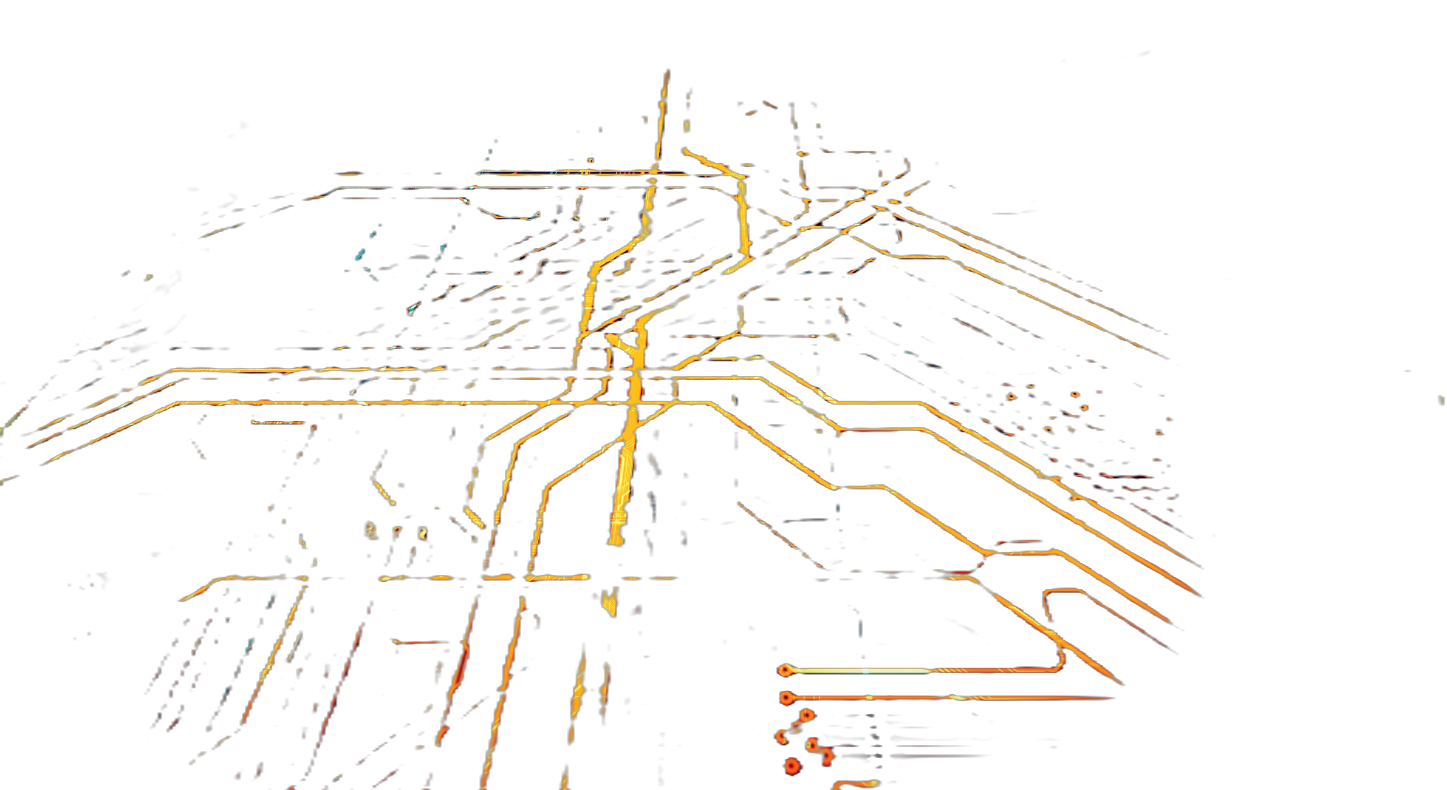
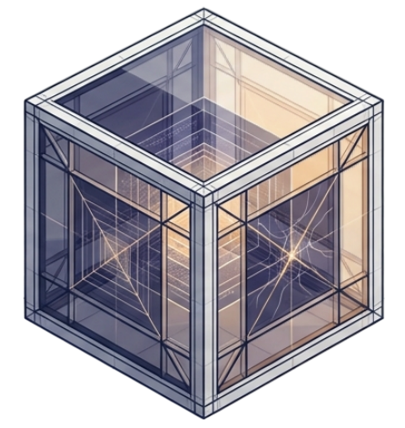
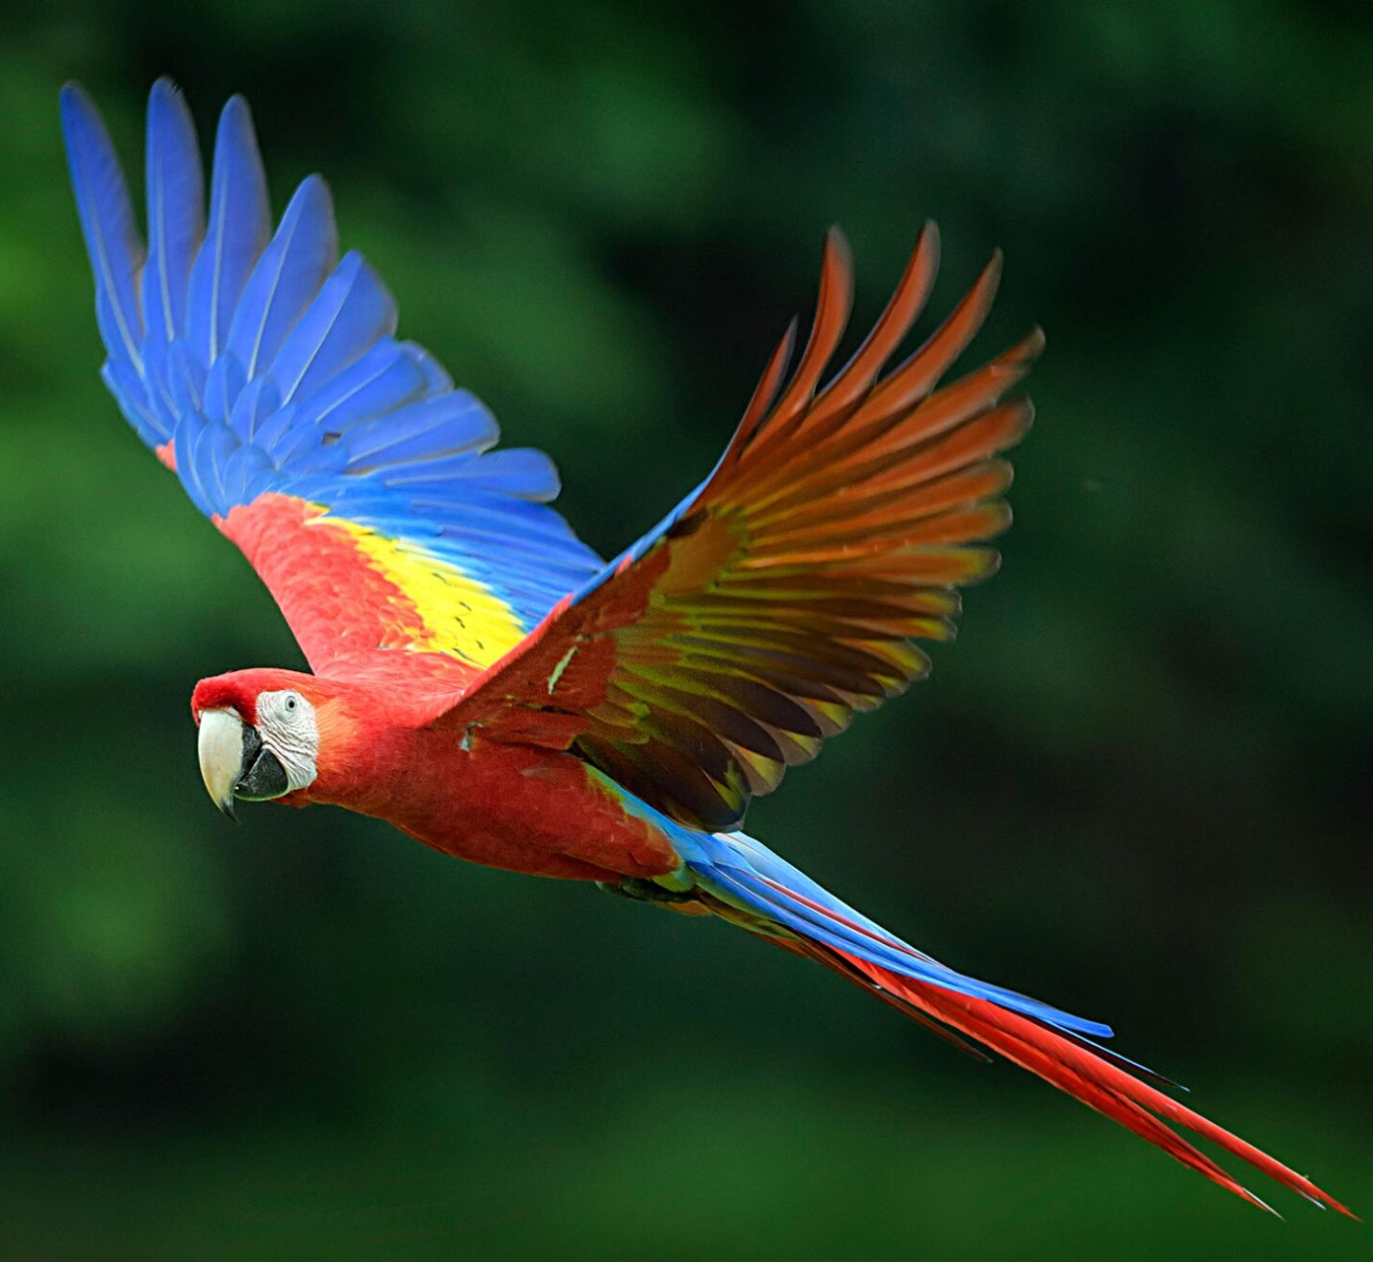
Why Visualise CNNs?
Prediction
Parrot
96%

Slide 3
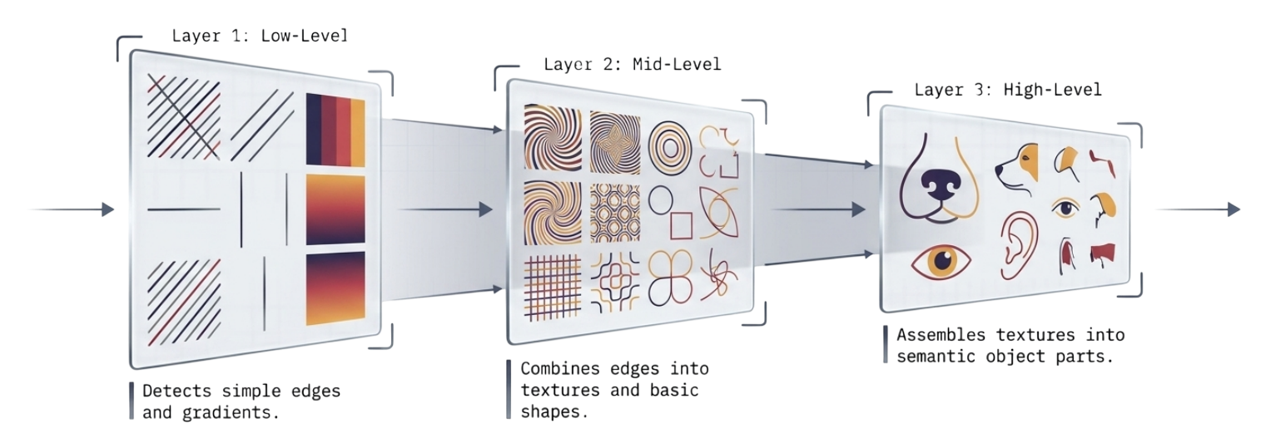
CNN Feature Hierarchy
Low-Level Features
High-Level Features

Slide 4
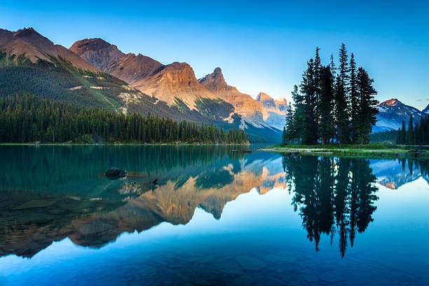
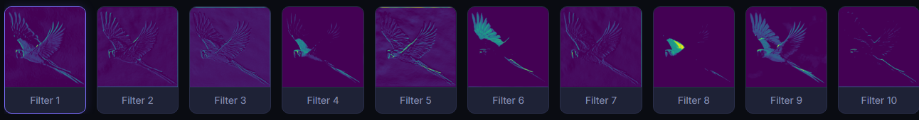
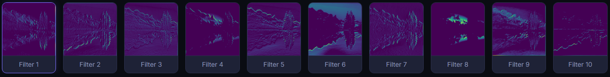
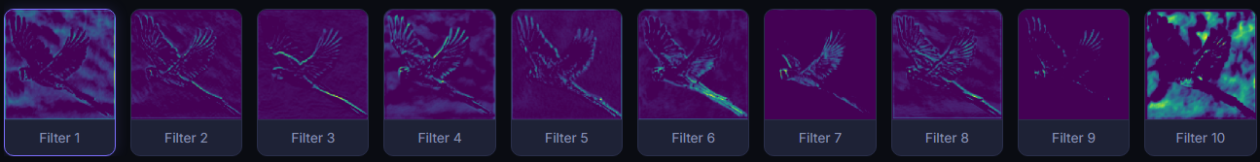
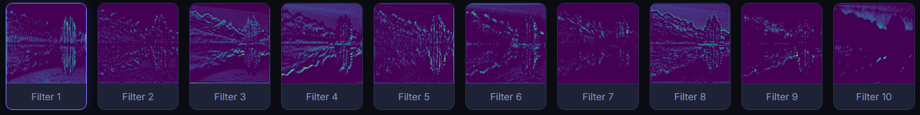
What are Feature Maps?
Feature Maps from Conv 1
Feature Maps from Conv 3

Slide 5


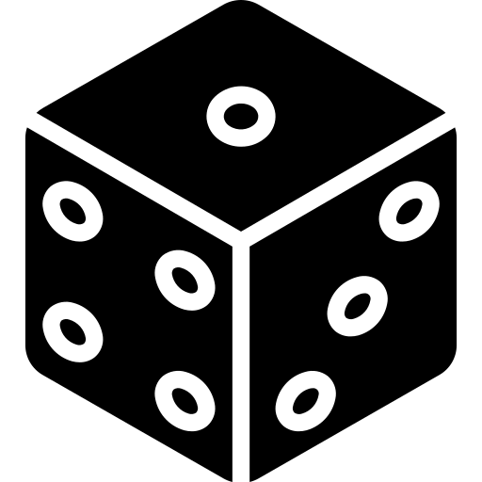
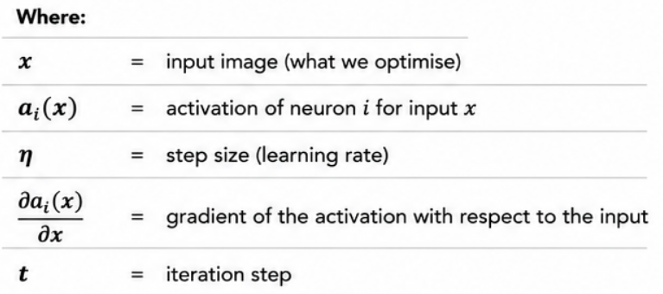


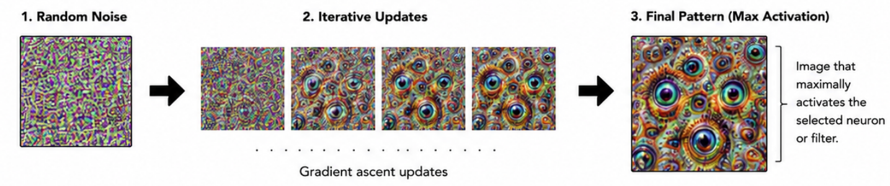
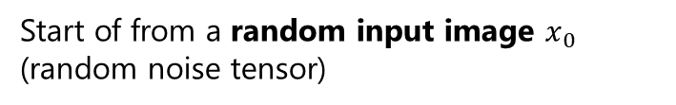

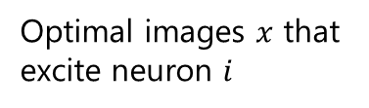
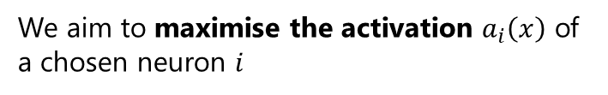

Activation Maximisation
The Goal is to find an input image that maximises the activation of a neuron or filter.
Optimal images $x$ that excite neuron $i$
$$x^{∗}=\arg{\max_{x}{a_{i}\left(x\right)}}$$
We aim to maximise the activation $a_{i}\left(x\right)$ of a chosen neuron $i$
$$x_{t+1}=x_{t}+η\frac{∂a_{i}\left(x\right)}{∂x}$$
Update rule using gradient ascent
Start of from a random input image $x_{0}$ (random noise tensor)
Use gradient ascent to iteratively update the image
The final image reveals the patterns that excite the neuron the most

Slide 6
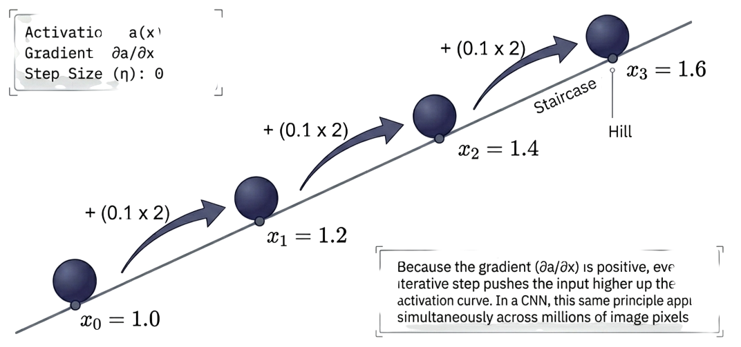
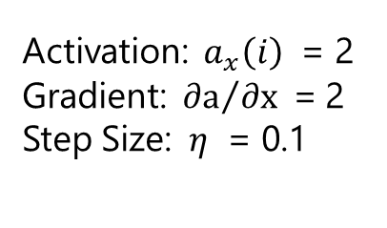
Gradient Ascent in Action
Activation: $a_{x}\left(i\right)$ = 2
Gradient:${ ∂a}/{∂x }$= 2
Step Size: $η$ = 0.1
Because the gradient is positive, every iterative step pushes the input higher.

Slide 7



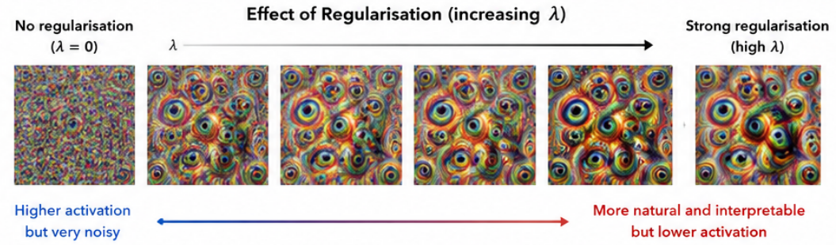
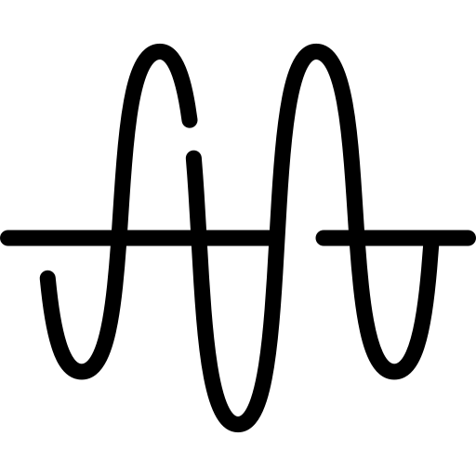
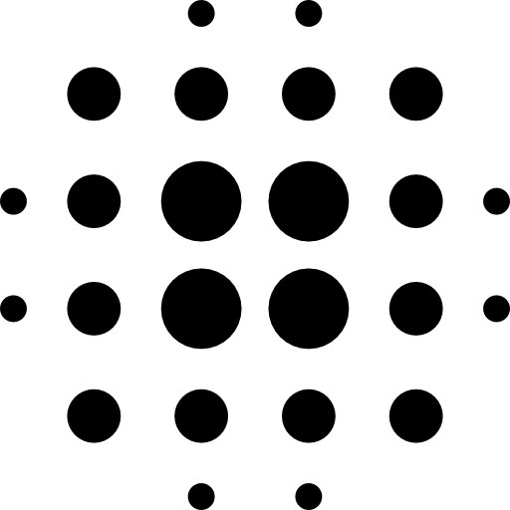





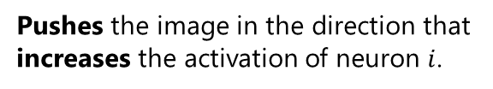

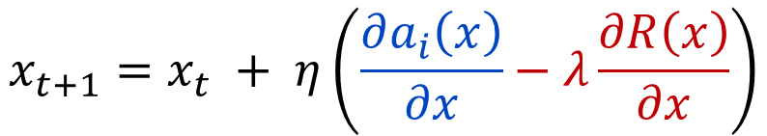






Regularisation Effects
$$x_{t+1}=x_{t} + η\left(\frac{∂a_{i}\left(x\right)}{∂x}−λ\frac{∂R\left(x\right)}{∂x}\right)$$
$$x$$
: input image
$$a_{i}\left(x\right)$$
: activation of neuron $i$
$$η$$
: step size (learning rate)
$$R\left(x\right)$$
: regularisation function
Increases Activation
Regularisation (penalty)
$$λ$$
: regularisation strength
Activation Term $\frac{∂a_{i}\left(x\right)}{∂x}$
Regularisaiton Term $−λ\frac{∂R\left(x\right)}{∂x}$
Pushes the image in the direction that increases the activation of neuron $i$.
Penalises undesirable properties (e.g. noise), encouraging natural-looking images.
Common Regularisers $R\left(x\right)$
Total Variation (TV)
reduces high-frequency noise
L2
L2 Norm
Discourages extreme pixel values
Gaussian Blur
Suppresses high-frequency noise

Slide 8
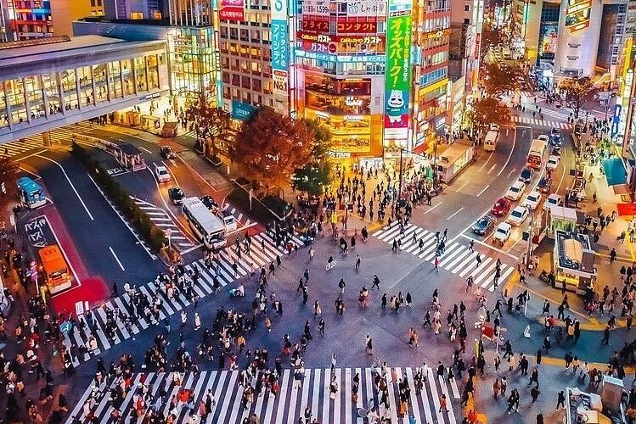


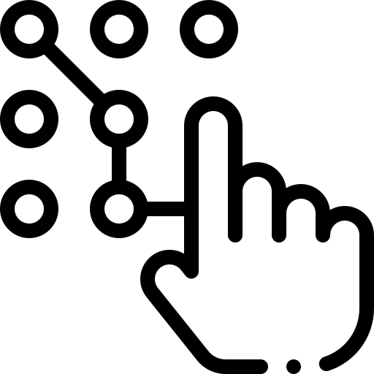

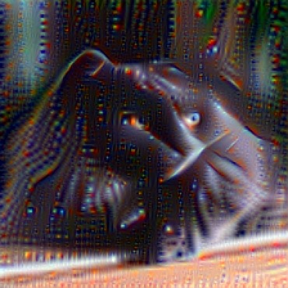
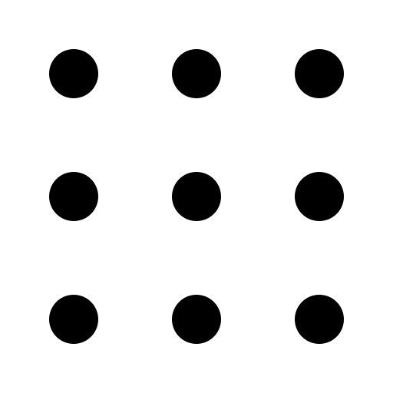

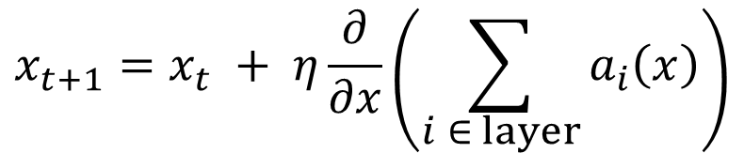
DeepDream Amplification
Original Images
DeepDream Output
$$x_{t+1}=x_{t} + η\frac{∂}{∂x}\left(\sum_{i ∈ layer}{a_{i}\left(x\right)}\right)$$
Starts from a real image
Instead of noise, DeepDream uses a real image as the starting point
Amplifies learned patters
It enhances the patters, textures and structures already present in the image
Optimises an entire layer
DeepDream optimises the activations of all neurons in a layer simultaneously, not just one
Different layers, different dreams
Earlier layers produce simpler textures and edges, while deeper layers create more complex object-like hallucinations

Slide 9

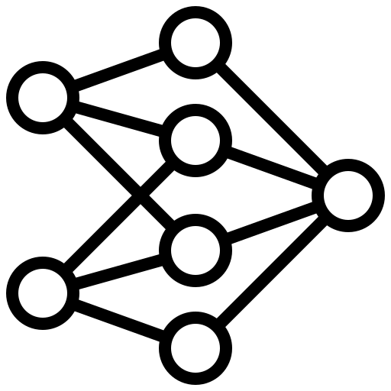



Real-World Applications
CNN Debugging
Medical Imaging
Model Interpretability
Adversarial understanding
Explainable AI

Slide 10





Limitations and Alternatives
Failure cases
When not to use
Alternatives
Repetitive textures or colour blobs
DeepDream may hallucinate random patterns
Outputs can be sensitive to parameter choices
For safety-critical decisions
Poor choice when you need one clear explanation for a real prediction
Not proof that the model understands the object
Grad-CAM: highlights important image regions
Saliency / Guided BP: pixel-level sensitivity
Feature maps: inspect intermediate activations.

Slide 11
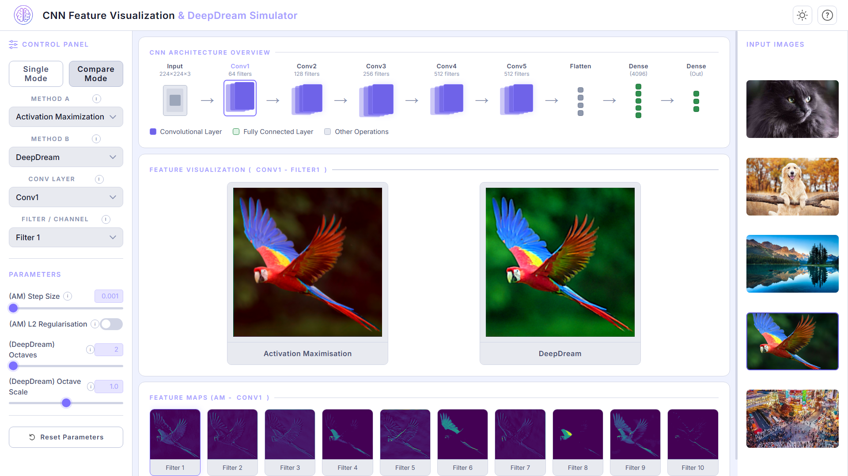

https://davidf-22.github.io/ARI5118-DeepLearningCV_Project/

Slide 12

Let’s See How Much You Understood ☺
Quiz Time

Slide 13
References Used
[1] C. Olah, A. Mordvintsev, and L. Schubert, \Feature Visualization," Distill,vol. 2, no. 11, Nov. 2017, doi: https://doi.org/10.23915/distill.00007. [2] Mordvintsev et al. “Inceptionism: Going Deeper into Neural Networks,” research.google. https://research.google/blog/inceptionism-going-deeper-into-neural-networks/ [3] K. Simonyan, A. Vedaldi, and A. Zisserman, \Deep Inside Convolutional Networks:Visualising Image Classification Models and Saliency Maps," arXiv.org, 2013. https://arxiv.org/abs/1312.6034 [4] A. Mahendran and A. Vedaldi, \Visualizing Deep Convolutional Neural NetworksUsing Natural Pre-images," International Journal of Computer Vision, vol. 120,no. 3, pp. 233{255, May 2016, doi: https://arxiv.org/abs/1512.02017. [5] A. Nguyen, J. Yosinski, and J. Clune, \Understanding Neural Networks viaFeature Visualization: A survey," arXiv.org, 2019. https://arxiv.org/abs/1904.08939 [6] M. D. Zeiler and R. Fergus, \Visualizing and Understanding ConvolutionalNetworks," arXiv.org, 2013. https://arxiv.org/abs/1311.2901

Slide 14
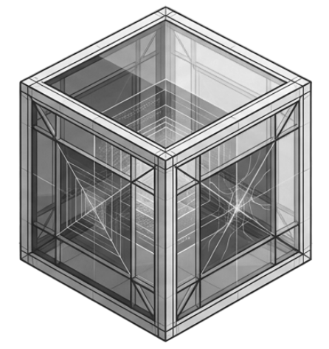
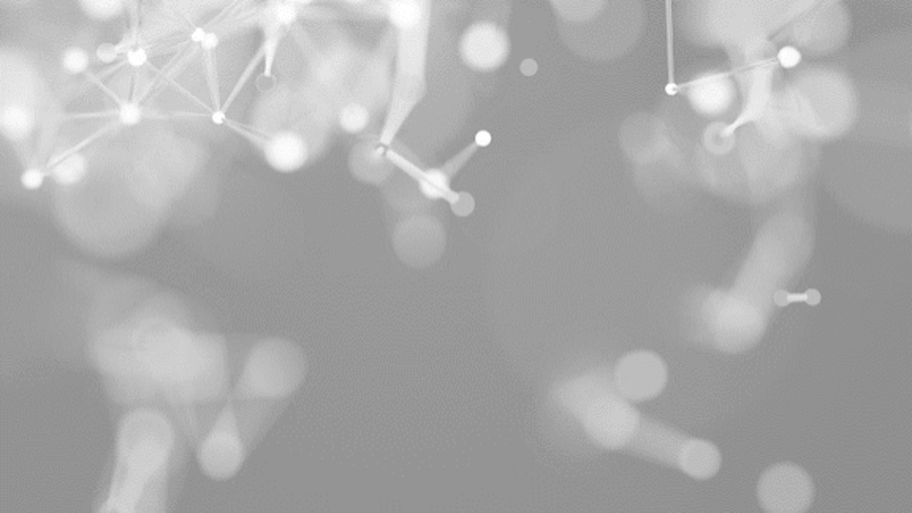


THANK YOU
david.farrugia.22@um.edu.mt
DavidF-22/ARI5118-DeepLearningCV_Project

