Slide 1
High Performance Computing Final Project
Project Team 2

Slide 2
Determinant
LU Decomposition:
Factoring a matrix into A = LU.
Determinant can be calculated using diagonal entries of A.
Using OpenMP.
LU Decomposition:
For I=0 to N:
For J=I+1 to N:
Ratio = matrix[j][i]/matrix[i][i]
For K=0 to N:
Matrix[j][k] -= ratio*matrix[i][k]
Determinant:​
Det = 1
For I=0 to N:​
Det *= matrix[i][i]
NOTICE: There is a crucial data dependency in the second loop. Hence, we can't parallelize the first for loop.

Slide 3
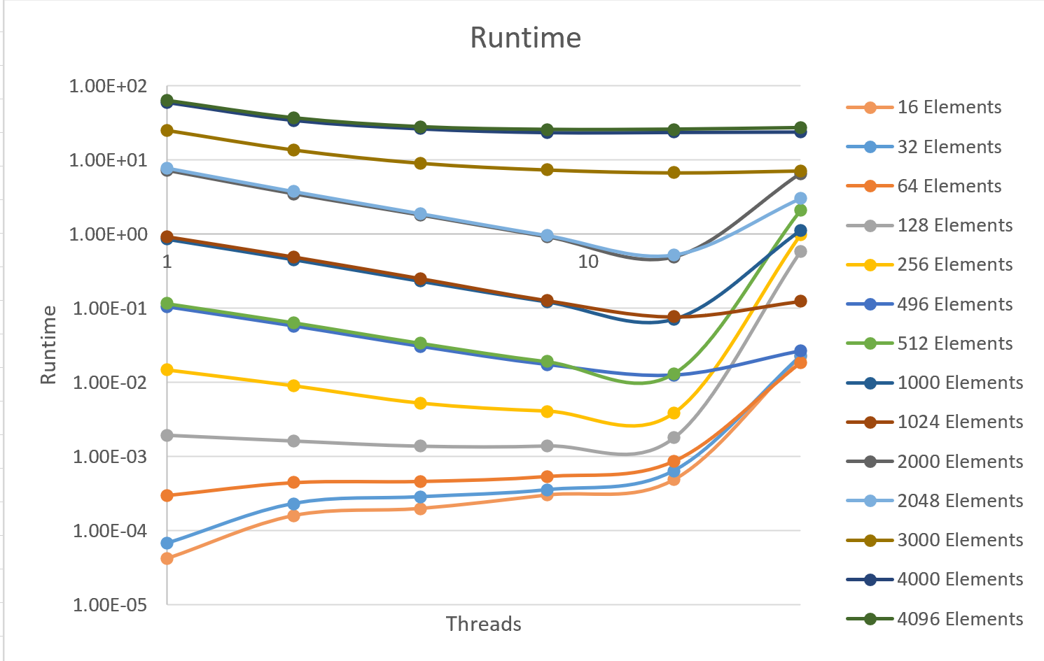
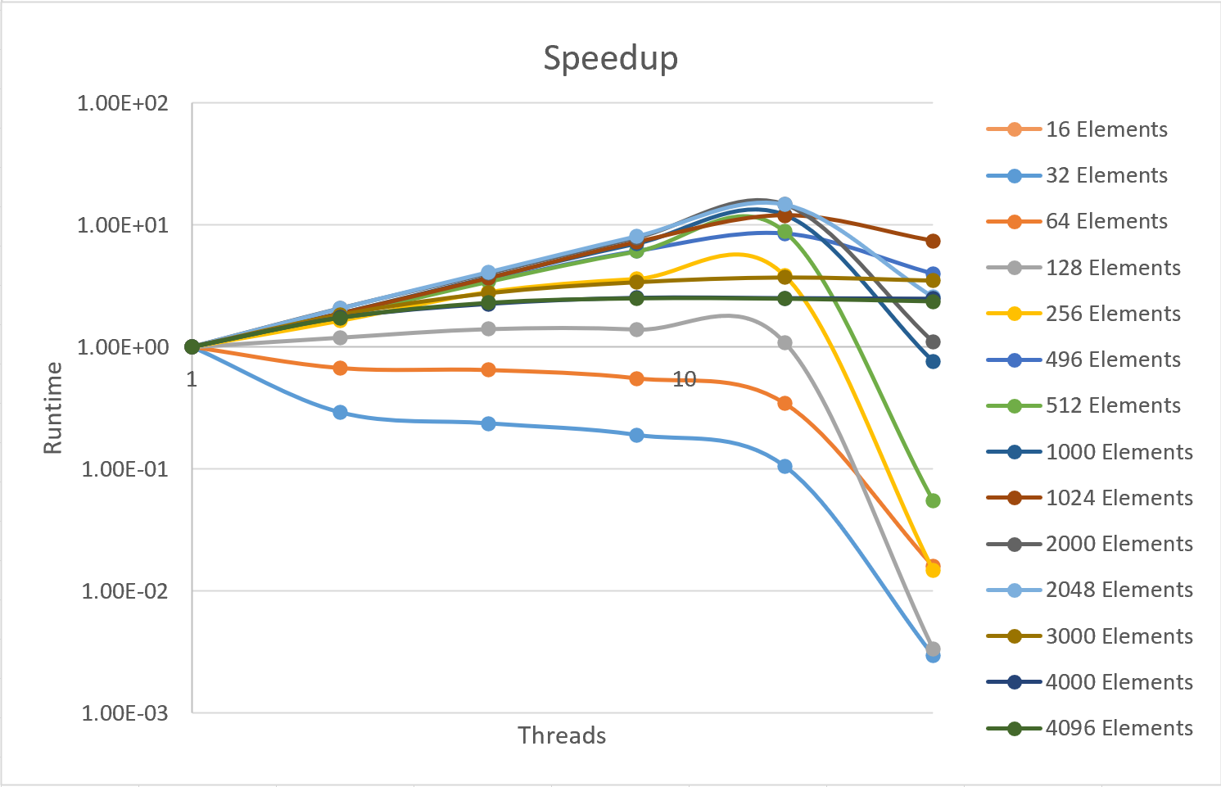
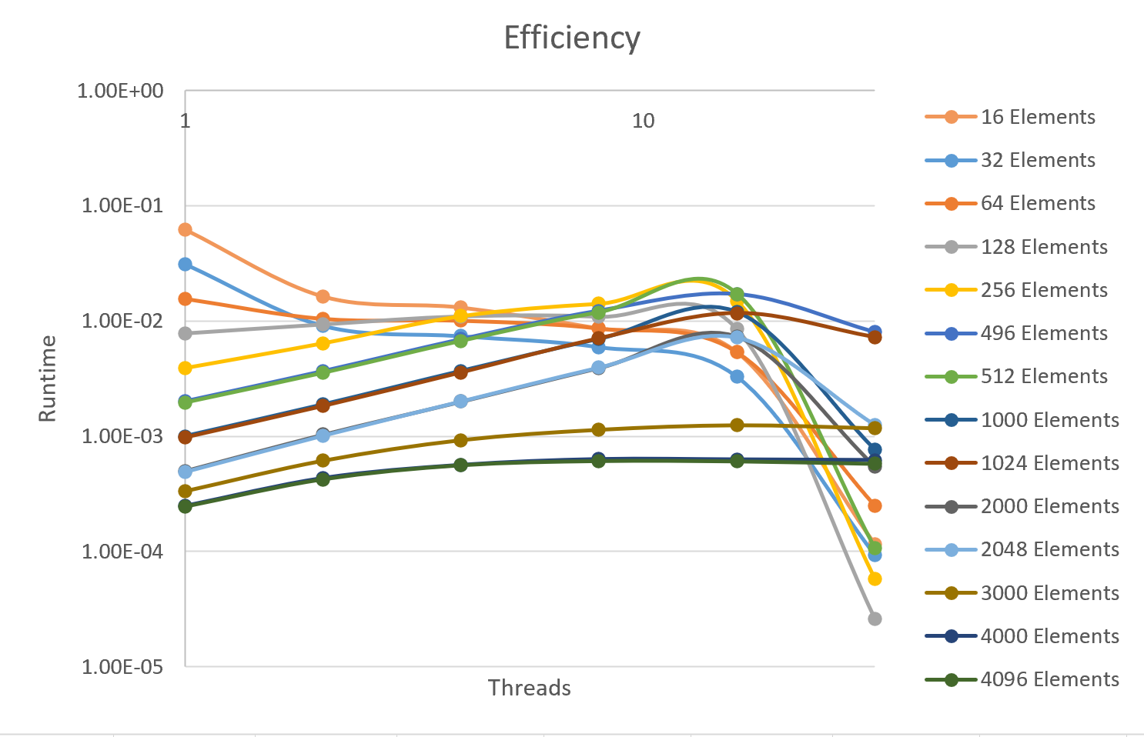
Determinant
Weakly-Scalable(High Volatility in Efficiency graph)

Slide 4
Traveling Salesman Problem
Stochastic Nearest Neighbor Heuristic
Introduces Randomness in hopes of greater exploration
Using MPI and OpenMP
Pseudocode
Starting city = random start;
While there are unvisited cities:
If( random chance (ODDS) ):
Randomly choose an unvisited city
Else:
Choose the unvisited city closest to the last

Slide 5
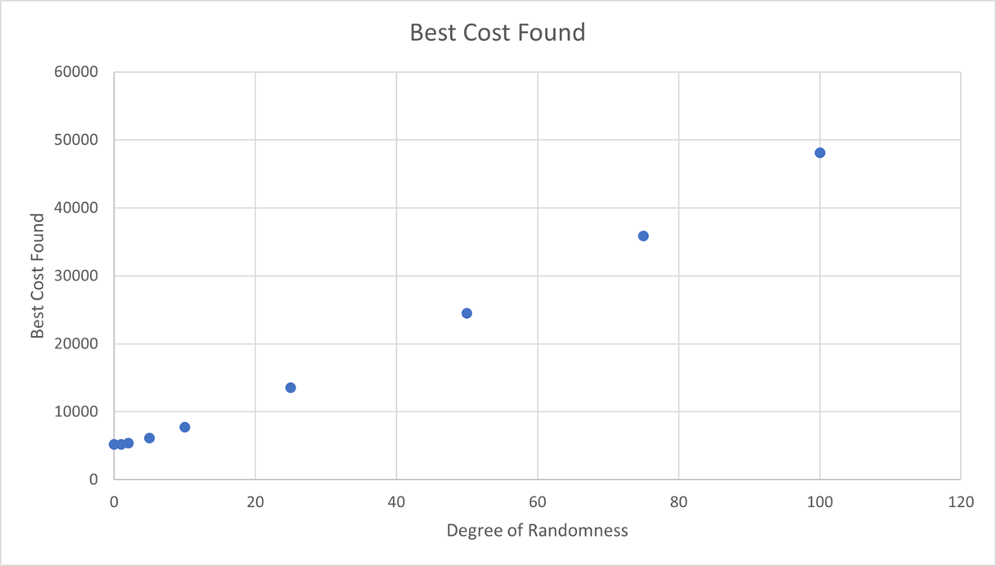
TSP: Degree of Randomness
More randomness, above 5%, hurts the quality of answer
At 5% and lower it seems interchangeable

Slide 6
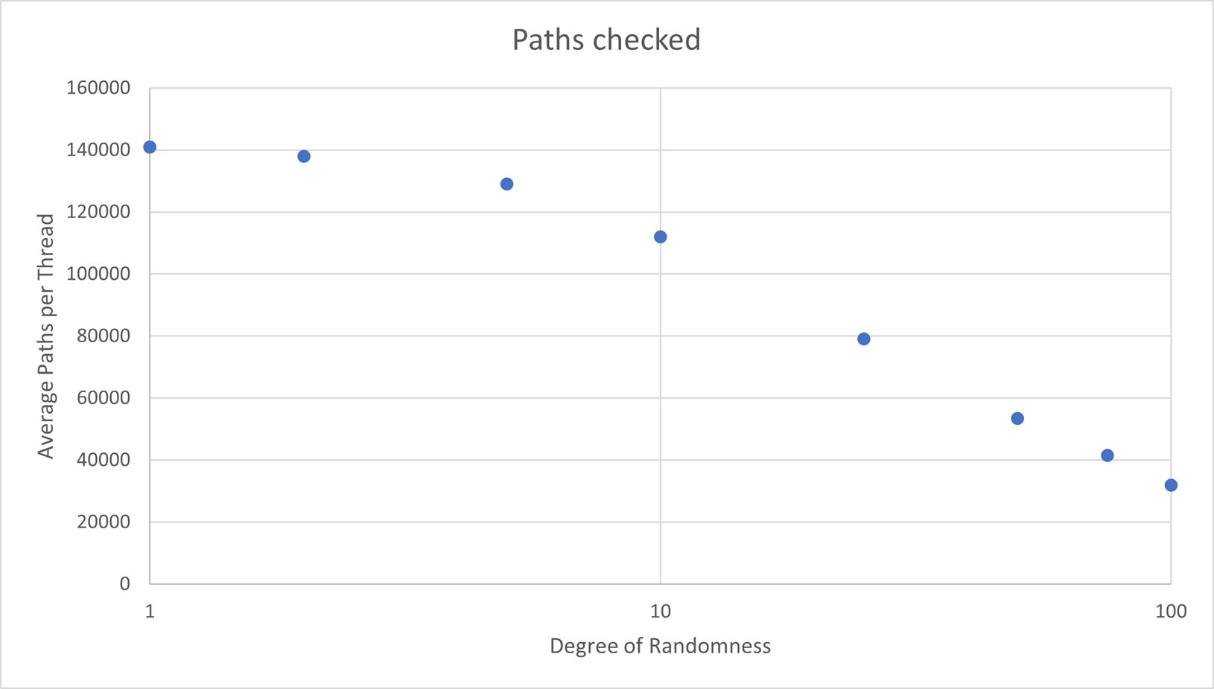
TSP: 'rand()' Function
Found that 'rand()', used for the random sections, eats up quite a bit of the runtime, limiting the amount of paths that can be checked.
Accounting for this, high random runtimes still don't find high quality answers

Slide 7
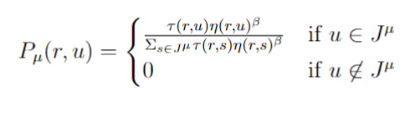

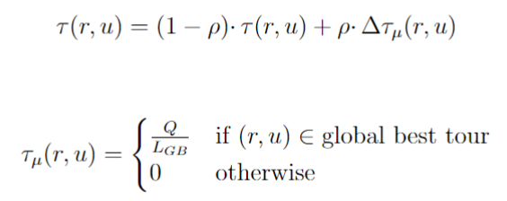
Traveling Salesman Problem
Ant Colony Optimization(Alternative to Stochastic Nearest Neighbor)
Randomness is spread throughout the program.
Using OpenMP
Agents select cities based on the probability equations.
Calculating best probability for the next city
Local pheromone updates:
Global pheromone updates:
Driver Code:
while iterations < iterations_max:
for i in num_agents:
generateSolutions()
globalPheromoneUpdate()
repeat
Generate Solutions:
let local_tour[n] and local_length = 0
while agent still has cities to visit:
calculate the best probability using equation (4)
add the best city to local_tour[n].
update pheromone table with current_city, best_city, and equation (5)
compare and/or update best global tour using local_tour[n]
repeat
Global Pheromone Update:
for each (r, u) pairing:
check if (r, u) is in best global tour using equation (7).
if (r, u) is in global tour:
update t[r][u] using equation (6)
else:
move to next pairing

Slide 8
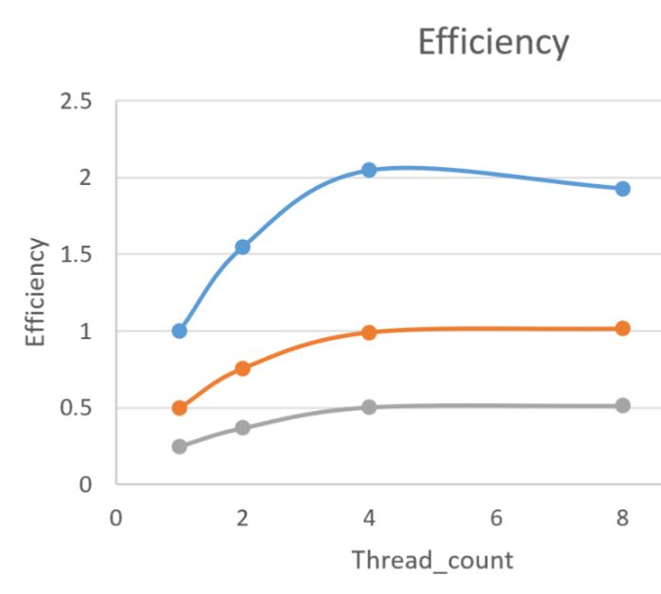
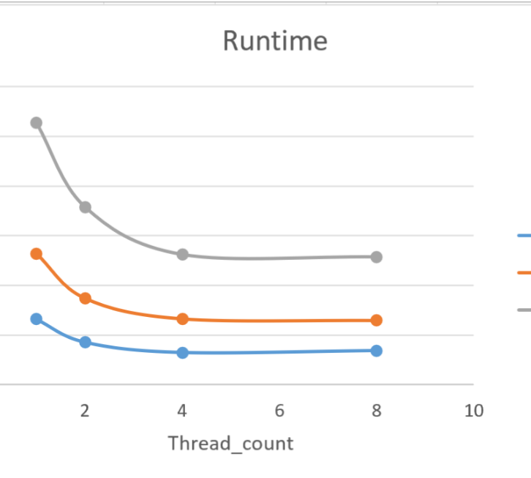
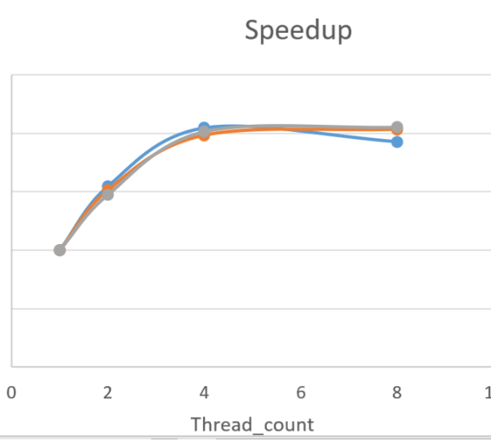
Traveling Salesman Problem
Q = 5.00, rho = 0.5, beta = 2, num_agents = 1.
Given these parameters and the efficiency graph's trend, this program lends toward being weakly-scalable.
Best_length = 5659 found in about 26 seconds.
Adding iterations turned out to not be very much with the given parameters

