Slide 1

Predicting Attrition
MSDS 6306: Doing Data Science – Case study 2
Notes:
Hello, my name is David. Today I am going to present the attrition study I performed for your company

Slide 2

Attrition Study Summary
Description:
There is one dataset, “Attrition” which contains 37 employee characteristics and the target variable.
Example of features:
Age
Business Travel
Department
Education
Performance Rating
Dropped features:
Over 18
Employee Number
Employee Count
Notes:
Let’s start by looking over the data that we used to this analysis. The dataset contained information about 870 employees and 37 characteristics for each of those employees. Some of the example of the characteristics where [LIST]. There where also features that from the get-go I knew those where not going to provide any value so they were drop, such as employee count and number, and is the employee over 18 (FYI all the employees are over 18)

Slide 3
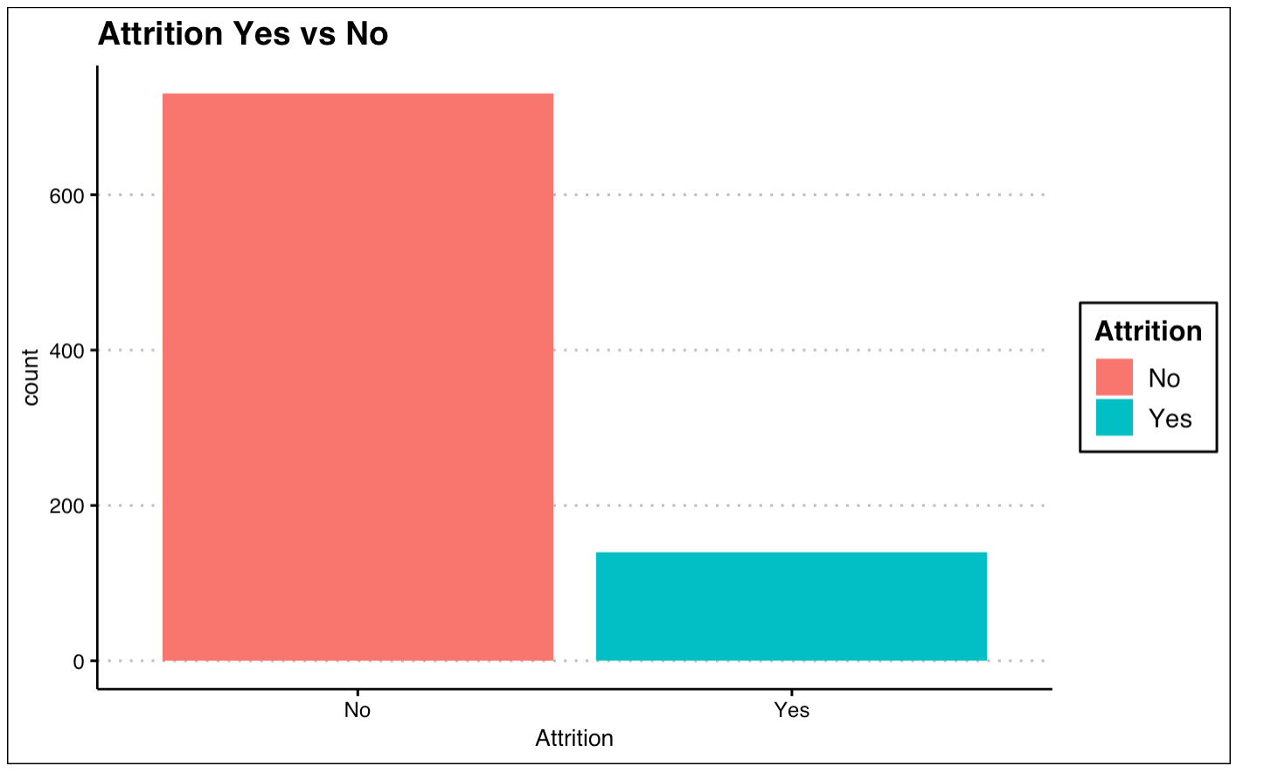
Attrition vs No Attrition
870 employee’s information
Attrition percentage: 16.09%
Notes:
Let’s move on to look at the attrition percentage for the company. Out of the 870 16% have left the company. This is an important number, because our analysis goes into investigating what are the main difference between this 16% vs the rest of the employees.

Slide 4
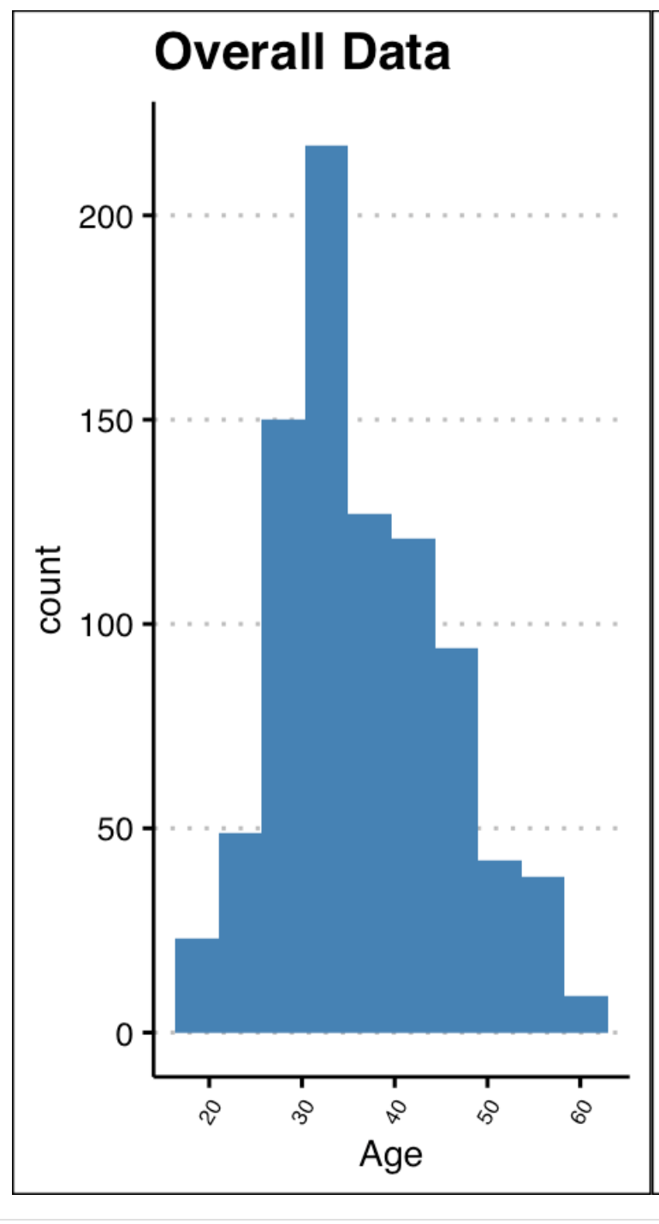
Employee demographics
Employee’s age rage from 18 to 65 years old
Notes:
Looking the employee demographics we can see that the employee age range goes from 18 to 65 years old. The bulk of the employee’s age goes somewhere from 30 to 35.

Slide 5
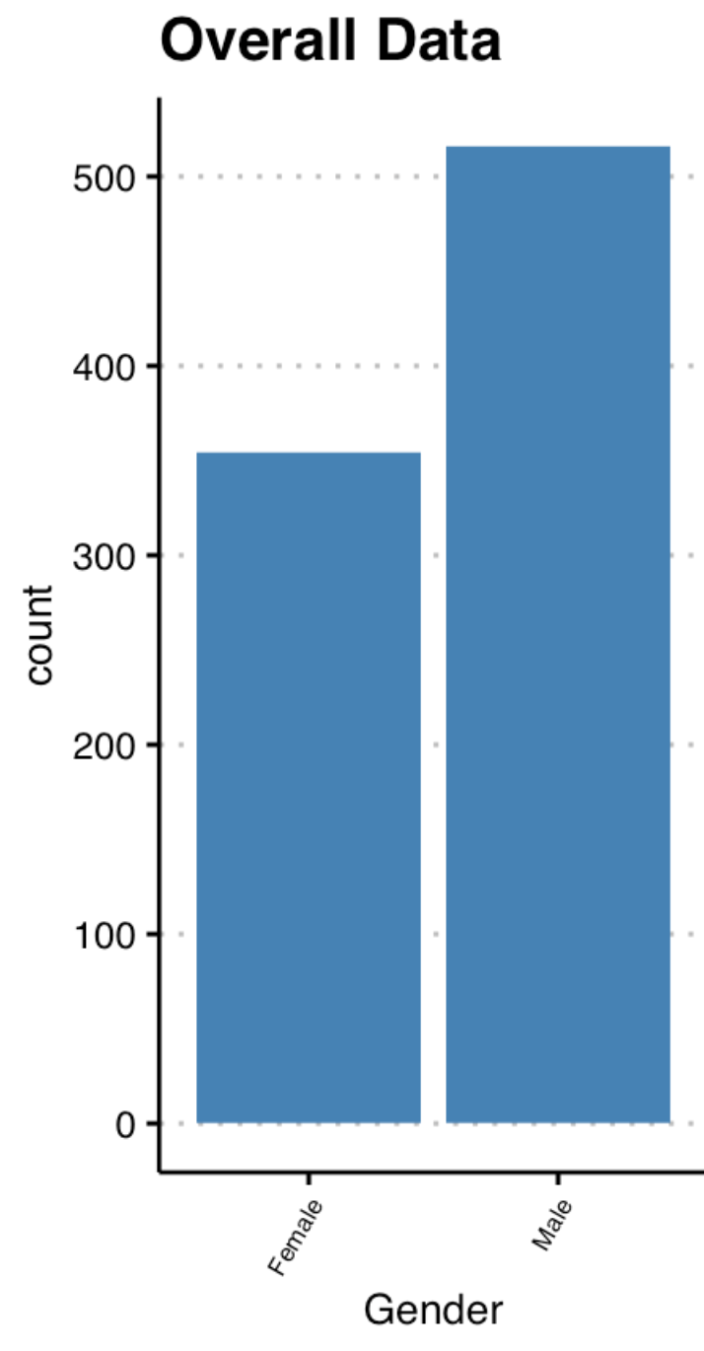
Employee demographics
Male employees represent 59% of the total number of employees.
Notes:
Moving into employee gender, we found out that the majority of all employees are Male. To be exact 59% of them.

Slide 6

Research Scientist Profile
Research Scientist's with performance rating higher than 3.5 are more likely to leave the company.
Overall, Research Scientists do not move between companies too much.
Most Research Scientists have been at their role for less than 5 years.
Most Research Scientists scientists are in their 30's.
Research Scientists that are in their early 30's tend to have higher attrition.
Notes:
We decided to investigate the typical employee profile for the research scientistic role and came up with some interesting insights: First, people in the role of Research Scientist's with performance rating higher than 3.5 are more likely to leave the company.
Second: Most research scientists don’t have to much work experience in different companies, most have only worked for this company, in fact the typical research scientists have been less than 5 years in this role which is to be expected because most early in their early 30’s. The last interesting insights is that There is also a trend that the younger the research scientist is the more likely is too leave the company.

Slide 7

Top Attrition Causes
Travel Frequency
Specific Job Titles
Monthly Salary
Marital Status
Number of Previous Companies Worked.
Over Time
Age
Notes:
So let’s move on into discussing the top attrition causes for all employees and roles. Based on the data, we identified 6 causes as being the major explainers for attrition. These where: [LIST]

Slide 8
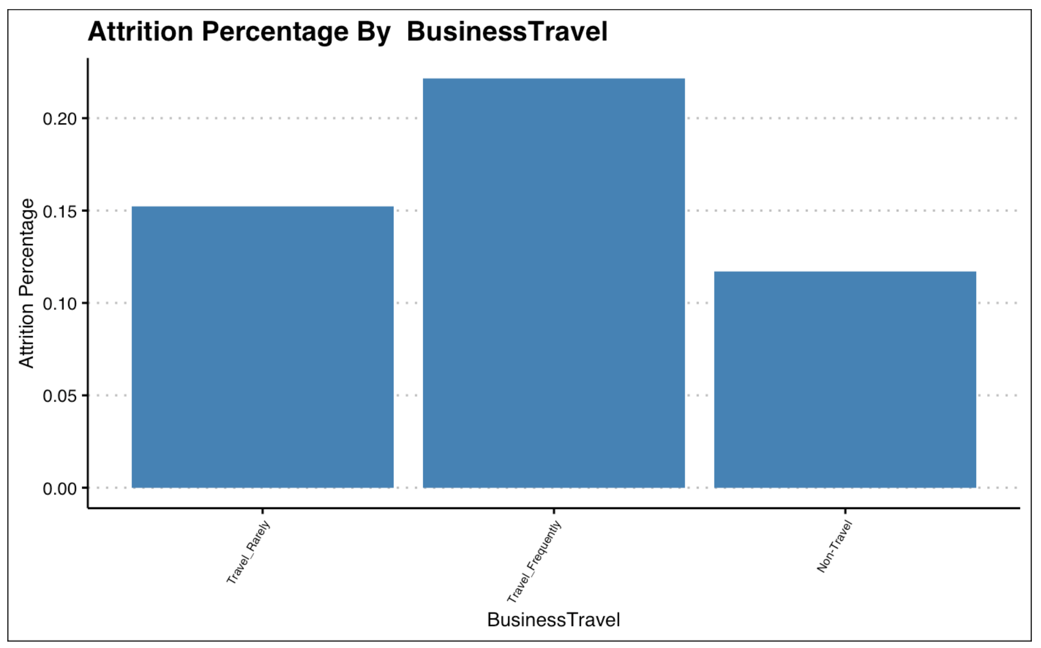
Travel Frequency
Employees who travel frequently show a higher attrition rate compared to employees who travel rarely or don't travel at all.
Notes:
Looking for closely at travel frequency, we identify that employees who travel more frequently are more likely to leave the company.

Slide 9
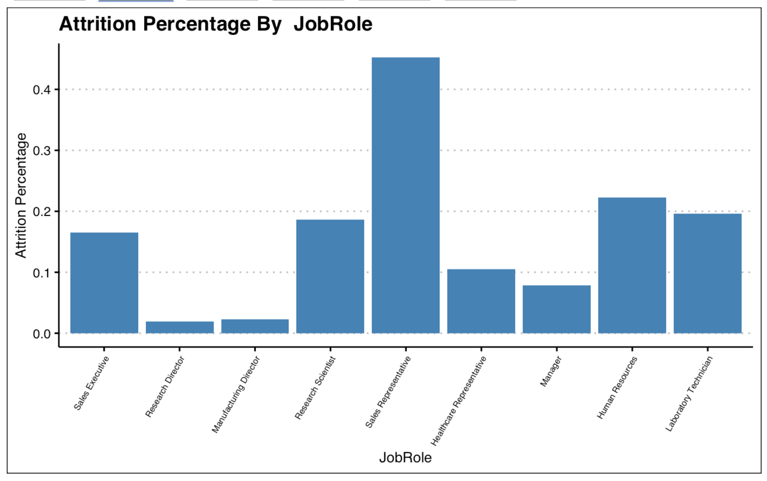
Job Title
The job title with the higher attrition percentage is sales representative.
Notes:
When looking at which job titles are the ones that are the most prone to attrition, sales representative was the one that stand out the most. This is inline with the travel frequency as sales representative travel more than most other job titles.

Slide 10
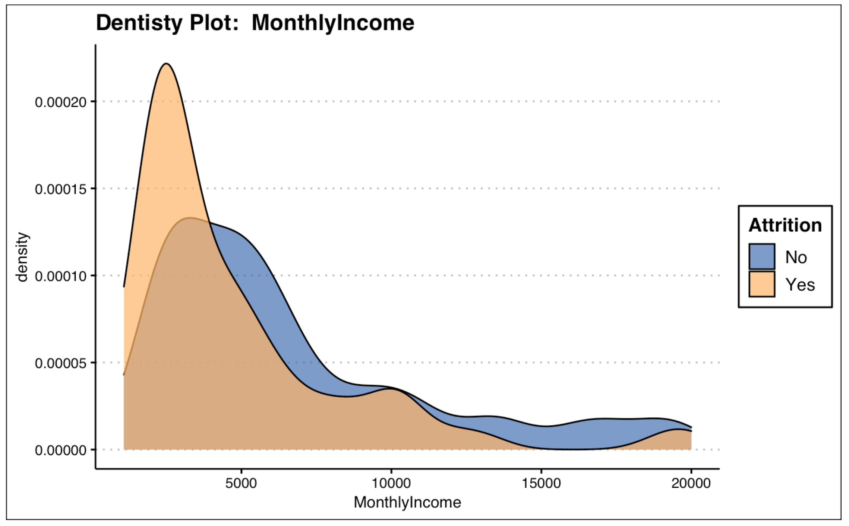
Monthly Income
Employees with a higher salary are less likely to result in leaving the company.
Notes:
Another big factor contribution to attrition was monthly income: Employees with lower monthly salaries are more likely to leave the company. One of the reasons for this is that most of the employees with low salary have sufficient enough years of experience to get better paid jobs in different companies

Slide 11
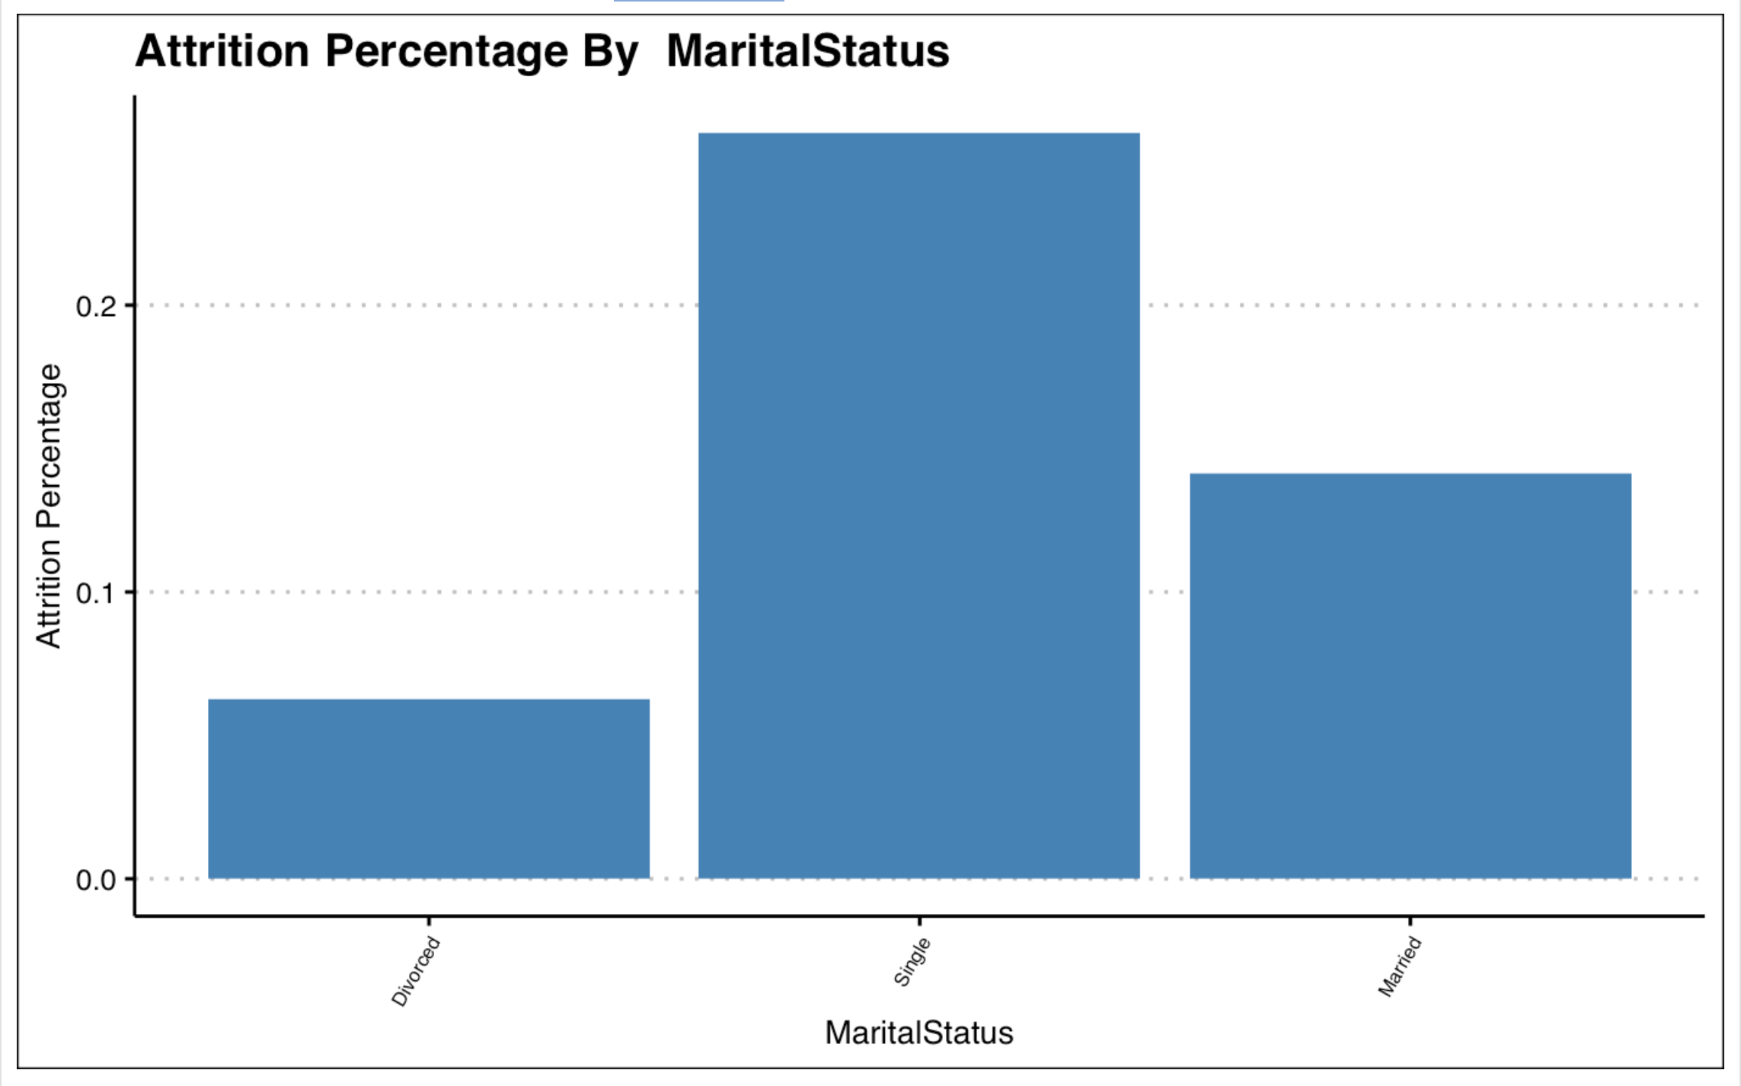
Marital Status
According to the data, single employees are more likely to result in attrition.
Notes:
Marital status is also a big factor contributing to attrition. Single people are more prone to leave the company. One reasons to explain this is that single people are more risk takers. Since most don’t have family obligations they might be more likely to favor new job new experience over job stability.

Slide 12
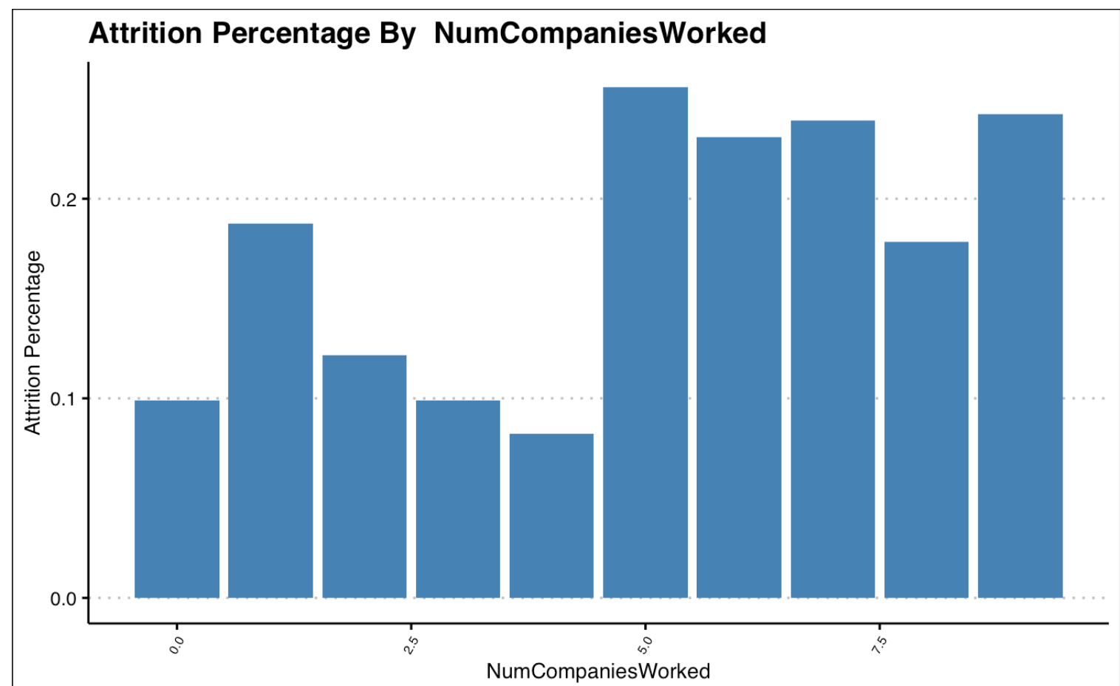
Number of Previously Companies Worked.
Employees who have previously worked in several companies show a higher percentage of attrition.
Notes:
Moving on into looking at the number of previous companies an employees have worked on, we can see that if in the past an employee have a track record of moving between companies very often, they are more prone to leave this company also in favor or a new job.

Slide 13
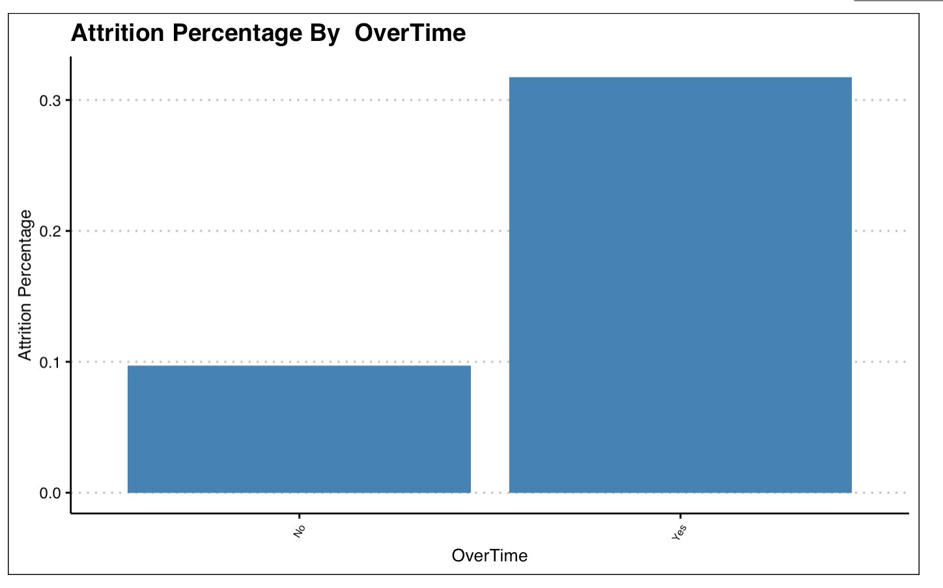
Over Time
Employees that work overtime are more likely to result on attrition.
Notes:
Over time is also a major to employees leaving the company. The more overtime hours worked the more likely an employee is to leave.

Slide 14
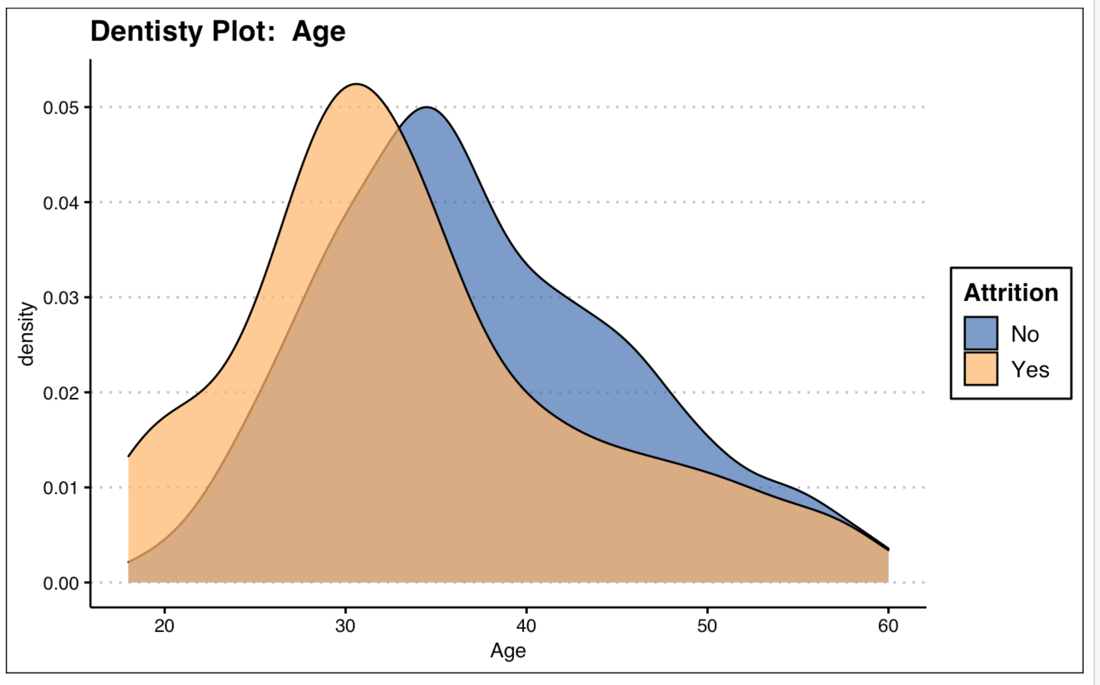
Age
Employees in their 20's are more likely to leave the company.
Notes:
And finally lets look at the last major attrition contributor. Employees of all ages leave the company, but younger employees are more prone to quit.

Slide 15
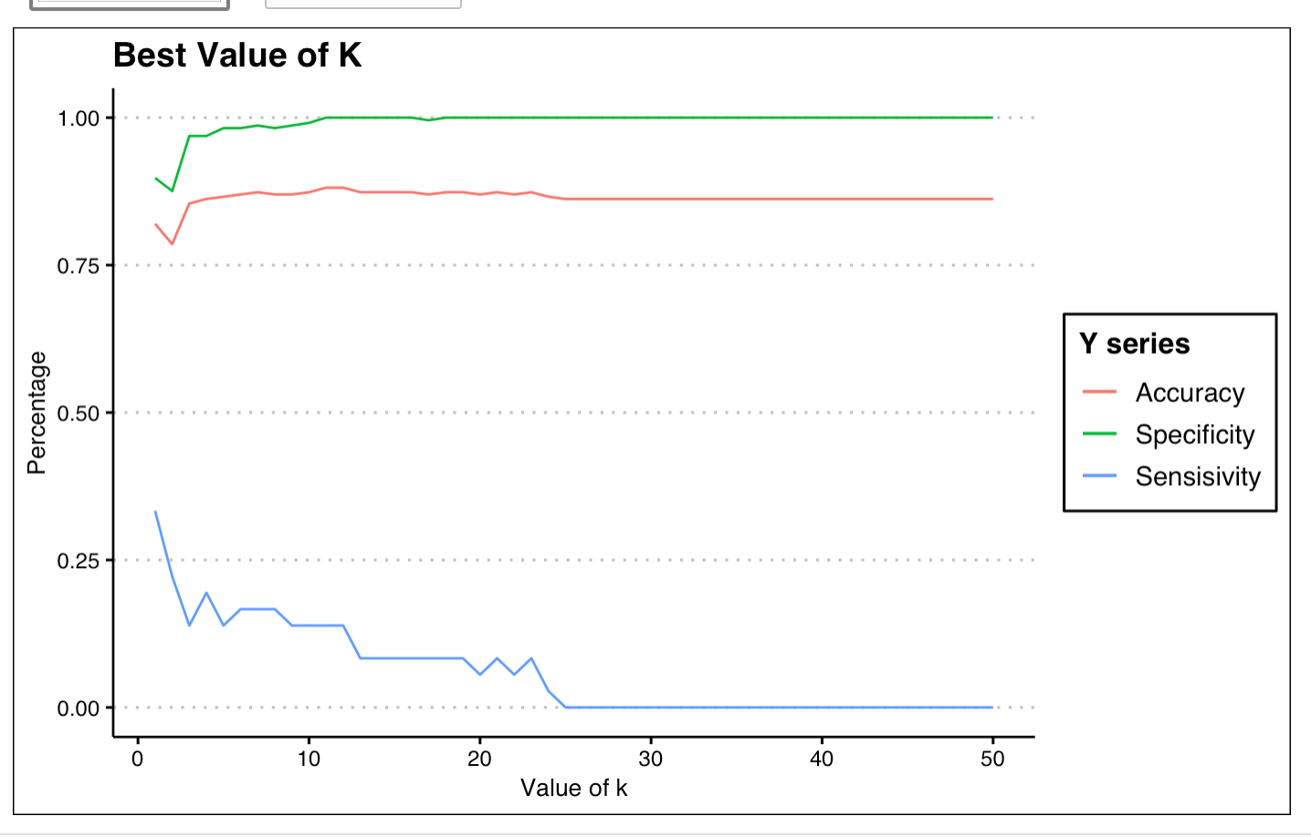
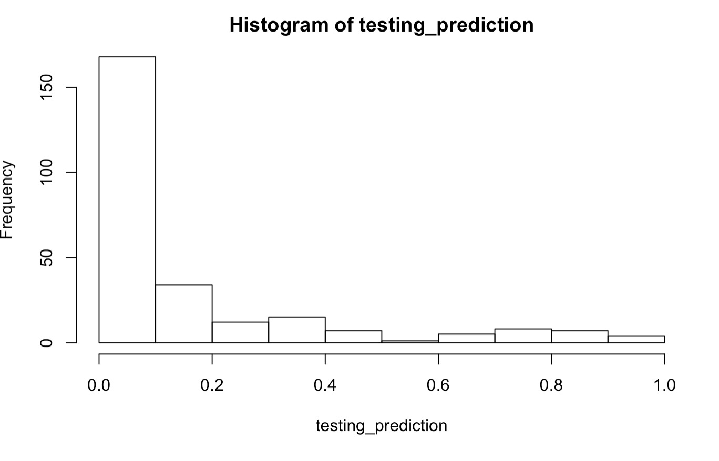
Attrition Prediction Model
KNN (K=5) Model Success Metrics
Sensitivity: 13%
Specificity: 98%
Logistic Regression Model Success Metrics
Sensitivity: 75%
Specificity: 92%
Notes:
Based on the characteristics described above. We where able to build a prediction model that is helps determine the likelihood of an employee leaving the company. As you can see from the model success metrics, previously discussed characteristics do a good job at explain and predicting if an employee will result in attrition. I hope this presentation has been insightful and thank you for your time.

