Slide 1
DDS For Live Session
UNIT 1
David Grijalva

Slide 2
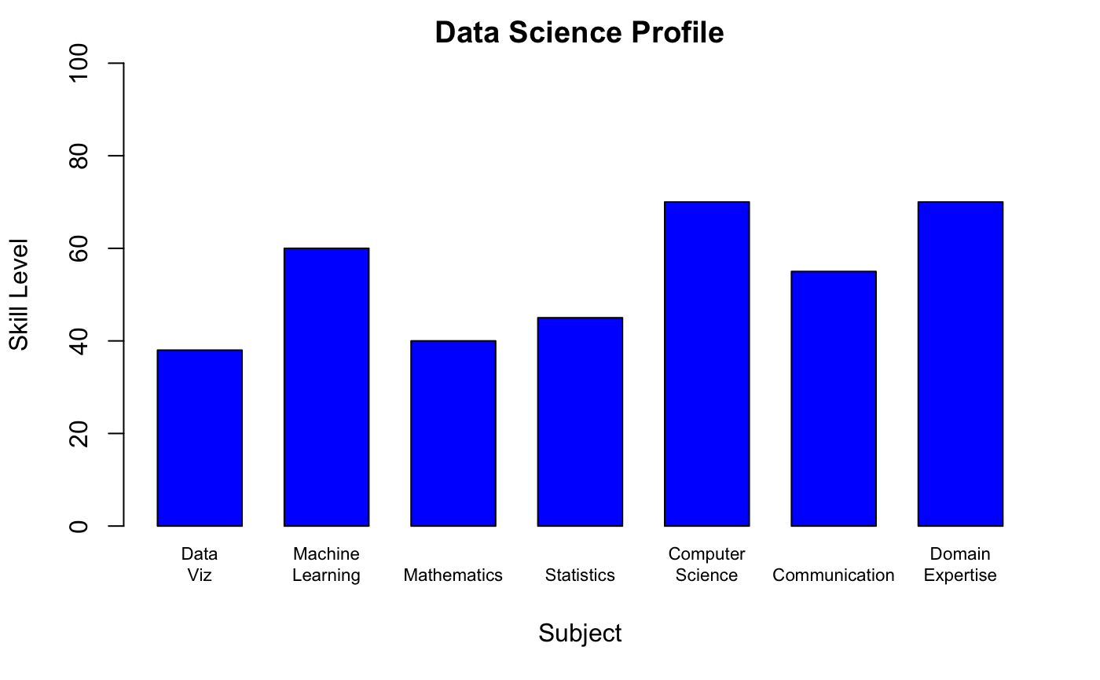
Data Science Profile
Code:
# Create arrays with subjects and skill levels
values = c(38, 60, 40, 45, 70, 55, 70)
area = c("Data\nViz", "Machine\nLearning", "Mathematics", "Statistics",
"Computer\nScience", "Communication", "Domain\nExpertise")
dfp = data.frame(Area = area, Values = values)
# Build Barchart
barplot(dfp$Values, names.arg = dfp$Area, col="blue", ylab="Skill Level",
xlab ="Subject", main="Data Science Profile", space=0.5, cex.names=0.70,
ylim=c(0,100))
# Sample standard deviation sd(ages)

Slide 3
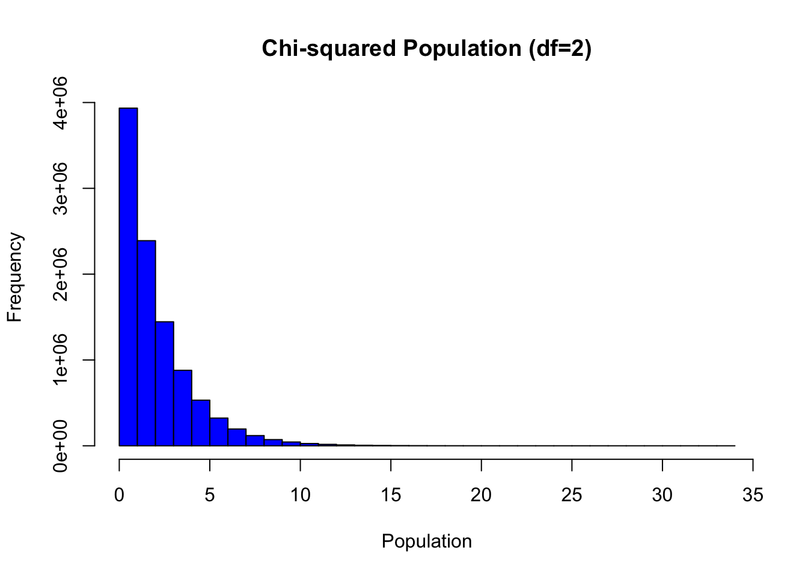
CLT
1. Adapt the code to generate a population of 10,000,000 from a chi-square distribution with 2 degrees of freedom. This is a heavily right skewed distribution.
2. Provide a histogram of this population… display the right skewness.
Code:
population = rchisq(10000000, 2) hist(population, main = "Chi-squared Population (df=2)", xlab="Population", col="blue")

Slide 4
CLT
3. Record the mean and standard deviation of this population.
Code:
Population Mean: 1.9998
Population Standard Deviation: 2.000214
# Population Mean mean(population)
# Population Standard Deviation sd(population)

Slide 5
CLT
4. According to the central limit theorem, what should be the approximate distribution of sample means of size 50 from this right skewed population? What should be the mean and standard error of the mean (standard deviation of the distribution of sample means)?
According to the CLT we expect that the sample means approximates to the one of the population and that the standard deviation, given a large enough sample will be smaller than the one from the original distribution. The expected mean is 2. The expected standard deviation is less than 2. I believe the number of samples should be large enough.
Since population distribution is not normal, we must use n>30, since we are using sample size of 50 we do meet this requirement.

Slide 6
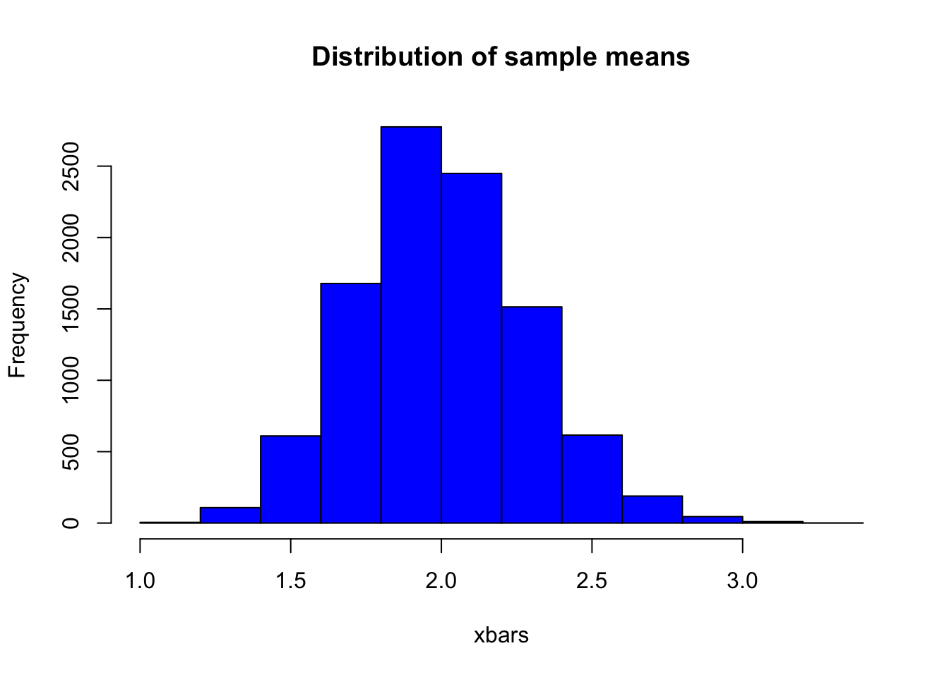
CLT
5. Now let’s check this: Adapt the CLT code to draw 10,000 means each of size 50 from this population and provide the sampling distribution of this sample mean. Provide a histogram of these 10,000 sample means.
Code:
xbarGenerator = function(sampleSize = 50,number_of_samples = 10000) { for(i in 1:number_of_samples) { theSample = sample(population,sampleSize) xbar = mean(theSample) xBarVec = c(xBarVec, xbar) } return(xBarVec) } # Run function xBarVec = c() xbars = xbarGenerator(50,10000) length(xbars)
hist(xbars, col="Blue", main="Distribution of sample means")

Slide 7
CLT
6. What is the mean and standard deviation of these 10,000 sample means?
Code:
Xbar Mean: 2.002255
Xbar Standard Deviation: 0.2847198
# xbars Mean mean(xbars)
# xbars Standard Deviation sd(xbars)

Slide 8
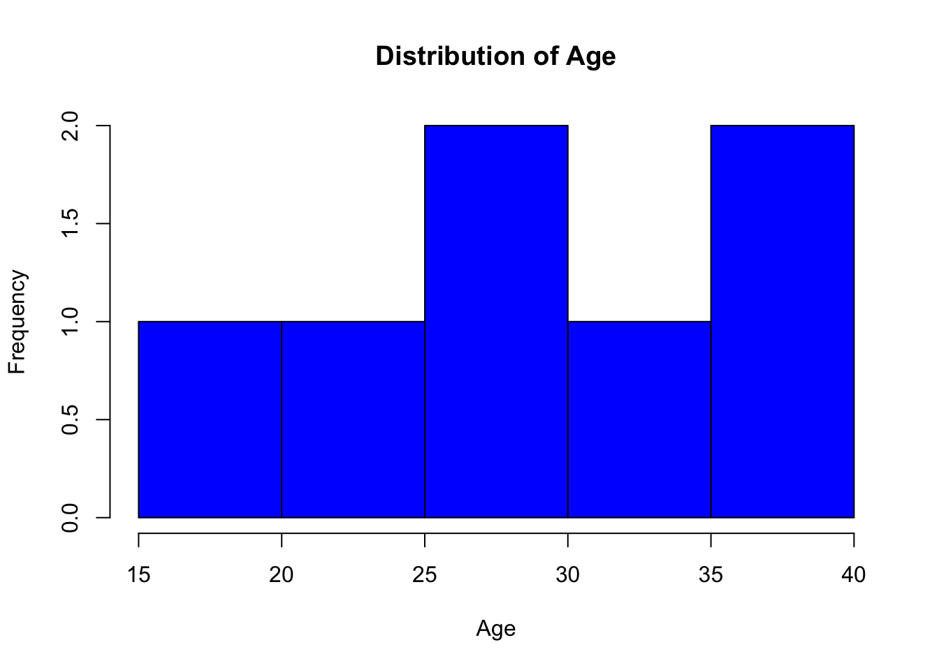
T-test & Hypothesis Testing
Conduct a 6 step hypothesis test to test this claim.
The following are ages of 7 randomly chosen patrons seen leaving the Beach Comber in South Mission Beach at 7pm! We assume that the data come from a normal distribution and would like to test the claim that the mean age of the distribution of Comber patrons is different than 21. ​
Dataset: 25, 19, 37, 29, 40, 28, 31​
Code:
# Data ages = c(25,19,37,29,40,28,31) hist(ages, main="Distribution of Age", col="Blue", xlab="Age") # Sample mean mean(ages)
# Sample standard deviation sd(ages)
Mean: 29.85714
Standard Deviation: 7.081162

Slide 9
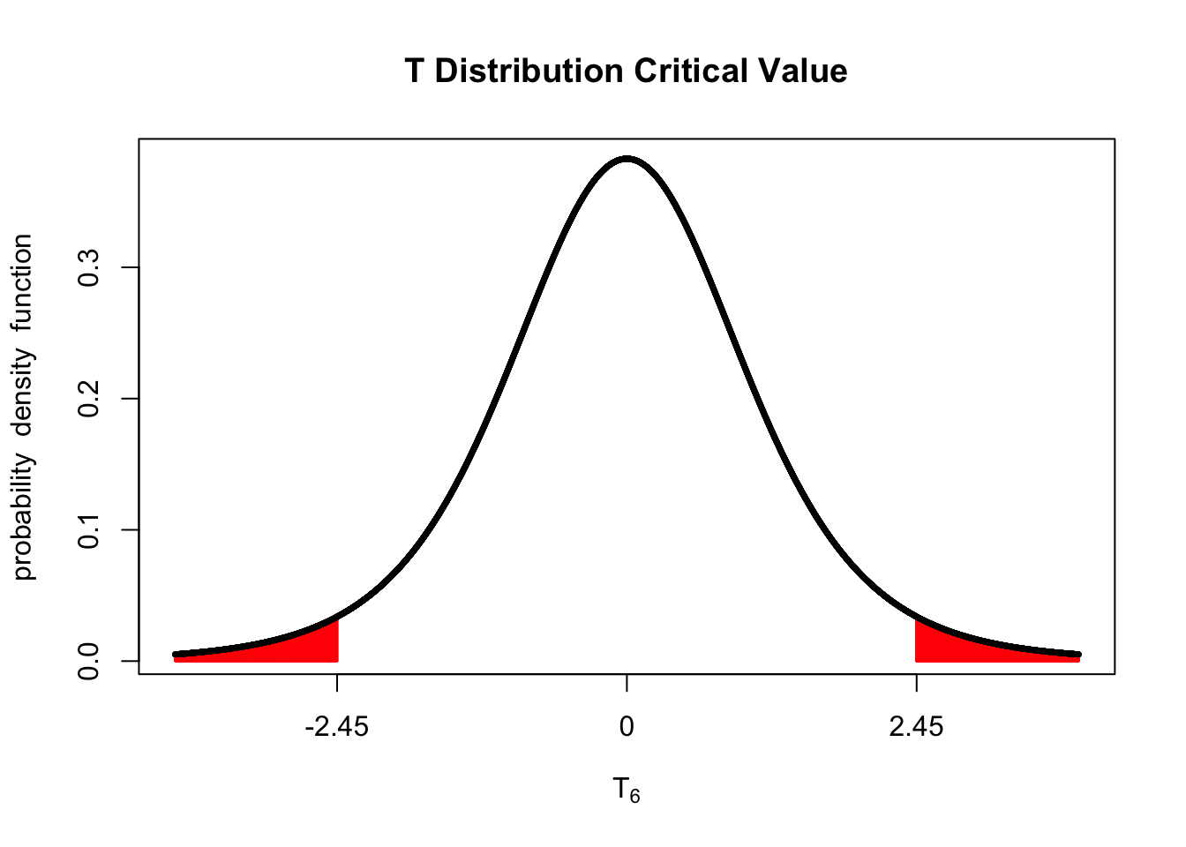
T-test & Hypothesis Testing
Step 1
This is a one sample two sides t-test.
h0 = 21
h1 != 21
Step 2
df = 6
Critical value = 2.447*
* Found using t-table
Code:
library(fastGraph) shadeDist( c(- 2.447, 2.447), "dt", 6, main = "T Distribution Critical Value" )

Slide 10
T-test & Hypothesis Testing
Step 3, 4
One Sample t-test data: ages t = 3.3093, df = 6, p-value = 0.01622 alternative hypothesis: true mean is not equal to 21 95 percent confidence interval: 23.30816 36.40613 sample estimates: mean of x 29.85714
Code:
t.test(ages, mu=21, conf.level=0.95)

Slide 11
T-test & Hypothesis Testing
Step 5
The P-value is less than 0.05, hence we reject the null hypothesis
Step 6
Conclusion: There is enough evidence that suggests that the mean age of patrons is different from 21 years old (P-value: 0.01622).

Slide 12
Takeaways
R coding for charts it's much easier than in python
The interactivity of using r-markdown files is nice. It remands me to jupyter notebooks.
t.test is easy to use. You just need to provided data, type of test and confidence level

Slide 13
Questions
How do we add the t-value and p-value information to the T-Distribution chart used in CLT?
In the hypothesis test section we determined that we have enough evidence to reject the null, in the reality a sample size of 7 seems like a very small sample to have a valid conclusion even if we have statistical significance (P<CV). How do we know what is the correct sample size required to ensure that the test has enough power?

Slide 14
Appendix
Link to code: https://github.com/DavidG16/SMU-MSDS-6036-Doing-Data-Science/blob/master/Units/Unit1/David-Grijalva-For-Live-Session-Unit1.Rmd

