Slide 1

Lab Book 0.1. ModeSolver
Student:

Slide 2
Instructions General
SCRIPTS
From GitHub →
Fork the repo: https://github.com/cccanvas-upv/pic-upv-lab0.git
Clone the repo using VSCode
Run the Jupyter Notebook:
010_MODESOLVER_Student.ipynb
INSTRUCTIONS
We are going to work with different Cross-Sections. In general, we will need: Materials definitions and the Geometrical parameters of each Cross-section.
W (width)
W (width)
Core
Core
h_core
h
(height)
Cladding
Cladding
Slab
XY Cross-section
h_slab
deep waveguide
shallow waveguide

Slide 3
Learning outcome #1 – Effective index of a waveguide
INSTRUCTOR:
Present Python and GDSFactory: materials, output, results.
Explain how to run a simulation for a particular cross-section.
Showcase how to change between shallow and deep waveguide.
Describe how to change the wavelength and width for the waveguide analysis.
Describe the outputs.
ALL EXAMPLE #1: waveguide width 1.2 µm, deep wvg, wavelength start and end same 1.55 µm → all ”Run”
ALL: Follow instructor, that will show how to 1) plot mode, 2) explore the results (neff …)
Document all your results (neff, plot fields of different modes, comparison between different polarizations…)

Slide 4
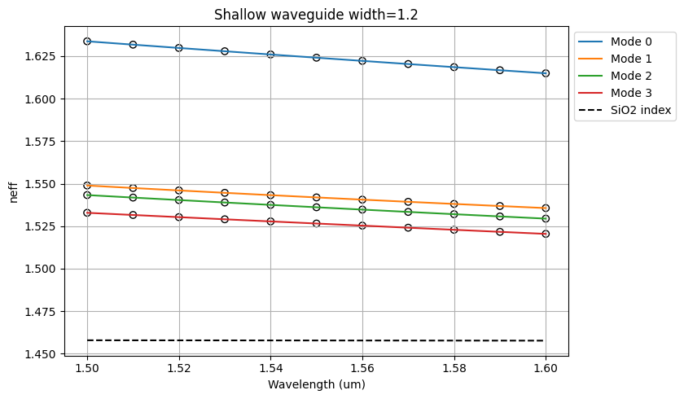
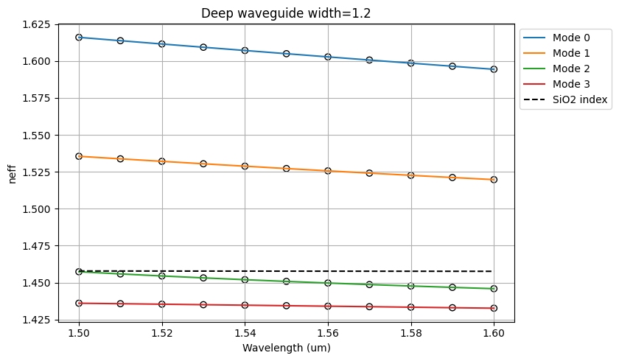
Learning outcome #2 – Wavelength behavior Wavelength 1.5-1.6 µm (step 0.02 µm) – width 1.2 µm
shallow waveguide
Paste plot here
Plot n_eff vs lambda
deep waveguide
Paste plot here
Plot n_eff vs lambda
slab = 150nm
Comment results (neff changes this way with wavelength, comparison between different waveguide cross-sections …)
Izquierda: el índice de refracción del cladding se mantiene aproximadamente constante en n(SiO2)=1.45775 y los cuatro modos calculados mantienen su n_eff por encima de este valor, por lo que todos se propagan a través de la guía shallow. Estos modos son, en orden creciente: TE (Mode 0), TM (Mode 1), híbrido (Mode 2), TE (Mode 3). Para este caso tendría sentido calcular un mayor número de modos solución, ya que todavía hay margen hasta la línea discontinua negra.
Derecha: en este caso solo los dos primeros modos calculados mantienen su n_eff por encima del índice de refracción del cladding, por lo que solo estos se propagan a través de la guía deep. Estos modos son: TE (Mode 0) y TM (Mode 1).

Slide 5

Thank you

