Slide 1

Lab Book 1.0. Waveguides
Student:

Slide 2
Instructions General
SCRIPTS
From GitHub →
Fork the repo: cccanvas-upv/pic-upv-lab1
Clone the repo using VSCode
Run the Jupyter Notebook:
WAVEGUIDES_Student.ipynb
W (width)
W (width)
Core
Core
h_core
h
(height)
Cladding
Cladding
Slab
h_slab
deep waveguide
shallow waveguide

Slide 3
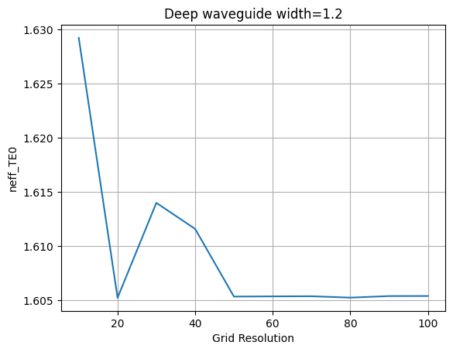
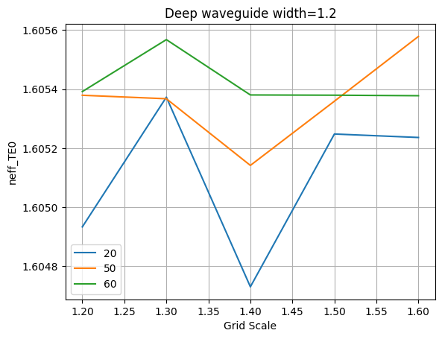
Learning outcome #1 – Convergence tests DE waveguide, w = 1.2 µm, neff_TE0, wvl 1.55 µm.
deep waveguide
Paste neff_TE0 vs grid_resolution plot here
deep waveguide
Paste neff_TE0 vs max_grid_scaling plot here
Comment results, determine above which grid value the effective index calculation does not change significantly:
When plotting the effective index in terms of the grid resolution, the numerical method achieves a stable solution after a grid resolution value of 50. However, for the given conditions (waveguide dimensions and materials) the solution is already correct for a value of 20, reason why we can use this one to demand less resources and increase the method’s efficiency.
In the second plot, the effective index is represented in terms of the grid scale parameter for a grid resolution of 20, 50 and 60. Taking the green curve as our most reliable reference, it can be observed that both green and blue curves achieve convergence for a grid scale value of 1’50. Those values will be chosen for the following simulations.

Slide 4
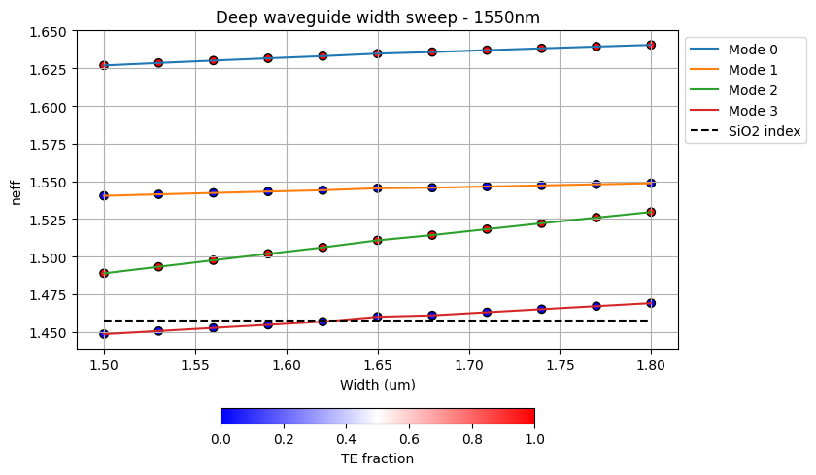
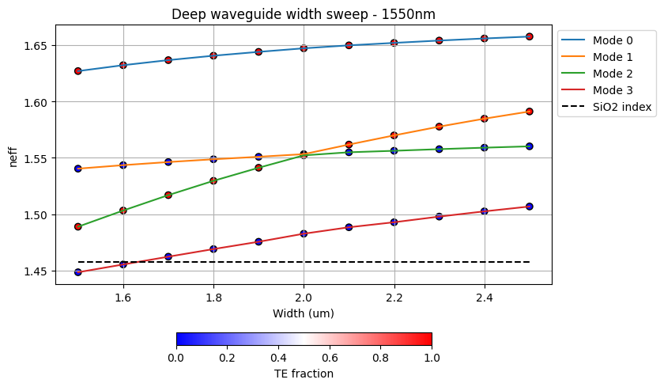
Learning outcome #2 – Width dependence Width 0.6 - 1.6 µm (step 0.1 µm) – Wavelength 1.55 µm
deep waveguide
Paste plot here
Comment results (neff changes this way with width, polarization behavior, etc…)
In the graphs above one can find the effective index parameter in terms of the waveguide’s width for the first four modes found by the solver. As shown in the plots, the wider the waveguide, the higher the effective index and, thus, the more modes overpass the cladding’s effective index and can propagate through the waveguide. Modes TE0, TM0 and TE01 propagate during the whole width sweep, whereas mode TM01 starts propagating for a width greater than 1.65 um.
As a comment about the solver (refer to the right plot), it can be seen how the orange and green curves cross and all of a sudden change their direction. This is an error of the solver, since it orders the modes in terms of their effective index value, which is smaller for the TE01 than the TM0 up until width<2.0 um, but greater for width>2.0 um.

Slide 5
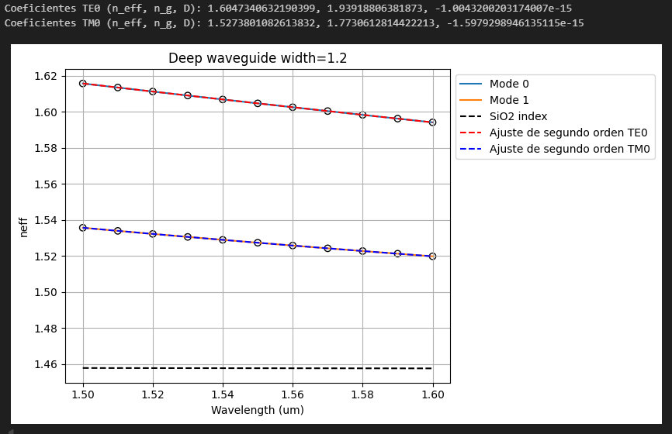
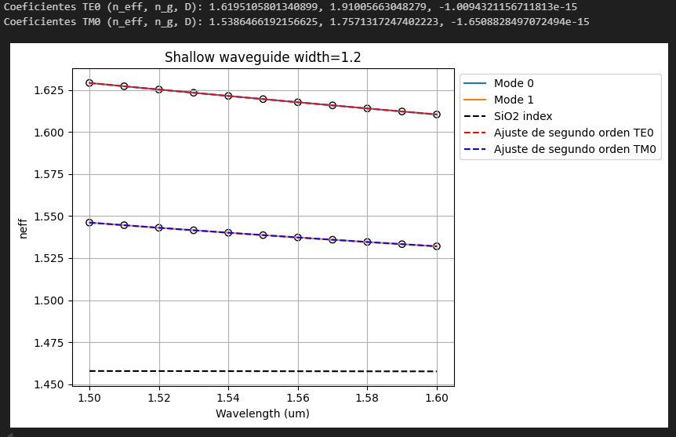

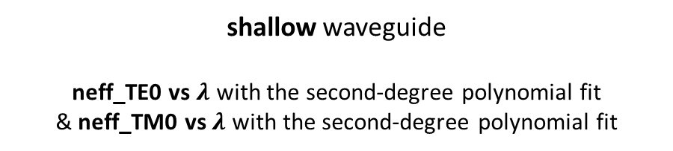
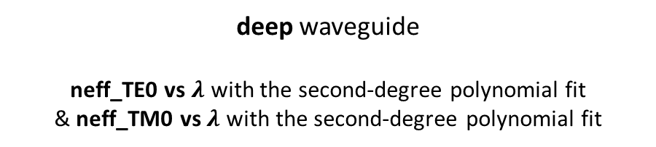
Learning outcome #3 – Waveguide compact model Let’s model the waveguide using a second order polynomial: $$n_{eff}\left(λ\right)=n_{1}+n_{2}\left(λ−λ_{0}\right)+n_{3}{\left(λ−λ_{0}\right)}^{2}$$
deep waveguide
neff_TE0 vs $λ$ with the second-degree polynomial fit
& neff_TM0 vs $λ$ with the second-degree polynomial fit
shallow waveguide
neff_TE0 vs $λ$ with the second-degree polynomial fit
& neff_TM0 vs $λ$ with the second-degree polynomial fit
slab: 150nm
Comment on the results found for the TE0 and TM0 for both deep and shallow waveguides:
The previous charts represent the effective index in terms of wavelength for a deep and a shallow waveguide, fitted with np.poly1d to find the first and second order polynomial coefficients, which define the group index and dispersion parameters of the mode in the waveguide. These values are also shown above the plots.
Both TE0 and TM0 modes propagate during the whole wavelength’s sweep, but it can be observed that the effective index is slightly greater in the shallow waveguide, which indicates that the mode’s optical power is more confined in the waveguide’s core.

Slide 6
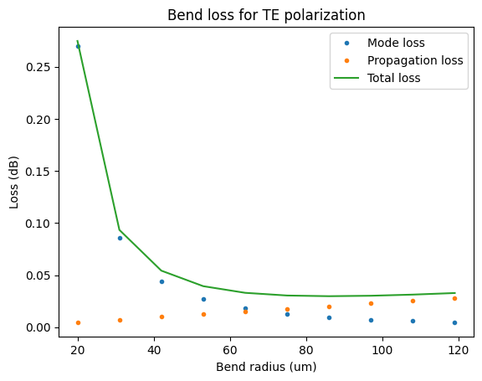
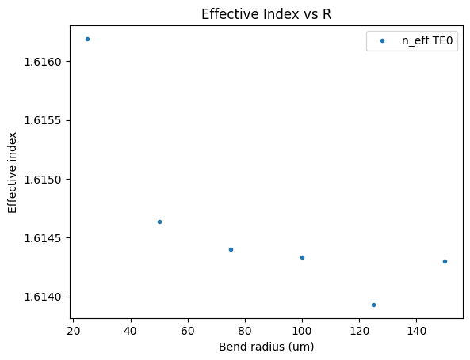
Learning outcome #4 – Bend waveguide radius vs. loss – deep Find neff_TE0 for wvl 1.55 µm, width 1.0 µm for R=25,50,75,100, 125,150 µm
deep waveguide
Paste losses [dB/90º] vs R and neff_TE0 vs R
$α\left[\frac{dB}{90°}\right]=$ $R\frac{π}{2}α\left[\frac{dB}{µm}\right]$
Comment results, which is the safe radius, consider safe means less than 0.1 dB/90º.
As shown in the left graph, the lower the bend radius is, the greater the mode-conversion losses and smaller the propagation losses for a 90º bend are. These results are consistent with the fact that a lower bend radius translates to a more curved bend and therefore a bigger mode-mismatch, but a shorter distance. The safest radius (smaller total losses) is found to be around 65 um.
In addition, in the right plot is represented the effective index in terms of the bend radius for the mode TE01. As expected, the simulation shows that the effective index decreases as the bend radius increases, since the bigger the bend radius, the more the optical power of the mode is moved to the external part of the waveguide, and thus greater is the propagation through the cladding, which has a lower refractive index.

Slide 7

Thank you

