Slide 1

Lab Book 2.0. Couplers
Student:

Slide 2
Instructions General
SCRIPTS
From GitHub →
Fork the repo: https://github.com/cccanvas-upv/pic-upv-lab2.git
Clone the repo using VSCode
Run the Jupyter Notebook:
COUPLERS_Student.ipynb
Cross-Sections to be studied:
w (width)
w (width)
h
(height)
Core
Core
h
(height)
MMI Body
g
(gap)
Cladding
Cladding
Directional coupler (DC)
Multimode Interference (MMI) coupler

Slide 3
Directional coupler

Slide 4
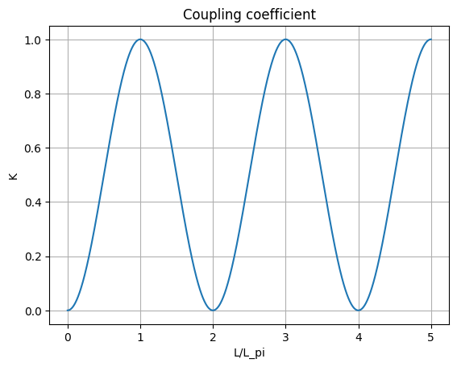
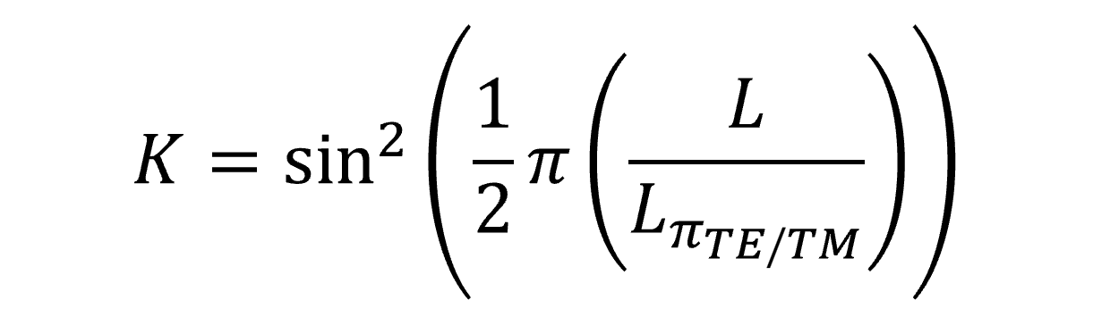
Learning outcome #1 – Directional coupler length and coupling coefficient Wavelength 1.5 µm – width 1.2 µm – gap 0.6 µm
deep waveguide
Paste L/Lpi vs K plot here
Comment results (distance needed for a complete energy transfer between waveguides, distance needed for splitting power in half.. )
In the graph above, the coupling coefficient in terms of the proportion L/L_pi is represented. This parameter indicates the proportion of energy transferred from one port to another in terms of the length of the directional coupler.
For a complete energy transfer, a distance of L_pi is required, obtaining a value k=1.0.
If we required a half power splitting, then the coupling coefficient needs to be k=0.5, which is found for L/L_pi=1.5, which means a length of 1.5 times L_pi.

Slide 5
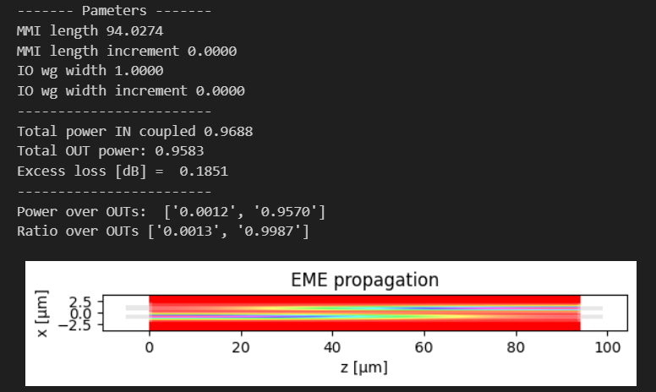
Learning outcome #2 – 2x2 Directional Coupler Width 1.2 um – Wavelength 1.55 µm
L = L_pi
deep waveguide
Paste propagation plots and output text here
Comment results (Coupling relationship, Lpi, losses, … )
The coupling relationship ratio is shown in the printed data as 0.0013 and 0.9987 for the respective outputs. This results are coherent with the input parameters, since the DC length corresponds to L_pi, thus obtaining a quasi-complete energy transfer from the lower to the upper port.
The solver also provides the calculation of L_pi for the given waveguide and gap dimensions, which is 94.0274 um.
Finally, a difference between the input and output optical powers is observed, resulting in an excess loss of 0.1851 dB.

Slide 6
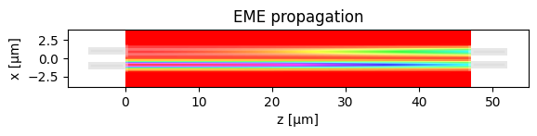
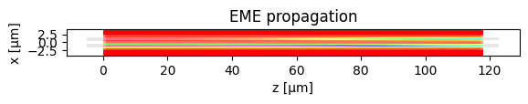
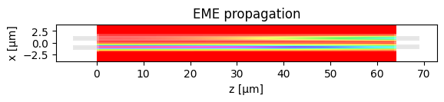
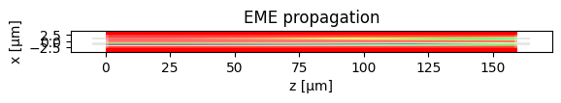
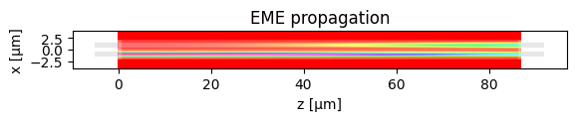
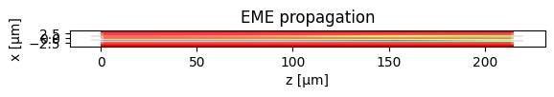
Learning outcome #2 – 2x2 Directional Coupler Gap sweep 0.6 - 1.6 µm (step 0.1 µm) – Wavelength 1.55 µm
Comment results (Coupling relationship, Lpi, losses, … )
In the graphs above, the power distribution in the longitudinal plane of the directional coupler has been simulated for a gap sweep of 0.6 – 1.6 um, but only the first six have been pasted for lack of space.
Then, a length of L_pi/2 was selected for the simulation of the device, obtaining the expected 50:50 power splitting for every configuration.

Slide 7
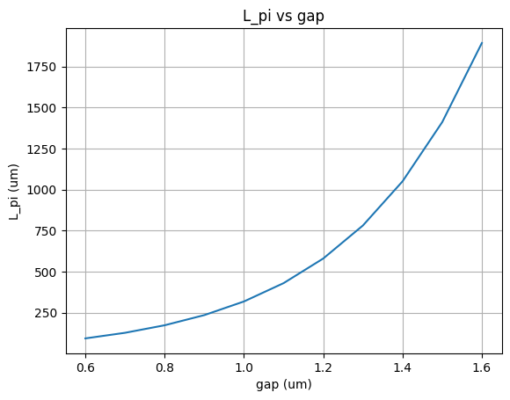
Learning outcome #2 – 2x2 Directional Coupler Gap sweep 0.6 - 1.6 µm (step 0.1 µm) – Wavelength 1.55 µm
Comment results (Coupling relationship, Lpi, losses, … )
The graph above represents the L_pi parameter in terms of the gap between two waveguides that conform a directional coupling. As expected, the bigger the gap, the bigger the L_pi, since the energy transfer ratio is smaller and, thus, more time (i.e. distance) is required to transfer all optical power from one port to the other.

Slide 8


Learning outcome #3 – Parallel uncoupled waveguides Wavelength 1.55 µm, width 1.0 µm, gap to be found for uncoupled wvgs
deep waveguide
Paste $K$ vs gap for 10 mm wvgs to be uncoupled
shallow waveguide
Paste $K$ vs gap for 10 mm wvgs to be uncoupled
Hints:
All waveguides running in parallel are coupled somehow. Controlling the degree of coupling is key for those waveguides you don’t want coupling over certain level (i.e. uncoupled waveguides). Uncoupled waveguide definition, we will use K<0.01. Parallel waveguide length = 10 mm (typical length of a chip). Find minimum gap shallow / deep w=1.0µm wvl 1.55 µm.

Slide 9

Learning outcome #3 – Parallel uncoupled waveguides Wavelength 1.55 µm, width 1.0 µm, gap to be found for uncoupled wvgs
deep waveguide
Paste $K$ vs gap for 10 mm wvgs to be uncoupled
shallow waveguide
Paste $K$ vs gap for 10 mm wvgs to be uncoupled
Hints:
All waveguides running in parallel are coupled somehow. Controlling the degree of coupling is key for those waveguides you don’t want coupling over certain level (i.e. uncoupled waveguides). Uncoupled waveguide definition, we will use K<0.01. Parallel waveguide length = 10 mm (typical length of a chip). Find minimum gap shallow / deep w=1.0µm wvl 1.55 µm.

Slide 10
Multimode Interferometer (MMI) Coupler

Slide 11
Learning outcome #4 – 4.1 2x2 Multimode Interference Coupler Wavelength 1.55 µm, wMMI = 6.6 µm
deep waveguide
Paste propagation plots and console results
Comment results (Coupling relationship, Lpi, losses, comparison with Directional Coupler… )

Slide 12
Learning outcome #4.2 – 2x2 Multimode Interference Coupler - Optimization Wavelength 1.55 µm, wMMI = 6.6 µm
deep waveguide
Paste propagation plot and console results
Target: make equal ratio over outputs (even if not 0.5) and minimize excess loss (even if not 0.0 dB)
With same settings of previous LO, now adjust try to manually optimize the MMI by changing iteratively:
- Change dL_MMI
- Change I/O waveguide position +/- dy
Hints: observe the 2D EME propagation results to guide you to the best settings of a) and b).
Comment results

Slide 13
Learning outcome #4.3 – 2x2 Multimode Interference Coupler – Optimization (II) Wavelength 1.55 µm, wMMI = 6.6 µm
deep waveguide
Paste propagation plot and console results
Target: make ratio over outputs 0.5 + excess loss < 0.1 dB
With same settings of previous LO, now modify the notebook so I/O waveguides have a different width.
- The nominal I/O waveguide width you have been using is 1.0 µm, increase it.
(Warning! Every time you change the I/O waveguide width you have to re-run modes calculation)
Hints: observe the 2D EME propagation results to guide you to the best settings of a) and b).
Comment results

Slide 14
Learning outcome #5 – 1x4 Multimode Interference Coupler Wavelength 1.55 µm, wMMI = ? µm
deep waveguide
Paste propagation plots and console results
Repeat all the design process for a 1x4 MMI Coupler.

Slide 15


Extra #1 – Directional wavelength dependence Wavelengths from 1.5 to 1.7 µm, gap = 0.6 µm, width 1.0 µm
deep waveguide
Paste $L_{π}$ vs wvl for TE and TM plot here
shallow waveguide
Paste $L_{π}$ vs wvl for TE and TM plot here
slab = 150nm
Comment results

Slide 16


Extra #2 – Directional coupler gap dependence Wavelength 1.55 µm, width 1.0 µm, gap 0.2-2.4 µm (step 0.2 µm)
deep waveguide
Paste $L_{π}$ vs gap for TE and TM plot here
shallow waveguide
Paste $L_{π}$ vs gap for TE and TM plot here
slab = 150nm
Make conclusions and observations from your results

Slide 17
Extra #3 – MMI coupler wavelength dependence Wavelengths from 1.5 to 1.7 µm, wMMI = 6.6 µm
deep waveguide
Paste $L_{π}$ vs wvl for TE and TM plot here
shallow waveguide
Paste $L_{π}$ vs wvl for TE and TM plot here
slab = 150nm
Comment results (Important. Compare with Directional Coupler)

Slide 18


Extra #4 – MMI coupler body width dependence Wavelength 1.55 µm, wMMI = 5-10 µm (steps 0.5 µm)
deep waveguide
Paste $L_{π}$ vs width for TE and TM plot here
shallow waveguide
Paste $L_{π}$ vs width for TE and TM plot here
slab = 150nm
Polarization independent coupler: is there any point for which the MMI coupler can work identically for TE and TM? Answer yes / no and explain why?

Slide 19

Thank you

