Slide 1
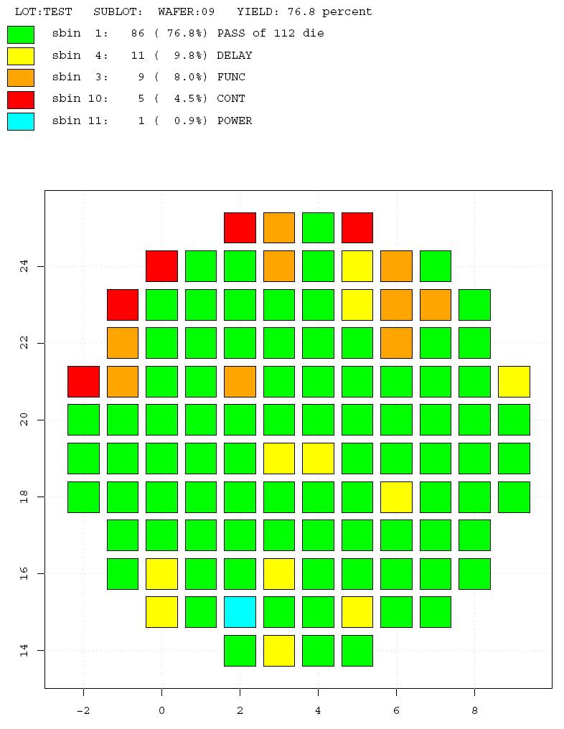
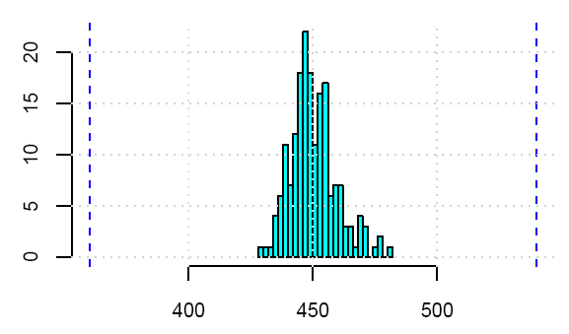
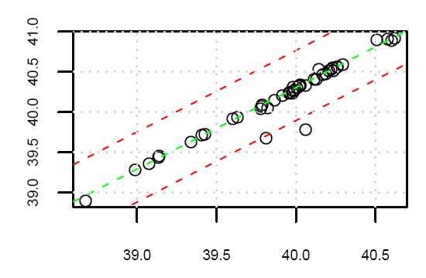
An Introduction to RADAR

Slide 2
Topics covered in this slide presentation:
==For the basic user ==
* What is R? Why R? Who uses R?
* What is RADAR?
* An introductory tutorial – part 1
ConvertStdf,SplitWafer,Wafermap,PlotRtdf,ConvertCSV
* Some Useful Things To Know...
* Installing RADAR
== For the more advanced user ==
* RTDF description
* An introductory tutorial – part 2 – using the R console
* Looking at some of the existing RADAR scripts
* Some of many R learning resources
* Test Conditions

Slide 3

What is R?
...R is a statistical computing package.
Other packages you may have encountered:
RS/1
Matlab and Octave
S-plus
O-Matrix
Scilab
Ox
Where to find R?
http://www.r-project.org/

Slide 4
Why R?
...Cost
R is open source. Some other packages can cost into the thousands
to tens of thousands for licenses.
...Performance
In benchmark exercises between various packages, R proved to
be among the fastest.
(www.sciviews.org/benchmark)
...Platform support
R is available in Linux, Mac, Windows, UNIX versions, and many
others
...Language features
- R is primarily a statistics language, so it already has an extensive set
of statistical commands.
- It has many plotting/graphing functions and allows an extensive
amount of customizing of various plot parameters.
- It has support for parsing binary and ascii files.
- It has Tcl/Tk support for GUI generation
- Interactive command line
- Interpretive language, so no compiling

Slide 5
Who uses R?
R is used in many post-graduate statistics and statistics related courses as well as in various industries and the medical science field. R has a strong international community with an estimated 1 million users globally.
A few of the supporting institutions...
Department of Biostatistics, Johns Hopkins University
MPI for Demographic Research, Rostock, Germany
Norwegian Institute of Marine Research, Bergen, Norway
School of Economics and Finance, Victoria University of Wellington,
New Zealand
ViaLactia Biosciences (NZ) Ltd, Auckland, New Zealand
Some Canadian specific users...
John Fox, Department of Sociology, McMaster University
John Nash, Telfer School of Management, University of Ottawa
Paul Gilbert, Bank of Canada
BC Cancer Agency, Vancouver, Canada
TERRA Lab, University of Regina - Department of Geography, Canada

Slide 6
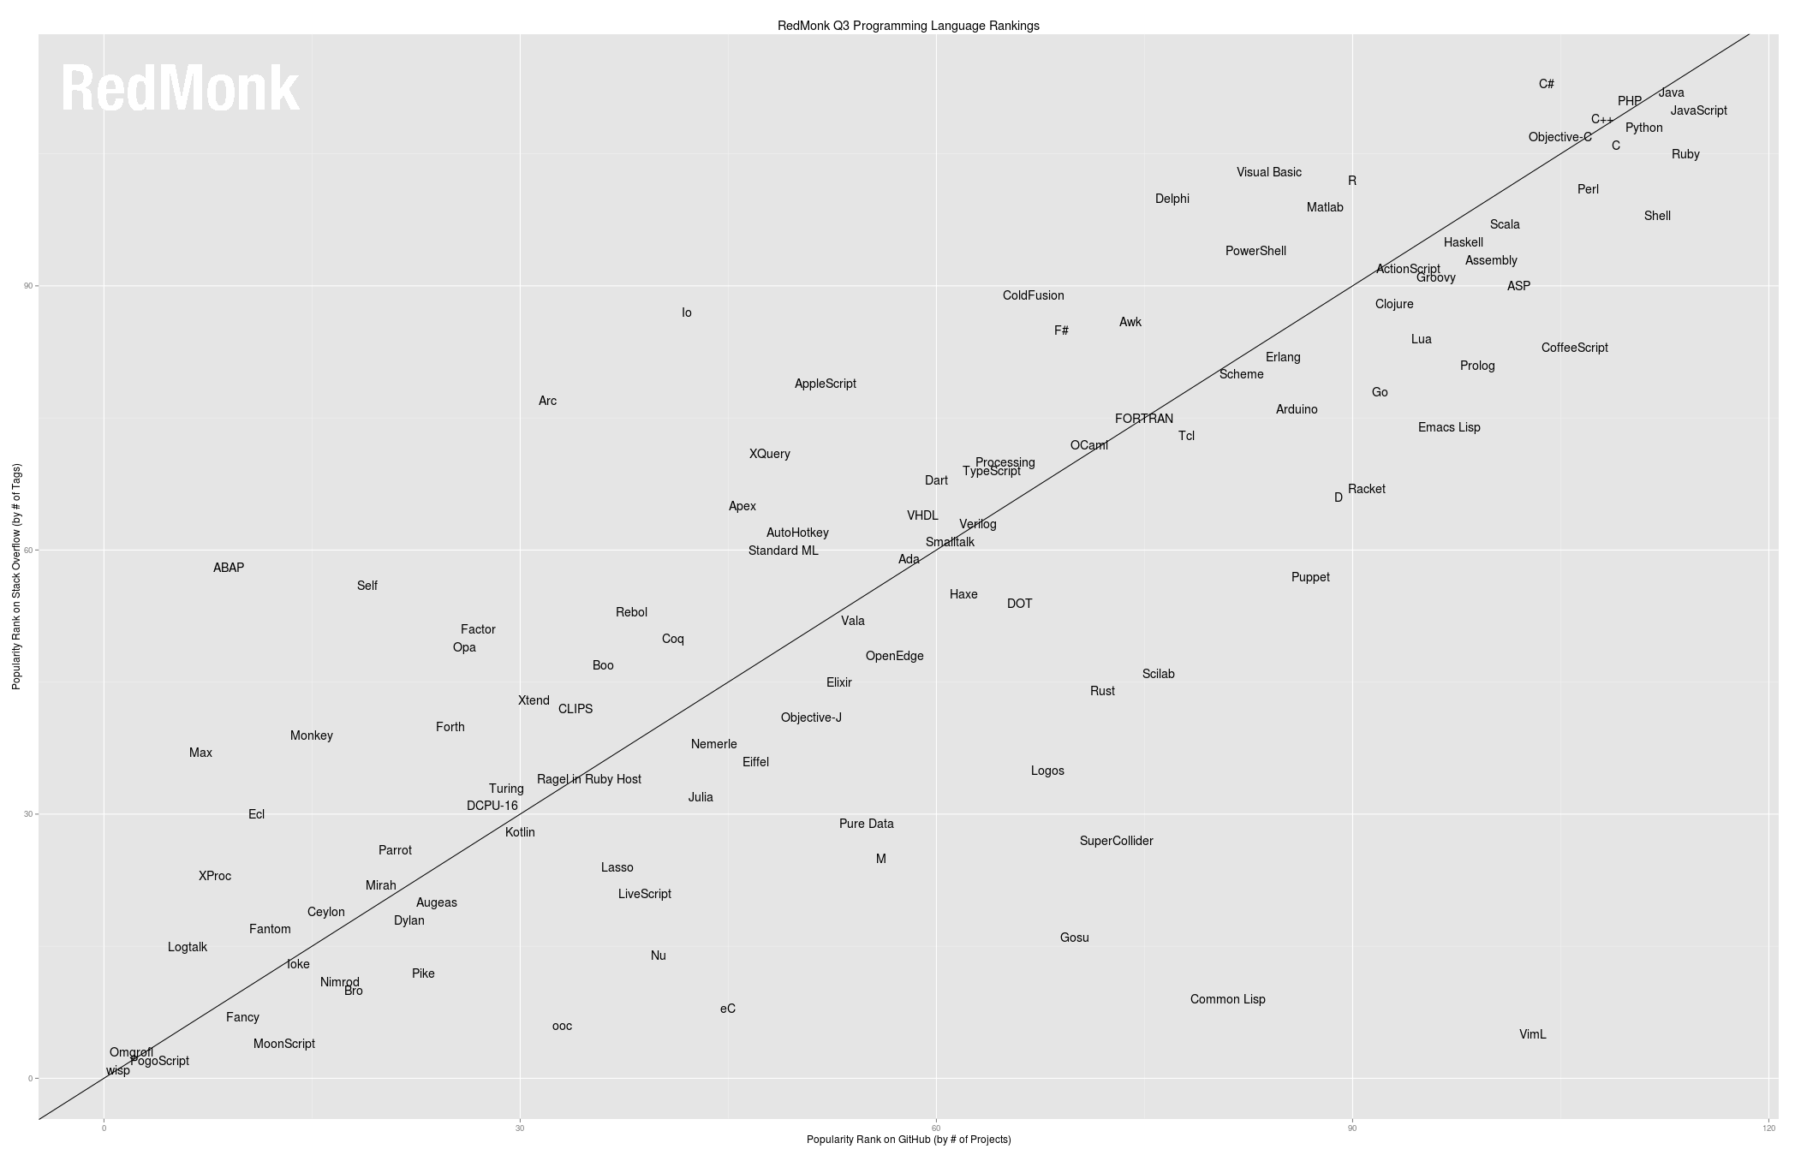
RedMonk Q3 Programming Language Ratings – June 2013

Slide 7
What is RADAR?
RADAR is a package of scripts written in R that can
- process ATE (Automated Test Equipment) data in STDF (Standard Test Data
Format) or various other ATE specific formats
- provide various common data manipulations like removing devices or
individual results
- generate histograms, xy plots, statistics tables, wafer maps, and
guardbands
These scripts are run in the R console, or alternatively can be executed using the TkRADAR GUI (Graphical User Interface).

Slide 8
An Introductory Tutorial – Part 1
# ...turn off buffered output... Misc -> buffered output
# NOTE: stdf file from: http://www.ge.infn.it/ATLAS/Electronics/home.html
USE GUI to convert stdf file into R friendly format (rtdf), generate histograms, wafermaps, and spreadsheet output.
- ConvertStdf (also look at .summary file)
- PlotRtdf (also look at statistics .csv file, search pdf for testname, histo vs norm)
- WaferMap (do parametric as well as soft bin)
- ConvertCSV
- PlotRtdf – normal probability plots
- ControlCharts
- FilterByBinning
Commands can also be typed in via the console, or run as a batch/script.
In “R”, function parameters can have default values or can be explicitly referenced, or implicitly by order
ConvertStdf(stdf_name = "a595.stdf.gz", rtdf_name = "a595.rtdf")
ConvertStdf(“a595.stdf.gz”)

Slide 9
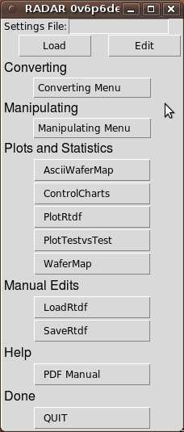
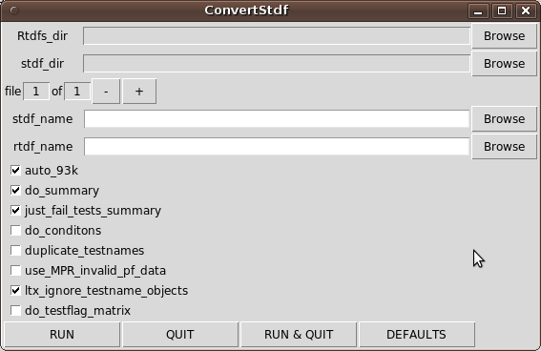
An Introductory Tutorial – Part 1 continued
#TkRadar() # start the GUI (Graphical User Interface)
# click on the Converting Menu → ConvertStdf button to bring up the ConvertStdf Gui
# this visually shows you all the options for the script as well
# as gives you a pointy-clicky way of setting the various
# options...

Slide 10
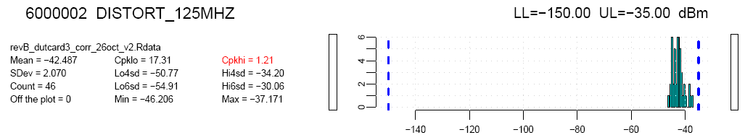
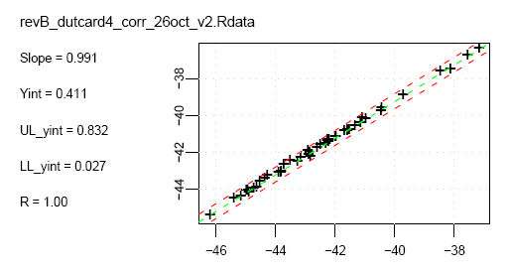
A closer look at PlotRtdf output:
Histogram
XY plot

Slide 11
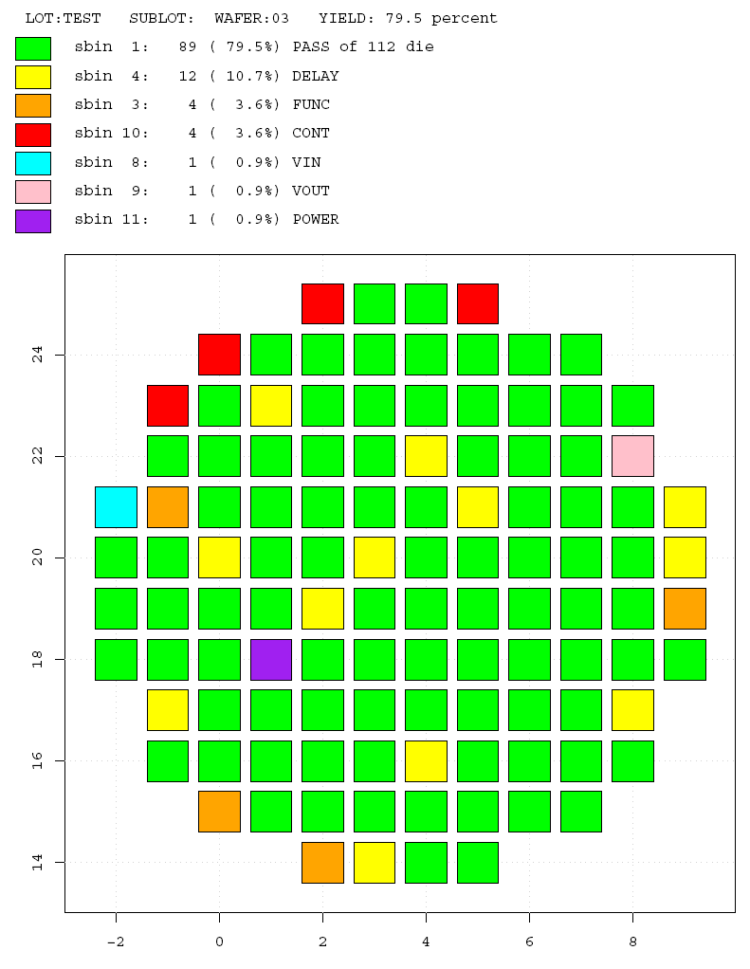
A closer look at WaferMap
Output
type = "sbin":

Slide 12
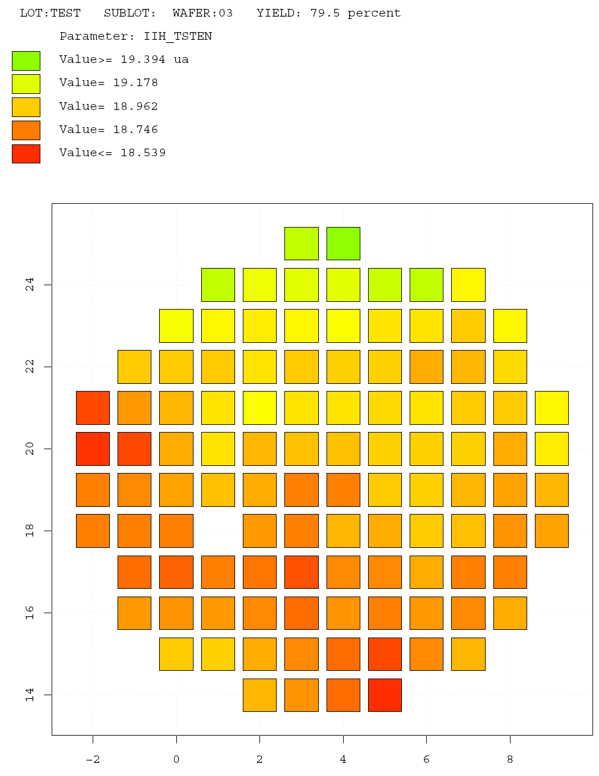
A closer look at WaferMap
Output
type = "parameter":

Slide 13
Some Useful Things To Know...
...about RADAR
- stdf files can be .gz compressed
...about the TkRadar GUI
- detachable menus
- multiple file selection
- settings files
- PDF help documentation
- TkRadar.log file
… about R
- up arrow/down arrow --- for command recall
- q() --- quiting your R session
- getwd() setwd() --- where are we? also Rgui directory control
- help(plot) --- getting help on built-in functions
- html search --- more help help.start()
- history()

Slide 14
Installing RADAR
See the PDF help documentation!
Install R
Install RADAR (Windows)
Create RADAR folder
Download RADAR package to this folder, unzip
Copy .Rprofile file from package subfolder to RADAR folder
Edit .Rprofile file to reflect location of package
Edit R desktop shortcut to look in RADAR folder

Slide 15
What is RTDF?
...An Rdata binary file containing a set of data objects; 4 main objects plus some additional ones as needed:
LotInfoFrame
ParametersFrame
DevicesFrame
ResultsMatrix
...as needed:
WaferInfoFrame
WafersFrame
HbinInfoFrame
SbinInfoFrame
TSRFrame
Lot
Info
Frame
DevicesFrame
[d in length]
ResultsMatrix
[d x p in size]
ParametersFrame
[p in length]

Slide 16
An Introductory Tutorial – Part 2
# Adjusting plot limits,test list, test order using alternate ParametersFrame
# in PlotRtdf...
# now adjust the limits for one test and replot...
ConvertParameters("a595.rtdf","a595_params.txt") # make plot_ul 130 for test 210
ConvertParameters("a595_params.txt")
PlotRtdf("a595.rtdf","a595_histos_v2.pdf",param_name="a595_params.rtdf")
# alternatively, ConvertCSV
# an example of multiple histograms per test...
SplitWafers("a595.rtdf") # break out rtdf file into 3 rtdf's one per wafer
PlotRtdf(c("a595_wafer02.rtdf","a595_wafer03.rtdf","a595_wafer09.rtdf"),
"a595_per_wafer_histos.pdf")
# find outliers...
FilterByResult("a595.rtdf","report",testname="IDD2 @ 5MHz", value=60,scaler="m")

Slide 17
Introductory Tutorial – Part 2 continued
# if you want to look at the rtdf structure...
# clear
#rm(list=ls(all=TRUE)) # or use button Misc -> remove all objects
load("a595.rtdf")
ls()
dim(ResultsMatrix)
dim(ParametersFrame)
ParametersFrame[1,]
ParametersFrame[4,]
dim(DevicesFrame)
DevicesFrame[1,]
bins = as.numeric(DevicesFrame[,"soft_bin"])
DevicesFrame[bins==11,]

Slide 18
Introductory Tutorial – Part 2 continued
# using the rtdf format,
# let's see if idd at 1.25MHz correlates with idd at 5.00MHz...
ParametersFrame[5,]
ParametersFrame[9,]
x_1Mhz = ResultsMatrix[,5]
y_5Mhz = ResultsMatrix[,9]
plot(x_1Mhz,y_5Mhz)
grid()
help(plot)
plot(x_1Mhz*1000.0,y_5Mhz*1000.0,xlab="Idd at 1MHz (mA)",ylab="Idd at 5MHz (mA)")
# or use the RADAR script:
source("Radar.R")
PlotTestvsTest("a595.rtdf","IDD1 @ 1.25MHz","IDD1 @ 5MHz")

Slide 19
Looking at a RADAR script...
FilterByBinning is one of the more straightforward scripts in the Manipulating Data section...
RADAR / TkRADAR is a “body on frame” structure. Command line “frame” portion with GUI “body” on top. FilterByBinning.R vs. FilterByBinningGUI.R
Radar.R – Overall script that loads individual command line functions
TkRadar.R / TkRadarDefaultsGUI.R – Overall script that loads Tk functions

Slide 20
Familiarizing yourself with the R language...
R_programming_crib_sheet.txt
# included in RADAR package folder
help.start() # and click on “An Introduction to R” link
# or “Search Engine & Keywords” link
Various places on the web...
http://math.illinoisstate.edu/dhkim/rstuff/rtutor.html
http://www.cyclismo.org/tutorial/R/
http://faculty.washington.edu/tlumley/Rcourse/R-fundamentals.pdf
# some examples of different graph/plot capabilities

Slide 21
Test Conditions
Test conditions are not explicitly handled in the STDFspecification. A few different approaches have been taken at different times, but more often than not, there is usually some test system somewhere that just won't support a given approach. (some test systems have been known to either inconsistently delay DTR records, or else to put them all at the end of a device run)
One approach currently supported in RADAR uses regular MPR or PTR records, with special testnames for the converter to key on.
"CONDITION=xxxxxx"
ie. "CONDITION=Vdda" 3.30 V [testname, value, units of PTR record]
An alternate approach supported in RADAR uses SplitBySubstr.R to trigger on testnames. An example would be testnames with _Vmin_ or _Vnom_ or _Vmax_ to indicate 3 conditions. The script would split the dataset into 3 separate datasets based on these substrings.

Slide 22
Visit the RADAR Web page...
To get the latest news and versions of the RADAR scripts
http://sites.google.com/site/stdfradar
Send an email...
To ask questions on how to do something
To provide feedback either on bugs, bug fixes, feature requests, improvements
To send STDF files [or other types of ATE generated files to add to the inventory of test cases
To submit scripts you've written to get included in the next package release
stdf.radar@gmail.com

