Slide 1

Modern Analytics Academy “Vignettes”
Follow up to Modern Analytics Academy: https://aka.ms/maa
Topical sessions that addresses:
New features and how to use them
Frequent questions we receive
Updates to a previous session
Cameron Kahrs
Cloud Solution Architect

Slide 2
Modern Analytics Academy “Vignettes”
Power BI Templates
https://aka.ms/maa
Cameron Kahrs
Cloud Solution Architect

Slide 3





Academy Sessions
Acquisition & Storage
Modeling
Pipelines
Security & Governance
Visualization
Azure Data Lake
Azure Cosmos DB
Azure Event Hubs
Synapse Link
Data Lake Structure
Synapse Spark Pools
Synapse SQL Pools
Synapse Serverless SQL
Azure Data Factory
Synapse Pipelines
Power BI Dataflows
Azure Stream Analytics
Auditing
Security
Azure Purview
Power BI
Paginated Reports
Power BI Embedded

Slide 4
Agenda
Overview
Demo
Power BI Templates

Slide 5
Power BI Templates Overview
Templates in Power BI can help jump start and standardize report creation.
Smaller file size (.pbit), no data just report definitions.

Slide 6
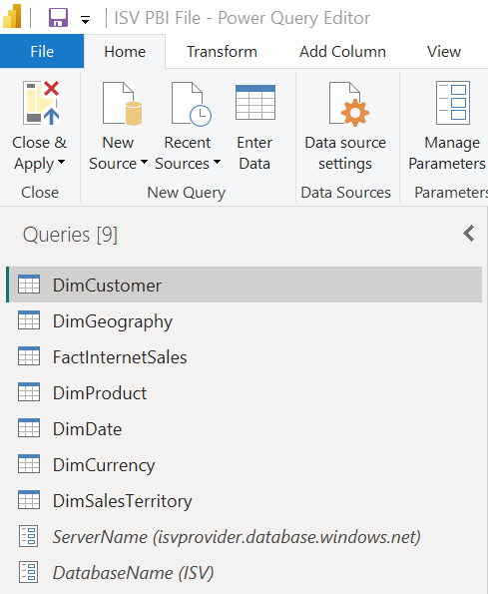
Power BI Templates Overview
Parameterize connections for easy use when handing off the templates
Example: Server and Database are parameterized

Slide 7
Agenda
Overview
Demo
Power BI Templates

Slide 8
Thank you!
Modern Analytics Academy “Vignettes”
Power BI Templates
https://aka.ms/maa

