Slide 1
Agenda
Threat Intelligence Overview
Fusion
Incident Investigation

Slide 2


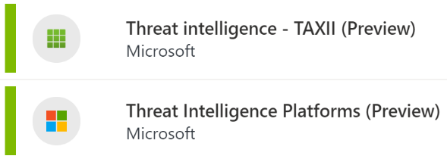




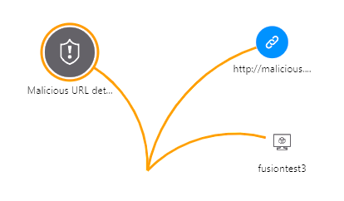


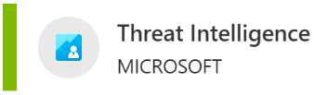
Threat intelligence is used throughout Microsoft Sentinel
Background
Background
Data Connectors
Solutions
Accent
Accent
Analytics
Incidents
Investigations
Alternate BG
Alternate BG
Playbooks
Notebooks
Workbooks

Slide 3
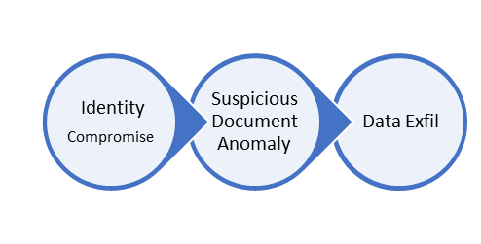
Microsoft Sentinel | Fusion – Advanced Multistage Attack Detection
Analyzing activities across multiple cloud services into high-fidelity security cases using Graph-powered Machine Learning
Activity
Anomalous signals
Graph-powered ML + probabilistic kill chain
Further ML analysis
+
2.4 | 1.5 | 2.3 | 1.1
….
Identity (millions of events)
Office 365 activity (millions of events)
Security alerts
(thousands)
Azure / AWS / GCP activities
(millions of events)
Suspicious candidates (hundreds)
High Fidelity Incidents
Anomalies
(thousands)
Host activities
(millions of events)
Firewall (multi-billion events)

Slide 4
Fusion Detects
122 multi-stage attack scenarios covering kill chain stages from initial access to impact.
Potential ransomware activities at defense evasion and execution stages
A new set of ML algorithms that detects emerging threats
Extended source signal coverage for all the assets monitored by the SOC team in a Sentinel workspace
A new configuration UI to fine tune the input and output of Fusion

Slide 5
Fusion Data Coverage
Fusion multistage attack
Fusion for ransomware
Fusion for emerging threats
Azure Active Directory Identity Protection
Microsoft Defender for Cloud
Microsoft Defender for Cloud Apps
Microsoft Defender for Endpoint
Palo Alto Networks
8 scheduled analytics rules*
Microsoft Defender for Cloud
Microsoft Defender for Cloud Apps
Microsoft Defender for Endpoint
Microsoft Defender for Identity
Alerts from scheduled analytics rules, both built-in and those created by your security analysts. *
Customizable anomalies
Azure Active Directory Identity Protection
Microsoft 365 Defender
Microsoft Defender for Cloud
Microsoft Defender for Cloud Apps
Microsoft Defender for Endpoint
Microsoft Defender for Identity
Microsoft Defender for IoT
Microsoft Defender for Office 365
Alerts from scheduled analytics rules, both built-in and those created by your security analysts. *
* Scheduled analytics rules must contain kill-chain (tactics) and entity mapping information in order to be used by Fusion

