Slide 1
ChatGPT Unleashed
From Code Wizards to Silly Shenanigans!
Notes:
Possible titles:
ChatGPT Unleashed: Unveiling the Fun, Fascinating, and Practival Applications!

Slide 2
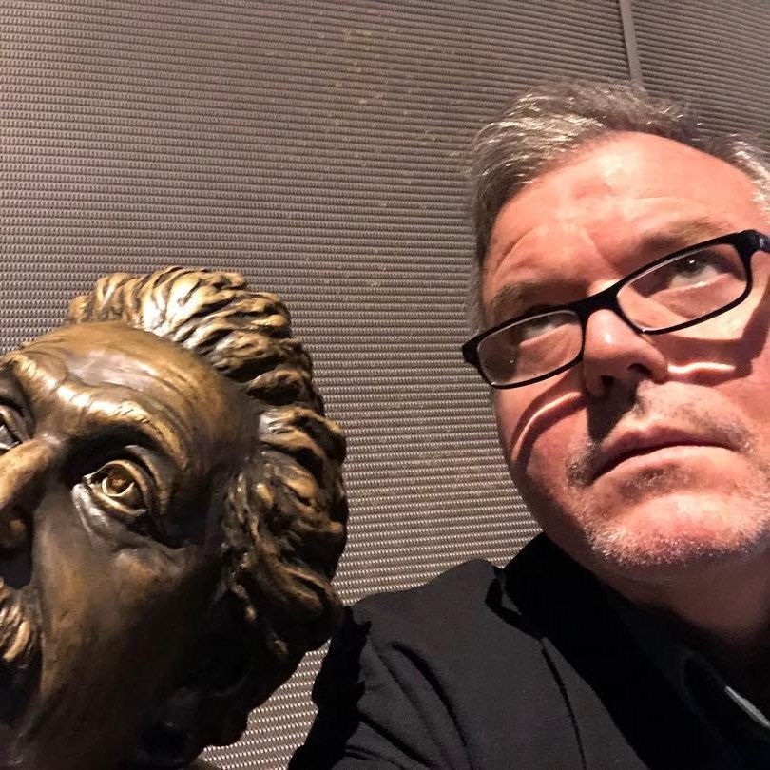
David Giard
Partner Solution Architect, Microsoft
davidgiard.com
technologyandfriends.com
aka.ms/gcast

Slide 3
What is ChatGPT?
“ChatGPT is a large language model developed by OpenAI, capable of performing a wide range of natural language processing tasks, including conversational chatbots, using deep learning-based unsupervised learning.”
-ChatGPT
Notes:
This quote was generated by ChatGPT. I asked it: “Describe ChatGPT in 1 sentence”

Slide 4
Definitions
Generative AI
A subset of Artificial Intelligence (AI) that creates new content based on what it has learned from existing content. Can include text, image, or audio
Large Language Models (LLMs)
Foundational Machine Learning models that use deep learning algorithms to process and understand natural language

Slide 5
Capabilities
Understands Natural Language
Remembers what user said earlier in the conversation
Allows user to provide follow-up corrections
Trained to decline inappropriate requests

Slide 6
Limitations
May occasionally generate incorrect information
May occasionally produce harmful instructions or biased content
Limited knowledge of world and events after 2021

Slide 7
Sign Up, Start Using It
https://chat.openai.com

Slide 8
Ways to Make ChatGPT Work for You: IT
Explain code
Generating code
Write automated test

Slide 9
Ways to Make ChatGPT Work for You: Career
Writing summaries, title, articles, and emails
Writing job descriptions or professional bios

Slide 10
Ways to Make ChatGPT Work for You: Education
Writing summaries, title, articles, and emails
Explain complex topics

Slide 11
Ways to Make ChatGPT Work for You: Having Fun
Engaging in casual conversations
Playing games with ChatGPT
Getting creative with ChatGPT
Asking ChatGPT for jokes or funny stories

Slide 12
Output Options
Text
Tabular
ASCII Art

Slide 13
Tips for Maximizing your ChatGPT Experience
Be Specific
Provide context
Define audience
Define speaker
Try different conversation starters
Ask open-ended questions
Be open-minded
Experiment with different types of games
Correct ChatGPT, when it is wrong

Slide 14
Ethical Questions
Can ChatGPT do my homework?
How much credit is due to the data in models?
Can I take credit for an outline, email, or article written by ChatGPT?
Can I trust ChatGPT?
Notes:
A Man Sued Avianca Airline. His Lawyer Used ChatGPT. - The New York Times (nytimes.com)

Slide 15
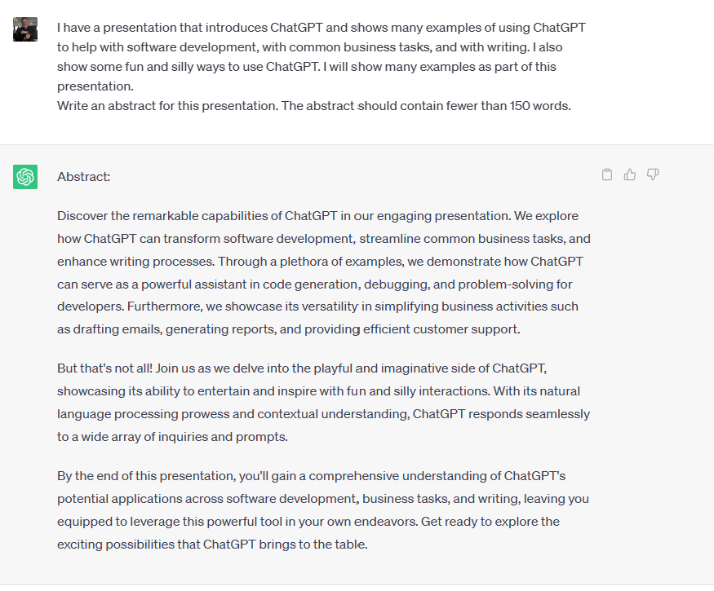

Slide 16
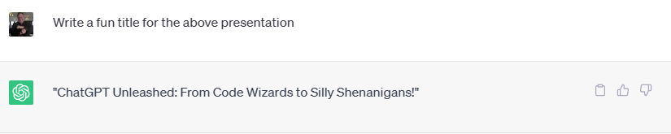

Slide 17
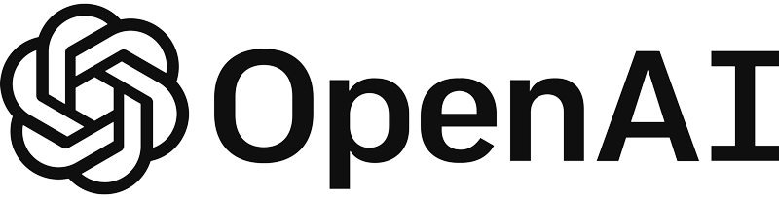
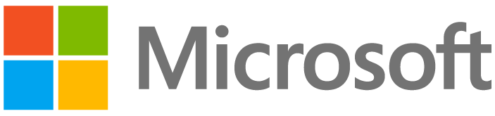
Microsoft and OpenAI partnership
Ensure that artificial general intelligence (AGI) benefits humanity
Empower every person and organization on the planet to achieve more
Azure OpenAI Service – as of November 15, 2023
GPT-4, GPT-4-Turbo, GPT-3.5-Turbo
GPT-4-Turbo with Vision
Babbage, Davinci, GPT-3.5-Turbo
DALL·E 3
Whisper
Language
Multi-Modal
Fine Tuning
Images
Transcription & Translation
Azure AI Studio
Notes:
Narrative/talk track:
The MSFT / OpenAI partnership and how we collaborate
Microsoft has formed a partnership with OpenAI to collaborate on the development of artificial intelligence technologies. The partnership aims to accelerate the development of advanced AI systems and bring the benefits of AI to more people.
As part of the partnership, Microsoft and OpenAI have agreed to work together on several key areas, including:
Developing AI technologies: The two companies will collaborate on the development of new AI models and algorithms, with a focus on natural language processing, computer vision, and other areas of AI.
Building an AI computing platform: Microsoft and OpenAI will work together to build a new AI computing platform that will allow developers to easily access and use advanced AI models and algorithms.
Advancing AI research: The two companies will also collaborate on a range of research projects aimed at advancing the state of the art in AI.
Making AI more accessible: The partnership aims to make AI more accessible to a wider range of developers and organizations, in order to bring the benefits of AI to more people.
Microsoft has also announced it will use OpenAI's GPT-3 technology to add more capabilities to its products such as Cortana, Power Virtual Agents and Dynamics 365.
Additionally, Microsoft has also made an investment in OpenAI, allowing the company to use Microsoft Azure as its preferred cloud platform, and allowing OpenAI to tap into the vast resources of Microsoft to accelerate its research. This partnership gives OpenAI the ability to scale its models and services on Azure and make them more widely available to customers.
Overall, the partnership between Microsoft and OpenAI aims to accelerate the development and use of advanced AI technologies, with a focus on making AI more accessible to developers and organizations, in order to bring the benefits of AI to more people.

Slide 18
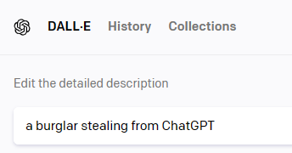

Demos
Disclaimer:
Mostly Harmless
Mostly Stolen

Slide 19
You Try It!

Slide 20
Links
https://github.com/DavidGiard/Presentation-Slides/tree/main/ChatGPT
https://gridfiti.com/best-chatgpt-prompts/
https://www.linkedin.com/feed/update/urn:li:activity:7066386899451428864/
https://www.linkedin.com/feed/update/urn:li:activity:7069281452240039936/?utm_source=share&utm_medium=member_ios
https://microsoft.sharepoint.com/teams/CS_CE/SitePages/CE-Beat-AIcareer.aspx
https://aka.ms/careergpt

