Slide 1
ChatGPT Unleashed
From Code Wizards to Silly Shenanigans!
Notes:
Possible titles:
ChatGPT Unleashed: Unveiling the Fun, Fascinating, and Practival Applications!

Slide 2
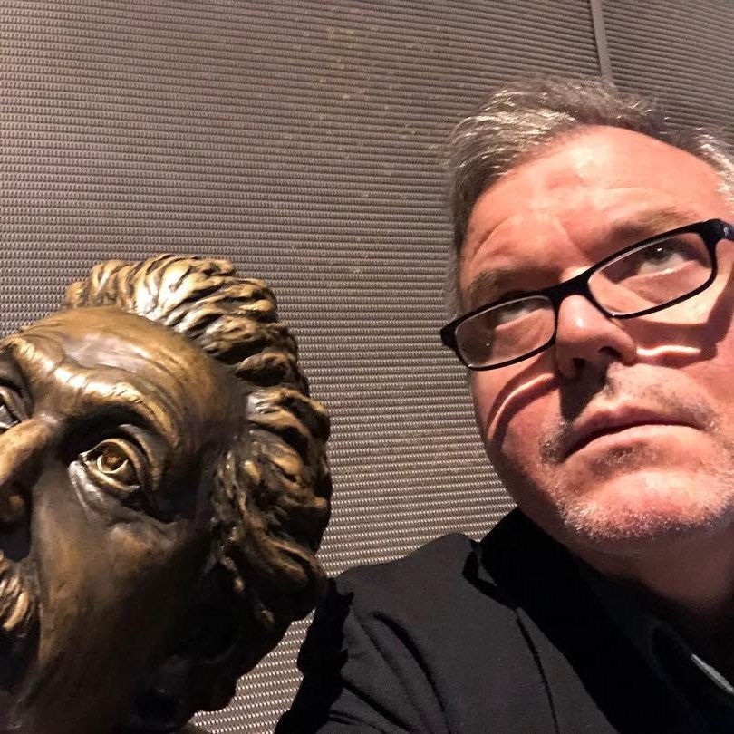
David Giard
Partner Solution Architect, Microsoft
davidgiard.com
technologyandfriends.com
aka.ms/gcast

Slide 3
What is ChatGPT?
“ChatGPT is a large language model developed by OpenAI, capable of performing a wide range of natural language processing tasks, including conversational chatbots, using deep learning-based unsupervised learning.”
-ChatGPT
Notes:
This quote was generated by ChatGPT. I asked it: “Describe ChatGPT in 1 sentence”

Slide 4
Capabilities
Understands Natural Language
Remembers what user said earlier in the conversation
Allows user to provide follow-up corrections
Trained to decline inappropriate requests

Slide 5
Limitations
May occasionally generate incorrect information
May occasionally produce harmful instructions or biased content
Limited knowledge of world and events after 2021

Slide 6
Ways to Make ChatGPT Work for You: IT
Explain code
Generating code
Write automated test

Slide 7
Ways to Make ChatGPT Work for You: Career
Writing summaries, title, articles, and emails
Writing job descriptions or professional bios

Slide 8
Ways to Make ChatGPT Work for You: Education
Writing summaries, title, articles, and emails
Explain complex topics

Slide 9
Ways to Make ChatGPT Work for You: Having Fun
Engaging in casual conversations
Playing games with ChatGPT
Getting creative with ChatGPT
Asking ChatGPT for jokes or funny stories

Slide 10
Examples of Fun Conversations with ChatGPT
Chatting about hobbies and interests
Playing trivia games with ChatGPT
Creating a story with ChatGPT
Asking ChatGPT to tell a joke or funny story

Slide 11
Tips
Be specific
Set Audience
Specify Output

Slide 12
Output Options
Text
Tabular
ASCII Art

Slide 13
Tips for Maximizing your ChatGPT Experience
Be open-minded
Ask open-ended questions
Try different conversation starters
Experiment with different types of games

Slide 14
Ethical Questions
Can ChatGPT do my homework?
How much credit is due to the data in models?
Can I take credit for an outline, email, or article written by ChatGPT?
Can I trust ChatGPT?
Notes:
A Man Sued Avianca Airline. His Lawyer Used ChatGPT. - The New York Times (nytimes.com)

Slide 15
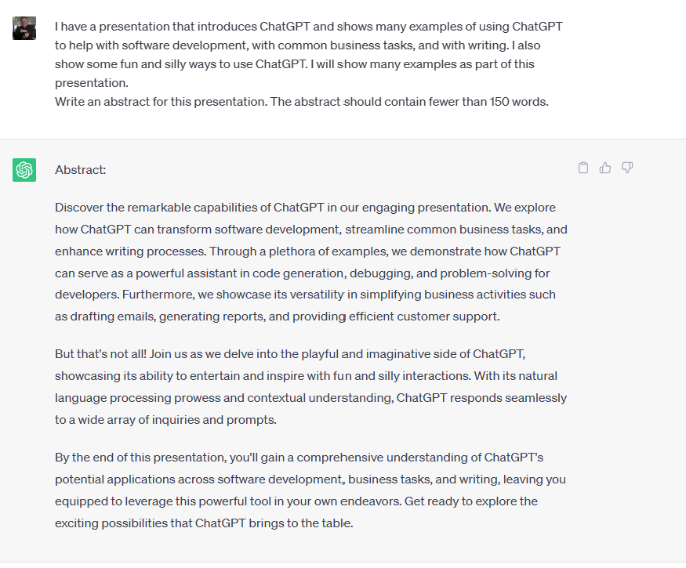

Slide 16
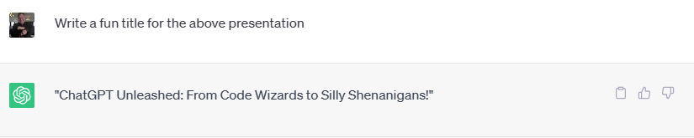

Slide 17
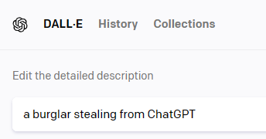

Demos
Disclaimer:
Mostly Harmless
Mostly Stolen

Slide 18
You Try It!

Slide 19
Links
https://github.com/DavidGiard/Presentation-Slides/tree/main/ChatGPT
https://gridfiti.com/best-chatgpt-prompts/
https://www.linkedin.com/feed/update/urn:li:activity:7066386899451428864/
https://www.linkedin.com/feed/update/urn:li:activity:7069281452240039936/?utm_source=share&utm_medium=member_ios
https://microsoft.sharepoint.com/teams/CS_CE/SitePages/CE-Beat-AIcareer.aspx
https://aka.ms/careergpt

