Slide 1
ChatGPT Unleashed
From Code Wizards to Silly Shenanigans!
Notes:
Possible titles:
ChatGPT Unleashed: Unveiling the Fun, Fascinating, and Practival Applications!

Slide 2
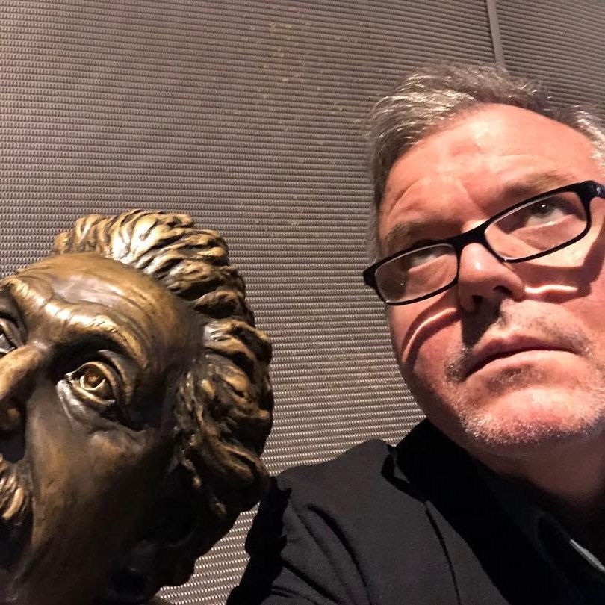
David Giard
Partner Solution Architect, Microsoft
davidgiard.com
technologyandfriends.com
aka.ms/gcast

Slide 3
What is ChatGPT?
“ChatGPT is a large language model developed by OpenAI, capable of performing a wide range of natural language processing tasks, including conversational chatbots, using deep learning-based unsupervised learning.”
-ChatGPT
Notes:
This quote was generated by ChatGPT. I asked it: “Describe ChatGPT in 1 sentence”

Slide 4
Capabilities
Understands Natural Language
Remembers what user said earlier in the conversation
Allows user to provide follow-up corrections
Trained to decline inappropriate requests

Slide 5
Limitations
May occasionally generate incorrect information
May occasionally produce harmful instructions or biased content
Limited knowledge of world and events after 2021

Slide 6
Sign Up, Start Using It
https://chat.openai.com

Slide 7
Ways to Make ChatGPT Work for You: IT
Explain code
Generating code
Write automated test

Slide 8
Ways to Make ChatGPT Work for You: Career
Writing summaries, title, articles, and emails
Writing job descriptions or professional bios

Slide 9
Ways to Make ChatGPT Work for You: Education
Writing summaries, title, articles, and emails
Explain complex topics

Slide 10
Ways to Make ChatGPT Work for You: Having Fun
Engaging in casual conversations
Playing games with ChatGPT
Getting creative with ChatGPT
Asking ChatGPT for jokes or funny stories

Slide 11
Output Options
Text
Tabular
ASCII Art

Slide 12
Tips for Maximizing your ChatGPT Experience
Be Specific
Provide context
Define audience
Define speaker
Try different conversation starters
Ask open-ended questions
Be open-minded
Experiment with different types of games
Correct ChatGPT, when it is wrong

Slide 13
Ethical Questions
Can ChatGPT do my homework?
How much credit is due to the data in models?
Can I take credit for an outline, email, or article written by ChatGPT?
Can I trust ChatGPT?
Notes:
A Man Sued Avianca Airline. His Lawyer Used ChatGPT. - The New York Times (nytimes.com)

Slide 14
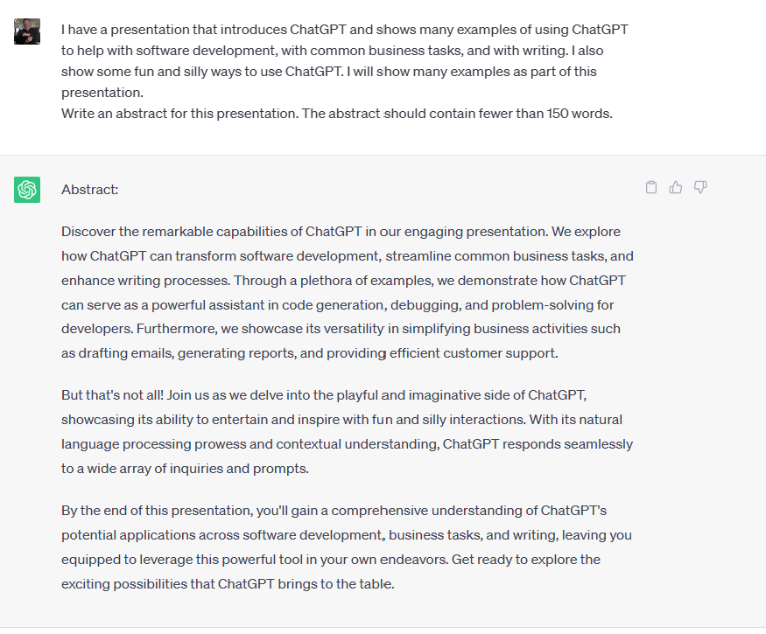

Slide 15
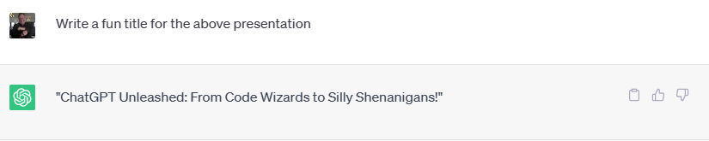

Slide 16
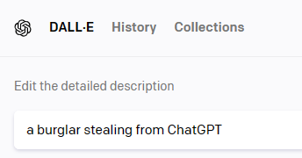

Demos
Disclaimer:
Mostly Harmless
Mostly Stolen

Slide 17
You Try It!

Slide 18
Links
https://github.com/DavidGiard/Presentation-Slides/tree/main/ChatGPT
https://gridfiti.com/best-chatgpt-prompts/
https://www.linkedin.com/feed/update/urn:li:activity:7066386899451428864/
https://www.linkedin.com/feed/update/urn:li:activity:7069281452240039936/?utm_source=share&utm_medium=member_ios
https://microsoft.sharepoint.com/teams/CS_CE/SitePages/CE-Beat-AIcareer.aspx
https://aka.ms/careergpt

