Slide 1
Rust’s Approach to Memory Safety
Seminar Work – David Grandel

Slide 2


Introduction
What do you think are some of the most common weaknesses in modern software systems?

Slide 3




Introduction
The following two errors are among the 10 most common:
1
9
Out-of-bounds Write
Use After Free
Buffer
Memory Unit
Write
Free
Access
“The product writes data past the end, or before the beginning, of the intended buffer.”_{[1]}
“The product reuses or references memory after it has been freed.”_{[2]}

Slide 4
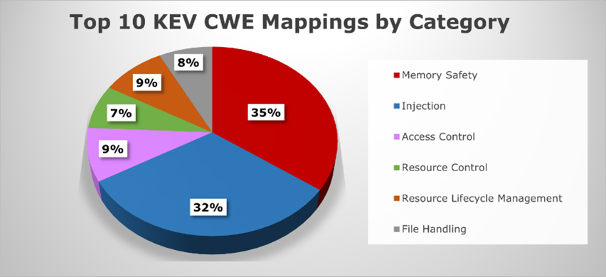
Introduction
The most common vulnerabilities have one thing in common: They are all related to Memory Safety issues.
[3]

Slide 5
Memory Safety
What is Memory Safety?
If a program contains any of the following memory access errors, it is classified as not memory safe:_{[4]}
Out-of-bounds Write
Out-of-bounds Read
Use After Free
Use of uninitialized Memory
Double Free

Slide 6
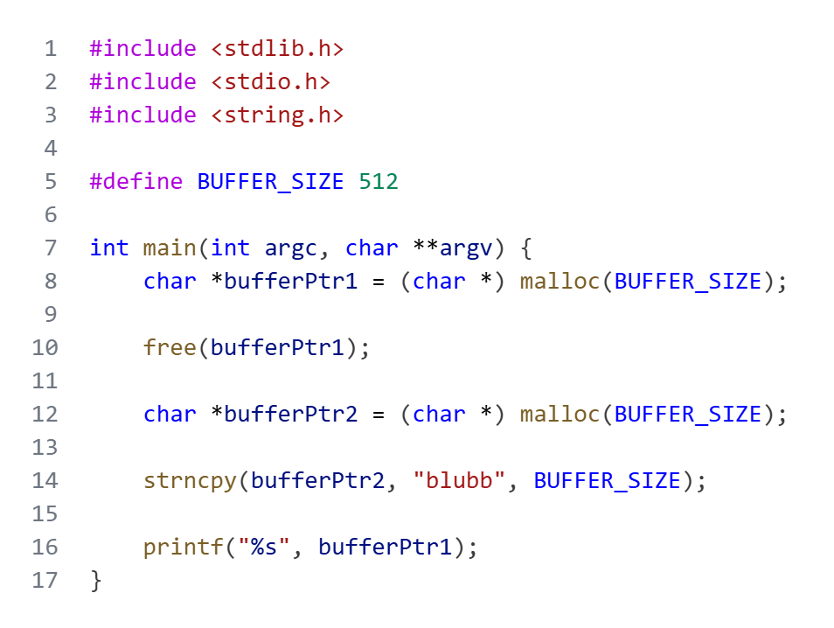

Memory Safety
Use After Free
Heap Memory
Memory Unit
512 Byte
Allocate Memory Unit
bufferPtr1

Slide 7

Memory Safety
Use After Free
Heap Memory
Memory Unit
512 Byte
Free Memory Unit
bufferPtr1

Slide 8

Memory Safety
Use After Free
Heap Memory
Memory Unit
512 Byte
Allocate Memory Unit
bufferPtr2

Slide 9


Memory Safety
Use After Free
Heap Memory
Memory Unit
512 Byte
Use Freed Memory Unit
bufferPtr1
bufferPtr2
Store “blubb” in Memory Unit
>blubb

Slide 10
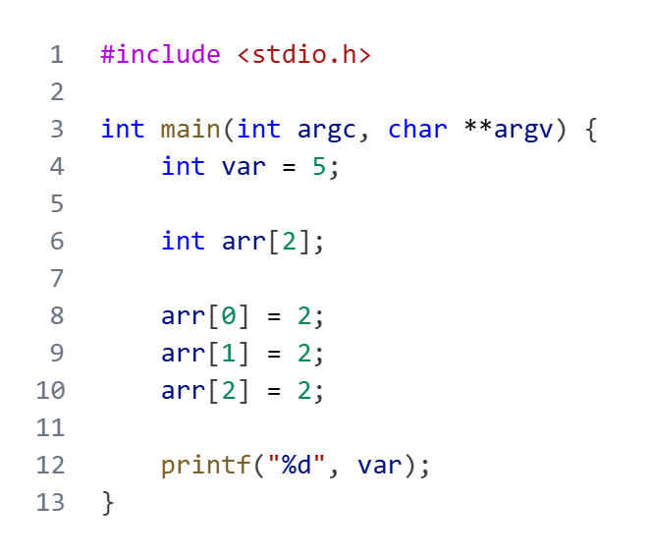
Memory Safety
Out-of-bounds Write
High Addresses
var
5
arr[1]
?
arr[0]
?
Stack Memory
Low Addresses

Slide 11
Memory Safety
Out-of-bounds Write
High Addresses
var
5
arr[1]
?
arr[0]
2
Stack Memory
Low Addresses

Slide 12
Memory Safety
Out-of-bounds Write
High Addresses
var
5
arr[1]
2
arr[0]
2
Stack Memory
Low Addresses

Slide 13
Memory Safety
Out-of-bounds Write
High Addresses
var
2
arr[1]
2
arr[0]
2
Stack Memory
Low Addresses
>2

Slide 14



Memory Safety
Consequences of this Behavior_{[5]}
Data integrity is lost:
  bufferPtr1 can also be used to manipulate the content of the Memory Unit in exactly the same way.
  The same applies to changing memory on the stack via Out-of-bounds Writes.
Availability of a service may be limited due to software crashes:
  If chunk consolidation occurs after a free, the program will crash the next time memory is accessed via bufferPtr1, as the chunk information is no longer valid.
  If the Out-of-bounds Write accidentally overwrites a return address of a function, this can also cause the program to crash.
24/7

Slide 15




Memory Safety
Approaches to achieving Memory Safety
The use of Programming Languages with Automatic Memory Management:
  Developers do not have the ability to manage memory themselves.
  Memory is managed by a Garbage Collector at runtime.
  Works extremely reliably, but costs immense performance at runtime.
Instrumentation of existing unsafe Programs to detect errors at runtime:
  In potentially memory-unsafe programs, instructions are inserted during compilation that can detect invalid memory accesses at runtime.
  The higher the detection rate (none of the tools achieve 100%), the higher the costs in terms of performance.
Programming Languages that enforce Memory Safety at Compile Time:
  Potential memory errors are not compiled at all.
  This requires some new rules and concepts.
  There is no runtime overhead.
  Rust offers such a solution.

Slide 16
Sources
https://cwe.mitre.org/data/definitions/787.html [Last Access: 09. Dec. 2025]
https://cwe.mitre.org/data/definitions/416.html [Last Access: 09. Dec. 2025]
https://cwe.mitre.org/top25/archive/2024/2024_kev_insights.html [Last Access: 09. Dec. 2025]
http://www.pl-enthusiast.net/2014/07/21/memory-safety/ [Last Access: 10. Dec. 2025]
https://cset.georgetown.edu/article/memory-safety-an-explainer/ [Last Access: 10. Dec. 2025]

