Slide 1
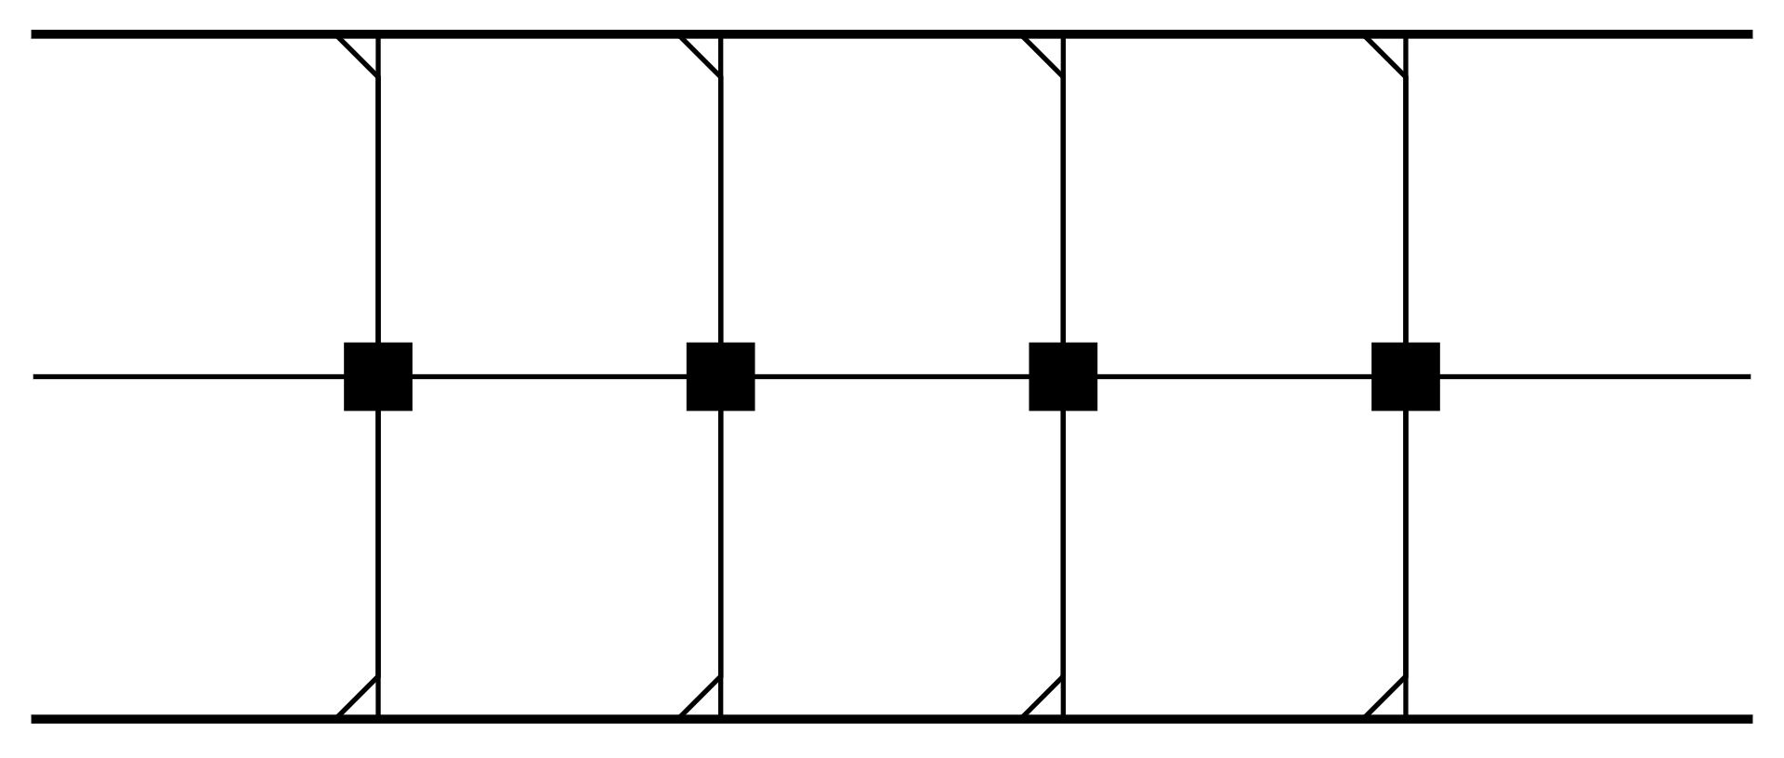









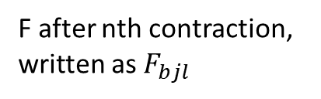


F after nth contraction, written as $F_{bjl}$
$$j$$
$$A_{sij}$$
$$i$$
$$s$$
$$b$$
$$W_{abst}$$
$$a$$
$$t$$
$$k$$
$$l$$
$$B_{tkl}$$

Slide 2












F contract with A, Now becomes $F_{sbil}$
$$j$$
$$A_{sij}$$
$$i$$
$$s$$
$$b$$
$$W_{abst}$$
$$a$$
$$t$$
$$k$$
$$l$$
$$B_{tkl}$$

Slide 3












F contract with W, Now becomes $F_{tail}$
$$j$$
$$A_{sij}$$
$$i$$
$$s$$
$$b$$
$$W_{abst}$$
$$a$$
$$t$$
$$k$$
$$l$$
$$B_{tkl}$$

Slide 4

F contract with B, Now becomes $F_{iak}$
$$j$$
$$A_{sij}$$
$$i$$
$$s$$
$$b$$
$$W_{abst}$$
$$a$$
$$t$$
$$k$$
$$l$$
$$B_{tkl}$$

Slide 5
