Slide 1
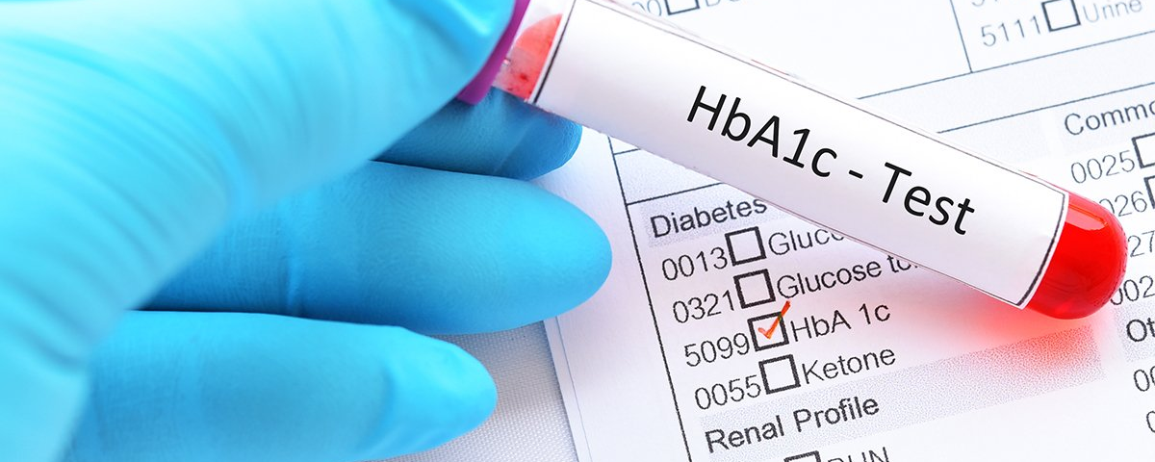
DIABETES HEALTH INDICATORS
MACHINE LEARNING - TERM PROJECT

Slide 2
DATASET
The dataset selected contains records with a person's health and lifestyle attributes collected from an annual CDC survey, along with a label for if that person has diabetes.
Based on 2018 data, 34.4 million Americans have diabetes and 88 million have pre-diabetes, meaning that they are in danger of developing the disease.
Determining the primary indicators would be helpful in alerting people of the risk and for preventing the disease.
Diabetes_binary
HighBP
HighChol
CholCheck
BMI
Smoker
Stroke
HeartDiseaseorAttack
PhysActivity
Fruits
Veggies
HvyAlcoholConsump
AnyHealthcare
NoDocbcCost
GenHlth
MentHlth
PhysHlth
DiffWalk
Sex
Age
Education
Income

Slide 3
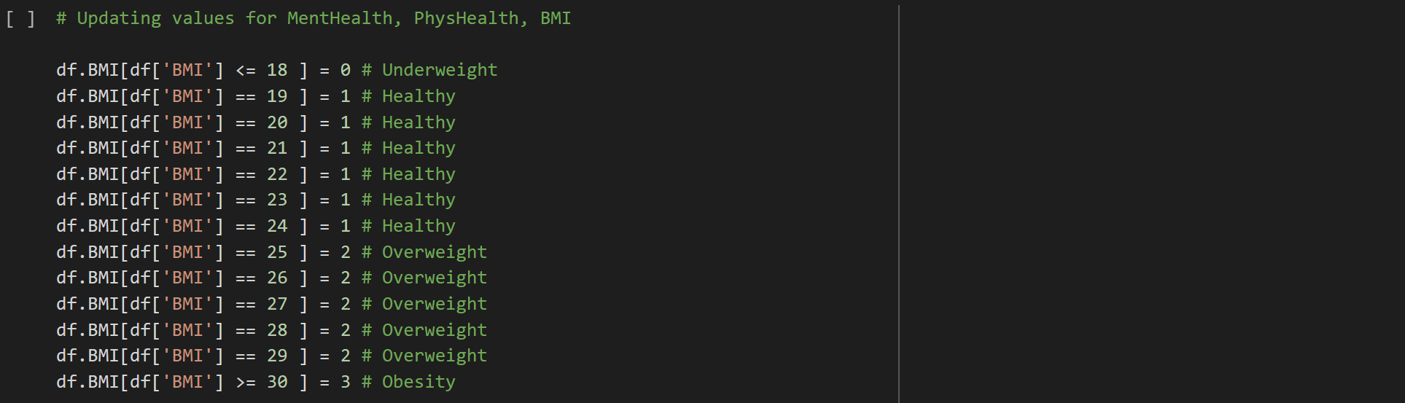
PREPROCESSING
There are several steps that we took for data preprocessing and cleansing:
Removed duplicate records.
Re-balanced the dataset to 65,000 data points.
Converted all attributes to type INT.
Adjusted certain attribute values to be in proper categories.

Slide 4
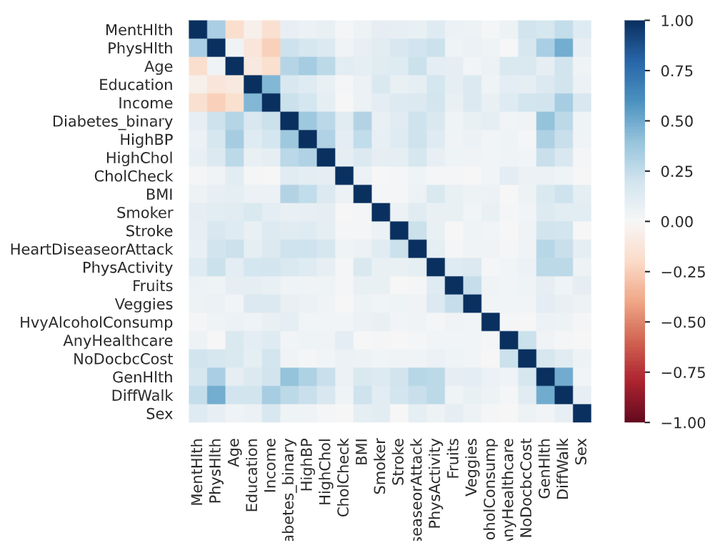
CORRELATION
[Physical Health, Physical Activity] and [Difficulty Walking]
[Mental Health, Physical Health] and [General Health]
[Difficulty Walking] and [Mental Health]
[Physical Health] and [Income]
[Education] and [Income]

Slide 5
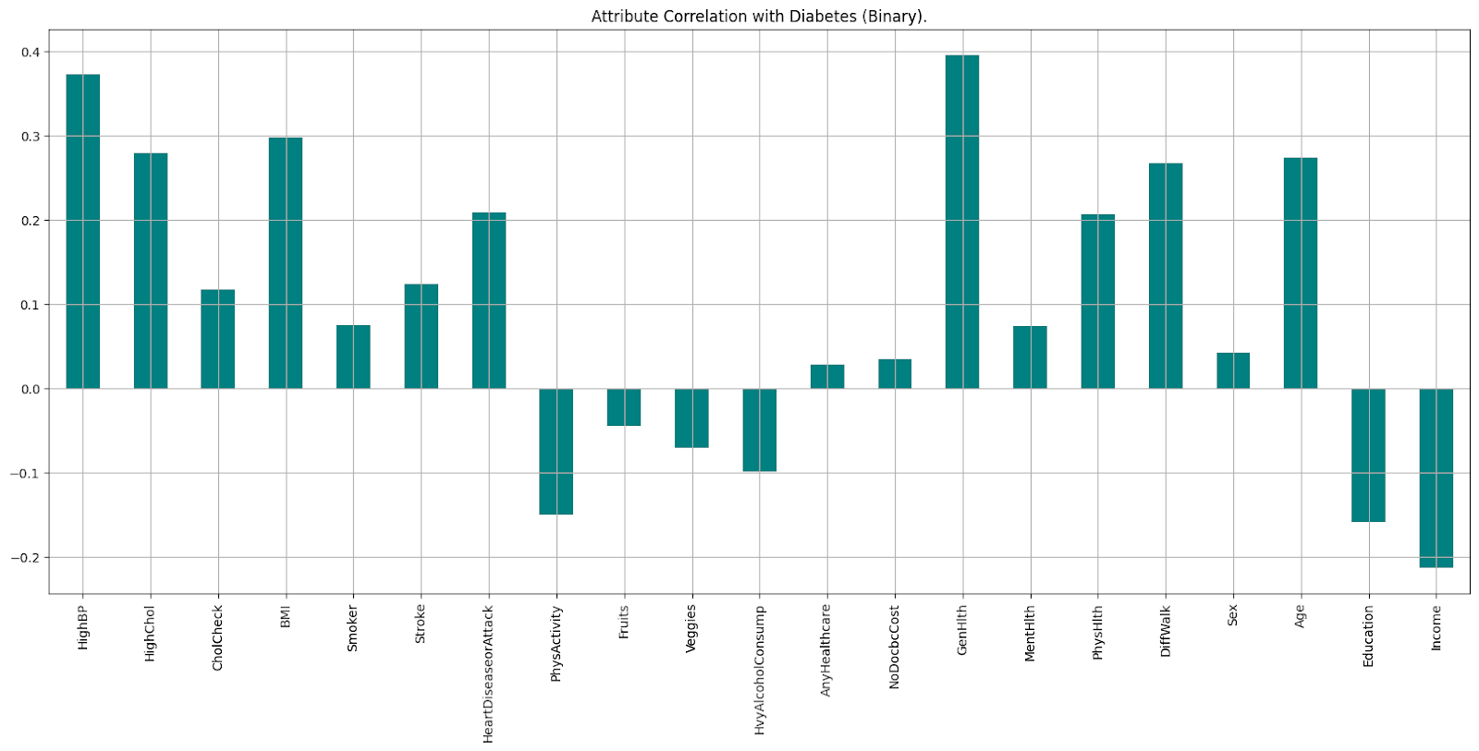
CORRELATION WITH DIABETES

Slide 6
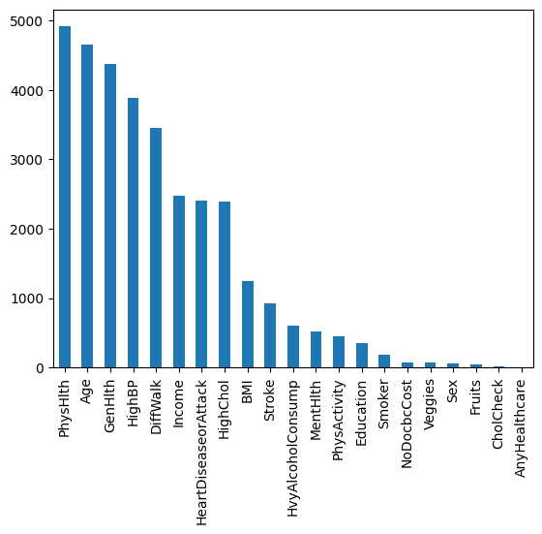
FEATURE SELECTION
CHI-SQUARE SCORES
The Chi-square is calculated between each feature and the target.
It determines if the association between two categorical variables of the sample would reflect their real association in the population.

Slide 7
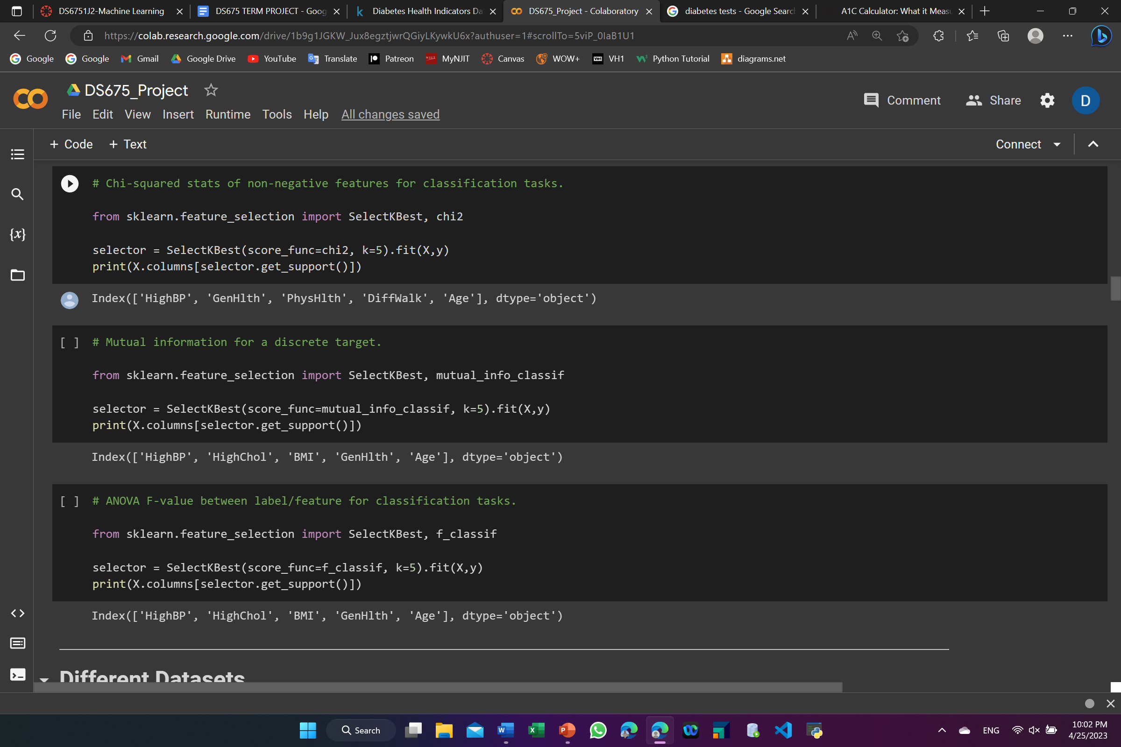
FEATURE SELECTION
MUTUAL INFORMATION FOR A DISCRETE TARGET
Highest scores are [HighBP], [HighChol], [BMI], [GenHlth] and [Age].
ANOVA F-VALUE
Highest scores are [HighBP], [HighChol], [BMI], [GenHlth] and [Age].

Slide 8
SPLITTING DATASET
DATASET 1
Contains all 21 attributes.
Contains 10 attributes that have the highest Chi-square scores "Diabetes_binary", "PhysHlth", "Age", "GenHlth", "HighBP", "DiffWalk", "Income", "HeartDiseaseorAttack", "HighChol", "BMI" and "Stroke".
Contains 5 attributes that have the highest ANOVA F-value "Diabetes_binary", "HighBP", "HighChol", "BMI", "GenHlth" and "Age".
We then split each dataset into train (80%), test (10%), and validation (10%) sets.
DATASET 2
DATASET 3
SETS

Slide 9
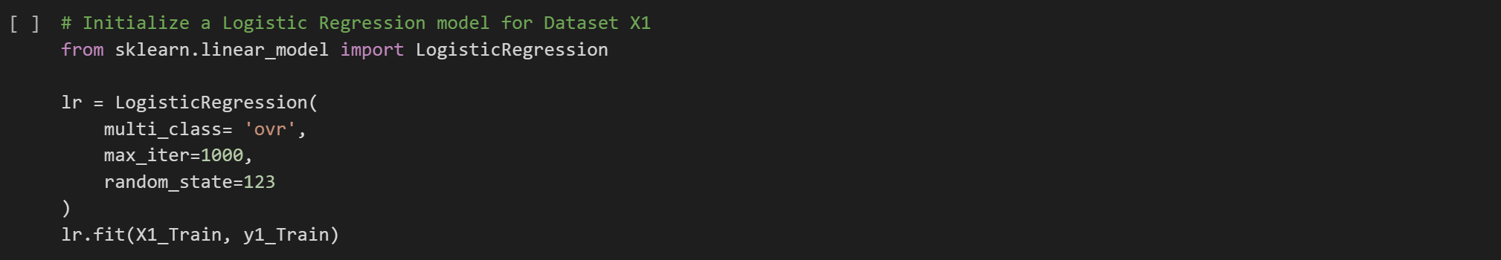
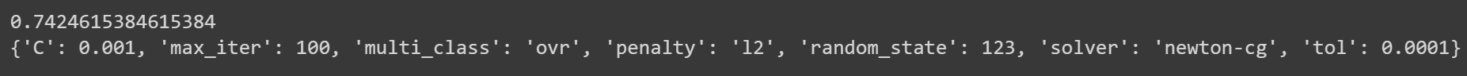
LOGISTIC REGRESSION
Then we performed Grid Search for each of the three datasets. After this hyperparameter tuning, the best accuracy is 0.7524615384615385 with below hyperparameters:

Slide 10
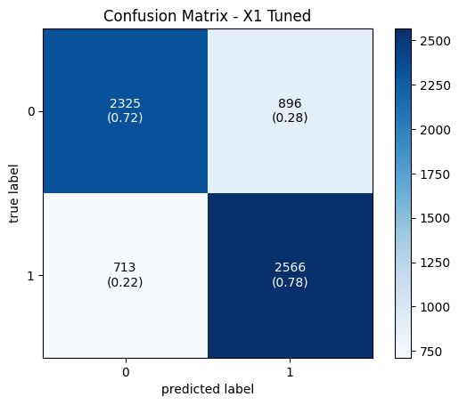
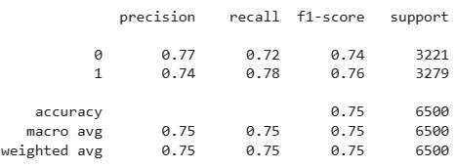
LOGISTIC REGRESSION
CONFUSION MATRIX
Meter tuning showed an improvement of about 1%. The final model has an average precision of 0.75 and recall of 0.75.

Slide 11
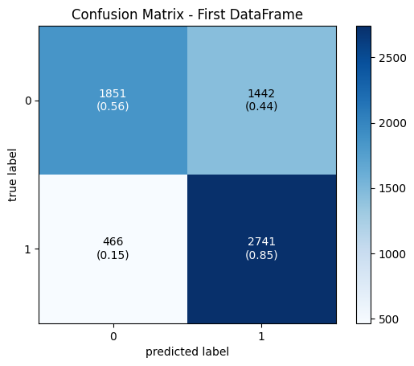
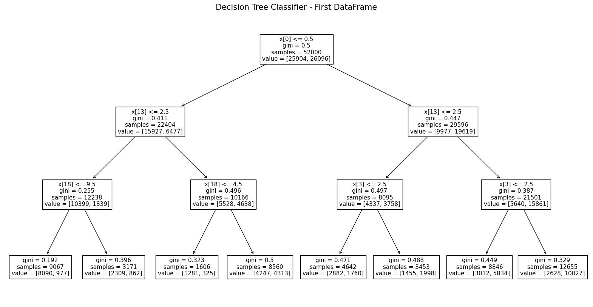
DECISION TREE
X[0]: High Blood Pressure.
X[13]: General Health.
X[18]: Age.
X[3]: Body Mass Index.

Slide 12
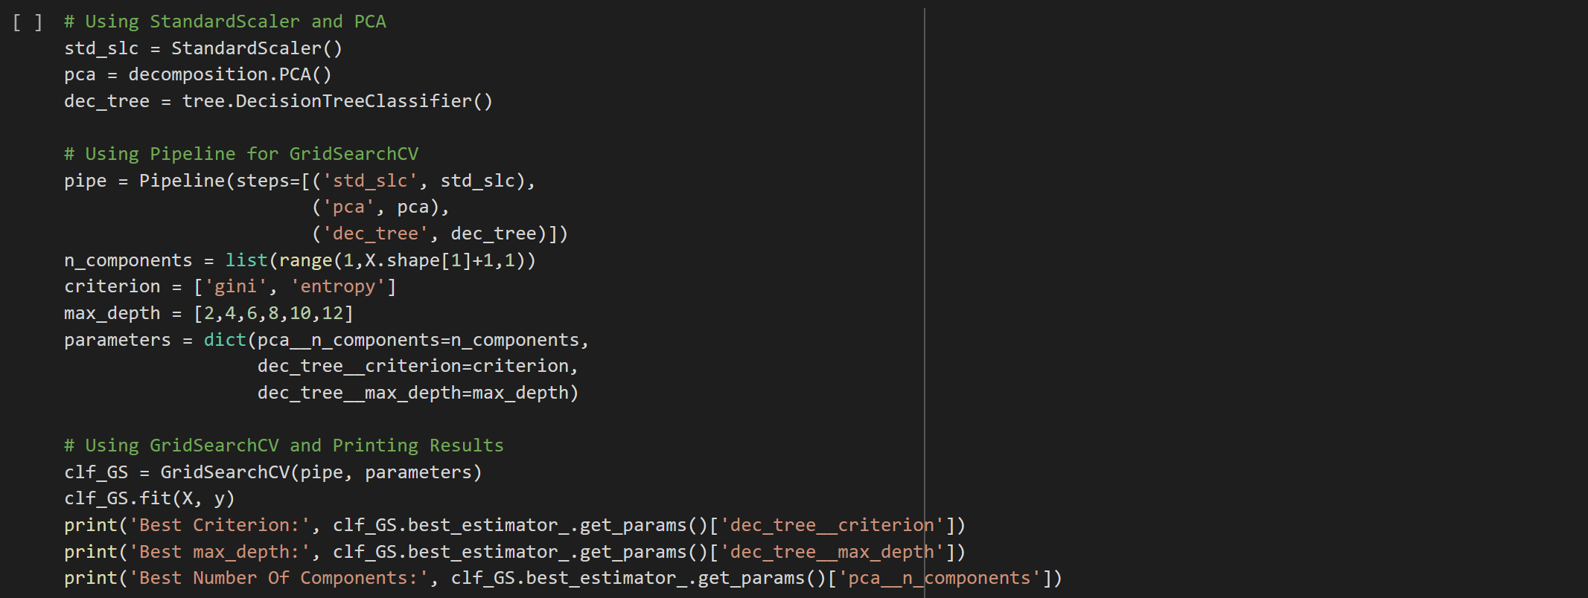
DECISION TREE
Then we used GridSearchCV technique for finding the optimal parameter values.
Best Criterion: gini.
Best Max_Depth: 6.
Best Number of Components: 21 (First Dataset).

Slide 13
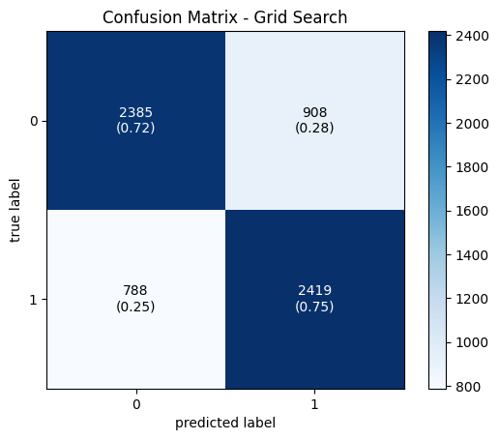
DECISION TREE
RECALL
The focus in this model is to find the positive cases by optimizing the recall, because it is more important where overlooked cases (false negatives) are more costly than false alarms (false positives).
Recall is used when you must correctly classify some event that has already occurred, because if somebody is ill, we need to spot their illness avoiding the false negatives.

Slide 14

RESULTS
Our approach was different from the previous work we saw on Kaggle in several ways:
We performed extensive data profiling to analyze the attributes.
For preprocessing and data cleansing, we re-categorized a few of the attributes so that it was more concise.
We then decided to create three different datasets to test in our models, each test of attribute correlation and feature selection provided slightly different results, and we wanted to try multiple options to ensure we get the highest accuracy.
We also chose to use two different models, logistic regression and decision tree, and performed grid search for hyperparameter tuning.

