Slide 1
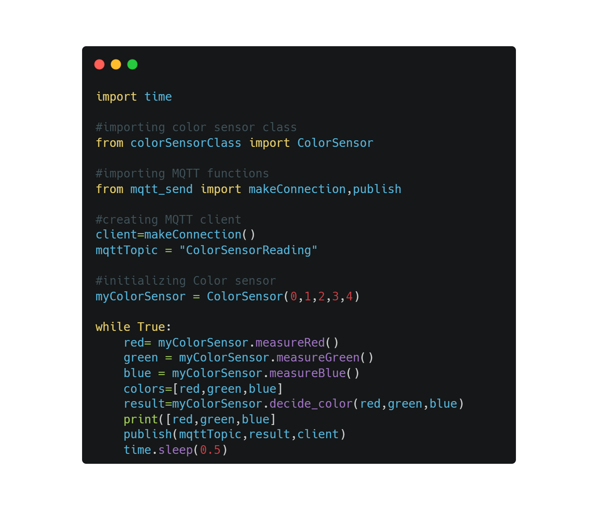
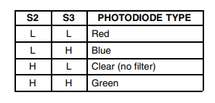
Color Sensor
makeConnection
Publish
Pins
measureRed
measureGreen
measureBlue
Decide_color

