Slide 1
Robotic
Arm
Using MQTT

Slide 2
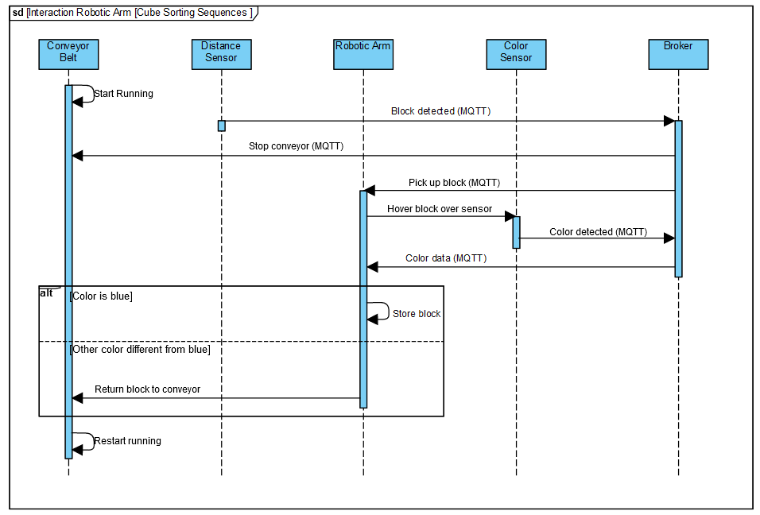

Slide 3
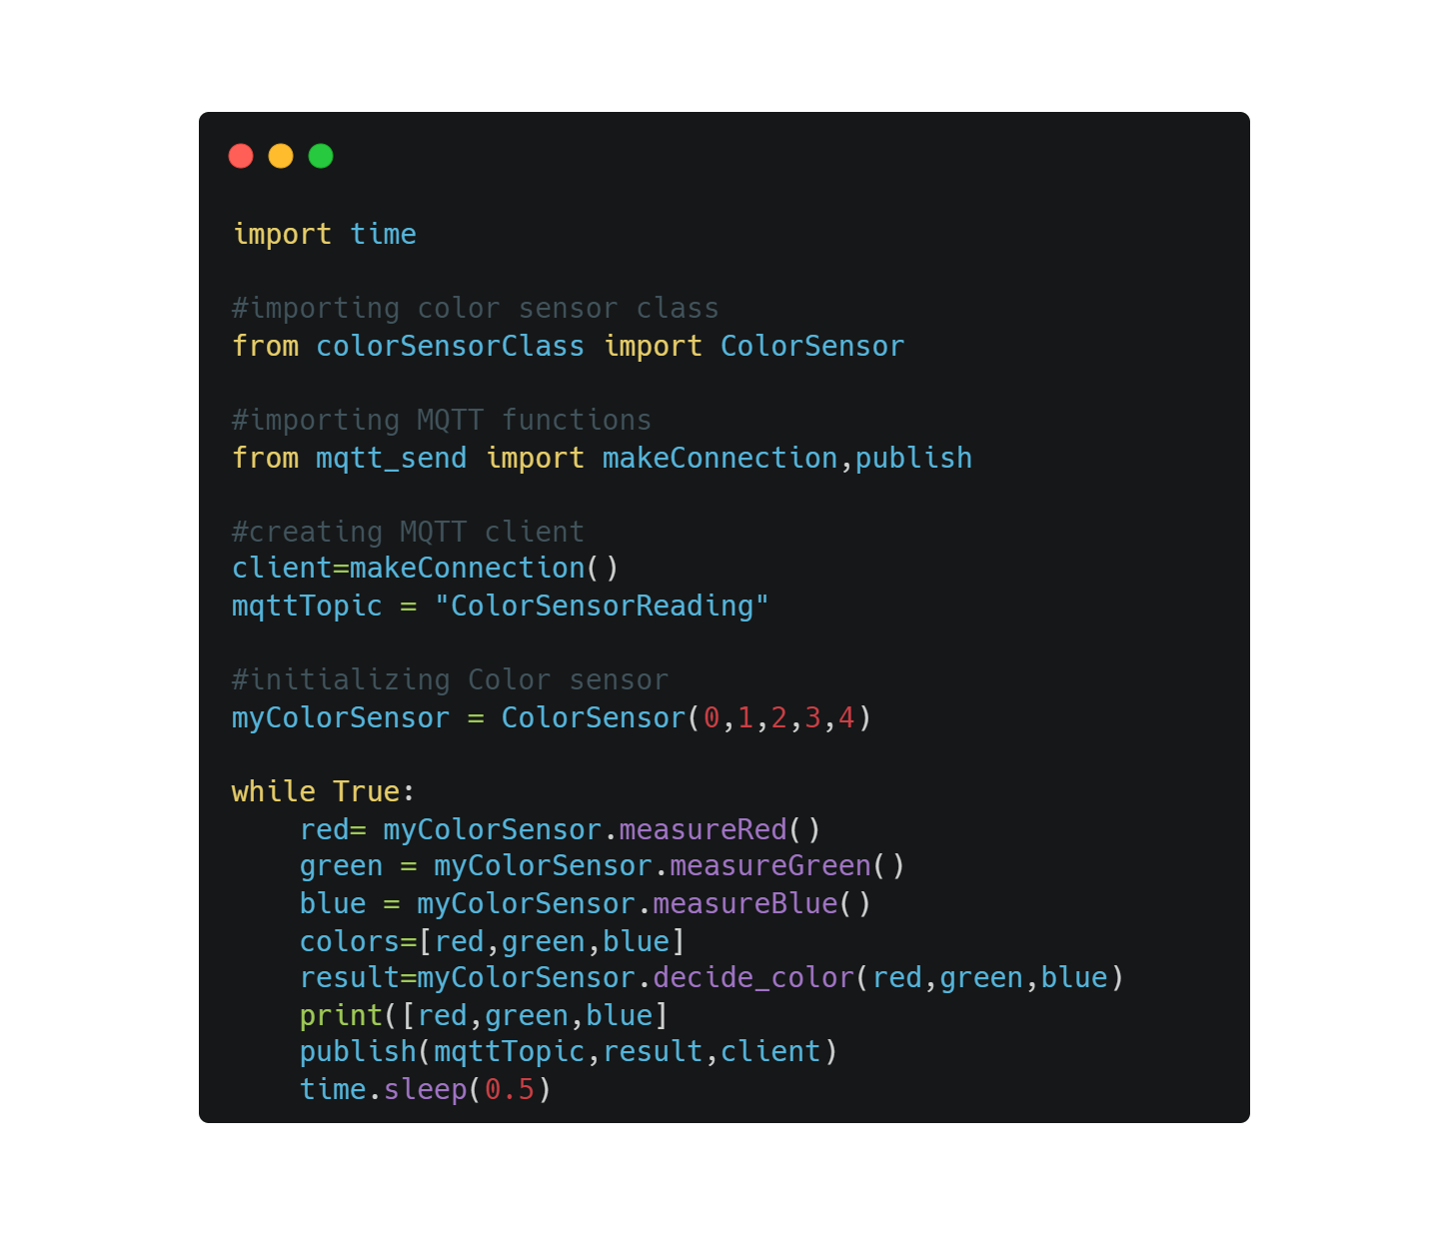
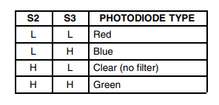
Color Sensor
makeConnection
Publish
Pins
measureRed
measureGreen
measureBlue
Decide_color

Slide 4
Importing libraries for MQTT, BLYNK, time and motor usage
R
O
B
O
T
I
C
-Declaring global for color sensor readings and message from conveyor belt
-Callbacks from for color sensor and conveyor belt topic and message
A
R
M
-Making connection to the MQTT
-Defining motors angles and speed
-Subscribing to conveyor belt
loop
-When conveyor belt sends a message, the robotic arm goes to conveyor belt and picks the cube
- The robotic arm place the cube on top of the color sensor
When the cube is blue, the robotic arm sorts it in the box, otherwise it goes to the conveyor belt again

Slide 5
-Importing libraries for MQTT and WLAN
-Defining the pins for the motor driver, WLAN and MQTT status
C
O
N
V
E
Y
O
R
-Connecting to WiFi and MQTT broker
-Subscribing to BoxDetection
B
E
L
T
loop
-if the MQTT is not connected yet, LED for MQTT status is low and the conveyor belt is static
-When no message from the ultrasonic is received, the conveyor belt moves, otherwise it will remain stop until the ultrasonic allows it

Slide 6
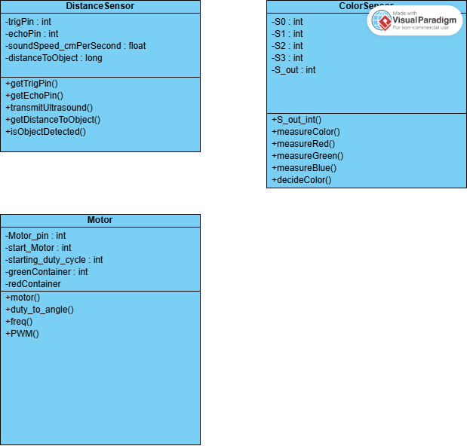
Class diagrams
Conveyer belt
-dirPin : int
-stepPin : int
+move : void
+stop : void

Slide 7
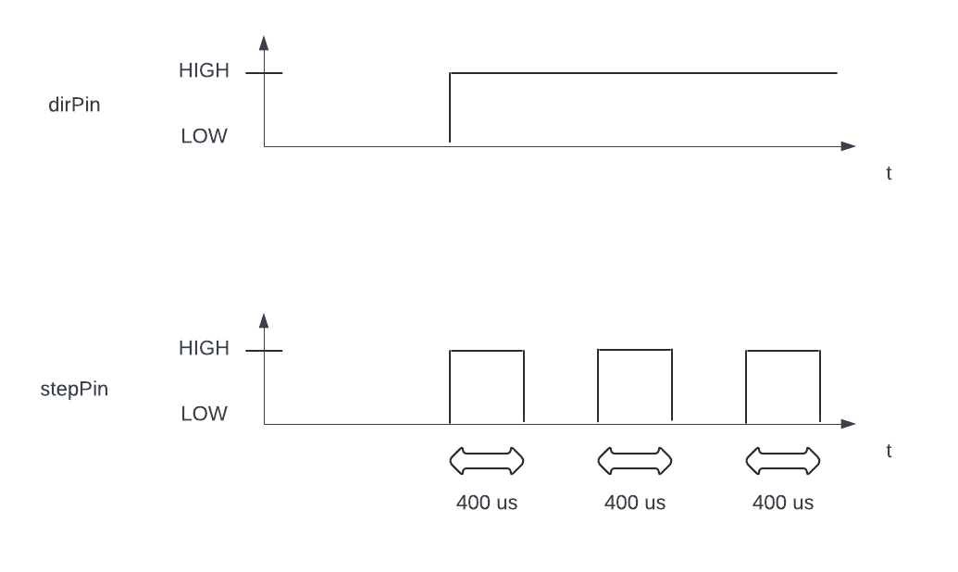
Conveyor belt motor

Slide 8
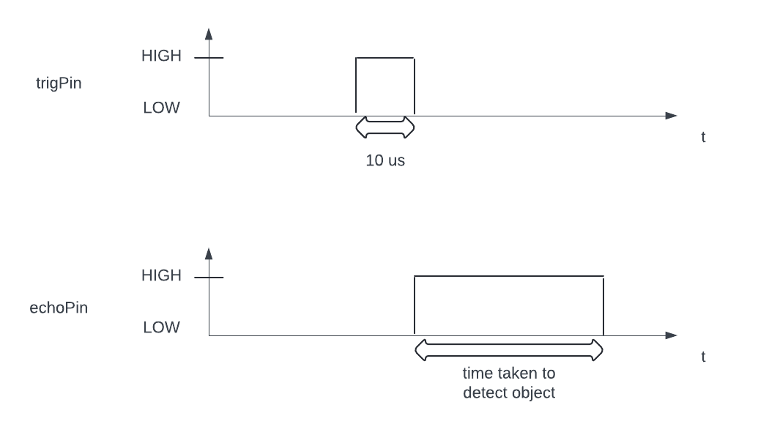
Distance sensor (HC-SR04)

