Slide 1
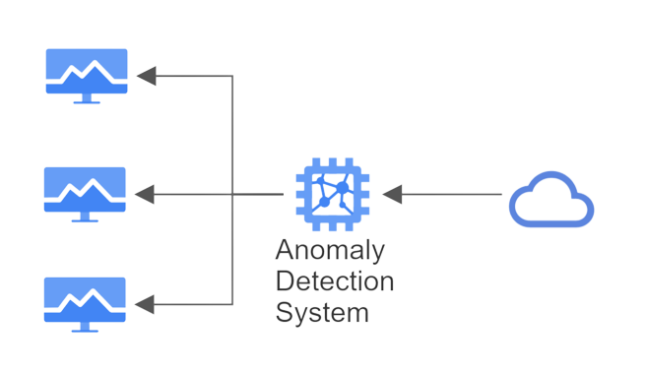

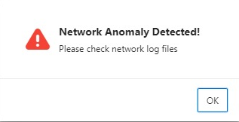
Network Anomaly Detection
IT & Mobile Security
David Goricanec
A binary classification system which monitors network traffic
Deep learning with PyTorch
Trained by the NSL-KDD Dataset
116 parameters used for classification
Alerts user in case of anomalies

