Slide 1
（10）导航实践

Slide 2
导航定位仿真
路径规划
配置你的机器人

Slide 3
导航定位仿真

Slide 4
仿真配置：
stage_ros
amcl
move_base
map_server
配置文件：
catkin_create_pkg navigation_tutorials
navigation_tutorials
--src
--launch
--move_base_config
--stage_config
--rviz_config
--CMakeLists.txt
--package.xml

Slide 5
move_base_config/amcl_node.xml
<launch>
<node pkg="amcl" type="amcl" name="amcl" respawn="true">
<remap from="scan" to="base_scan" />
<!-- Publish scans from best pose at a max of 10 Hz -->
<param name="odom_model_type" value="omni"/>
<param name="odom_alpha5" value="0.1"/>
<param name="transform_tolerance" value="0.2" />
<param name="laser_model_type" value="likelihood_field"/> <param name="odom_frame_id" value="odom"/>
<param name="resample_interval" value="1"/>
.............................
</node>
</launch>

Slide 6
move_base_config/base_local_planner_params.yaml
TrajectoryPlannerROS:
acc_lim_th: 3.2
acc_lim_x: 2.5
acc_lim_y: 2.5
max_vel_x: 0.65
min_vel_x: 0.1
max_rotational_vel: 1.0
min_in_place_rotational_vel: 0.4
escape_vel: -0.1
holonomic_robot: true
y_vels: [-0.3, -0.1, 0.1, -0.3]
xy_goal_tolerance: 0.1
yaw_goal_tolerance: 0.05
sim_time: 1.7
sim_granularity: 0.025
vx_samples: 3
vtheta_samples: 20
.......................................

Slide 7
move_base_config/local_costmap_params.yaml
local_costmap:
publish_voxel_map: true
global_frame: odom
robot_base_frame: base_link
update_frequency: 5.0
................
move_base_config/global_costmap_params.yaml
global_costmap:
global_frame: /map
robot_base_frame: base_link
update_frequency: 5.0
publish_frequency: 0.0
static_map: true
rolling_window: false
footprint_padding: 0.02
move_base_config/costmap_common_params.yaml
map_type: voxel
.............
observation_sources: base_scan
base_scan: {data_type: LaserScan, expected_update_rate: 0.4,
observation_persistence: 0.0, marking: true, clearing: true, max_obstacle_height: 0.4, min_obstacle_height: 0.08}

Slide 8
move_base_config/slam_gmapping.xml
<launch>
<node pkg="gmapping" type="slam_gmapping" name="slam_gmapping" output="screen">
<remap from="scan" to="base_scan"/>
<param name="odom_frame" value="odom"/>
<param name="map_update_interval" value="30.0"/> #How long (in seconds) between updates to the map
<param name="maxUrange" value="16.0"/> #The maximum usable range of the laser.
<param name="sigma" value="0.05"/>#The sigma used by the greedy endpoint matching
<param name="kernelSize" value="1"/>
<param name="lstep" value="0.05"/>
<param name="astep" value="0.05"/>
<param name="iterations" value="5"/> #The number of iterations of the scanmatcher
<param name="lsigma" value="0.075"/>#The sigma of a beam used for likelihood computation
<param name="ogain" value="3.0"/>
<param name="lskip" value="0"/>
<param name="srr" value="0.01"/>
<param name="srt" value="0.02"/>

Slide 9
<param name="str" value="0.01"/>
<param name="stt" value="0.02"/>
<param name="linearUpdate" value="0.5"/>#Process a scan each time the robot translates this far
<param name="angularUpdate" value="0.436"/>#Process a scan each time the robot rotates this far
<param name="temporalUpdate" value="-1.0"/>
<param name="resampleThreshold" value="0.5"/>
<param name="particles" value="80"/>
<param name="xmin" value="-50.0"/> #Initial map size
<param name="ymin" value="-50.0"/>
<param name="xmax" value="50.0"/>
<param name="ymax" value="50.0"/>
<param name="delta" value="0.025"/>#Resolution of the map
<param name="llsamplerange" value="0.01"/>
<param name="llsamplestep" value="0.01"/>
<param name="lasamplerange" value="0.005"/>
<param name="lasamplestep" value="0.005"/>
</node>
</launch>

Slide 10
move_base_config/move_base.xml
<launch>
<node pkg="move_base" type="move_base" respawn="false" name="move_base_node" output="screen">
<param name="footprint_padding" value="0.01" />
<param name="controller_frequency" value="10.0" />
<param name="controller_patience" value="3.0" />
<param name="oscillation_timeout" value="30.0" />
<param name="oscillation_distance" value="0.5" />
<rosparam file="$(find navigation_tutorials)/move_base_config/costmap_common_params.yaml" command="load" ns="global_costmap" />
<rosparam file="$(find navigation_tutorials)/move_base_config/costmap_common_params.yaml" command="load" ns="local_costmap" />
<rosparam file="$(find navigation_tutorials)/move_base_config/local_costmap_params.yaml" command="load" />
<rosparam file="$(find navigation_tutorials)/move_base_config/global_costmap_params.yaml" command="load" />
<rosparam file="$(find navigation_tutorials)/move_base_config/base_local_planner_params.yaml" command="load" />
</node>
</launch>

Slide 11
launch/move_base_amcl.launch
<launch>
<master auto="start"/>
<param name="/use_sim_time" value="true"/>
<include file="$(find navigation_tutorials)/move_base_config/move_base.xml"/>
<node name="map_server" pkg="map_server" type="map_server" args="$(find navigation_tutorials)/stage_config/maps/willow-full-0.025.pgm 0.025" respawn="false" />
<node pkg="stage_ros" type="stageros" name="stageros" args="$(find navigation_tutorials)/stage_config/worlds/willow-pr2-2.5cm.world" respawn="false" >
<param name="base_watchdog_timeout" value="0.2"/>
</node>
<include file="$(find navigation_tutorials)/move_base_config/amcl_node.xml"/>
<node name="rviz" pkg="rviz" type="rviz" args="-d $(find navigation_tutorials)/rviz_config/single_robot.rviz" />
</launch>

Slide 12
launch/move_base_gmapping.launch
<launch>
<master auto="start"/>
<param name="/use_sim_time" value="true"/>
<include file="$(find navigation_tutorials)/move_base_config/move_base.xml"/>
<node pkg="stage_ros" type="stageros" name="stageros" args="$(find navigation_tutorials)/stage_config/worlds/willow-pr2-2.5cm.world" respawn="false" >
<param name="base_watchdog_timeout" value="0.2"/>
</node>
<include file="$(find navigation_tutorials)/move_base_config/slam_gmapping.xml"/>
<node name="rviz" pkg="rviz" type="rviz" args="-d $(find navigation_tutorials)/rviz_config/single_robot.rviz" />
</launch>

Slide 13
CMakeLists.txt
cmake_minimum_required(VERSION 2.8.3)
project(navigation_tutorials)
find_package(catkin REQUIRED)
catkin_package()

Slide 14
package.xml
<?xml version="1.0"?>
<package>
<name>navigation_tutorials</name>
<version>0.2.3</version>
<description>
This package holds example launch files for running the ROS navigation stack in stage.
</description>
<license>BSD</license>
<buildtool_depend>catkin</buildtool_depend>
<run_depend>amcl</run_depend>
<run_depend>gmapping</run_depend>
<run_depend>map_server</run_depend>
<run_depend>move_base</run_depend>
<run_depend>stage_ros</run_depend>
</package>

Slide 15
路径规划

Slide 16
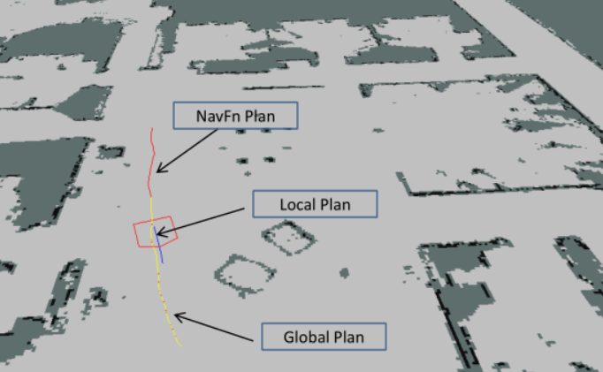
目标导航
MoveBaseAction：
geometry_msgs/PoseStamped target_pose
---
---
geometry_msgs/PoseStamped base_position
路径规划
GetPlan服务
geometry_msgs/PoseStamped start
geometry_msgs/PoseStamped goal
float32 tolerance
---
nav_msgs/Path plan

Slide 17
配置你的机器人

Slide 18
导航launch文件
<?xml version="1.0"?>
<launch>
<master auto="start"/>
<!-- Run the map server -->
<node name="map_server" pkg="map_server" type="map_server" args="$(find my_map_package)/my_map.pgm my_map_resolution"/>
<!--- Run AMCL -->
<include file="$(find amcl)/examples/amcl_omni.launch" />
<node pkg="move_base" type="move_base" respawn="false" name="move_base" output="screen">
<rosparam file="$(find my_robot_name_2dnav)/costmap_common_params.yaml" command="load" ns="global_costmap" />
<rosparam file="$(find my_robot_name_2dnav)/costmap_common_params.yaml" command="load" ns="local_costmap" />
<rosparam file="$(find my_robot_name_2dnav)/local_costmap_params.yaml" command="load" />
<rosparam file="$(find my_robot_name_2dnav)/global_costmap_params.yaml" command="load" />
<rosparam file="$(find my_robot_name_2dnav)/base_local_planner_params.yaml" command="load" />
</node>
</launch>

