Slide 1
(11)gazebo

Slide 2
Gazebo概述
Turtlebot in Gazebo
Turtlebot Navigation

Slide 3
Gazebo概述

Slide 4
Gazebo特性
Dynamics Simulation
直接控制物理引擎参数
Building Editor
无需代码即可在Gazebo中创建机器人模型
Advanced 3D Graphics
提高真实性
Sensors
提供激光雷达，摄像头，RGBD摄像头，IMU等传感器
Robot Models
提供多种机器人模型，包括PR2, iRobot，Create, TurtleBot, 机械臂，灵巧手等
Environments
提供多种模拟环境
Programmatic Interfaces
支持ROS，API接口

Slide 5
Gazebo构架
服务器:
执行物理循环，生成传感器数据
执行文件: gzserver
Libraries: Physics, Sensors, Rendering, Transport
客户端:
提供用户交互和可视化仿真
执行文件: gzclient
Libraries: Transport, Rendering, GUI

Slide 6
运行gazebo
单独运行server和client
gzserver
gzclient
同时运行gazebo server和client
gazebo
从ROS中启动
rosrun gazebo_ros gazebo
故障排除
1.服务器进程无法启动
ps ax | grep [g]z
kill
2.找不到models
cd ~/.gazebo
mkdir models
在https://bitbucket.org/osrf/gazebo_models/downloads下载models
解压到models

Slide 7
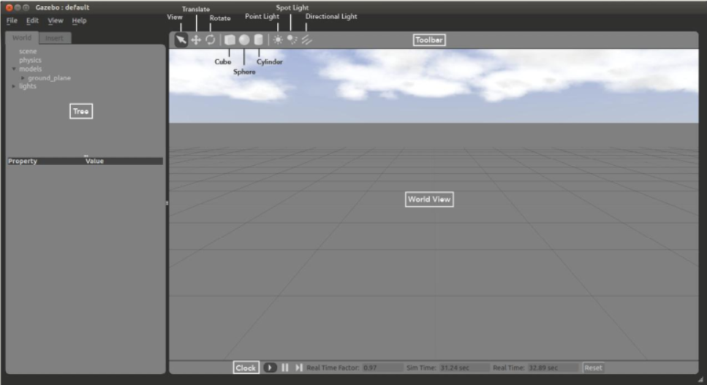
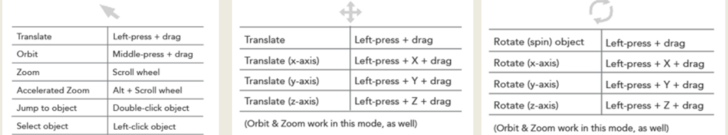

Slide 8
Gazebo empty_world.launch文件
<launch>
<!-- these are the arguments you can pass this launch file, for example paused:=true -->
<arg name="paused" default="false"/>
<arg name="use_sim_time" default="true"/>
<arg name="extra_gazebo_args" default=""/>
<arg name="gui" default="true"/>
<arg name="headless" default="false"/>
<arg name="debug" default="false"/>
<arg name="world_name" default="worlds/empty.world"/> <!-- Note: the world_name is with respect to GAZEBO_RESOURCE_PATH environmental variable -->
<!-- set use_sim_time flag -->
<group if="$(arg use_sim_time)">
<param name="/use_sim_time" value="true" />
</group>

Slide 9
<!-- set command arguments -->
<arg unless="$(arg paused)" name="command_arg1" value=""/>
<arg if="$(arg paused)" name="command_arg1" value="-u"/>
<arg unless="$(arg headless)" name="command_arg2" value=""/>
<arg if="$(arg headless)" name="command_arg2" value="-r"/>
<arg unless="$(arg verbose)" name="command_arg3" value=""/>
<arg if="$(arg verbose)" name="command_arg3" value="--verbose"/>
<arg unless="$(arg debug)" name="script_type" value="gzserver"/>
<arg if="$(arg debug)" name="script_type" value="debug"/>
<!-- start gazebo server-->
<node name="gazebo" pkg="gazebo_ros" type="$(arg script_type)" respawn="false" output="screen"
args="$(arg command_arg1) $(arg command_arg2) $(arg command_arg3) -e $(arg physics) $(arg extra_gazebo_args) $(arg world_name)" />
<!-- start gazebo client -->
<group if="$(arg gui)">
<node name="gazebo_gui" pkg="gazebo_ros" type="gzclient" respawn="false" output="screen"/>
</group>
</launch>

Slide 10
willowgarage_world.launch
<launch>
<!-- We resume the logic in empty_world.launch, changing only the name of the world to be launched -->
<include file="$(find gazebo_ros)/launch/empty_world.launch">
<arg name="world_name" value="worlds/willowgarage.world"/> <!-- Note: the world_name is with respect to GAZEBO_RESOURCE_PATH environmental variable -->
<arg name="paused" value="false"/>
<arg name="use_sim_time" value="true"/>
<arg name="gui" value="true"/>
<arg name="headless" value="false"/>
<arg name="debug" value="false"/>
</include>
</launch>

Slide 11
willowgarage.world
<?xml version="1.0" ?>
<sdf version="1.4">
<world name="default">
<include>
<uri>model://ground_plane</uri>
</include>
<include>
<uri>model://sun</uri>
</include>
<include>
<uri>model://willowgarage</uri>
</include>
</world>
</sdf>

Slide 12
Turtlebot in Gazebo

Slide 13
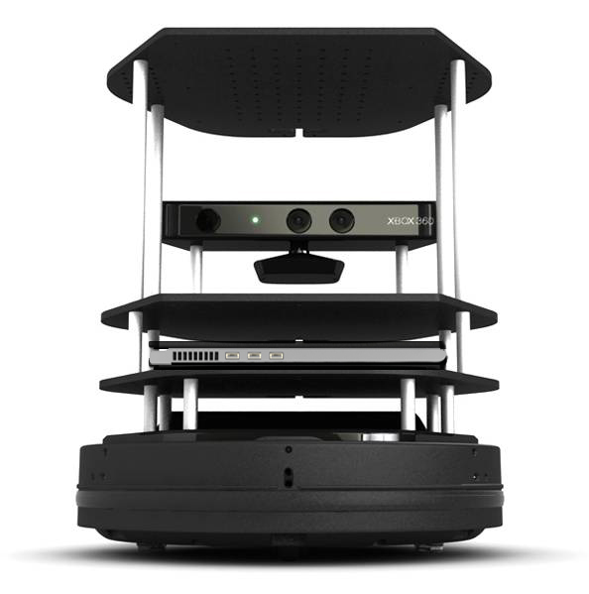
安装：
sudo apt-get install ros-indigo-turtlebot-gazebo ros-indigo-turtlebot-apps
运行：
roslaunch turtlebot_gazebo turtlebot_world.launch
roslaunch turtlebot_teleop keyboard_teleop.launch

Slide 14
turtlebot_description/urdf/turtlebot_gazebo.urdf.xacro
<?xml version="1.0"?>
<robot name="turtlebot_gazebo" xmlns:xacro="http://ros.org/wiki/xacro">
<!-- Microsoft Kinect / ASUS Xtion PRO Live for simulation -->
<xacro:macro name="turtlebot_sim_3dsensor">
<gazebo reference="camera_link">
<sensor type="depth" name="camera">
<always_on>true</always_on>
<update_rate>20.0</update_rate>
<camera>
<horizontal_fov>${60.0*M_PI/180.0}</horizontal_fov>
<image>
<format>R8G8B8</format>
<width>640</width>
<height>480</height>
</image>
<clip>
<near>0.05</near>
<far>8.0</far>
</clip>
</camera>
<plugin name="kinect_camera_controller" filename="libgazebo_ros_openni_kinect.so">

Slide 15
<cameraName>camera</cameraName>
<alwaysOn>true</alwaysOn>
<updateRate>10</updateRate>
<imageTopicName>rgb/image_raw</imageTopicName>
<depthImageTopicName>depth/image_raw</depthImageTopicName>
<pointCloudTopicName>depth/points</pointCloudTopicName>
<cameraInfoTopicName>rgb/camera_info</cameraInfoTopicName>
<depthImageCameraInfoTopicName>depth/camera_info</depthImageCameraInfoTopicName>
<frameName>camera_depth_optical_frame</frameName>
<baseline>0.1</baseline>
<distortion_k1>0.0</distortion_k1>
<distortion_k2>0.0</distortion_k2>
<distortion_k3>0.0</distortion_k3>
<distortion_t1>0.0</distortion_t1>
<distortion_t2>0.0</distortion_t2>
<pointCloudCutoff>0.4</pointCloudCutoff>
</plugin>
</sensor>
</gazebo>
</xacro:macro>
</robot>

Slide 16
URDF生成
rosrun gazebo_ros spawn_model -file `rospack find [robot_description_package]`/urdf/myrobot.urdf -urdf -x 0 -y 0 -z 1 -model myrobot
Turtlebot base_launch.xml(部分)
<arg name="urdf_file" default="$(find xacro)/xacro.py '$(find turtlebot_description)/robots/$(arg base)_$(arg stacks)_$(arg 3d_sensor).urdf.xacro'" />
<param name="robot_description" command="$(arg urdf_file)" />
<!-- Gazebo model spawner -->
<node name="spawn_turtlebot_model" pkg="gazebo_ros" type="spawn_model"
args="$(optenv ROBOT_INITIAL_POSE) -unpause -urdf -param robot_description -model turtlebot"/>
<node pkg="robot_pose_ekf" type="robot_pose_ekf" name="robot_pose_ekf">
<remap from="imu_data" to="turtlebot_node/imu/data"/>
<remap from="robot_pose_ekf/odom" to="odom_combined"/>
...........
</node>

Slide 17
Turtlebot Navigation

Slide 18
turtlebot_amcl.launch
<launch>
<arg name="world_file" default="$(env TURTLEBOT_GAZEBO_WORLD_FILE)"/>
<arg name="base" value="$(optenv TURTLEBOT_BASE kobuki)"/> <!-- create, roomba -->
<arg name="gui" default="true"/>
<arg name="3d_sensor" value="$(optenv TURTLEBOT_3D_SENSOR kinect)"/> <!-- kinect, asus_xtion_pro -->
<include file="$(find gazebo_ros)/launch/empty_world.launch">
<arg name="use_sim_time" value="true"/>
<arg name="debug" value="false"/>
<arg name="gui" value="$(arg gui)" />
<arg name="world_name" value="$(arg world_file)"/>
</include>
<include file="$(find turtlebot_gazebo)/launch/includes/$(arg base).launch.xml">
<arg name="base" value="$(arg base)"/>
<arg name="stacks" value="$(arg stacks)"/>
<arg name="3d_sensor" value="$(arg 3d_sensor)"/>
</include>
<node pkg="robot_state_publisher" type="robot_state_publisher" name="robot_state_publisher">
<param name="publish_frequency" type="double" value="30.0" />
</node>

Slide 19
<node pkg="nodelet" type="nodelet" name="laserscan_nodelet_manager" args="manager"/>
<node pkg="nodelet" type="nodelet" name="depthimage_to_laserscan"
args="load depthimage_to_laserscan/DepthImageToLaserScanNodelet laserscan_nodelet_manager">
<param name="scan_height" value="10"/>
<param name="output_frame_id" value="/camera_depth_frame"/>
<param name="range_min" value="0.45"/>
<remap from="image" to="/camera/depth/image_raw"/>
<remap from="scan" to="/scan"/>
</node>
<arg name="map_file" default="$(env TURTLEBOT_GAZEBO_MAP_FILE)"/>
<node name="map_server" pkg="map_server" type="map_server" args="$(arg map_file)" />
<!-- Localization -->
<arg name="initial_pose_x" default="0.0"/>
<arg name="initial_pose_y" default="0.0"/>
<arg name="initial_pose_a" default="0.0"/>
<include file="$(find turtlebot_navigation)/launch/includes/amcl.launch.xml">
<arg name="initial_pose_x" value="$(arg initial_pose_x)"/>
<arg name="initial_pose_y" value="$(arg initial_pose_y)"/>
<arg name="initial_pose_a" value="$(arg initial_pose_a)"/>
</include>
<include file="$(find turtlebot_navigation)/launch/includes/move_base.launch.xml">
</include>
</launch>

Slide 20
turtlebot_gmapping
turtlebot_walk
catkin_create_pkg turtlebot_walk std_msgs rospy roscpp

