Slide 1
（五）ROS仿真

Slide 2
stage simulator
Rviz

Slide 3
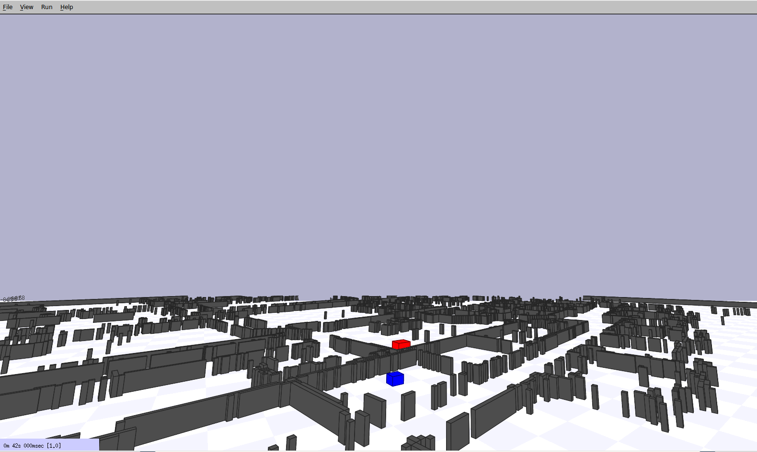
stage simulator
world文件
Actuator model
Blinkenlight model
Blobfinder model
Camera model
Fiducial detector model
Gripper model
Position model
Ranger model
Wifi model

Slide 4
Ranger model
ranger
(
sensor (
pose [ x y z a ]
size [ x y z ]
fov a
range [min max]
)
watts 2.0
color_rgba [ 0 1 0 0.15 ]
)
Blobfinder model
blobfinder
(
colors_count 0
colors [ ]
image[ 80 60 ]
range 12.0
fov 3.14159/3.0
pan 0.0
size [ 0.0 0.0 0.0 ]
)
Position model
position
(
drive "diff"
velocity [ 0.0 0.0 0.0 0.0 ]
localization "gps"
localization_origin [ <defaults to model's start pose> ]
odom_error [0.03 0.03 0.00 0.05]
wheelbase 1.0
velocity_bounds [-1 1 -1 1 -1 1 -90 90 ]
acceleration_bounds [-1 1 -1 1 -1 1 -90 90]
)

Slide 5
订阅的主题
/cmd_vel (geometry_msgs/Twist)
发布的主题
/odom (nav_msgs/Odometry)
/base_scan (sensor_msgs/LaserScan)
/base_pose_ground_truth (nav_msgs/Odometry)
/image (sensor_msgs/Image)
/depth (sensor_msgs/Image)
/camera_info (sensor_msgs/CameraInfo)
提供的tf
base_link → base_laser
base_footprint → base_link
odom → base_footprint
base_link → camera

Slide 6
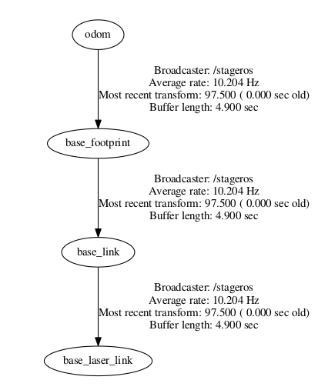
控制机器人运动
sudo apt-get install ros-indigo-teleop-twist-keyboard
rosrun teleop_twist_keyboard teleop_twist_keyboard.py
简单的gmapping&保存map
rosrun gmapping slam_gmapping scan:=base_scan
rosrun map_server map_saver

Slide 7
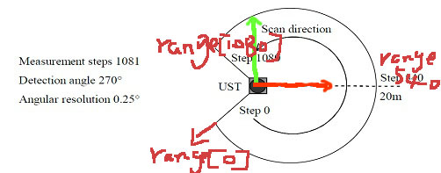
激光雷达应用：障碍物检测
sensor_msgs/LaserScan.msg
std_msgs/Header header
float32 angle_min
float32 angle_max
float32 angle_increment
float32 time_increment
float32 scan_time
float32 range_min
float32 range_max
float32[] ranges
float32[] intensities

Slide 8
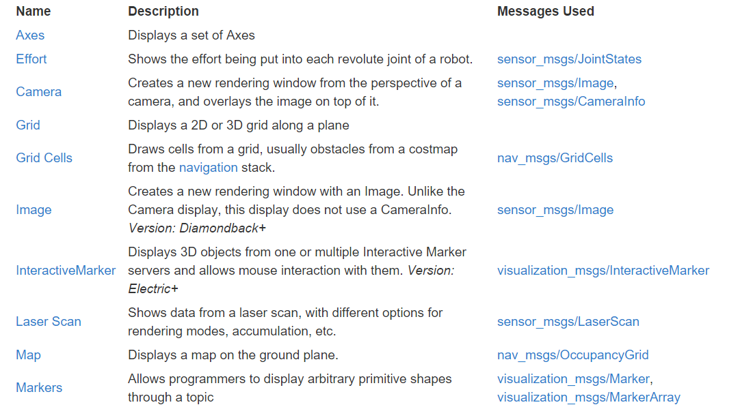
Rviz属性

Slide 9
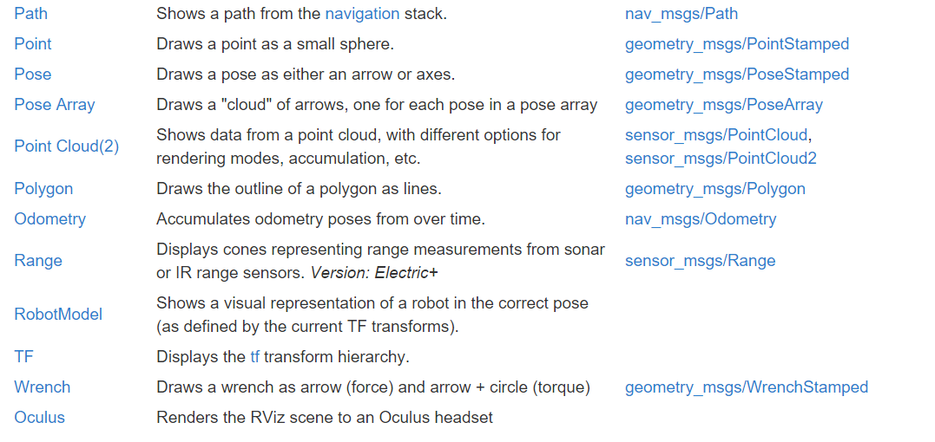

Slide 10
turtlebot_stage in Rviz
安装：sudo apt-get install ros-indigo-turtlebot-simulator
运行：roslaunch turtlebot_stage turtlebot_in_stage.launch
troubleshooting
Invalid <arg> tag: environment variable 'TURTLEBOT_STAGE_MAP_FILE' is not set.
Arg xml is <arg default=" $(env TURTLEBOT_STAGE_MAP_FILE)" name="map_file"/>
The traceback for the exception was written to the log file
export TURTLEBOT_STAGE_WORLD_FILE="/opt/ros/indigo/share/turtlebot_stage/maps/stage/maze.world"
export TURTLEBOT_STAGE_MAP_FILE="/opt/ros/indigo/share/turtlebot_stage/maps/maze.yaml"
运行指定的Rviz文件
rosrun rviz rviz -d `rospack find stage_ros`/rviz/stage.rviz

Slide 11
stage_ros gmapping
<launch>
<node name="stage" pkg="stage_ros" type="stageros" args="$(find
stage_ros)/world/willow-erratic.world"/>
<node name="gmapping" pkg="gmapping" type="slam_gmapping">
<param name="scan" value="base_scan"/>
</node>
<node name="rviz" pkg="rviz" type="rviz" args="$(find
stage_ros)/rviz/stage.rviz"/>
</launch>
在Rviz中载入地图
<launch>
<arg name="map_file" default="$(find my_package)/maps/willow-full-
0.05.pgm"/>
<!-- Run the map server -->
<node name="map_server" pkg="map_server" type="map_server" args="$(arg
map_file) 0.05" />
</launch>

