Slide 1
(6)ROS与传感器

Slide 2
Kinect
Ladar
Arduino
发布传感器信息（fake sensor）

Slide 3
Kinect

Slide 4
安装：
sudo apt-get install ros-indigo-openni-camera
sudo apt-get install ros-indigo-openni-launch
驱动
https://github.com/avin2/SensorKinect
安装方法：
进入目录 "Platform/Linux/CreateRedist".
运行脚本 "./RedistMaker".
之后会在"Platform/Linux/Redist"目录下创建一个redist包
进入"Platform/Linux/Redist"，运行"sudo ./install.sh"
运行
roslaunch openni_launch openni.launch

Slide 5
Ladar

Slide 6
安装rplidar
驱动
https://github.com/robopeak/rplidar_ros
catkin_make
运行：
roslaunch rplidar_ros rplidar.launch
注意事项：
在运行之前需要修改port的权限
sudo chmod 777 ttyUSB0

Slide 7
Arduino

Slide 8
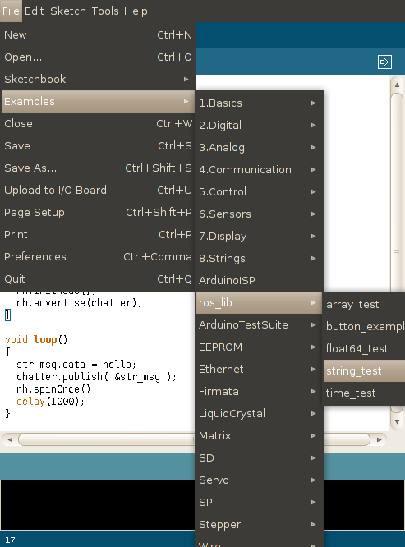
安装
sudo apt-get install ros-indigo-rosserial-arduino
sudo apt-get install ros-indigo-rosserial
cd <ws>/src
git clone https://github.com/ros-drivers/rosserial.git
cd <ws>
catkin_make
cd <sketchbook>/libraries
rm -rf ros_lib
rosrun rosserial_arduino make_libraries.py .

Slide 9
发布传感器信息（fake sensor）

Slide 10
fake odometry
nav_msgs/Odometry.msg数据结构
Header header
string child_frame_id
geometry_msgs/PoseWithCovariance pose
geometry_msgs/TwistWithCovariance twist
fake laser

