Slide 1
SLAM&Gmapping

Slide 2
slam_gmapping&hector_gmapping
实践

Slide 3
slam_gmapping与hector_gmapping

Slide 4
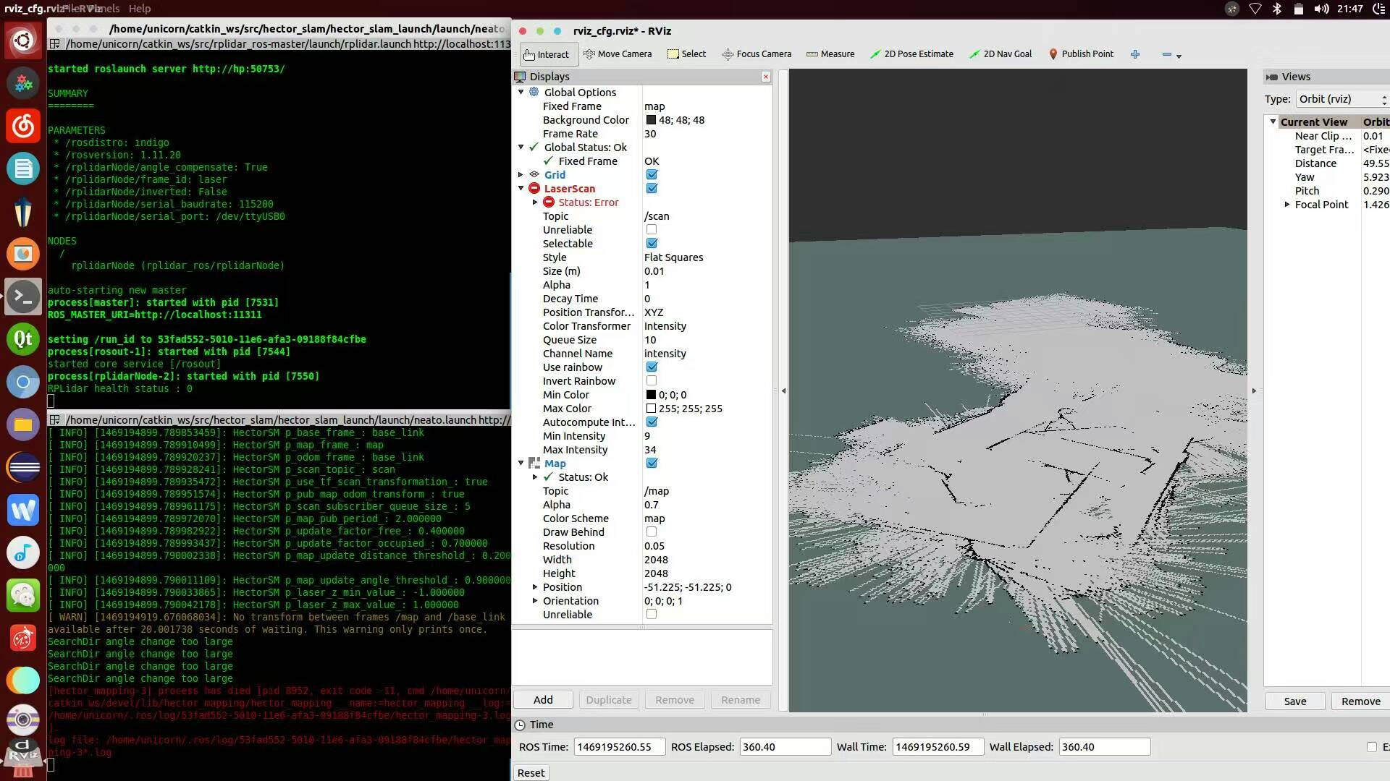
gmapping
根据激光数据（或者深度数据模拟的激光数据）建立地图。
SLAM
机器人在未知环境中从一个未知位置开始移动,在移动过程中根据位置估计和地图进行自身定位,同时在自身定位的基础上建造增量式地图。

Slide 5
/map_metadata nav_msgs/MapMetaData.msg
time map_load_time
float32 resolution
uint32 width
uint32 height
geometry_msgs/Pose origin
map /nav_msgs/OccupancyGrid.msg
std_msgs/Header header
nav_msgs/MapMetaData info
int8[] data
dynamic_map/ nav_msgs/GetMap.srv
nav_msgs/OccupancyGrid map

Slide 6
 | slam_gmapping | hector_mapping
订阅主题 | scan tf | scan
发布主题 | map_metadata map | map_metadata map slam_out_pose poseupdate
服务 | dynamic_map | dynamic_map
要求的tf变换 | base_laser → base_link base_link → odom | base_laser → base_frame
提供的tf变换 | map → odom | map → odom
优点 | 定位准确 | 定位不够准确
缺点 | 需要完整硬件平台支持 | 手持激光雷达即可实现

Slide 7
实现gmapping
硬件要求
A配置：激光雷达，移动机器人平台，里程计（slam_gmapping，move base）
B配置：激光雷达（hector_gmapping）
C配置：RGBD摄像头（hector_gmapping）

Slide 8
B配置实现gmapping
配置文件
git https://github.com/tu-darmstadt-ros-pkg/hector_slam.git
在~/catkin_ws/src/hector_slam/hector_slam_launch/launch/新建一个demo.launch
<?xml version="1.0"?>
<launch>
<include file="$(find rplidar_ros)/launch/rplidar.launch"/>
<node pkg="tf" type="static_transform_publisher" name="map_to_odom" args="0.0 0.0 0.0 0 0 0.0 /odom /base_link 10"/>
<node pkg="tf" type="static_transform_publisher" name="base_frame_laser" args="0 0 0 0 0 0 /base_link /laser 10"/>
<!--<node pkg="rviz" type="rviz" name="rviz"
args="-d $(find hector_slam_launch)/rviz_cfg/mapping_demo.rviz"/>-->
<include file="$(find hector_mapping)/launch/mapping_default.launch"/>
<node pkg="rviz" type="rviz" name="rviz" args="-d rviz_cfg.rviz"/>
<include file="$(find hector_geotiff)/launch/geotiff_mapper.launch"/>
</launch>

Slide 9
修改~/catkin_ws/src/hector_slam/hector_mapping/launch/mapping_default.launch
<?xml version="1.0"?>
<launch>
<arg name="tf_map_scanmatch_transform_frame_name" default="/scanmatcher_frame"/>
<arg name="base_frame" default="base_link"/>
<arg name="odom_frame" default="base_link"/>
<arg name="pub_map_odom_transform" default="true"/>
<arg name="scan_subscriber_queue_size" default="5"/>
<arg name="scan_topic" default="scan"/>
<arg name="map_size" default="2048"/>
<node pkg="hector_mapping" type="hector_mapping" name="hector_mapping" output="screen">
<!-- Frame names -->
<param name="map_frame" value="map" />
<param name="base_frame" value="$(arg base_frame)" />
<param name="odom_frame" value="$(arg base_frame)" />
<!-- Tf use -->
<param name="use_tf_scan_transformation" value="true"/>
<param name="use_tf_pose_start_estimate" value="false"/>
<param name="pub_map_odom_transform" value="$(arg pub_map_odom_transform)"/>

Slide 10
<!-- Map size / start point -->
<param name="map_resolution" value="0.050"/>
<param name="map_size" value="$(arg map_size)"/>
<param name="map_start_x" value="0.5"/>
<param name="map_start_y" value="0.5" />
<param name="map_multi_res_levels" value="2" />
<!-- Map update parameters -->
<param name="update_factor_free" value="0.4"/>
<param name="update_factor_occupied" value="0.7" />
<param name="map_update_distance_thresh" value="0.2"/>
<param name="map_update_angle_thresh" value="0.9" />
<param name="laser_z_min_value" value = "-1.0" />
<param name="laser_z_max_value" value = "1.0" />
<!-- Advertising config -->
<param name="advertise_map_service" value="true"/>
<param name="scan_subscriber_queue_size" value="$(arg scan_subscriber_queue_size)"/>
<param name="scan_topic" value="$(arg scan_topic)"/>
<param name="tf_map_scanmatch_transform_frame_name" value="$(arg tf_map_scanmatch_transform_frame_name)" />
</node>
</launch>

Slide 11
修改rplidar驱动文件
在rplidar_ros/src/node.cpp中找到
nh_private.param<std::string>("frame_id", frame_id, "laser_frame");
将其改成：
nh_private.param<std::string>("frame_id", frame_id, "laser");
编译后运行：
roslaunch hector_slam_launch demo.launch

Slide 12
实践

Slide 13
B配置实际导航

