Slide 1
(9)导航基础知识

Slide 2
导航概述
规划器
代价地图
Move base
AMCL

Slide 3
导航概述

Slide 4
硬件需求
虽然导航功能包集被设计成尽可能的通用，在使用时仍然有三个主要的硬件限制：
它是为差分驱动的完全约束的轮式机器人设计的。它假设移动基站受到理想的运动命令的控制并可实现预期的结果，命令的格式为：x速度分量，y速度分量，角速度(theta)分量。
它需要在移动基站上安装一个平面二维激光。这个激光用于构建地图和定位。
导航功能包集是为正方形的机器人开发的，所以方形或圆形的机器人将是性能最好的。 它也可以工作在任意形状和大小的机器人上，但是较大的矩形机器人将很难通过狭窄的空间，例如门道。

Slide 5
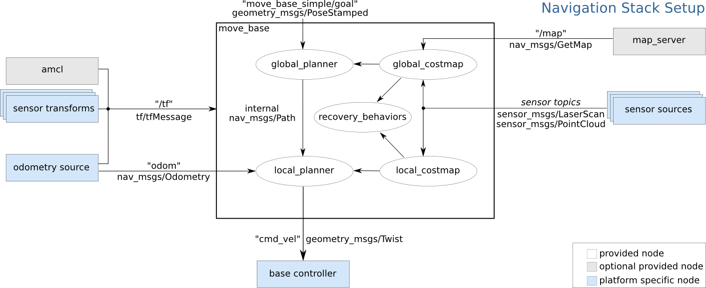
ROS导航包集

Slide 6
导航包主要内容
软件包 | 解释
map_server | 以ROS服务的形式提供地图数据
gmapping | 基于激光的SLAM（持续定位与建图）
amcl | 概率定位系统
global_planner | 用于导航的快速全局规划实现，接受costmap生成的 global costmap 规划出从起始点到目标点的路径，为local_planner作出参考。
local_planner | 用于导航的局部规划实现，以及避障，接受costmap 生成的local costmap 规划出速度
move_base | 连接global_planner和local_planner共同完成导航
costmap_2d | 由传感器得到的不同的数据被处理成统一的格式：栅格地图，权值用经过概率方法处理过的，表示空间中障碍物，未知与安全区域。生成出来的costmap则是planner 的输入。
recovery_behavior | 规定move_base 行为集合中处理异常情况的行为

Slide 7
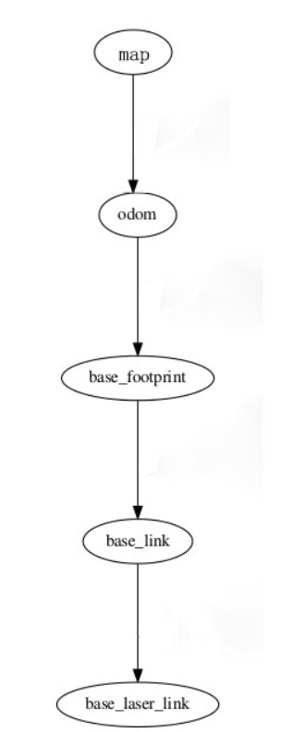
导航包框架
frame | 解释
/map | 地图上的固定坐标系，世界坐标系，Rviz中的FixedFrame
/odom | 只使用里程计信息得到的自洽坐标系
/base_footprint | 机器人底座坐标系
/base_link | 机器人底座旋转中心的坐标系
/base_laser_link | 激光雷达坐标系

Slide 8
规划器

Slide 9
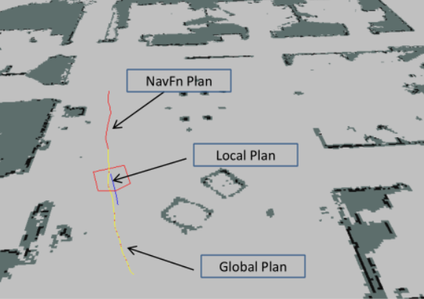
Local Planner
Local Planner为局部导航了提供Trajectory Rollout和Dynamic Window Approach算法，给定的规划和代价地图后，控制器便能产生速度控制指令给机器人基座。
基本局部规划器配置
robot configuration parameters
goal tolerance parameters
forward simulation parameters
trajectory scoring parameters
oscillation prevention parameters
global plan parameters
发布的主题
global_plan (nav_msgs/Path)
local_plan (nav_msgs/Path)
cost_cloud (sensor_msgs/PointCloud2)
订阅的主题
odom (nav_msgs/Odometry)

Slide 10
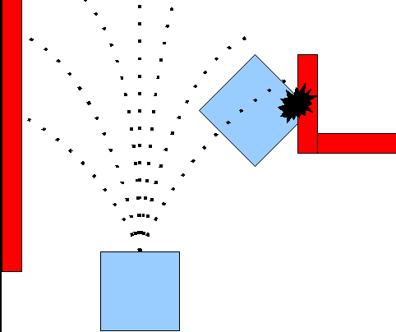
Trajectory Rollout和Dynamic Window Approach算法的基本思想
1） 采样机器人当前的状态（dx,dy,dtheta）；
2） 针对每个采样的速度，计算机器人以该速度模拟行驶一段时间后的状态，得出一条行驶的路线；
3） 利用一些评价标准为多条路线打分（如与障碍物，目标等的接近度），丢弃不可行的路线；
4） 根据打分，选择最优路径；
5） 重复上面过程。
在实际应用中，尽管两者的实际表现相似，但是我们采用DWA算法，因为
它采样的区域小，相对来说更加有效一些。

Slide 11
base_local_planner.yaml
TrajectoryPlannerROS:
#机器人加速度限制
acc_lim_th: 3.2
acc_lim_x: 2.5
acc_lim_y: 2.5
#机器人速度限制
max_vel_x: 0.65
min_vel_x: 0.1
max_rotational_vel: 1.0
min_in_place_rotational_vel: 0.4 就地旋转
#当机器人卡住时退出速度
escape_vel: -0.1
#是否为全向轮，false为差分轮
holonomic_robot: true
#因为我们设定为全向轮，这里设定y轴速度
y_vels: [-0.3, -0.1, 0.1, -0.3]
#到达目标的容差
xy_goal_tolerance: 0.1
yaw_goal_tolerance: 0.05

Slide 12
base_local_planner.yaml（续）
sim_time: 1.7
sim_granularity: 0.025 #给定路径点间的步长
vx_samples: 3 #x轴速度方向上取样的数量
vtheta_samples: 20 #theta速度方向上取样的数量
#Parameters for scoring trajectories
pdist_scale: 0.6控制器与给定路线距离远近的权重
gdist_scale: 0.8控制器到达局部目标以及控制速度偏差的权重
occdist_scale: 0.01控制器如何避免障碍物的权重
heading_lookahead: 0.325为不同就地旋转路线打分时应参考的前方距离
dwa: true
#How far the robot must travel before oscillation flags are reset
oscillation_reset_dist: 0.05晃动标签被重置之前机器人应该移动的距离
#Eat up the plan as the robot moves along it
prune_plan: true 1m之后减掉

Slide 13
Global Planner
在机器人运动之前，根据给定的目标位置进行总体路径的规划，为navigation的全局规划器，接受costmap生成的 global costmap 规划出从起始点到目标点的路径，为local_planner作出参考。 NavFn 为路径规划提供了快速插值的导航功能
发布的主题
plan (nav_msgs/Path)

Slide 14
代价地图

Slide 15
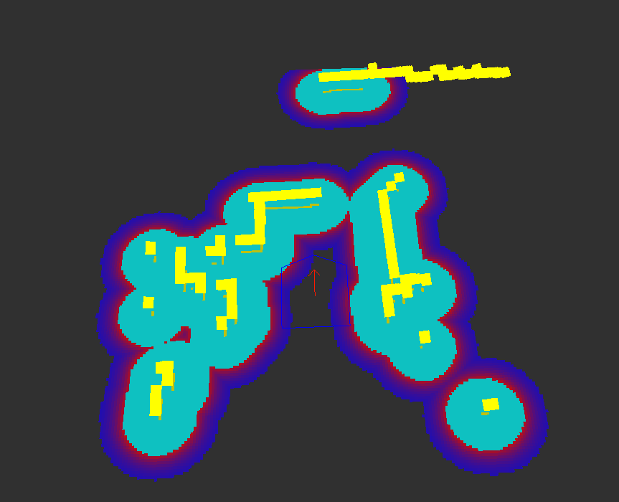
代价地图
代价地图是一种基于环境的覆盖网格地图（occupancy grid map）和用户指定膨胀系数，表示安全区域的栅格；在ROS中，有两种类型的代价地图，分别是Global costmap 和 Local costmap
订阅的主题
footprint (geometry_msgs/Polygon)
发布的主题
grid (nav_msgs/OccupancyGrid)
grid_updates (map_msgs/OccupancyGridUpdate)
voxel_grid (costmap_2d/VoxelGrid)

Slide 16
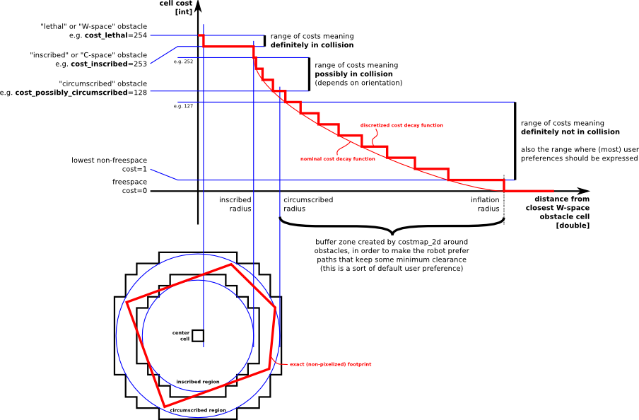
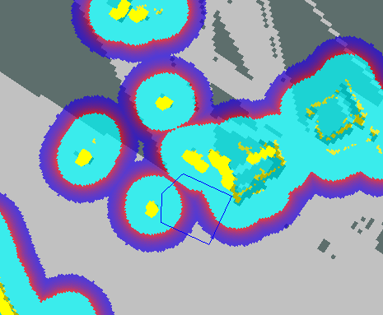
膨胀
更新地图
update_frequency参数指定代价地图更新
地图的频率
在每一轮循环中：
传感器数据输入
在代价地图中标记和清除障碍物信息
在代价地图中为覆盖结构赋恰当值，代价地图中每一个
单元有一个整数值，0表示空区域，255表示未知区域，
每个单元的障碍物膨胀用LETHAL_OBSTACLE 参数的
值表示

Slide 17
代价地图参数文件
costmap_common_params.yaml
global_costmap_params.yaml
local_costmap_params.yaml

Slide 18
costmap_common_params.yaml
#支持 "voxel" 和 "costmap" 两种类型 with the difference between them being a 3D-view of the world vs. a 2D-view of the world.
map_type: voxel
#Voxel grid specific parameters costmap parameter only：track_unknown_space (bool, default: false)
origin_z: 0.0
z_resolution: 0.2
z_voxels: 10
unknown_threshold: 9 The number of unknown cells allowed in a column considered to be "known"
mark_threshold: 0 The maximum number of marked cells allowed in a column considered to be "free".
#Set the tolerance we're willing to have for tf transforms
transform_tolerance: 0.3 Specifies the delay in transform (tf) data that is tolerable in seconds
#Obstacle marking parameters
obstacle_range: 2.5 引入障碍物到代价地图的传感器读数的最大范围 机器人只会更新以其底盘为中心半径2.5米内的障碍信息
max_obstacle_height: 2.0障碍物高于2m将写入代价地图中should set to be slightly higher than the height of your robot.
raytrace_range: 3.0 确定的空白区域内光线追踪的范围。 设置为3.0米意味着机器人将试图根据传感器读数清除其前面3.0米远的空间
#The footprint of the robot and associated padding
footprint: [[-0.325, -0.325], [-0.325, 0.325], [0.325, 0.325], [0.46, 0.0], [0.325, -0.325]]
footprint_padding: 0.01 内边距
#Cost function parameters
inflation_radius: 0.55 膨胀半径设定在0.55米意味着机器人所有路径与障碍物保持0.55米或更的远离
cost_scaling_factor: 10.0
#The cost at which a cell is considered an obstacle when a map is read from the map_server
lethal_cost_threshold: 100
#Configuration for the sensors that the costmap will use to update a map
observation_sources: base_scan
base_scan: {data_type: LaserScan, expected_update_rate: 0.4,
observation_persistence: 0.0, marking: true, clearing: true, max_obstacle_height: 0.4, min_obstacle_height: 0.08}

Slide 19
global_costmap_params.yaml
global_costmap:
#Set the global and robot frames for the costmap
global_frame: /map
robot_base_frame: base_link
#Set the update and publish frequency of the costmap
update_frequency: 5.0
publish_frequency: 0.0 The frequency in Hz for the map to be publish display information.
#We'll use a map served by the map_server to initialize this costmap
static_map: true If the rolling_window parameter is set to true, this parameter must be set to false.
rolling_window: false
footprint_padding: 0.02

Slide 20
local_costmap_params.yaml
local_costmap:
#We'll publish the voxel grid used by this costmap
publish_voxel_map: true
#Set the global and robot frames for the costmap
global_frame: odom
robot_base_frame: base_link
#Set the update and publish frequency of the costmap
update_frequency: 5.0
publish_frequency: 2.0
#We'll configure this costmap to be a rolling window... meaning it is always
#centered at the robot
static_map: false
rolling_window: true
width: 6.0 The width of the map in meters.
height: 6.0
resolution: 0.025
origin_x: 0.0 The x origin of the map in the global frame in meters.
origin_y: 0.0

Slide 21
move base

Slide 22
move base
订阅的主题
move_base_simple/goal (geometry_msgs/PoseStamped)
发布的主题
cmd_vel (geometry_msgs/Twist)
动作订阅主题
move_base/goal (move_base_msgs/MoveBaseActionGoal)
move_base/cancel (actionlib_msgs/GoalID)
动作发布主题
move_base/feedback (move_base_msgs/MoveBaseActionFeedback)
move_base/status (actionlib_msgs/GoalStatusArray)
move_base/result (move_base_msgs/MoveBaseActionResult)
服务
~make_plan (nav_msgs/GetPlan)

Slide 23
move_base.xml
<launch>
<node pkg="move_base" type="move_base" respawn="false" name="move_base_node" output="screen">
<param name="footprint_padding" value="0.01" />
<param name="controller_frequency" value="10.0" /> The rate in Hz at which to run the control loop and send velocity commands to the base.
<param name="controller_patience" value="3.0" /> How long the controller will wait in seconds without receiving a valid control before space-clearing operations are performed.
<param name="oscillation_timeout" value="30.0" /> How long in seconds to allow for oscillation before executing recovery behaviors.
<param name="oscillation_distance" value="0.5" />How far in meters the robot must move to be considered not to be oscillating.
<rosparam file="$(find navigation_stage)/move_base_config/costmap_common_params.yaml" command="load"
ns="global_costmap" />
<rosparam file="$(find navigation_stage)/move_base_config/costmap_common_params.yaml" command="load"
ns="local_costmap" />
<rosparam file="$(find navigation_stage)/move_base_config/local_costmap_params.yaml" command="load" />
<rosparam file="$(find navigation_stage)/move_base_config/global_costmap_params.yaml" command="load" />
<rosparam file="$(find navigation_stage)/move_base_config/base_local_planner_params.yaml" command="load" />
</node>
</launch>

Slide 24
AMCL

Slide 25
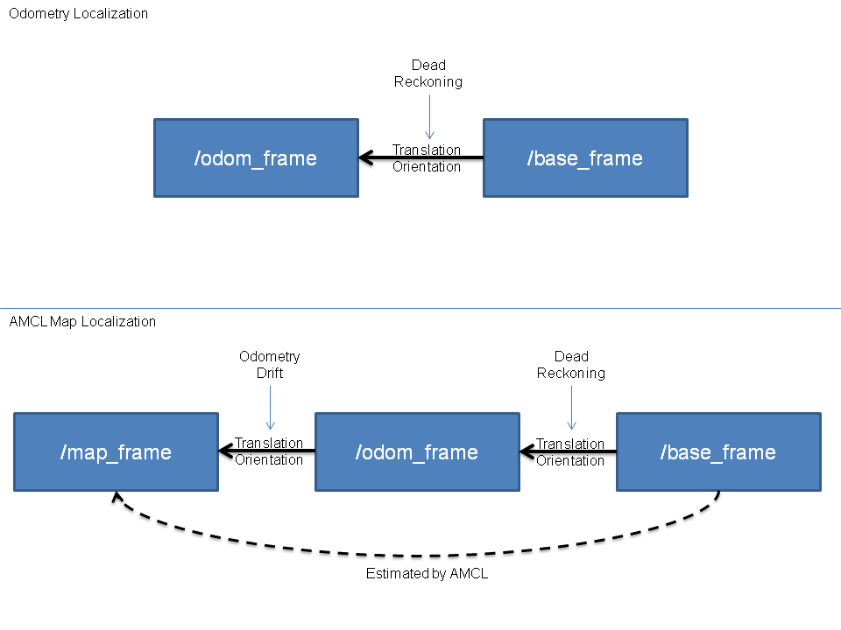
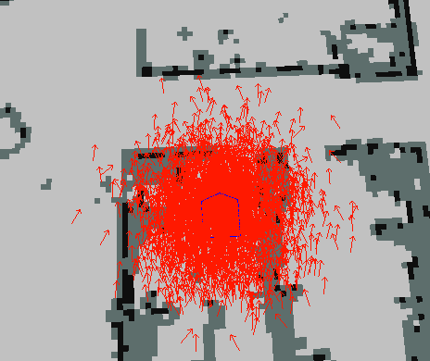
AMCL
amcl是移动机器人二维环境下的概率定位系统。它实现了自适应的蒙特卡罗定位方法，针对已有的地图使用粒子滤波器跟踪机器人的姿态
订阅的主题
scan (sensor_msgs/LaserScan)
tf (tf/tfMessage)
initialpose(geometry_msgs/PoseWithCovarianceStamped)
map (nav_msgs/OccupancyGrid)
发布的主题
amcl_pose (geometry_msgs/PoseWithCovarianceStamped)
particlecloud (geometry_msgs/PoseArray)
tf (tf/tfMessage)

Slide 26
AMCL参数：
Overall filter parameters
Laser model parameters
Note that whichever mixture weights are in use should sum to 1. The beam model uses all 4: z_hit, z_short, z_max, and z_rand. The likelihood_field model uses only 2: z_hit and z_rand.
Odometery model parameters
If ~odom_model_type is "diff" then we use the sample_motion_model_odometry algorithm from Probabilistic Robotics，this model uses the noise parameters odom_alpha_1 through odom_alpha4
If ~odom_model_type is "omni" then we use a custom model for an omni-directional base, which uses odom_alpha_1 through odom_alpha_5. The meaning of the first four parameters is similar to that for the "diff" model. The fifth parameter capture the tendency of the robot to translate (without rotating) perpendicular to the observed direction of travel.

Slide 27
amcl_node.xml <launch> <!-- Example amcl configuration. Descriptions of parameters, as well as a full list of all amcl parameters, can be found at http://www.ros.org/wiki/amcl. --> <node pkg="amcl" type="amcl" name="amcl" respawn="true"> <remap from="scan" to="base_scan" /> <!-- Publish scans from best pose at a max of 10 Hz --> <param name="odom_model_type" value="omni"/> <param name="odom_alpha5" value="0.1"/> <param name="transform_tolerance" value="0.2" /> <param name="gui_publish_rate" value="10.0"/>Maximum rate (Hz) at which scans and paths are published for visualization, -1.0 to disable. <param name="laser_max_beams" value="30"/> <param name="min_particles" value="500"/> <param name="max_particles" value="5000"/> <param name="kld_err" value="0.05"/> Maximum error between the true distribution and the estimated distribution. <param name="kld_z" value="0.99"/>Upper standard normal quantile for (1 - p), where p is the probability that the error on the estimated distrubition will be less than kld_err. <param name="odom_alpha1" value="0.2"/> <param name="odom_alpha2" value="0.2"/>

Slide 28
<param name="odom_alpha3" value="0.8"/> <param name="odom_alpha4" value="0.2"/> <param name="laser_z_hit" value="0.5"/> <param name="laser_z_short" value="0.05"/> <param name="laser_z_max" value="0.05"/> <param name="laser_z_rand" value="0.5"/> <param name="laser_sigma_hit" value="0.2"/> <param name="laser_lambda_short" value="0.1"/> <param name="laser_lambda_short" value="0.1"/> <param name="laser_model_type" value="likelihood_field"/> <!-- <param name="laser_model_type" value="beam"/> --> <param name="laser_likelihood_max_dist" value="2.0"/> <param name="update_min_d" value="0.2"/> <param name="update_min_a" value="0.5"/> <param name="odom_frame_id" value="odom"/> <param name="resample_interval" value="1"/>Number of filter updates required before resampling. <param name="transform_tolerance" value="0.1"/>Time with which to post-date the transform that is published, to indicate that this transform is valid into the future. <param name="recovery_alpha_slow" value="0.0"/>Exponential decay rate for the slow average weight filter, used in deciding when to recover by adding random poses. A good value might be 0.001. <param name="recovery_alpha_fast" value="0.0"/> </node> </launch>

