Slide 1
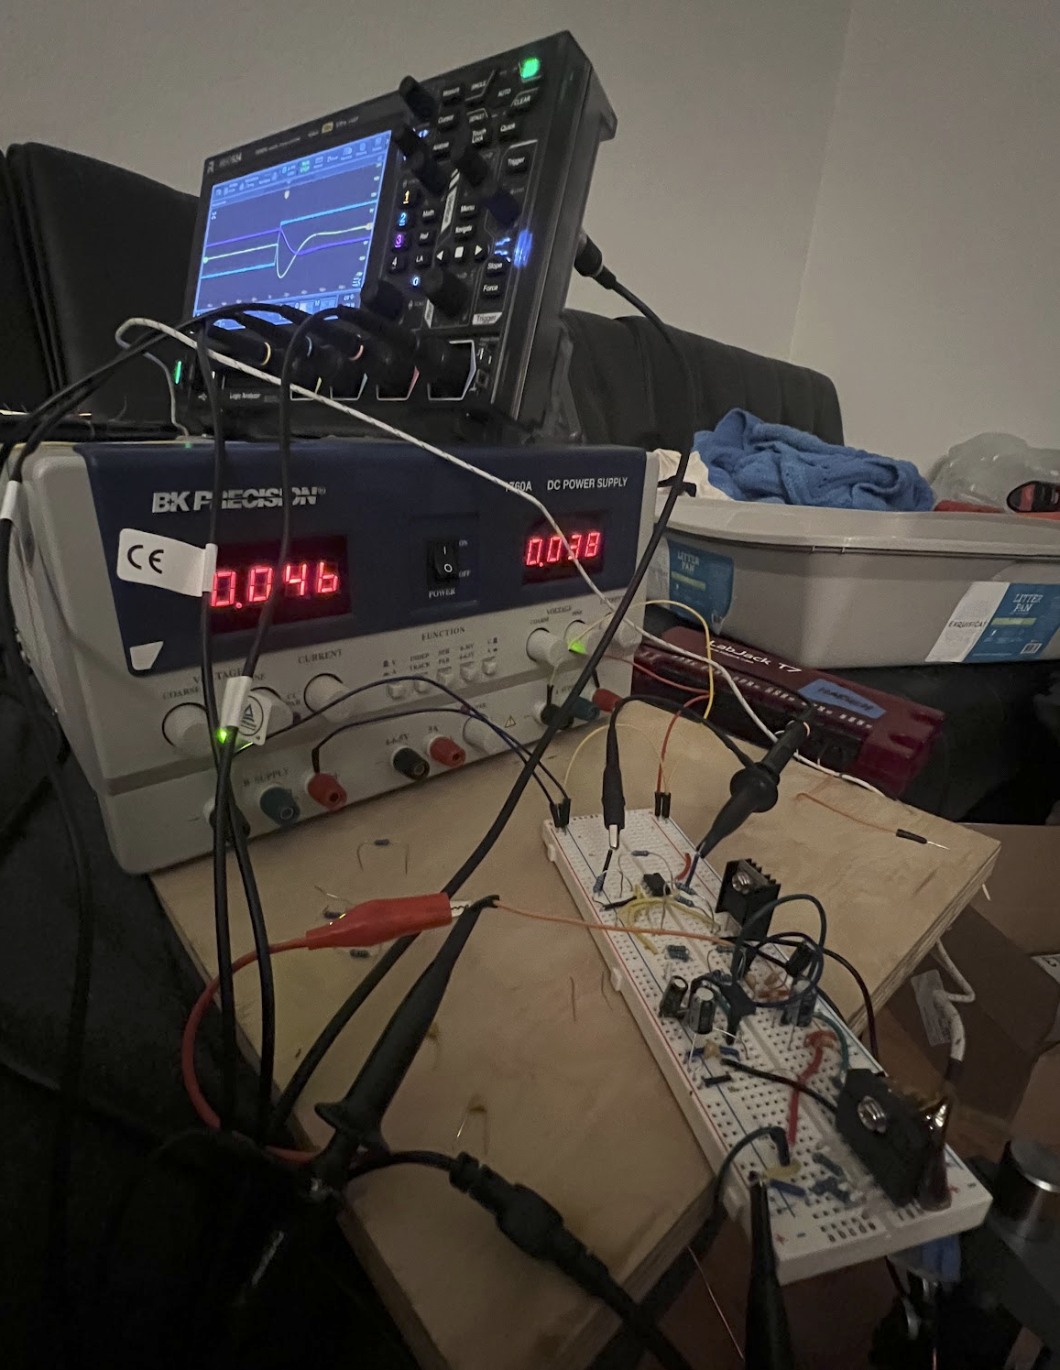
Rigol MHO934
Scope + Func. Gen
BK 1760A
Linear Power Supply
+/-30V 2A
Ch3/Pink
Shunt
Resistor
Current Feedback Diff Amp
LM3886
Ch2/Cyan
PI Filter
Ch1/Yellow
Actuator (Load)

