Slide 1

Academy 2015 –SOAP Web Services

Slide 2
Disclaimer
Document Name: ACADEMY 2015 – SOAP WEB SERVICES
Data Classification: INTERNAL
Disclaimer
The contents of this document are property of Softtek, and are classified as Confidential. Any reproduction in whole or in part is strictly prohibited without the written permission of Softtek.
This document is subject to change. Comments, corrections or questions should be directed to the author.
Audience/Viewership | Purpose
Java Academy trainees | Training
Revision Chart
The following chart list the revisions made to this document. Use this to describe the changes and additions each time this document is re-published. The description should be detailed as possible and include the names of the reviewers who request the changes.
Version No. | Version Date | Types of Changes | Owner/Author | Date of Review/Expiration
1.0 | 14-10-2015 | Initial draft | Jose Antonio Hernandez Vazquez

Slide 3
1 SOAP Web Services in nutshell

Slide 4
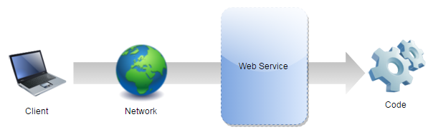
What are Web Services?
A web service is a network accessible interface to application functionality, built using standard Internet technologies.

Slide 5
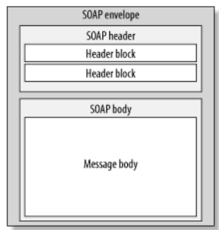
What are SOAP Web Services?
SOAP is stand for Simple Object Access Protocol.
SOAP Web services are web services which use a standardized XML messaging system (SOAP).

Slide 6
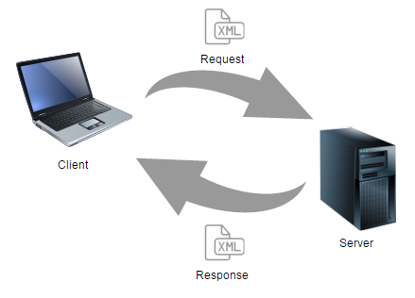
How does SOAP Web Services work?

Slide 7
Characteristics
XML based protocol.
Loosely coupled.
Interoperability.
Simple and extensible.
Neutrality.

Slide 8
2 Architecture

Slide 9
Components
WSDL.
XSD.
SOAP request and SOAP response.
Provider.
Consumer.
UDDI.

Slide 10
WSDL
Web Service Description Language.
Lists all operations available in the service as well as all required parameters.
Provides all necessary information to consume the web service.
Is a contract for clients defined inside an XML file.

Slide 11
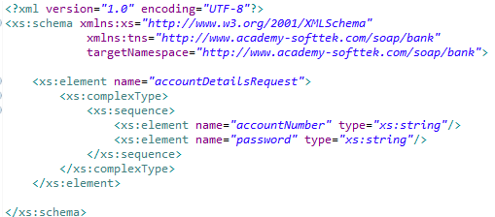
XSD
XML Schema Definition.
Describes the structure of an XML document.
Define the legal building blocks of an XML document.

Slide 12
SOAP request and response
Data sent to server and retrieved from server.
Data in XML format which follows SOAP protocol.
Contains the following elements:
Element | Description | Required
Envelope | Identifies the XML document as a SOAP message. | Yes
Header | Contains header information. | No
Body | Contains call, and response information. | Yes
Fault | Provides information about errors that occurred while processing the message. | No

Slide 13
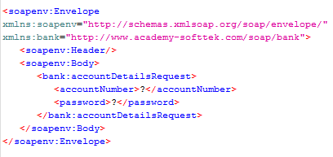
SOAP request example

Slide 14
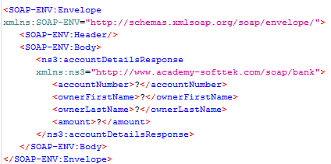
SOAP response example

Slide 15
Provider
SOAP Provider is a software system that process the request and provide the response.
Exposes services to be consumed by the clients.

Slide 16
Consumer
The software system that requests data.

Slide 17
UDDI
Universal Description, Discovery and Integration.
Registry based on XML to list services on the Internet, and a mechanism to register and locate web service applications.

Slide 18
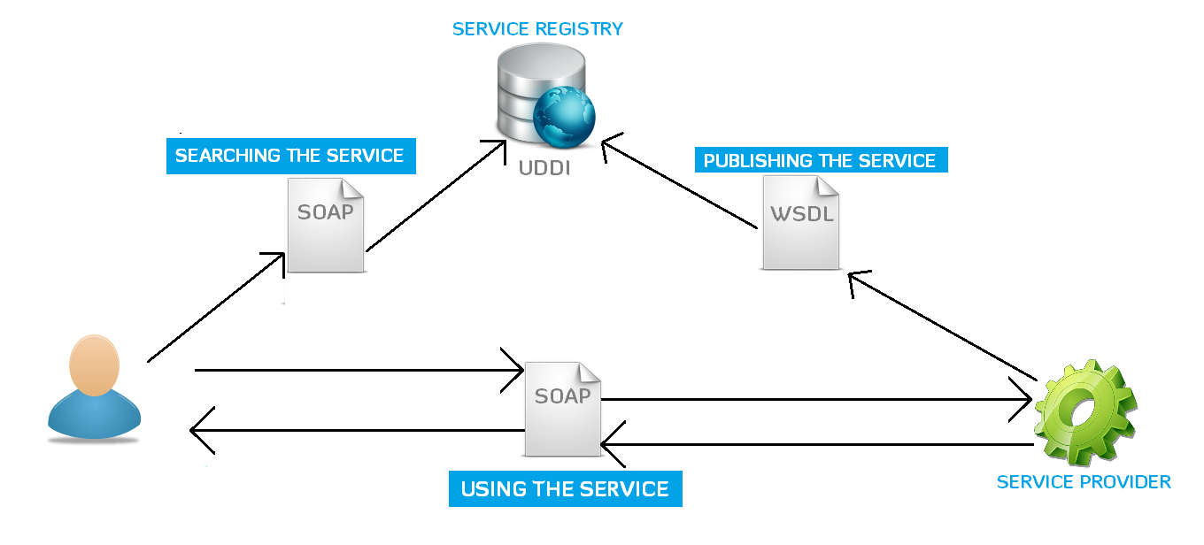
Architecture

Slide 19
3 Spring Web Service

Slide 20
Spring WS
Spring Web Services facilitates contract-first SOAP web service development.
Allows the creation of flexible web services using one of the many ways to manipulate XML payloads.
Based on JAX-WS.

Slide 21
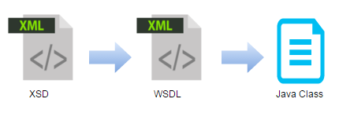
Contract-first
When using contract-first, you start with the WSDL contract, and use Java to implement said contract.
WSDL is based on XSD.
When using contract-first, you explicitly describe what XML is sent where, thus making sure that it is exactly what you want.

Slide 22
4 Writing Contract-First Web Services

Slide 23
Writing Contract-First Web Services
The most important thing when doing contract-first Web service development is to try and think in terms of XML.
Define XML messages (request and response).
Define format and rules for messages (XSD).
Define contract for service (WSDL). Based on the XSD.
Spring-WS can create the WSDL for you.
Implementing Endpoint.
Publishing WSDL.
Consume Web Service.

Slide 25
The End

Slide 26
References
Official Spring WS page
http://projects.spring.io/spring-ws/

