Slide 1

Academy 2015 –SOAP Web Services

Slide 2
Disclaimer
Document Name: ACADEMY 2015 – SOAP WEB SERVICES
Data Classification: INTERNAL
Disclaimer
The contents of this document are property of Softtek, and are classified as Confidential. Any reproduction in whole or in part is strictly prohibited without the written permission of Softtek.
This document is subject to change. Comments, corrections or questions should be directed to the author.
Audience/Viewership | Purpose
Java Academy trainees | Training
Revision Chart
The following chart list the revisions made to this document. Use this to describe the changes and additions each time this document is re-published. The description should be detailed as possible and include the names of the reviewers who request the changes.
Version No. | Version Date | Types of Changes | Owner/Author | Date of Review/Expiration
1.0 | 14-10-2015 | Initial draft | Jose Antonio Hernandez Vazquez

Slide 3
1 SOAP Web Services in nutshell

Slide 4
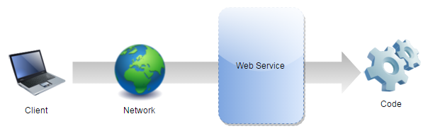
What are Web Services?
A web service is a network accessible interface to application functionality, built using standard Internet technologies.

Slide 5
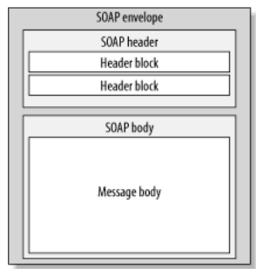
What are SOAP Web Services?
SOAP is stand for Simple Object Access Protocol.
SOAP Web services are web services which use a standardized XML messaging system (SOAP).

Slide 6
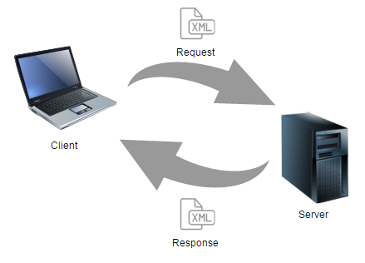
How does SOAP Web Services work?

Slide 7
Characteristics
XML based protocol.
Loosely coupled.
Interoperability.
Simple and extensible.

Slide 8
2 Architecture

Slide 9
Components
WSDL.
XSD.
SOAP request and SOAP response.
Provider.
Consumer.
UUDI.

Slide 10
WSDL
Web Service Description Language.
Lists all operations available in the service as well as all required parameters.
Is a contract for clients defined inside an XML file.

Slide 11
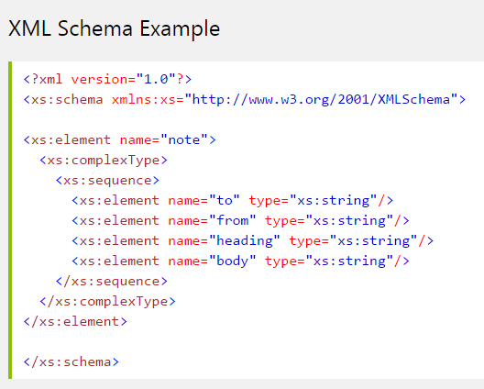
XSD
XML Schema Definition.
Describes the structure of an XML document.
Define the legal building blocks of an XML document.

Slide 12
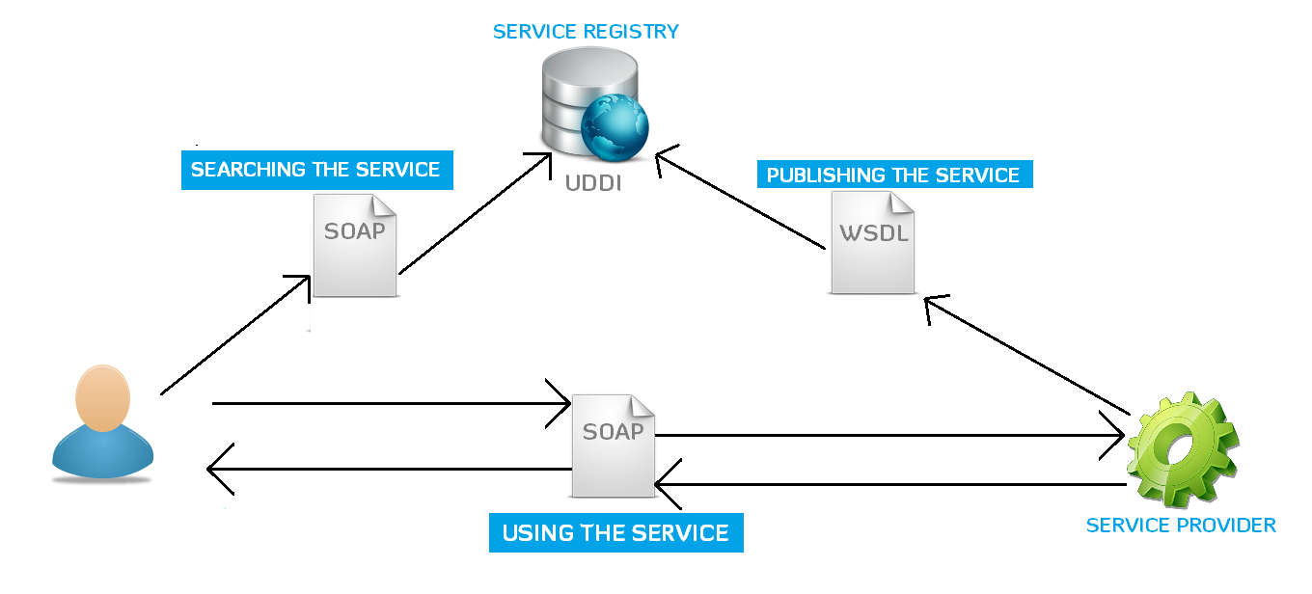
Architecture

Slide 13
3 Spring Web Service

Slide 14
Spring WS
Spring Web Services facilitates contract-first SOAP web service development.
Allows the creation of flexible web services using one of the many ways to manipulate XML payloads.
Based on JAX-WS.

Slide 15
Contract-first

Slide 16
Level 3 Working with the DOM

Slide 17
Acting on interaction

Slide 18
Refactor using Traversing

Slide 19
Traversing and Filtering

Slide 20
Level 4 On DOM load

Slide 21
Expanding on on()

Slide 22
Keyboard Events

Slide 23
Link Layover

Slide 24
Level 5 Taming CSS

Slide 25
Challenges

Slide 26
Challenges
Animation

Slide 28
The End

Slide 29
References
Official Spring WS page
http://projects.spring.io/spring-ws/

