Slide 1

Academia 2015 –SOAP Web Services

Slide 2
Disclaimer
Document Name:
Data Classification: INTERNAL
Disclaimer
The contents of this document are property of Softtek, and are classified as Confidential. Any reproduction in whole or in part is strictly prohibited without the written permission of Softtek.
This document is subject to change. Comments, corrections or questions should be directed to the author.
Audience/Viewership | Purpose
Java Academiy trainees | Training
Revision Chart
The following chart list the revisions made to this document. Use this to describe the changes and additions each time this document is re-published. The description should be detailed as possible and include the names of the reviewers who request the changes.
Version No. | Version Date | Types of Changes | Owner/Author | Date of Review/Expiration
1.0 | 14-10-2015 | Initial draft | Jose Antonio Hernandez Vazquez

Slide 3
1 SOAP Web Services in nutshell

Slide 4
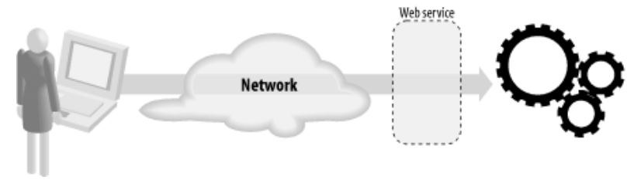
What are Web Services?
A web service is a network accessible interface to application functionality, built using standard Internet technologies

Slide 5
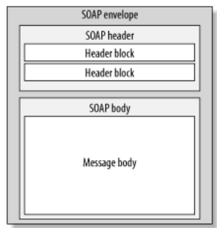
What are SOAP Web Services?
SOAP is stand for Simple Object Access Protocol.
SOAP Web services are web services which use a standardized XML messaging system (SOAP).

Slide 6
Characteristics
XML based protocol
Loosely coupled
Interoperability
Simple and extensible

Slide 7
2 Architecture

Slide 8
Components
WSDL
XSD
SOAP request and SOAP response
Provider
Consumer
UUDI

Slide 9
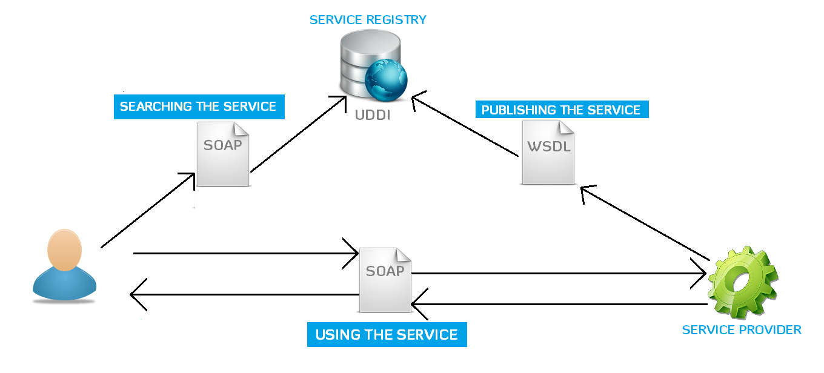
Architecture

Slide 10
Using jQuery

Slide 11
Level 2 Searching the DOM

Slide 12
Traversing

Slide 13
Level 3 Working with the DOM

Slide 14
Acting on interaction

Slide 15
Refactor using Traversing

Slide 16
Traversing and Filtering

Slide 17
Level 4 On DOM load

Slide 18
Expanding on on()

Slide 19
Keyboard Events

Slide 20
Link Layover

Slide 21
Level 5 Taming CSS

Slide 22
Challenges

Slide 23
Challenges
Animation

Slide 25
The End

Slide 26
References
Official jQuery page
https://jquery.com/
Videos, challenges, tutorials
http://try.jquery.com/
Official jQuery API documentation
http://api.jquery.com/

