Slide 1

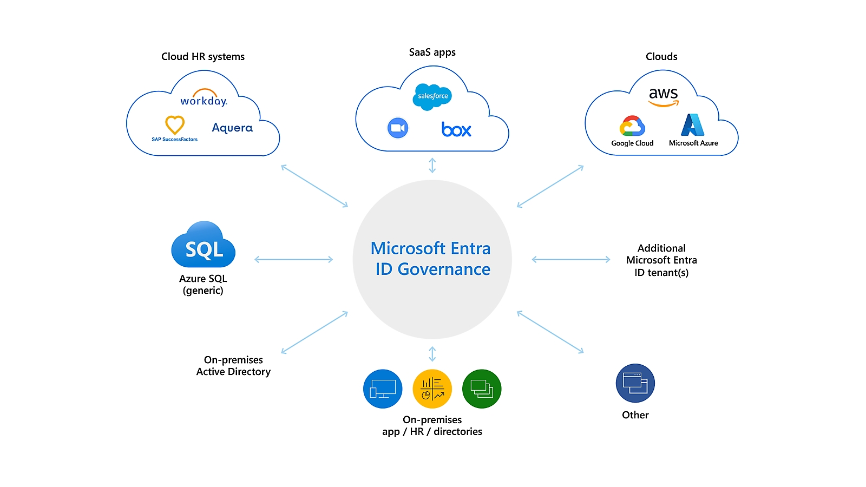
Microsoft Entra ID Governance
In a time when organizational credentials are constantly under attack, ensuring that the right people have the right access to the right resources at the right time for the right duration is critical. Entra ID Governance augments Entra ID, automating, securing and governing employee, supplier and business partner access to resources on-premises and in the cloud, in a compliant manner.
Insert company’s logo
With Entra ID Governance you can:
Manage user identities, access right and entitlements across IT environments
Ensure proper access controls, mitigate risk, and maintain compliance with regulatory requirements
Contact Us
Contact xxxx@xxxxxxx.com to schedule a
Microsoft Entra ID Governance workshop
After the workshop, you will:
Gain a better understanding of the value and use cases of Microsoft Entra ID Governance
Set next steps based on your needs and objectives
Learn more at
https://aka.ms/IdentityGovernanceOverview

