Slide 1
Self Driving Cars Mid-term Competition
Presenter: De Yu Hong (洪得瑜)
Student ID: 309611087

Slide 2
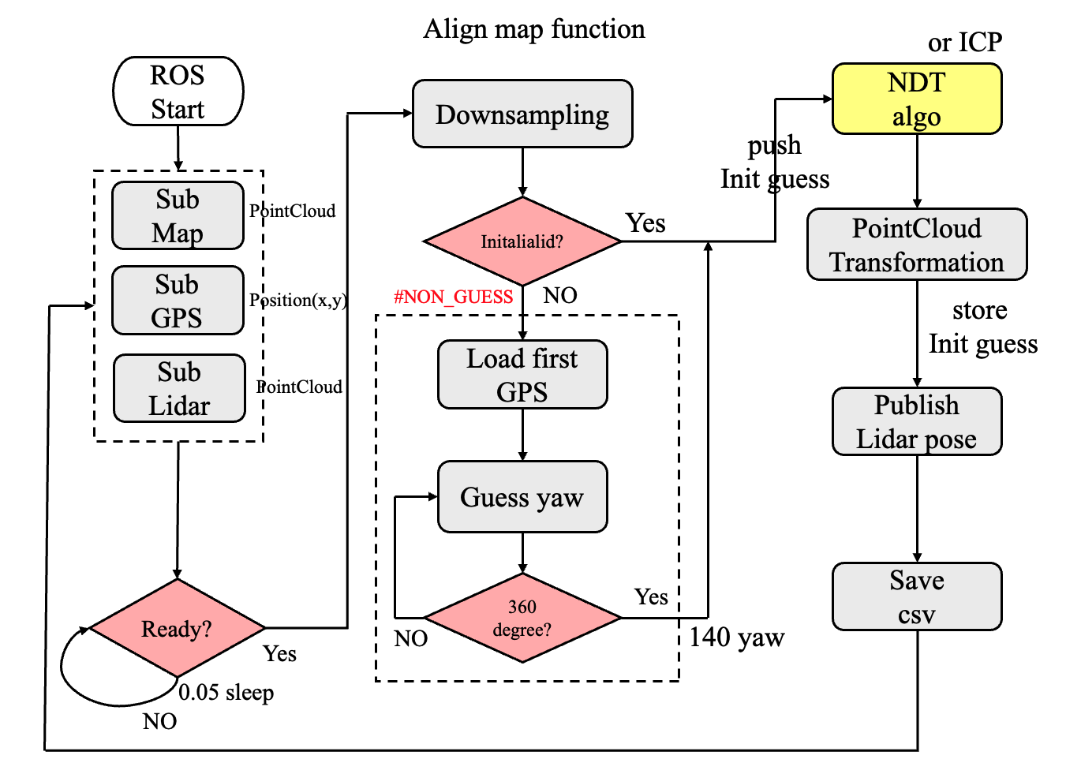
Flow chart
ITRI Bag
Experiments:
Full path use ICP
Full path use NDT

Slide 3
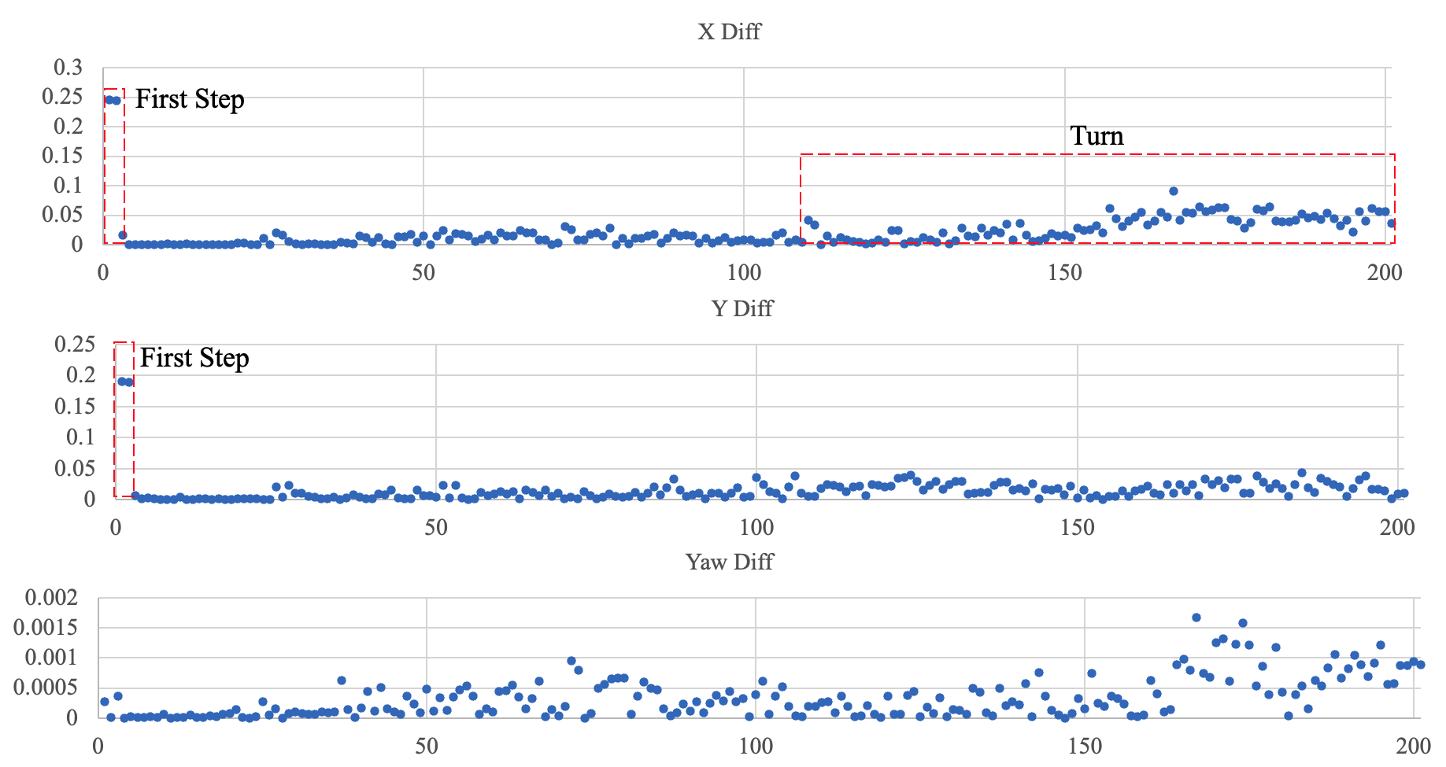
Analysis
Method : diff= abs(NDT-ICP)
Kaggle score : ICP > NDT
Precise : NDT > ICP
Result:
First step error : Init guess worst
X-axis error is increasing (turn)
Conclusion:
First step use NDT

Slide 4
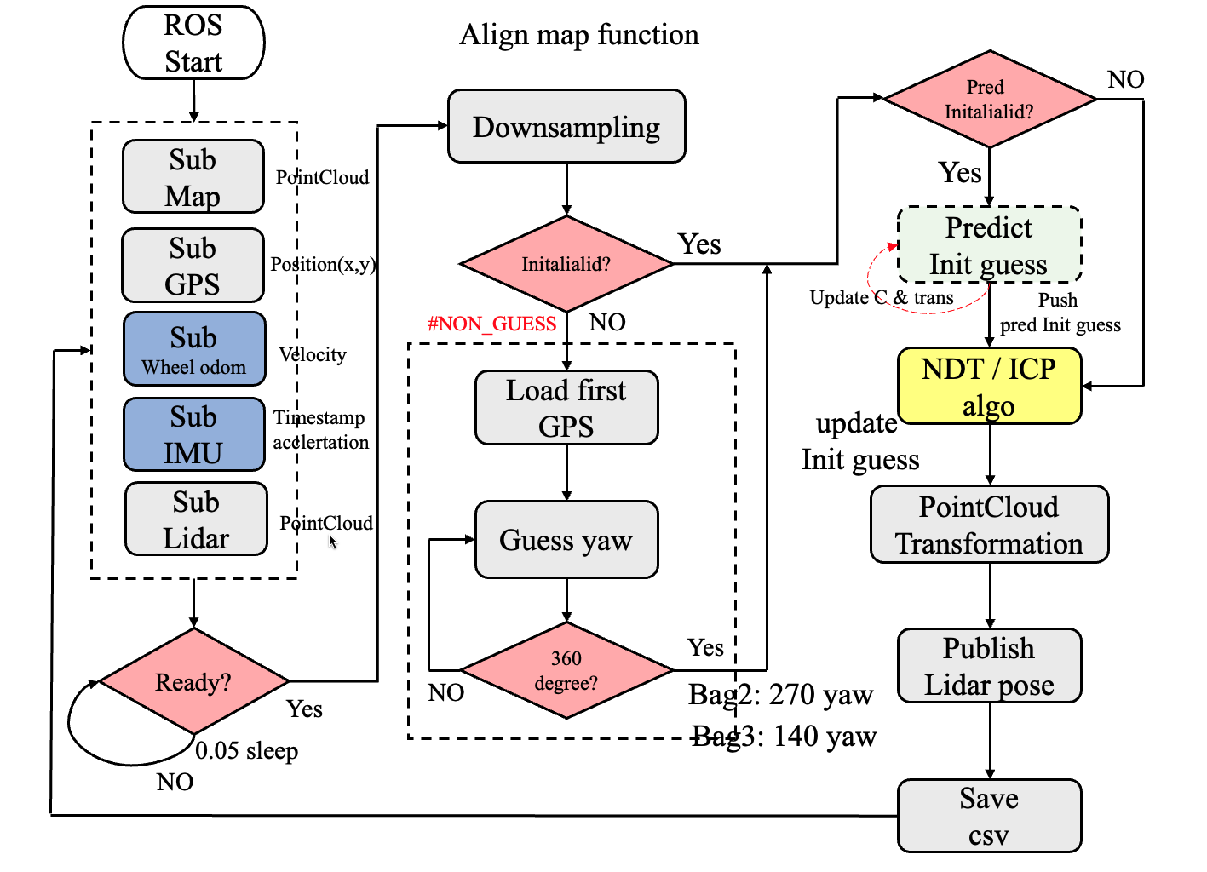
Flow chart
nuScenes2&3 :
Base on ITRI :
NDT First step
Switch NDT / ICP
Tracking Init guess:
Wheel odom node
IMU node

Slide 5
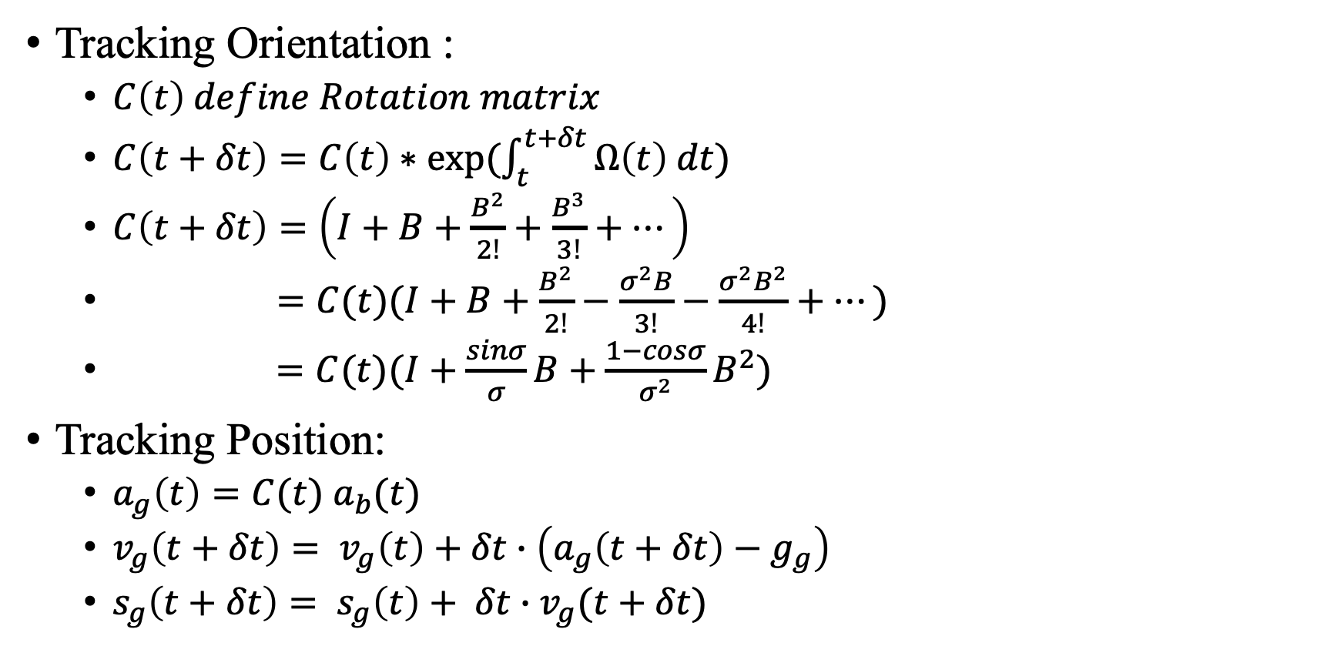


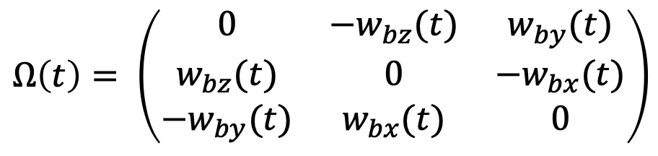
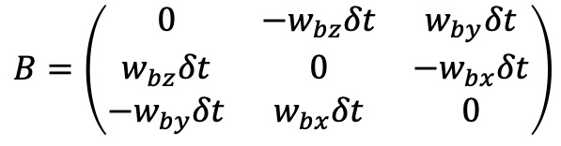
Tracking
$$Ω\left(t\right)= \left(\begin{matrix}0 & {−w}_{bz}(t) & w_{by}(t) \\ w_{bz}(t) & 0 & −w_{bx}(t) \\ −w_{by}(t) & w_{bx}(t) & 0\end{matrix}\right)$$
Tracking Orientation :
$C\left(t\right) define Rotation matrix$
$C\left(t+δt\right)=C\left(t\right)∗exp⁡(\int_{t}^{t+δt}{Ω\left(t\right) dt})$
$C\left(t+δt\right)=\left(I+B+\frac{B^{2}}{2!}+\frac{B^{3}}{3!}+…\right)$
$=C(t)(I+B+\frac{B^{2}}{2!}−\frac{σ^{2}B}{3!}−\frac{σ^{2}B^{2}}{4!}+…)$
$=C(t)(I+\frac{sinσ}{σ}B+\frac{1−cosσ}{σ^{2}}B^{2})$
Tracking Position:
$a_{g}\left(t\right)=C(t){ a}_{b}(t)$
$v_{g}\left(t+δt\right)= v_{g}\left(t\right)+δt∙\left(a_{g}\left(t+δt\right)−g_{g}\right)$
$s_{g}\left(t+δt\right)= s_{g}\left(t\right)+ δt∙v_{g}(t+δt)$
Rectangular
rule
$$B=\left(\begin{matrix}0 & −w_{bz}δt & w_{by}δt \\ w_{bz}δt & 0 & −w_{bx}δt \\ −w_{by}δt & w_{bx}δt & 0\end{matrix}\right)$$
$$w_{b}{=(w_{bx},w_{by},w_{bz})}^{T}$$
$$σ=\left|w_{b}δt\right|$$
[1] Woodman, O. J. (2007). An introduction to inertial navigation (No. UCAM-CL-TR-696). University of Cambridge, Computer Laboratory.

Slide 6
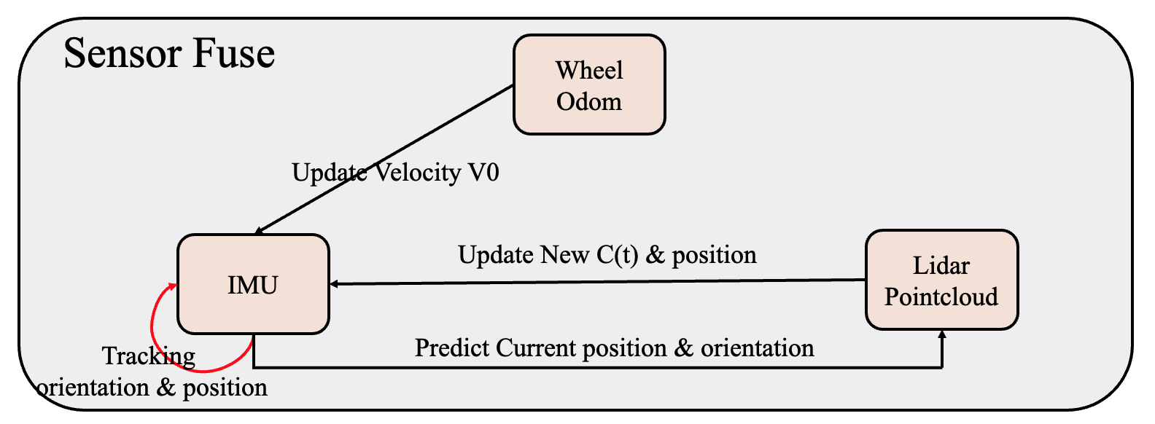
Tracking
Relationship:

Slide 7
Conclusion
Init guess : ICP >> NDT
Robust: NDT >> ICP
Precise : NDT > ICP (Init guess is not good)
Performance: NDT >> ICP
NDT cannot be calculated in real time. (Total time : 1 day )
EKF method (ICP) is better than full NDT(tracking) in nuScenes3.
First step use NDT.

