Slide 1



David Jayakumar · G00419108
BEng (Hons) Software & Electronic Eng.

Slide 2

Simulation to Reality
Christmas
Summer
Notes:
Slide 1 — "From Simulation to Reality" (~40 seconds)
This project is a live network defence system — a trained RL agent from simulation observes a real containerised network, detects attacks, and executes defensive actions on real containers in real time. That's what this presentation is about.
At Christmas I'd researched RL from scratch — training various algorithms on environments like cartpole & FrozenLake and concluded PPO was the right algorithm for network defence. At the start of this semester I attempted to train a GNN-PPO agent in CybORG myself, but training was taking too long — I could either spend the semester waiting on a run that might not converge, or use a pre-trained agent and build something real. I chose real.

Slide 3
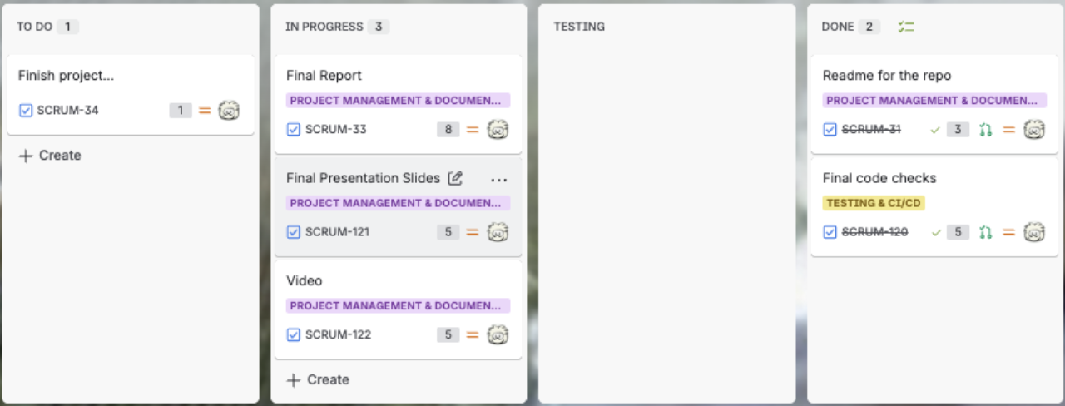
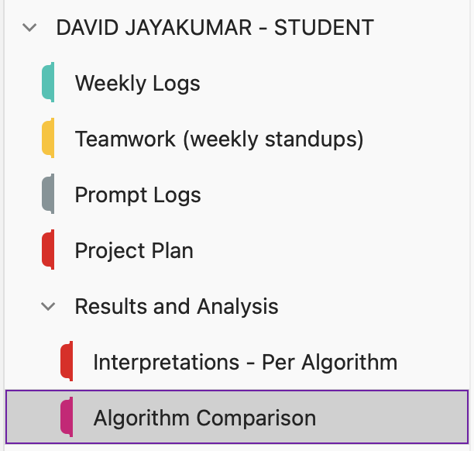

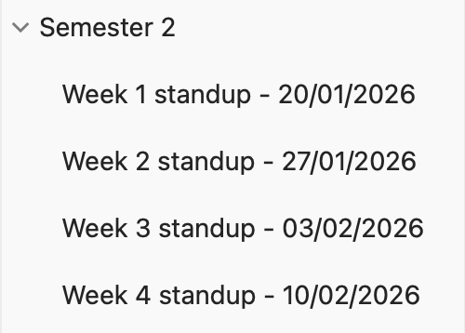

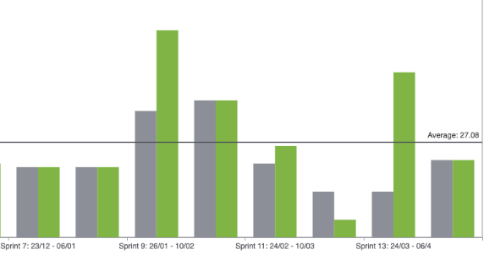
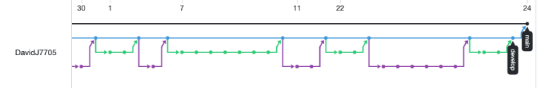
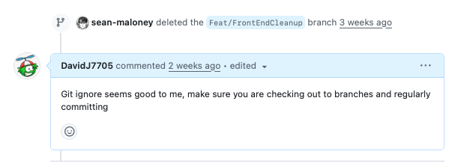
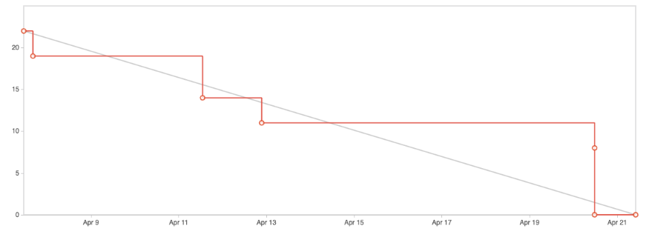
PROCESS
JIRA
ONENOTE
RETRO & PERFORMANCE
GITHUB
Notes:
Slide 2 — "Process" (~90 seconds)
I ran this project using Scrum across 15 sprints. Looking at the Jira board here — most stories had acceptance criteria and deliverables clearly defined, and every branch was named a certain way so tickets and code were always linked.
For reflection I used OneNote throughout. i tracked weekly logs where I document any work I did day-by-day, findings from research papers, teamwork standups, and my AI prompting proof. I also kept a record of my supervisor meetings here — I was in regular contact throughout the semester, which kept me honest about scope and progress rather than drifting.
I led my own sprint planning and retrospectives after each sprint using the Jira reports — the retrospectives directly changed how I approached the next one. The velocity and burndown charts show consistent output across the semester — and where work was lost, it was made up for in the next sprint.
On collaboration — the weekly standups kept me aligned with the rest of the class. Beyond that I had regular conversations with peers about their projects.those checkins helped me course-correct my own decisions and stay on track. The PR comment here shows peer review in action, or you would've seen my collaboration in mark carrolls project where he made an ai photo of me in a bikini

Slide 4
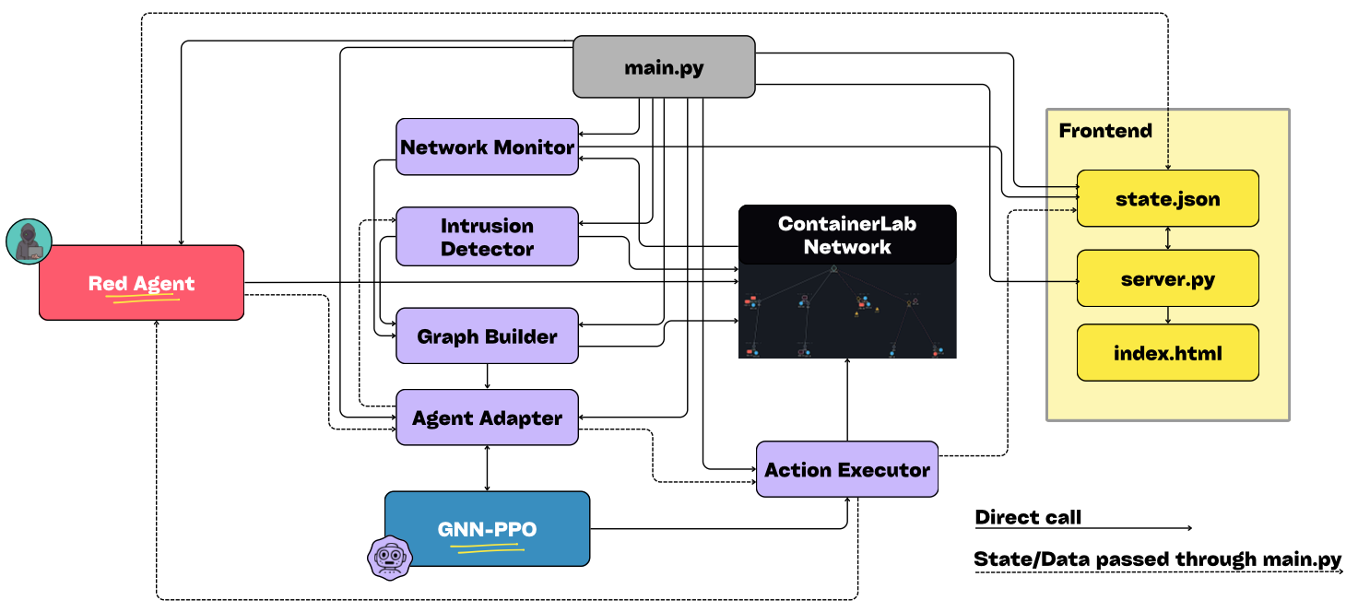
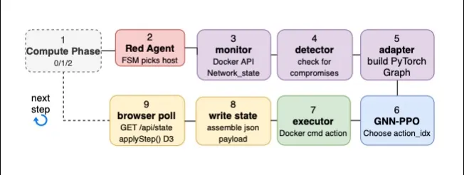
ARCHITECTURE
Notes:
Slide 3 — "Architecture & Design" (~45 seconds)
"The system has six components in a pipeline. The network monitor discovers all running containers and classifies them. The graph builder turns that into a PyTorch Geometric graph where each host is a 192-dimensional feature vector matching what the agent was trained on. The agent adapter loads the trained agent and then chooses an action integer. The action executor translates that integer into a real Docker operation. The red agent simulates the attacker using a finite state machine. And the intrusion detector scans containers for compromise markers between steps.
And the loop diagram on the right shows how these wire together at runtime for each step in an episode — goes from the red agent picking a host, to blue agent taking an action and all the way through to the browser polling the updated state for the dashboard

Slide 5
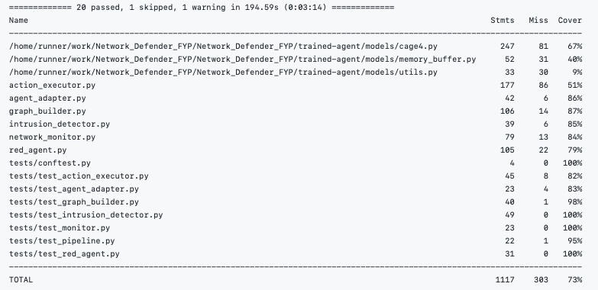
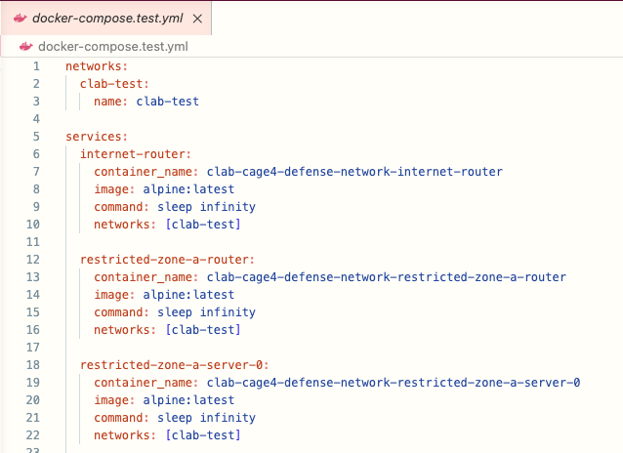
Implementation & Testing
Notes:
Slide 4 — "Implementation & Testing" (~75 seconds)
"On build quality — each component has a single responsibility. Every file has a header comment with run instructions from deploying the topology to tearing it down. Like at Christmas I continued using a GitFLow methodology so there’s no direct pushes to main.
I have a test file per component so for the network_monitor, graph builder, agent adapter etc etc. The test _pipeline file covers the full chain from monitor through to executor in one call. Overall theres 20 passed, 1 skipped, 73% total coverage across the full codebase. And evaluate.py is a system test — it runs a full 100-step live episode, logs every blue and red action to CSV, and with that, you can generate analysis plots.
CI runs on every push via GitHub Actions. It spins up a 24-container Docker Compose topology that mirrors the live network exactly with the same container names, same network structure. This is so the tests run against real Docker containers, not mocks and so Every merge is validated against a topology that matches what runs in production.

Slide 6
Challenges
Sim-to-Real Gap
Root Compromises
Train from Scratch
20% Actions Wasted
Sample()
Research Papers – Huang & Ontañón 2022 and Wilson et al. 2024.
User-level only
Restore same host
Match CybORG Re-imaging
Attempted to train PPO agent
Ran 88 minutes with -3.5k reward
Inference pivot due to limitations
Notes:
Slide 5 — "Challenges" (~60 seconds)
"Three specific problems.
1. the sim-to-real action gap. The agent was trained with 81 valid actions. In the live network, actions 64 to 79 are actions that are ineffective on the containers. That's 20% of the action budget wasted. I fixed this with inference-time masking. This means I alter the probability distribution, zero those indices, renormalize, and sample them to a better action. I tried an argmax function first but it always returned Monitor because the observation is sparser than in training. Sampling however preserves the stochastic behaviour the agent was trained with. I backed this up with the research papers listed.
2. root compromise persistence. Restore was only clearing the user-level marker, leaving the root marker intact. The intrusion detector kept seeing a host as compromised, so the agent kept picking Restore on that same host. To Fix this I cleared both markers, matching CybORG's full re-image semantics which I was initially wrong about.
3. training from scratch. Early on I tried training a new PPO agent. It ran for 88 minutes with the best reward at -3,525 with a downward trend. On CPU only with no GPU, training a capable agent within the remaining time wasn't practical. The project pivoted to inference using the pre-trained Cybermonic GNN-PPO agent and building the bridge around them. That decision shaped everything that followed.

Slide 7
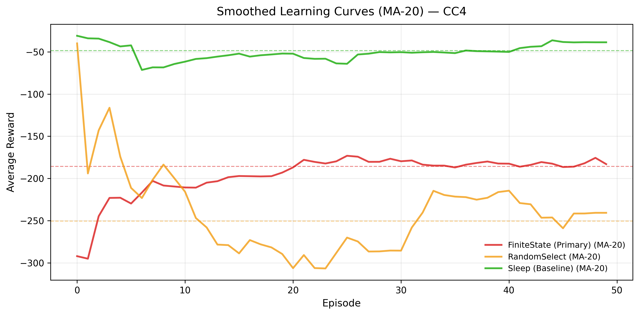
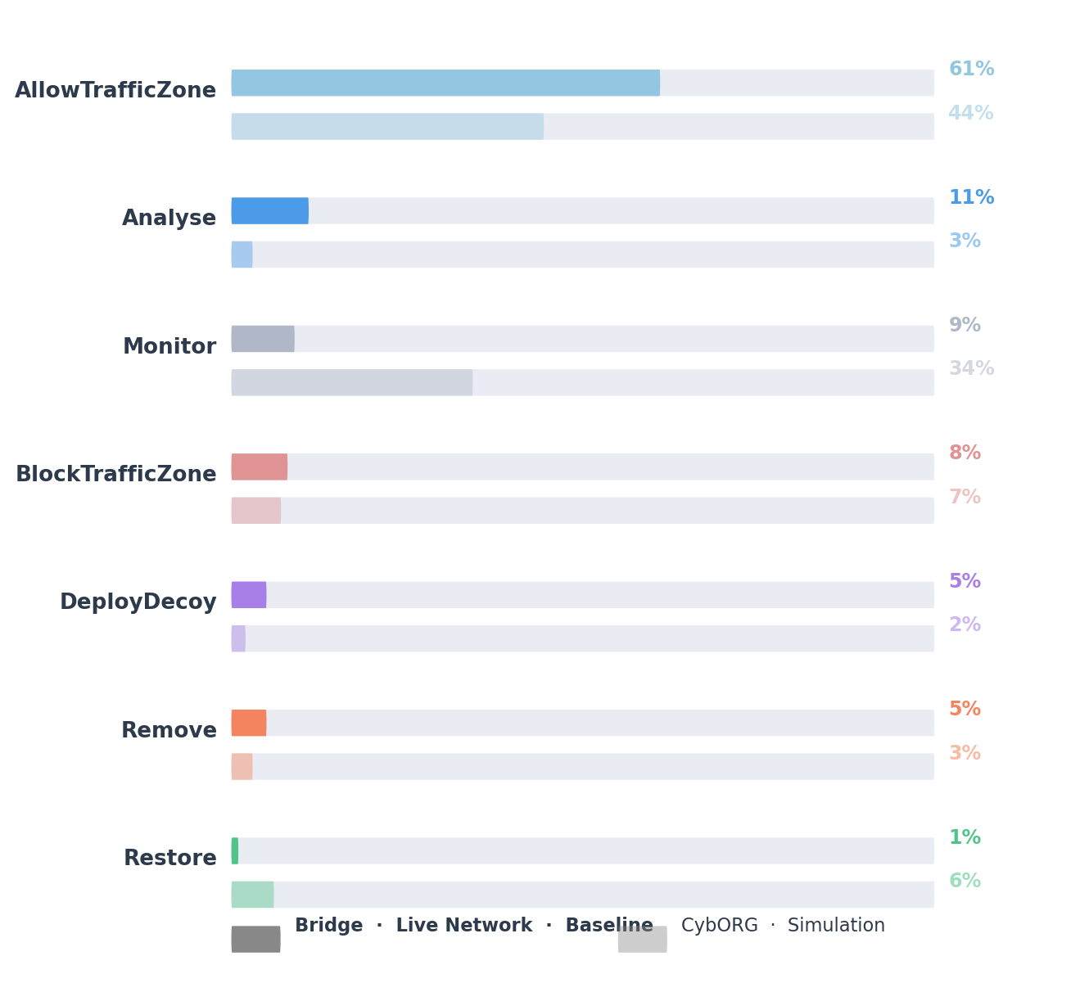
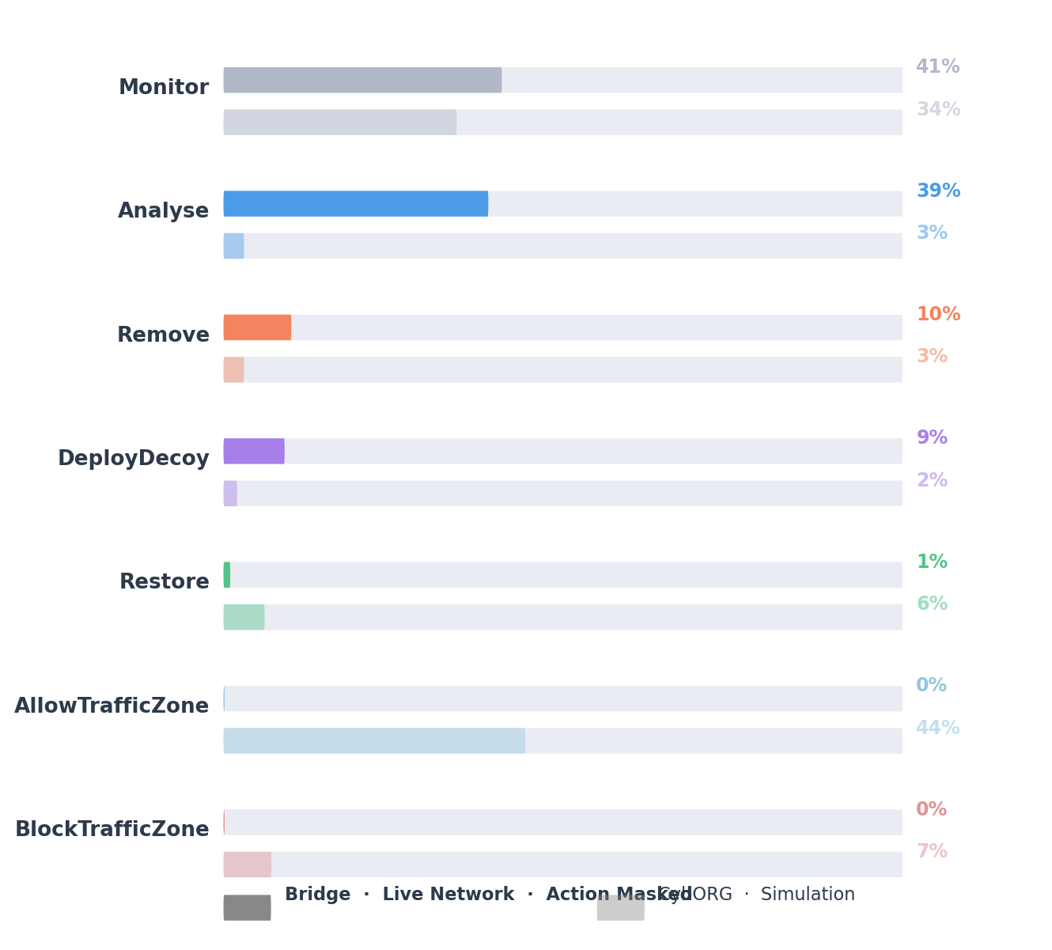
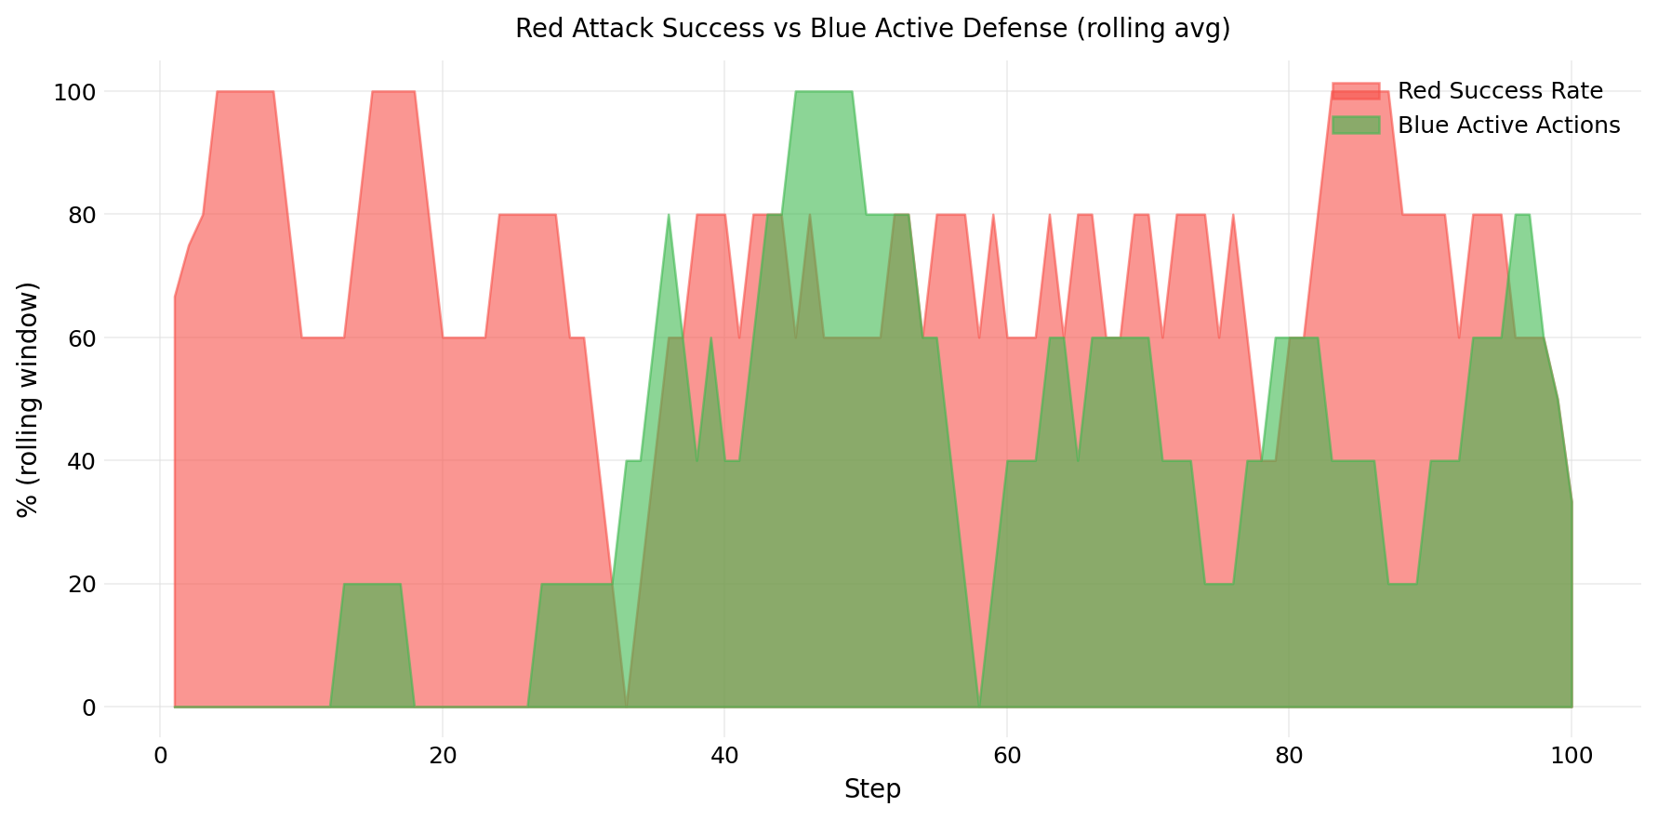
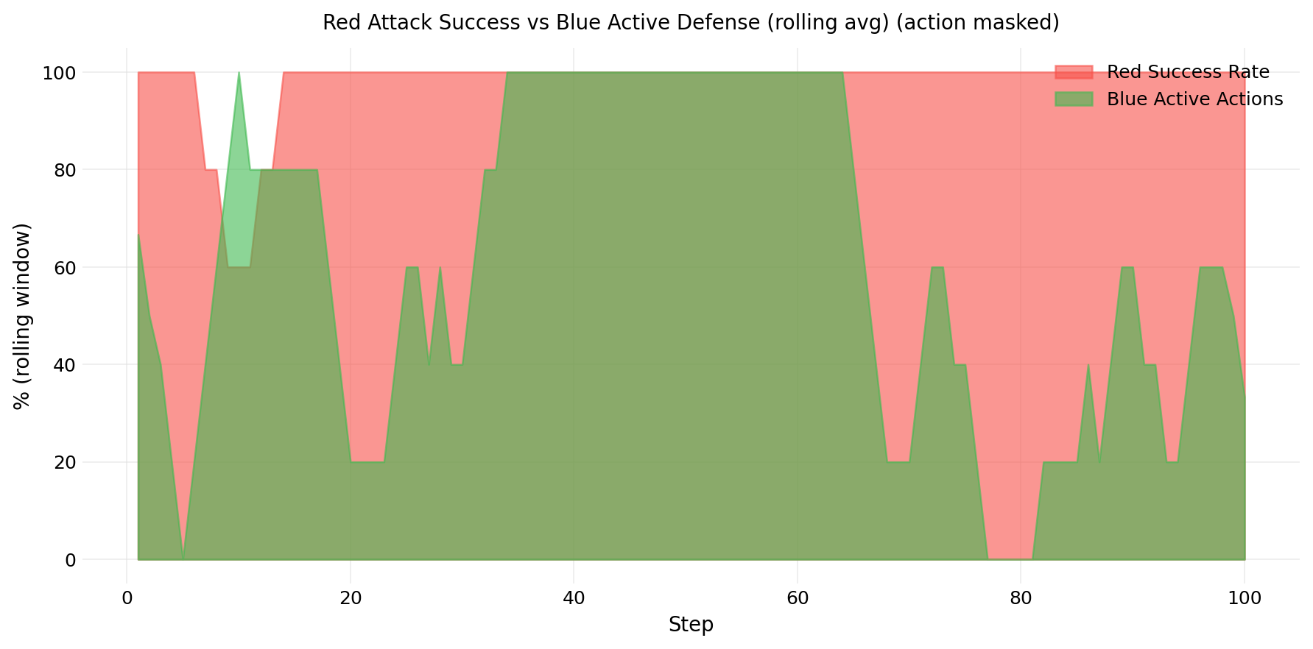
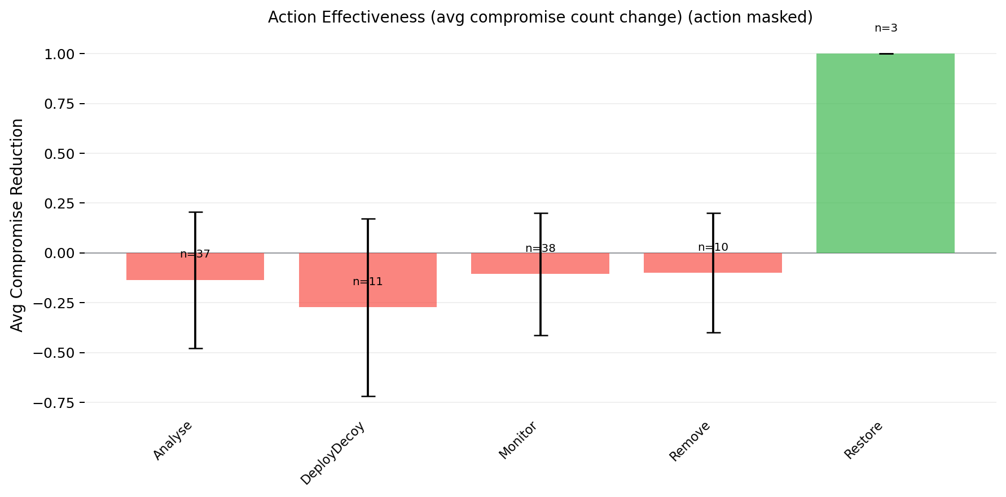
Results
CybORG – Sim Results
BRIDGE v Simulation Action Distribution
UNMASKED
MASKED
RED v BLUE Success Rate
Action Effectiveness
UNMASKED
MASKED
MASKED
Notes:
Slide 6 — "Results" (~45 seconds)
"CybORG evaluation shows the agent stabilises at around minus 180 reward against the finite state red agent. Against Random attacking agents it fails almost all of the time. This shows the GNN learns structure, but random behaviour has none.
Comparing the three environments tells the full story. In CybORG the agent is passive 85% of the time — Monitor at 34%, but allow & block actions are 51%. Those are valid in simulation, but In the unmasked bridge, edge actions are ineffective on the live network. Monitor actually drops to just 9%. The agent is actively trying to use these edge actions it was trained on, and wasting steps.
With action masking applied, Monitor is 41%, Analyse 39%, Remove 10%, DeployDecoy 9%. Shows the agent was capable of active defence all along. The edge acitons were absorbing most of its probability mass. The remaining spread across Monitor and Analyse reflects observation sparsity. The simulation metadata like OS versions and file system paths don't exist on real containers, so the agent has less signal to commit to stronger actions like Restore.
You can see that here in the red/blue timeline — with masking, blue is genuinely contesting the network. And Restore is the only action that actually reduces compromise count. That's the sim-to-real gap finding."

Slide 8
Conclusion
Policy Transferred
Mask Unlocked Defense
Sim-to-Real Deployment Achieved
Action distribution mirrors simulation closely
Edge ops absorbed 69% of actions
Project Completed & exceeded initial plans!!
Notes:
Slide 7 — "Conclusion" (~30 seconds, then pivot to demo)
"At Christmas I was running CartPole in a gym environment. Today there's a trained RL agent making real-time defensive decisions on a containerised network.
Three findings.
The policy transferred — the action distribution in the real network mirrors what we saw in simulation.
Masking unlocked active defence — edge no-ops were absorbing 69% of the agent's probability mass, and once removed, the agent was capable of genuine host-level defence all along.
And the sim-to-real deployment is done — what was listed as future work at Christmas is now running live.
Let me show you."

