Slide 1
Masterclass: A software engineers walk through implementing algorithms in C++
James Giller, JLR
23-7-2020
Github for links: DavidJPOS/Masterclass-A-software-engineers-walk-through-implementing-algorithms-in-Cpp
Rstudio cloud for coding along: https://rstudio.cloud/project/1471581
Notes:
Greetings,
This is tech maths 4 (introduction to fundamentals of statistics)

Slide 2
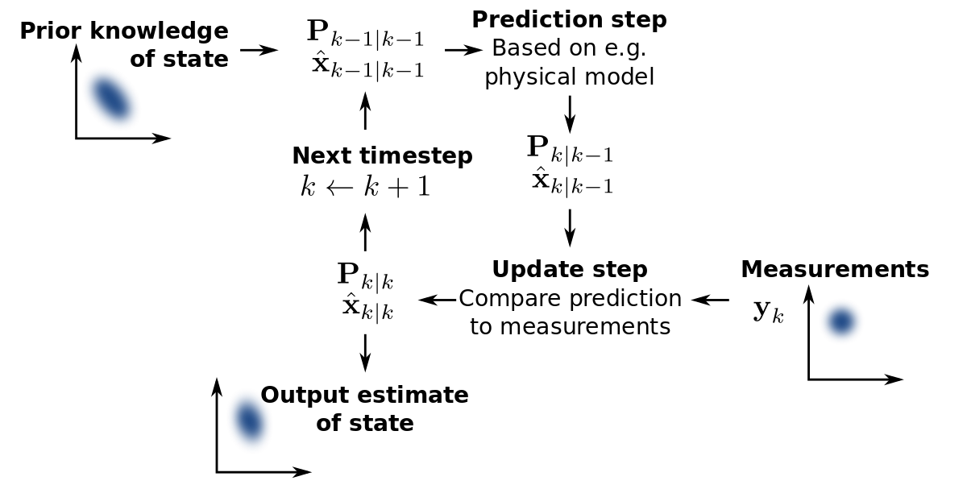
Walk through C++
Github for links: DavidJPOS/Masterclass-A-software-engineers-walk-through-implementing-algorithms-in-Cpp
Rstudio cloud for coding along: https://rstudio.cloud/project/1471581
C++ is industry standard for fast and reliable software
Anyone who needs speed should consider writing some code in C++
James has extensive experience in this
Live coding implementation of a Kalman filter
Brief Q&A at the end (maybe)

