Slide 1
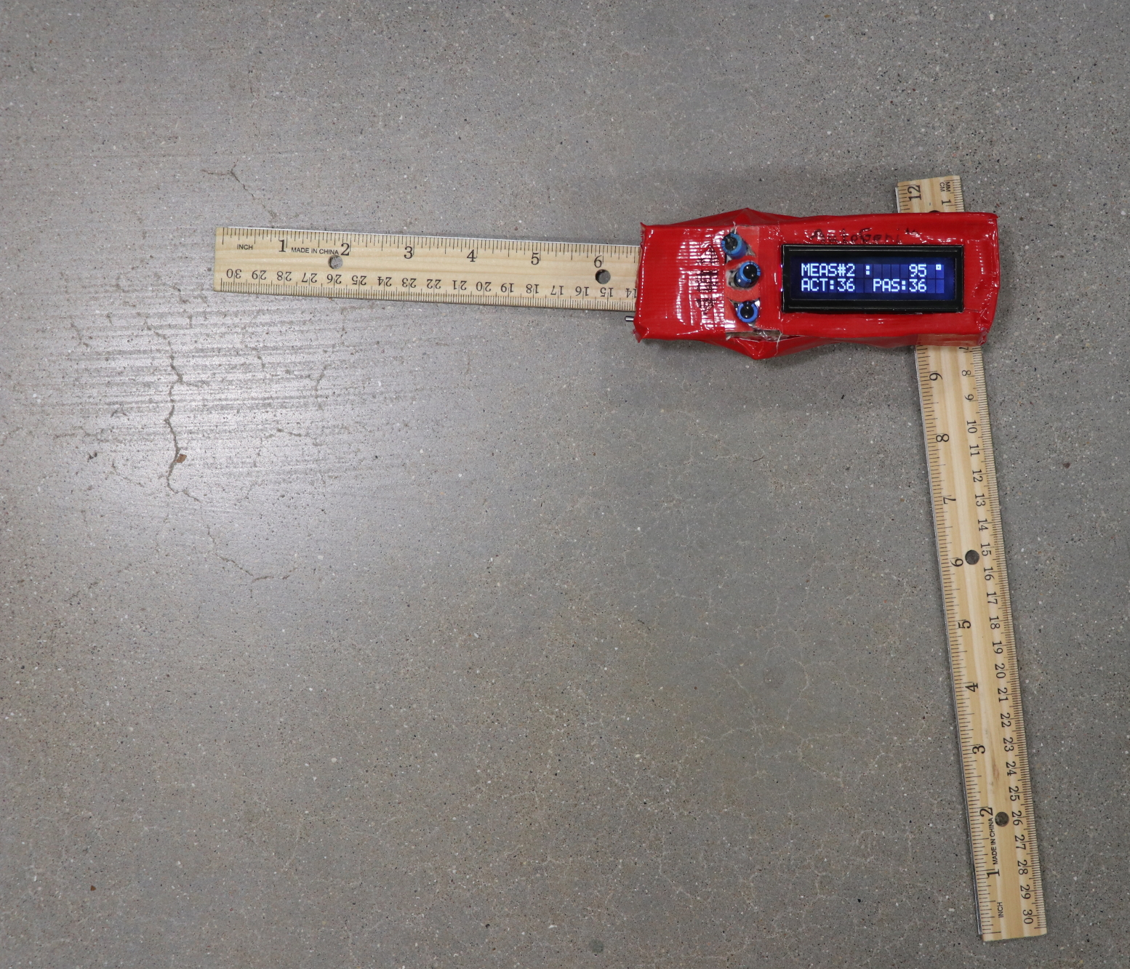

AutoGoni ©
Presented by
BIEN 4280 Class

Slide 2


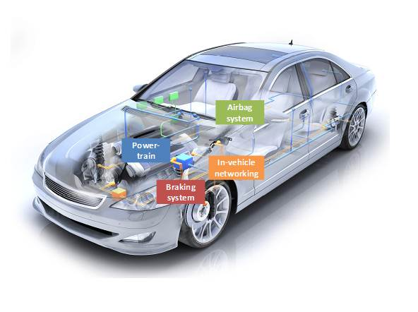
Course Context
What is a microcontroller?
What is an embedded system?
What is real-time operating system (RTOS)?
http://www.learnembedded.com/embedded-systems-face-tomorrow/
Notes:
David

Slide 3
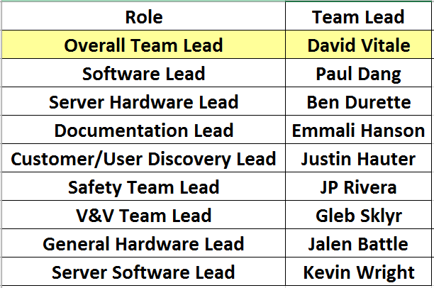
Product Challenge -
Project Timeline: 16 Weeks
Notes:
David

Slide 4
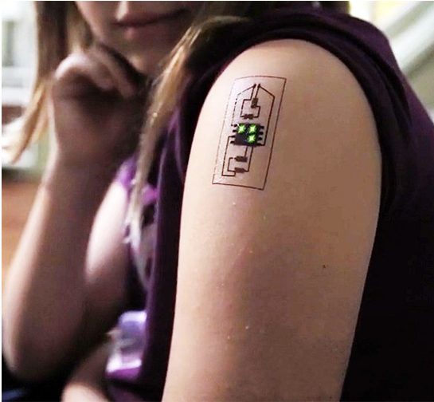
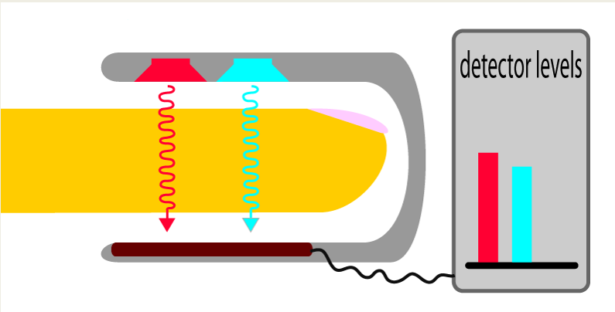
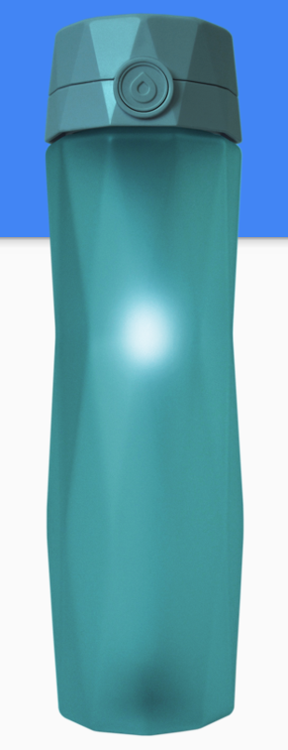
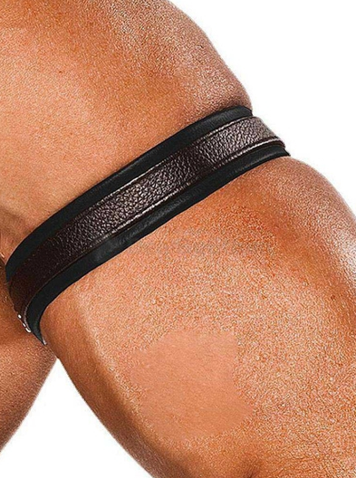
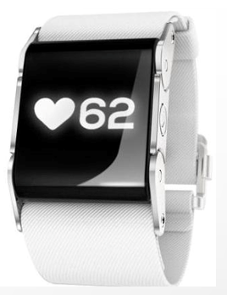
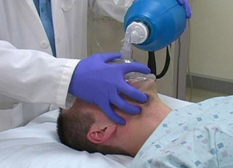
Product Design Project:
-Potential medical device need?
-Idea Pitches
Notes:
David

Slide 5
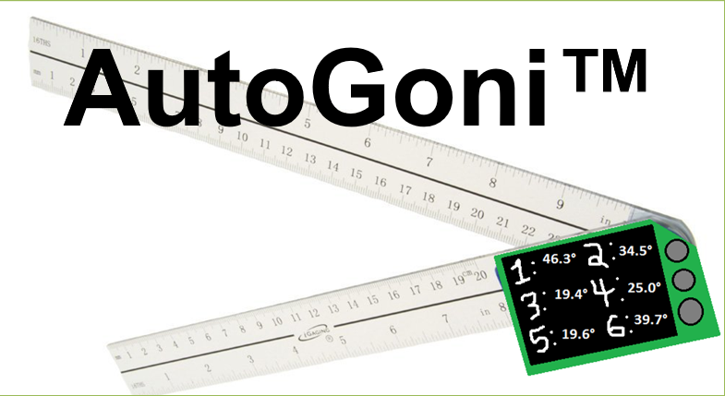
Product Design Project:
-Potential medical device need?
-Idea Pitches
Notes:
David

Slide 6
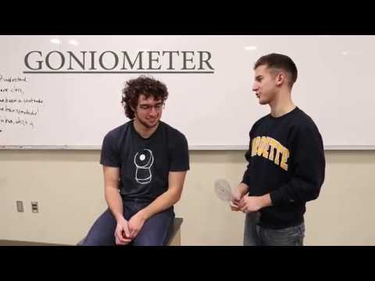
Background and Context
-What is a goniometer?
-What is it used for?
-Who is it used by?
Notes:
David

Slide 7
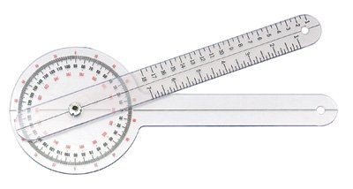
Problem Statement and Hypothesis
-Manual goniometer can be improved
-There is time to be saved in patient data acquisition for Physical Therapists
-Time to measure angles
-Time to record values
-Time to enter to Electronic Medical Records
Notes:
David

Slide 8
Customer Outreach - Interview Phase
Pre-Planning Customer Discovery
Is our original hypothesis supported?
What does the customer want vs. need? Is there a need?
Allowed us to determine the minimum viable product
What is a realistic prototype given the parameters, timeline of the project?
Customer Discovery Interviews
Design considerations?
Feedback
Customer Outreach Included:
-PT Students & Professionals (varying levels of experience)
-Private PT Clinic (Athletico)
-Marquette Sports Rehabilitation Clinic
Notes:
Justin

Slide 9
Customer Voice - Requirement Analysis
Can be tedious…
"there are times when I choose not to measure because I feel it is not that important and I will spend my time doing something else."
[PT interviewee when asked if they always take measurements of the patient]
Can be difficult…
“Sometimes it is difficult to measure because the demarcations are in spaced out intervals”
[PT interviewee when asked about reading measurements]
Different populations can hold different challenges…
“Pediatric patients can be easily distracted and neurological patients (have spasticity based on their injury) may not be cognitively intact. There are a lot of other considerations that need to be addressed while trying to take the goniometric measurement….”
[PT interviewee when asked about factors complicating measurements]
Notes:
Justin

Slide 10
Customer Pains - Translation to Use Case
Addressing - Difficult in reading measurements
-Values are determined and displayed on LCD screen.
Addressing - Time saved in reading measurement
-Value does not need to be read. One click replaces reading of values
Values are saved internally and can be displayed / exported to PC in format
*See Appendix for Customer Needs Table with Proposed Solutions
Notes:
Justin
ex. removes difficulty associated with reading small numbers against dark clothes

Slide 11
Use Cases
Performing goniometric measurements
The physical device should be able to…
Device data archival
Once a measurement is displayed on the device …
Application of data with software component(s)
Once the measurements are saved to the device and exported …
Notes:
Justin

Slide 12
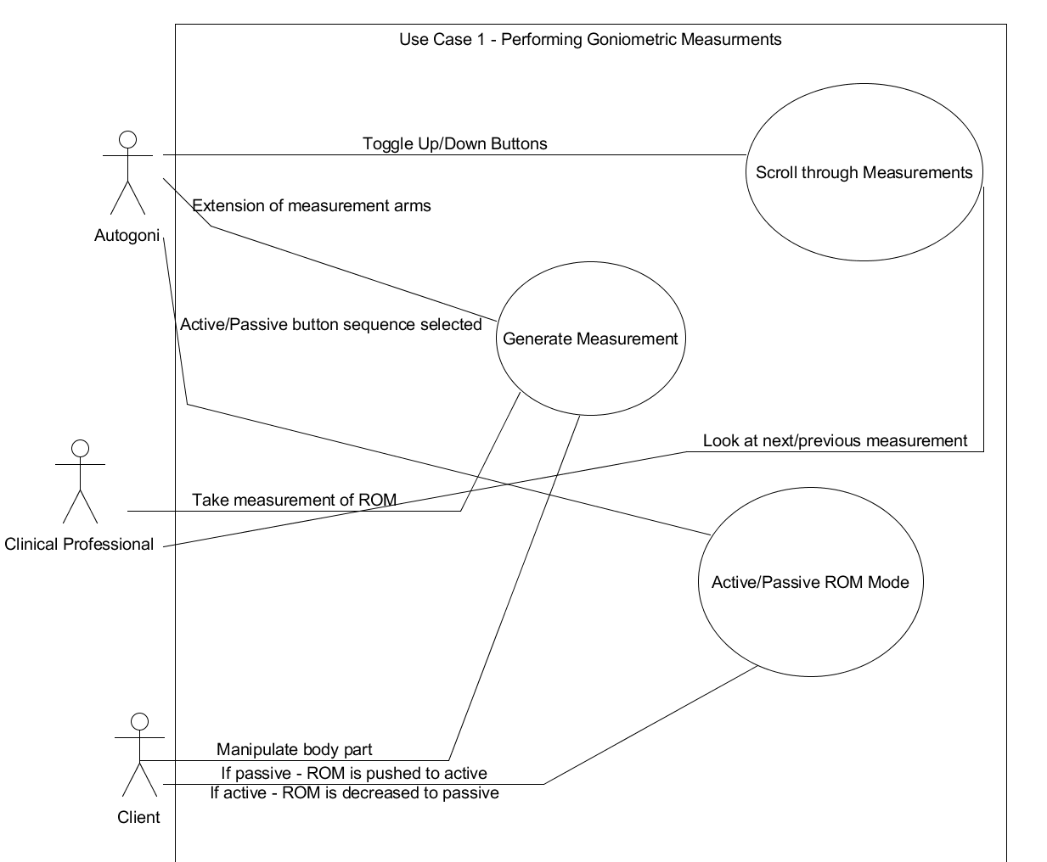
Use Case 1 - Performing Goniometric Measurements
*See appendix for use case narrative
Autogoni should be able to:
Have same basic functionality as a goniometer
Allow user to scroll through previous measurements
Allow user to designate passive and active ROM measurements
Notes:
Justin

Slide 13
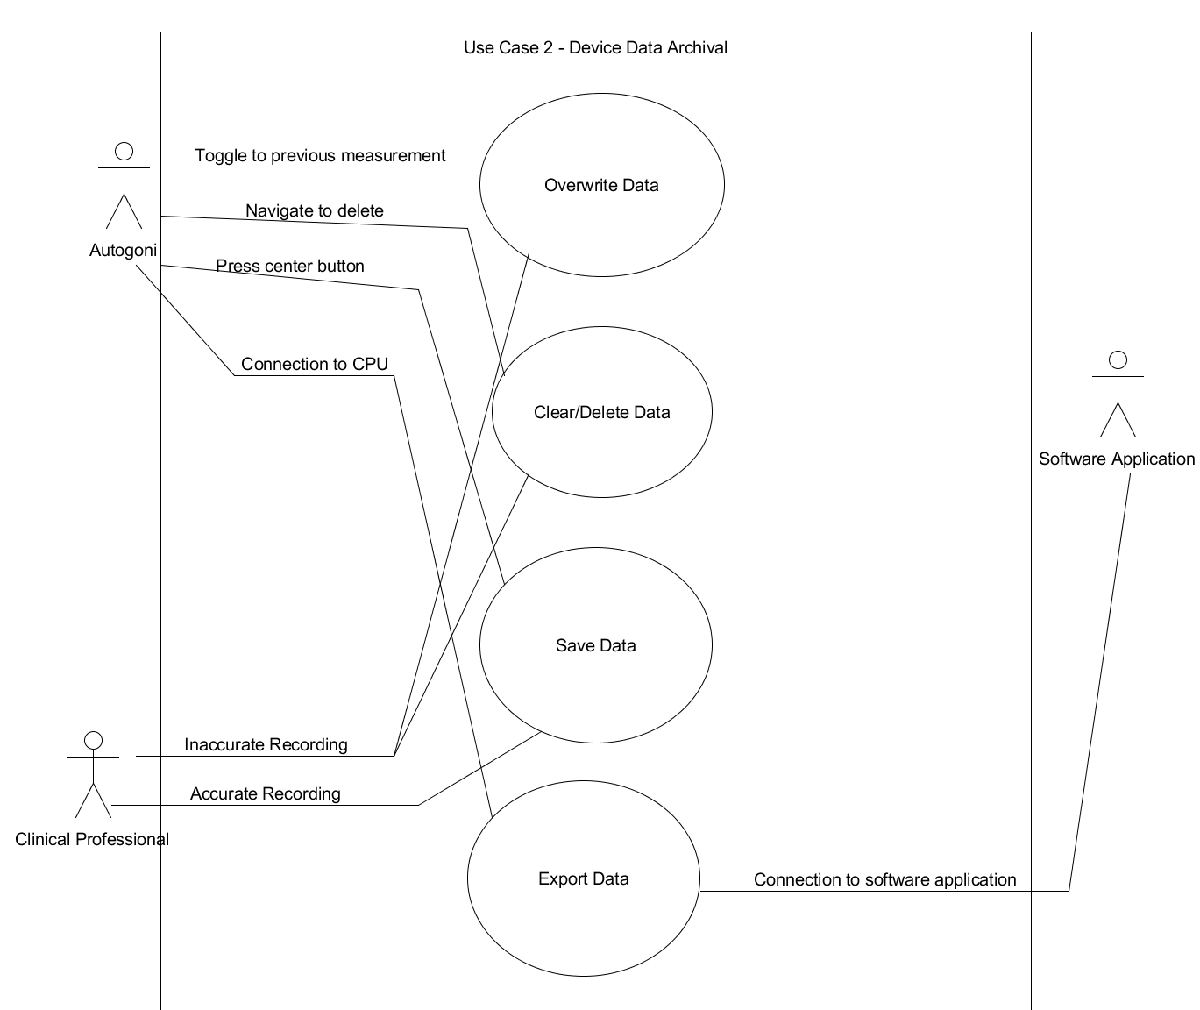
Use Case 2 - Device data archival
*See appendix for use case narrative
Autogoni should be able to:
Save measurements to device
Clear/Delete measurement(s)
Overwrite previously recorded data
Export measurements to external software application
Notes:
Justin

Slide 14
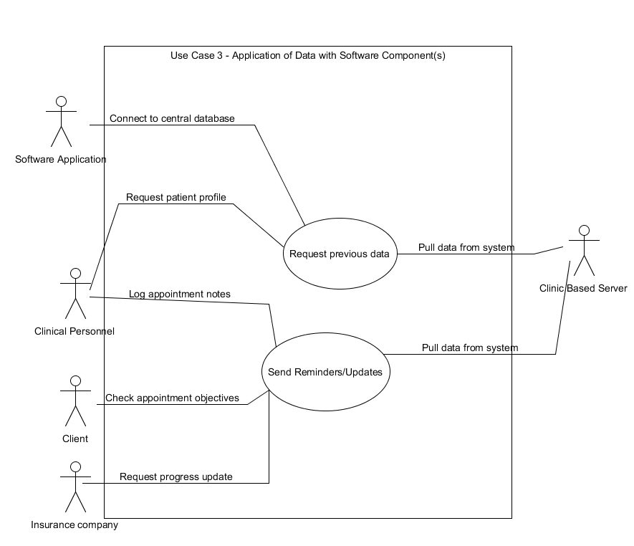
Use Case 3 - Application of data with software component(s)
*See appendix for use case narrative
*Idealized future use case
External software should be able to:
Store data on accessible location
  Retrieve previous measurements
  Show trends in progress
    Utilize analytics
Notify clinician/patient
  Interface with insurance companies?
  Goals of the week?
  Appointment times?
Notes:
Justin

Slide 15
Prototype Proposal - with Rationale
Features / Capabilities:
-Calculates angle automatically
-Stores up to 64 values in ordered format (Measurement #, Active vs Passive)
-Exports recorded values via USB to a formatted CSV file
User Interface (Hardware):
-Rulers used to measure angle
-Three buttons allow for interaction with the system
-LCD for easy viewing
User Interface (Software):
-Up/Down button used to navigate between measurements
-Center button used to record measurement
-Press all buttons for export
Notes:
Ben

Slide 16
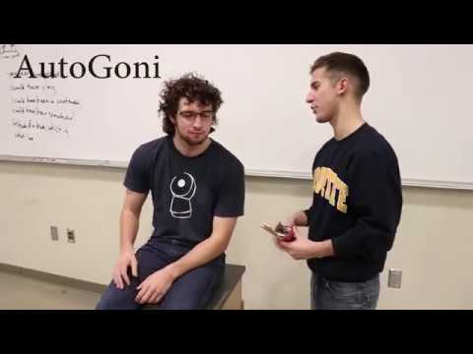
Demo
Notes:
Ben

Slide 17
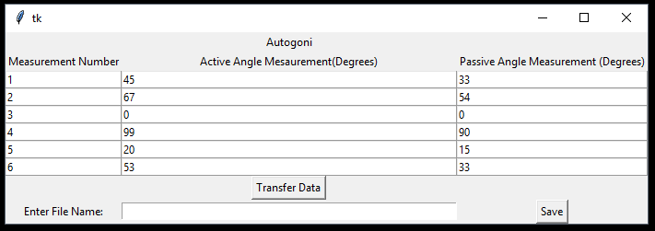
Software - Archival Side
Data Storage
Transfers measurements recorded on the Autogoni
Steps
Connect Autogoni to computer via USB
Open Autogoni Application
Verify/Modify measurments
Enter file name
Save data to computer
Notes:
Kevin

Slide 18
Software - Embedded Side / Device UI
-Developed in C and assembly; running on uC-OS II for real-time event tracking
-Two sets of values are stored on click, for either active or passive measurement
-Using button interface, user is able to scroll through previous measurements
-User is able to overwrite / clear previous values
Notes:
Paul

Slide 19
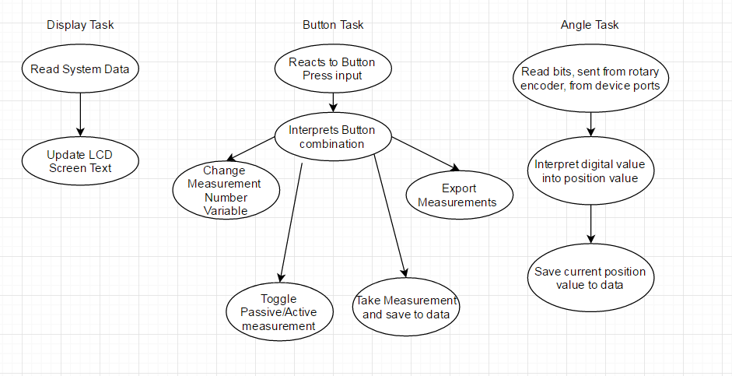
Software - Embedded Side / Device UI
Notes:
Paul

Slide 20
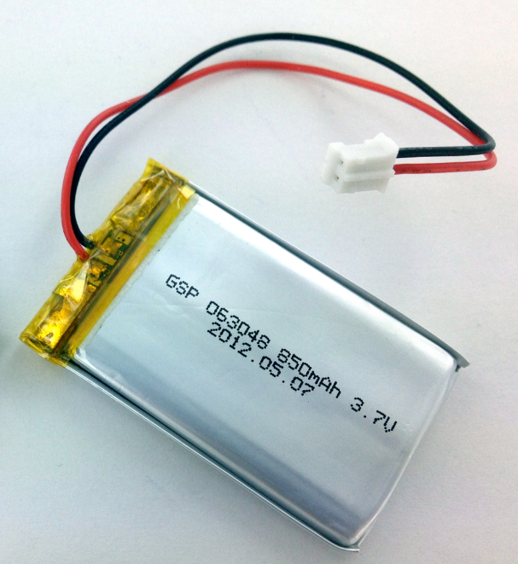
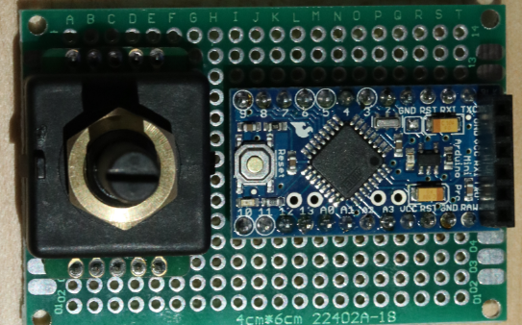
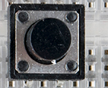
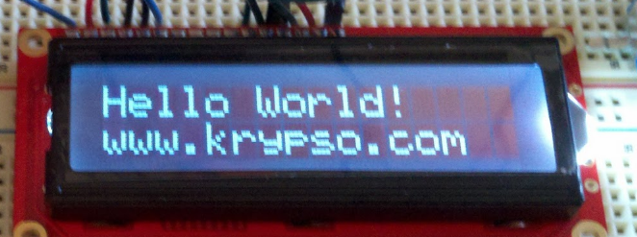
Hardware
Components:
-Arduino Mini used as microcontroller and for data processing
-6mm tactile buttons used as user input
-HD44780U LCD II Screen used for display and for user interaction
-ACE-128 Rotary Encoder used as hardware interface for angle measurements
-3.3V Battery used as power source
-2x Rulers used as goniometer arms for measurement
-Mini-USB adapter used for interfacing with computer
-USB to mini-USB cable used for serial transmission and charging

Slide 21
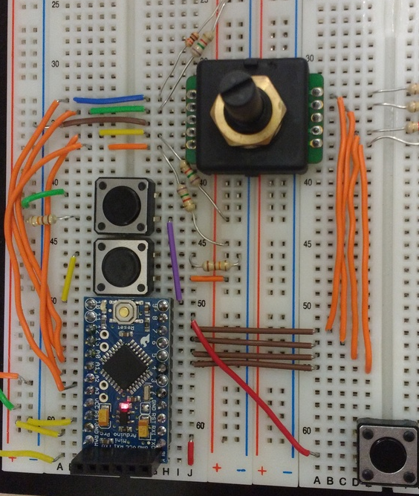
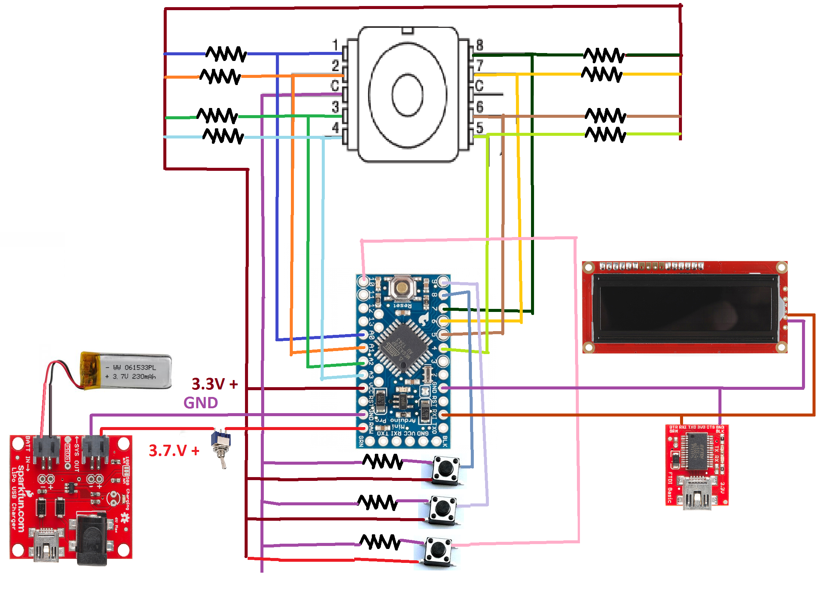
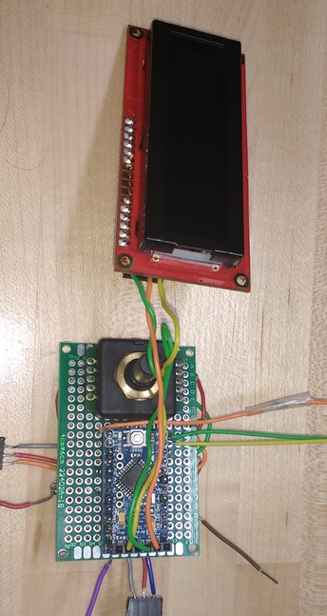
Prototyping Process

Slide 22
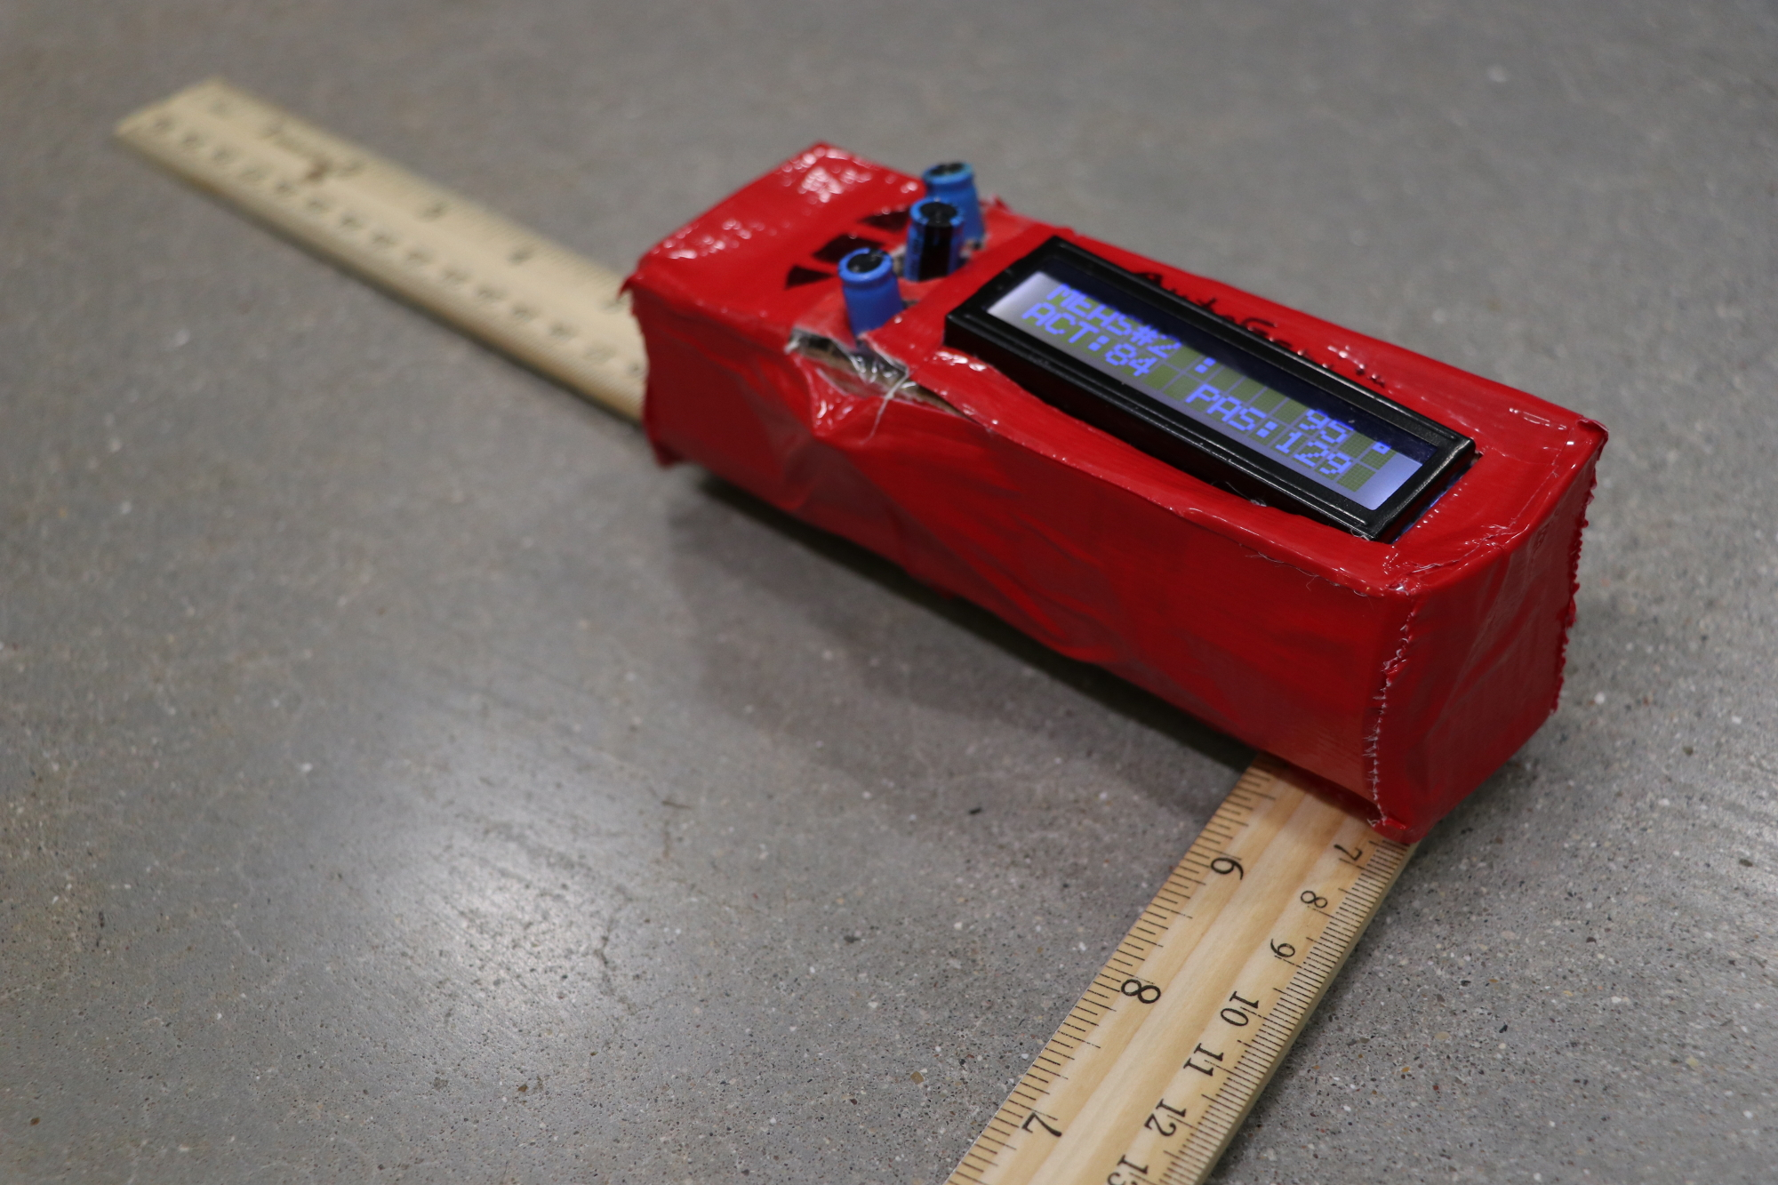
Assembled Prototype

Slide 23
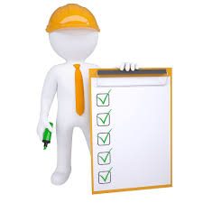
Testing
“Did we build what the customer wanted?”
Customer feedback on the prototype
Comparison to existing manual goniometer
“Did we build what we intended to build?”
Automated full Range of Motion test bench in Python
Notes:
Gleb

Slide 24
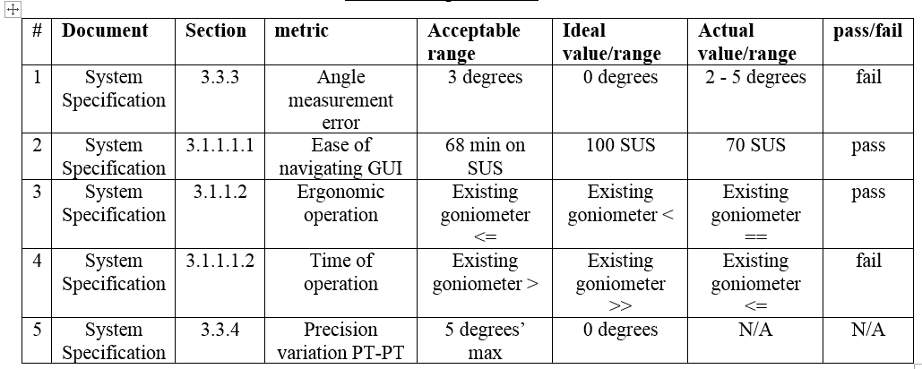
Product Verification Summary
Notes:
Gleb

Slide 25
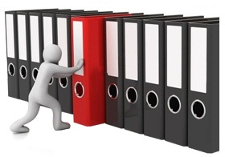
Documentation
Three main specification documents
System
Hardware
Software
Each document details requirements that the device needs to meet
Requirements are used in testing and final results are detailed in testing document
All specifics are considered and outlined
Scales and limits are given for appropriate requirements
Everything is detailed and thought through here so the goals of the product are clear for development
Answers the questions
“Did we build the right product?”
“Did we build the product right?”

Slide 26
Safety & Failure Mode Effects Analysis (FMEA)
The safety team looked at the potential failure modes, and hazards associated with the hardware and software. Developed a mitigation plan for any hazards that occur in the device.
Occurrence - how often?
Severity - how bad?
Detection - before an error occurs
RPN - Risk Priority number

Slide 27


Future Possibilities
Future capabilities
Integration with established clinic software
Stand alone product for smaller applications
Future market research

Slide 28
Conclusion
Idea Selection
Customer outreach
Prototype proposal
Software
  AutoGoni side
  Archive side
Hardware
Verification
Safety
Documentation
Future Possibilities

Slide 29
Acknowledgements
-Dr. Scheidt and Richard Schroeder (Advisors)
-Jeff Wilkens (MUPT Department)
-Elizabeth Zierke (Athletico)
-Albojay Deacon, Corrie Gustin, Casey Houlihan, Jennifer Burke, Abigail Teofanovic, Michelle Naumen and Mrs. Durette (Interviewees)

Slide 30
Questions?

Slide 31
Appendix

Slide 32
Use Case Narrative for use case 1 - Performing Goniometric Measurements
Nominal flow of events:
This use case occurs when a patient would enter a clinic for any type of care (rehabilitative, complaint of pain, etc…). The Autogoni would then be utilized like a goniometer in that the PT would generate and record measurements in order to serve as a baseline value for the insurance company (if they were providing co-payment) or for the PT’s use (to provide a targeted improvement plan). During the course of measurement, the PT may want to specify different measurements (active vs. passive), or review measurements from earlier in the measurement process.
Exceptional flow of events:
An exceptional flow of the events may occur if a patient is in the middle of an appointment (after measurements have already been collected) and begins to experience a sudden tightening of a given muscle. The PT would then be called into action to startup the Autogoni and take another set of measurements, possibly utilizing both active and passive measurements. Given the PT had already ported their measurements to an external software application - this interruption in the appointment could be handled gracefully by the Autogoni.

Slide 33
Use Case Narrative for use case 2 - Device data archival
Nominal flow of events:
This use case occurs when a PT has lined up the patient’s extremity to the correct ROM and wishes to record the angle value. The PT would simply press the center circle button, saving the value they have displayed on the screen. The PT may also feel the need to delete measurements, overwrite a previous measurement, all of which can be accomplished by selecting the correct sequencing of the buttons. Finally, the patient will wish to export the data to a software application for storage - this will be accomplished by connecting the device via serial port to a CPU.
Exceptional flow of events:
An exceptional flow of the events may occur if for whatever reason, the system reads in garbage values from the Autogoni. In this instance, the PT would need to delete the previously recorded values in the Autogoni, possibly powercycle the device, and quickly retake the measurements running through the same work flow as the nominal flow of events describes. If this situation were to occur, the PT may or may not choose to forgo measurements given, they had already spent valuable time taking measurements in the beginning of the appointment.

Slide 34
Use Case Narrative for use case 3 - Application of data with software component(s)
Nominal flow of events:
This use case occurs when a PT has uploaded the patient data to their system’s database and may wish to send it to a central electronic medical record (EMR) system for further application. Although none of the functionality has been created, in theory, the data could be utilized to show trends in patient data, utilize analytics, or provide notifications to any of the groups involved in payment for the patients’ treatment (insurance groups included).
Exceptional flow of events:
An exceptional flow of the events may occur if for whatever reason, a patient’s place of employment is refuses to assist in payment of a rehabilitation therapy program because they no longer see data to support it. The data analysis that had been performed on the patient’s database (stored in a larger EMR system) could be utilized to convince the employer that in fact the patient is still on track in their treatment plan and can save them more money, if they receive appropriate treatment versus if they continue to miss work due to pain from the initial injury.

Slide 35
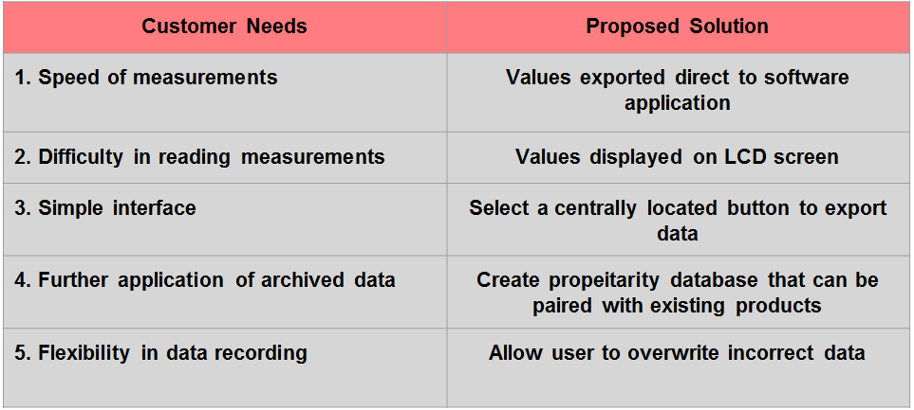
Customer Needs Table

