Slide 1
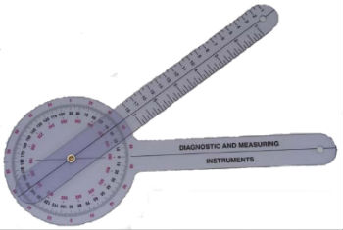
™
AutoGoni
The Automatic Goniometer
The goniometer is a type of protractor used by Physical Therapists to measure angles of body joints.
The Problem
It is cumbersome to use both hands to move the goniometer while simultaneously reading and recording the results

Slide 2
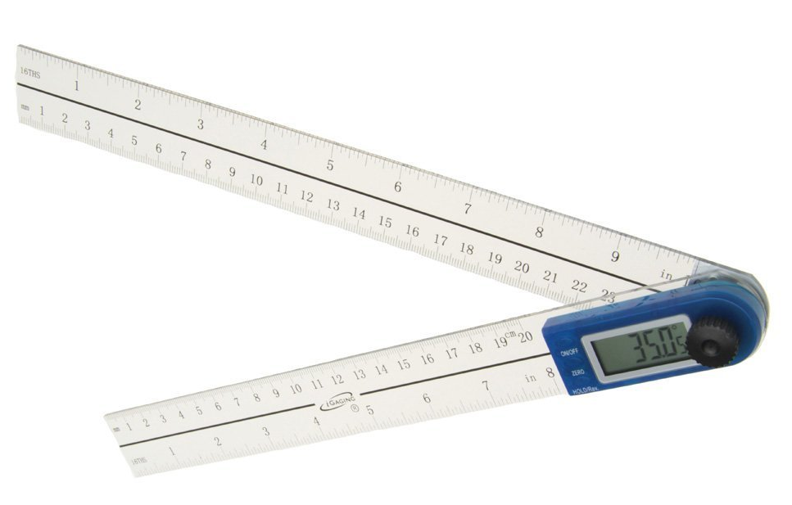
™
AutoGoni
The Automatic Goniometer
Digital Goniometers exist…
But you must still read the results and write it down for each measurement…
Wasted Time!
What if there was a better way?

Slide 3
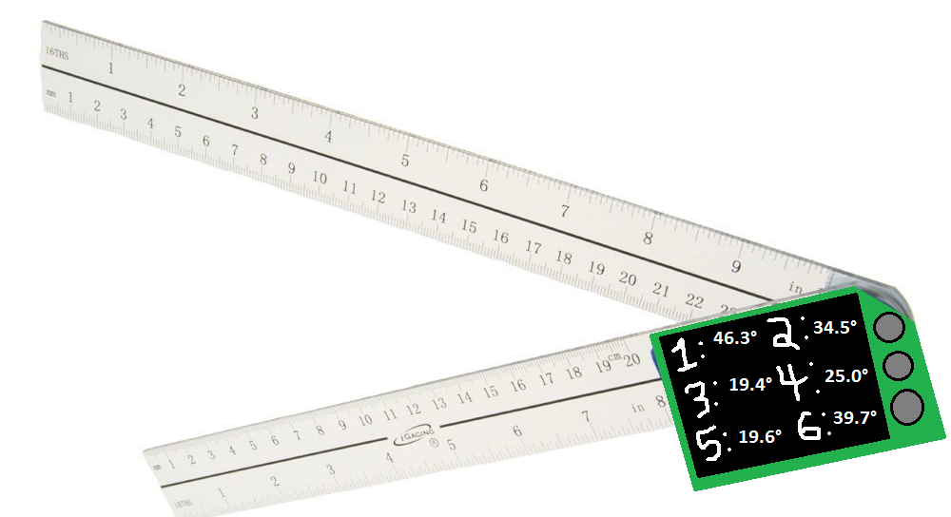
AutoGoni™
- Automatically detects the max angle achieved per measurement
- Up to 6 measurements visible on the screen at a time
- Up to 255 measurements can be stored in the device to either be read through externally or transferred digitally over the computer

Slide 4
™
AutoGoni
The Automatic Goniometer
Other Functionality?
Sync to computer program to automatically track and display progress over multiple session’s measurements
Real-time data acquisition of angle vs. time, speed, etc.
And anything else!
Questions?

