Slide 1
Count 4-bit
https://people.vts.su.ac.rs/~pmiki/_DALJINSKA_NASTAVA_MIKROKONTROLERI/07.04/count4bit.mp4
void loop(){
for(int i=0; i<16; i++)
// increment automatically from 0 to 15
{
int a=i%2; // calculate LSB
int b=i/2 %2;
int c=i/4 %2;
int d=i/8 %2; //claculate MSB
digitalWrite(5,d); //write MSB
digitalWrite(4,c);
digitalWrite(3,b);
digitalWrite(2,a); // write LSB
delay(200); // wait for a second
}
}
void setup(){
pinMode(2,OUTPUT);
// declare LED pins as output pins
pinMode(3,OUTPUT);
pinMode(4,OUTPUT);
pinMode(5,OUTPUT);
}

Slide 2
Count 4-bit
void loop(){
for(int i=0; i<16; i++)
// increment automatically from 0 to 15
{
int a=i%2; // calculate LSB
int b=i/2 %2;
int c=i/4 %2;
int d=i/8 %2; //claculate MSB
digitalWrite(5,d); //write MSB
digitalWrite(4,c);
digitalWrite(3,b);
digitalWrite(2,a); // write LSB
delay(200); // wait for a second
}
}

Slide 3
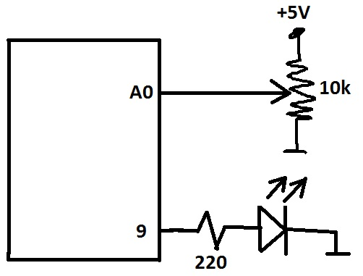
LED intensity with pot-meter
https://people.vts.su.ac.rs/~pmiki/_DALJINSKA_NASTAVA_MIKROKONTROLERI/07.04/potPWM.mp4
int potPin = A0;
int potValue = 0;
int LED = 9;
void setup() {
Serial.begin(9600);
pinMode(LED, OUTPUT);
}
void loop() {
potValue = analogRead(potPin);
Serial.println(potValue);
analogWrite(LED, potValue / 4);
delay(10);
}

Slide 4
Žmigavac bez korišćenja funkcije Delay

Slide 5
Hardver
Koristi se samo LED na nožici 13, dodatno povezivanje nije potrebno.
digitalWrite(13, HIGH);
delay (2000); // wait 2s from now
digitalWrite(13, LOW);
delay (5000); // wait 5s from now
// no common referent time!!!

Slide 6
millis()
Jedan od najmoćnijih Arduno funkcija.
Ova funkcija sadrži broj milisekundi od priključenja napona napajanja, ili od poslednjeg reset-a.
Kad posmatramo ručni sat, on nam kazuje koliko vremena je proteklo od ponoći. To je ideja funkcije millis().

Slide 7
delay() vs. millis()
delay(): treba čekati određeni vremenski interval
millis(): pitamo se koliko vremena je prošlo?

Slide 8
Primer 1.
void setup() {
pinMode(13, OUTPUT);
}
void loop() {
digitalWrite(13, HIGH); // set the LED on
delay(1000); // wait for a second
digitalWrite(13, LOW); // set the LED off
delay(1000); // wait for a second
}
// Kod je svaki put blokiran po 1000ms.

Slide 9
Primer 2.
Koristimo delay, ali samo 1ms unutar for petlje.
void setup() {
pinMode(13, OUTPUT);
}
void loop() {
digitalWrite(13, HIGH); // set the LED on
for (int x=0; x < 1000; x++) { // Wait for 1 second
delay(1);
}
digitalWrite(13, LOW); // set the LED on
for (int x=0; x < 1000; x++) { // Wait for 1 second
delay(1);
}
}
Moguće je
pozivati druge
funkcije unutar
for petlje, ali
to će uticati
na vreme
kašnjenja.

Slide 10
Primer 3: Žmigavac sa millis() funkcijom
unsigned long interval=1000; // the time we need to wait
unsigned long previousMillis=0; // millis() returns an unsigned long.
bool ledState = false; // state variable for the LED
void setup() {
pinMode(13, OUTPUT);
digitalWrite(13, ledState);
}
void loop() {
unsigned long currentMillis = millis(); // grab current time
// check if "interval" time has passed (1000 milliseconds)
if ((unsigned long)(currentMillis - previousMillis) >= interval) {
ledState = !ledState; // "toggles" the state
digitalWrite(13, ledState); // sets the LED based on ledState
// save the "current" time
previousMillis = millis();
}
}

Slide 11
Primer 4. Dva LED-a sa millis() funkcijom
LED-ovi su priključeni na nožice 12 i 13. Intervali treptanja nisu isti.
// each "event" (LED) gets their own tracking
// variable
unsigned long previousMillisLED12=0;
unsigned long previousMillisLED13=0;
// different intervals for each LED
int intervalLED12 = 500;
int intervalLED13 = 1000;
// each LED gets a state varaible
boolean LED13state = false;
// the LED will turn ON inthe first iteration of loop()
boolean LED12state = false;
// need to seed the light to be OFF
void setup() {
pinMode(13, OUTPUT);
pinMode(12, OUTPUT);
}

Slide 12
Primer 4. Dva LED-a sa millis() funkcijom
void loop() {
// get current time stamp
// only need one for both if-statements
unsigned long currentMillis = millis();
// time to toggle LED on Pin 12?
if ((unsigned long)(currentMillis - previousMillisLED12) >= intervalLED12) {
LED12state = !LED12state;
digitalWrite(12, LED12state);
// save current time to pin 12's previousMillis
previousMillisLED12 = currentMillis;
}
// time to toggle LED on Pin 13?
if ((unsigned long)(currentMillis - previousMillisLED13) >= intervalLED13) {
LED13state = !LED13state;
digitalWrite(13, LED13state);
// save current time to pin 12's previousMillis
previousMillisLED13 = currentMillis;
}
}

Slide 13
Button press
LED on pin 13, resistor 220Ω.
2-ground: 10kΩ, 2-VCC pushbutton
const int buttonPin = 2;
const int ledPin = 13;
int buttonState = 0;
void setup() {
pinMode (ledPin, OUTPUT);
pinMode (buttonPin, INPUT);
}
void loop() {
buttonState = digitalRead(buttonPin);
if (buttonState == HIGH) {
digitalWrite(ledPin, HIGH);
}
else {
digitalWrite(ledPin, LOW);
}
}
Prepraviti program tako da se
broj pritisaka tastera prikazuje
na Serial monitor-u.

Slide 14
Adrese
https://people.vts.su.ac.rs/~pmiki/_DALJINSKA_NASTAVA_MIKROKONTROLERI/07.04/rnd1LED.mp4
https://people.vts.su.ac.rs/~pmiki/_DALJINSKA_NASTAVA_MIKROKONTROLERI/07.04/rnd1LEDb.mp4
https://people.vts.su.ac.rs/~pmiki/_DALJINSKA_NASTAVA_MIKROKONTROLERI/07.04/rnd4LED.mp4

Slide 15
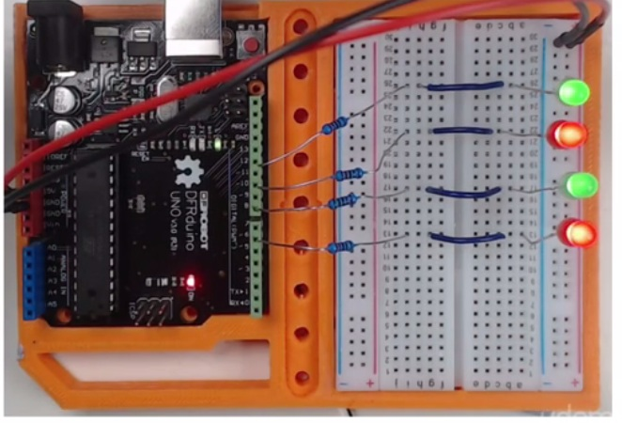
Random blinks

Slide 16
1. primer
int led1 = 6;
int led2 = 8;
int led3 = 10;
int led4 = 12;
void setup() {
pinMode(led1, OUTPUT);
pinMode(led2, OUTPUT);
pinMode(led3, OUTPUT);
pinMode(led4, OUTPUT);
}
void loop() {
digitalWrite(random(6,13), HIGH);
delay(100);
digitalWrite(led1, LOW);
digitalWrite(led2, LOW);
digitalWrite(led3, LOW);
digitalWrite(led4, LOW);
delay(1000);
}

Slide 17
2. primer
void loop() {
digitalWrite(led1, random(0,2));
digitalWrite(led2, random(0,2));
digitalWrite(led3, random(0,2));
digitalWrite(led4, random(0,2));
delay(200);
digitalWrite(led1, LOW);
digitalWrite(led2, LOW);
digitalWrite(led3, LOW);
digitalWrite(led4, LOW);
}
int led1 = 6;
int led2 = 8;
int led3 = 10;
int led4 = 12;
void setup() {
pinMode(led1, OUTPUT);
pinMode(led2, OUTPUT);
pinMode(led3, OUTPUT);
pinMode(led4, OUTPUT);
}

Slide 18
3. primer
void loop() {
digitalWrite(led1, random(0,2));
digitalWrite(led2, random(0,2));
digitalWrite(led3, random(0,2));
digitalWrite(led4, random(0,2));
delay(random(100,600));
digitalWrite(led1, LOW);
digitalWrite(led2, LOW);
digitalWrite(led3, LOW);
digitalWrite(led4, LOW);
}
int led1 = 6;
int led2 = 8;
int led3 = 10;
int led4 = 12;
void setup() {
pinMode(led1, OUTPUT);
pinMode(led2, OUTPUT);
pinMode(led3, OUTPUT);
pinMode(led4, OUTPUT);
}

Slide 19
Adrese
https://people.vts.su.ac.rs/~pmiki/_DALJINSKA_NASTAVA_MIKROKONTROLERI/07.04/reactionHardware.mp4
https://people.vts.su.ac.rs/~pmiki/_DALJINSKA_NASTAVA_MIKROKONTROLERI/07.04/reactionTime.mp4

Slide 20
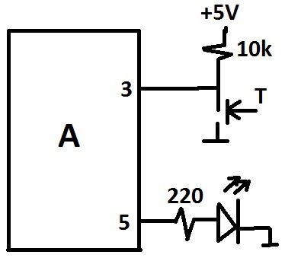
Vreme reakcije
int counter = 0;
int button = 3;
int led = 5 ;
void setup() {
pinMode(button, INPUT);
pinMode(led, OUTPUT);
Serial.begin(9600);
}
void loop() {
delay(random(2000, 5000));
digitalWrite(led, HIGH);
while(digitalRead(button) == HIGH){
counter = counter + 1;
delay(10);
}
Serial.print(“Vaše vreme je ");
Serial.print(counter);
Serial.println(" stotinki sekunde.");
digitalWrite(led, LOW);
delay(2000);
counter = 0;
}

