Slide 1
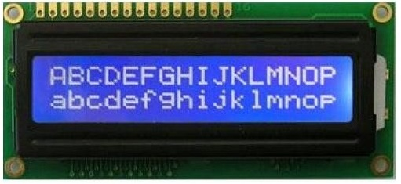
LIQUID CRYSTAL DISPLAY (LCD)

Slide 2
LCD
2x16 karaktera
Hitachi HD44780
Pozadinsko osvetljenje
Podešavanje kontrasta
DDRAM (Data Display)
CGRAM (Character Generation)
Generisanje sopstvenih karaktera

Slide 3
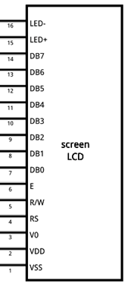
LCD
VSS– masa
VDD – napajanje
V0 – kontrast
RS – register select
R/W – Read/Write
E – enable
D0-D7 – Data bus
LED+ – pozadinsko osvetljenje
LED- – pozadinsko osvetljenje

Slide 4
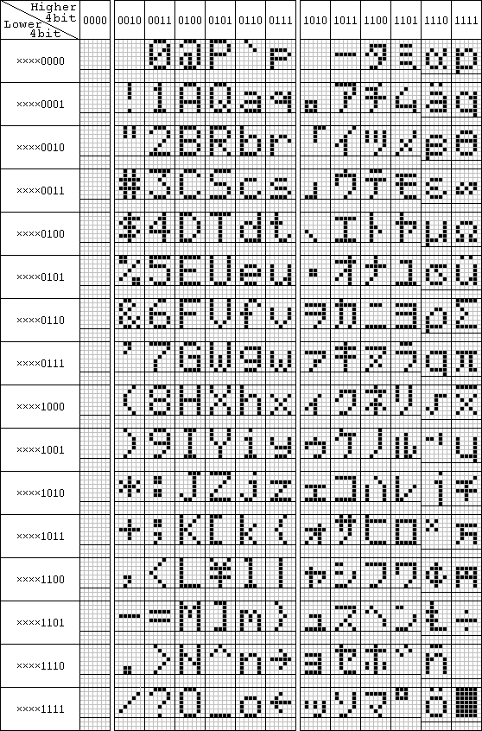
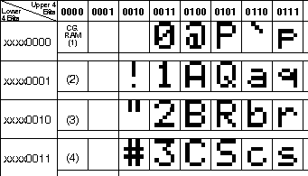
Karakteri

Slide 5
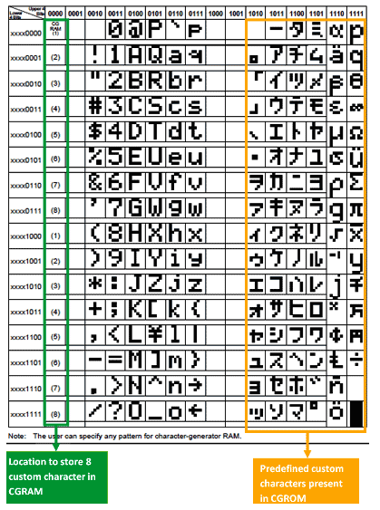
Karakteri

Slide 6
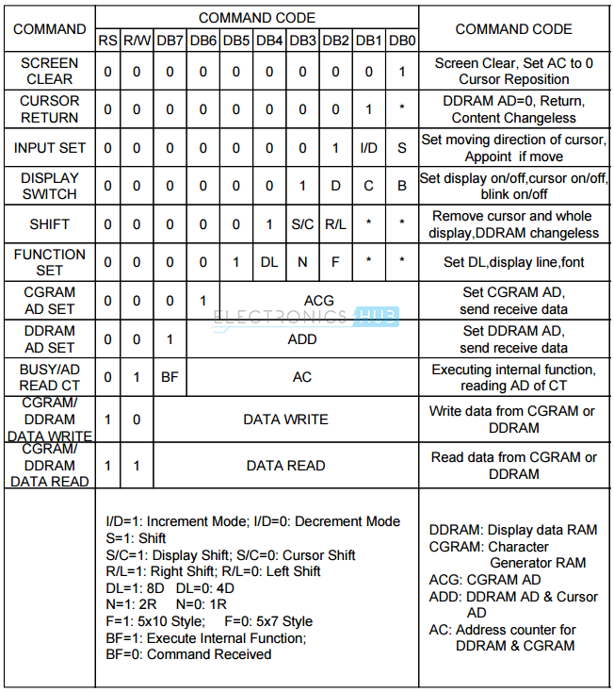
Tabela sa komandama

Slide 7
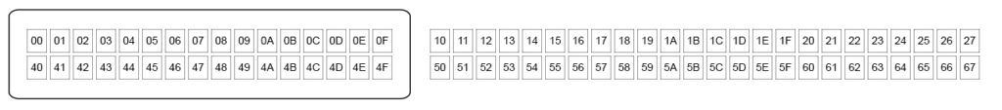
Memorija

Slide 8
Arduino biblioteka LiquidCrystal.h
#include <LiquidCrystal.h>
Ugrađene funkcije
begin(), clear(), home(), setCursor(), cursor(), noCursor(), blink(), noBlink()
write(): char, print(): text
scrollDisplayLeft(), scrollDisplayRight()
leftToRight(), rightToLeft()
createChar()

Slide 9
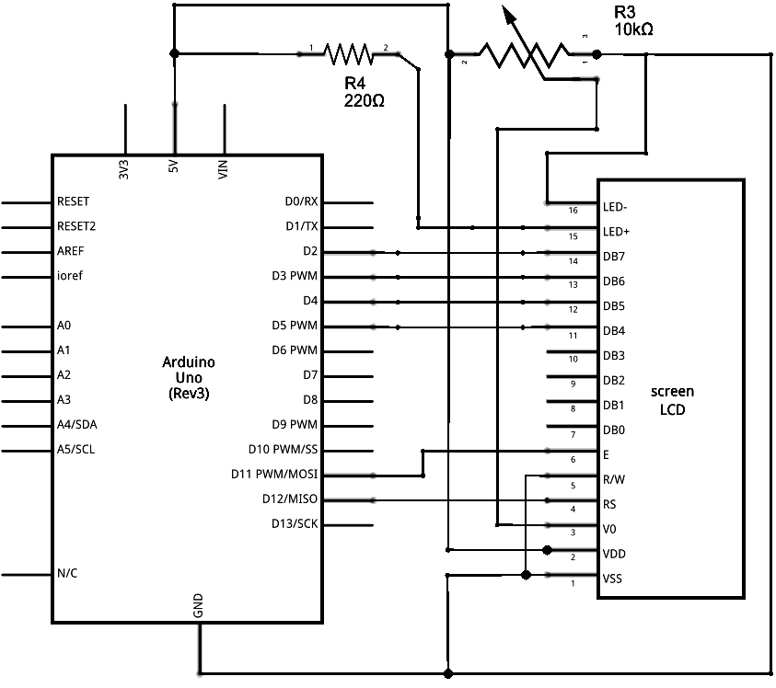
Hardver

Slide 10
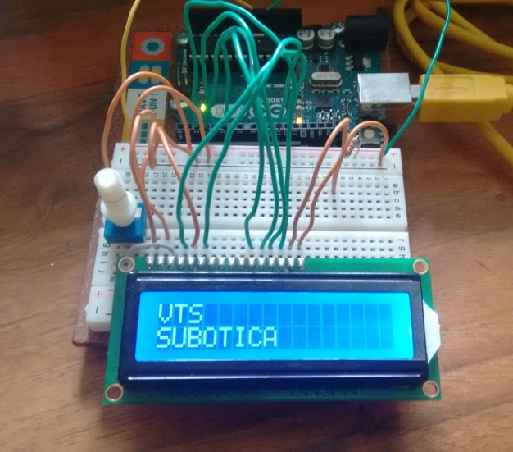
Primer 1.
// include the library code:
#include <LiquidCrystal.h>
// initialize the library with the numbers of the interface pins
// RS, E, D4, D5, D6, D7
LiquidCrystal lcd(12, 11, 5, 4, 3, 2);
void setup() {
// set up the number of columns and rows on the LCD
lcd.begin(16, 2);
}
void loop() {
lcd.setCursor(0, 0);
lcd.print("VTS");
lcd.setCursor(0, 1);
lcd.print("SUBOTICA");
delay(500);
lcd.clear();
}

Slide 11
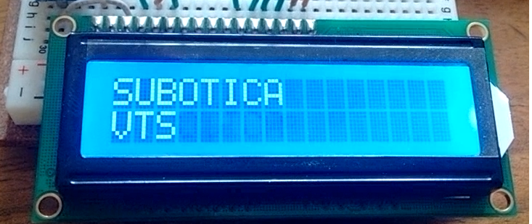
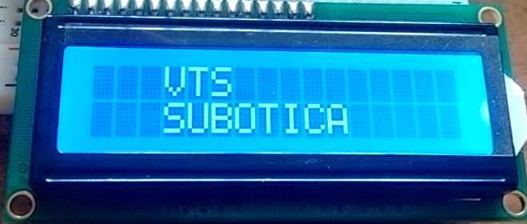
Primer 2.
// include the library code:
#include <LiquidCrystal.h>
// initialize the library
// RS, E, D4, D5, D6, D7
LiquidCrystal lcd(12, 11, 5, 4, 3, 2);
void setup() {
// set up the number of columns and rows
lcd.begin(16, 2);
}
void loop() {
lcd.clear();
lcd.cursor();
lcd.blink();
delay(5000);
lcd.noCursor();
lcd.noBlink();
for (int i=1; i<6; i++){
lcd.setCursor(0, 0);
lcd.print("VTS");
lcd.setCursor(0, 1);
lcd.print("SUBOTICA");
delay(500);
lcd.clear();
lcd.setCursor(0, 1);
lcd.print("VTS");
lcd.setCursor(0, 0);
lcd.print("SUBOTICA");
delay(500);
lcd.clear();
}
lcd.setCursor(0, 0);
lcd.print("VTS");
lcd.setCursor(0, 1);
lcd.print("SUBOTICA");
delay(2000);
lcd.scrollDisplayRight();
delay(1000);
lcd.scrollDisplayRight();
delay(1000);
lcd.scrollDisplayRight();
delay(1000);
lcd.scrollDisplayLeft();
delay(1000);
lcd.scrollDisplayLeft();
delay(1000);
lcd.scrollDisplayLeft();
delay(1000);
while(true);
}
https://people.vts.su.ac.rs/~pmiki/_DALJINSKA_NASTAVA_MIKROKONTROLERI/29.04/p2.mp4

Slide 12
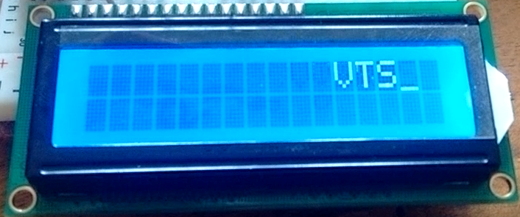
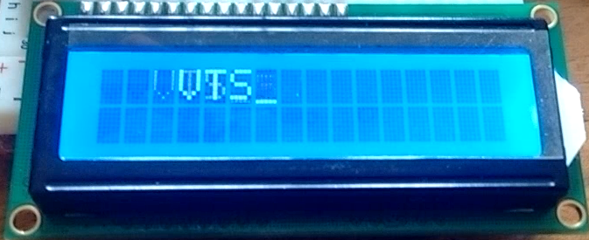
Primer 3.
// include the library code:
#include <LiquidCrystal.h>
// initialize the library with the numbers of the interface pins
LiquidCrystal lcd(12, 11, 5, 4, 3, 2);
void setup() {
// set up the number of columns and rows on the LCD
lcd.begin(16, 2);
}
void loop() {
lcd.clear();
lcd.cursor();
lcd.blink();
lcd.print("VTS");
for(int i=1; i<51; i++){
lcd.scrollDisplayRight();
delay(200);
}
while(true);
}
https://people.vts.su.ac.rs/~pmiki/_DALJINSKA_NASTAVA_MIKROKONTROLERI/29.04/p3.mp4

Slide 13
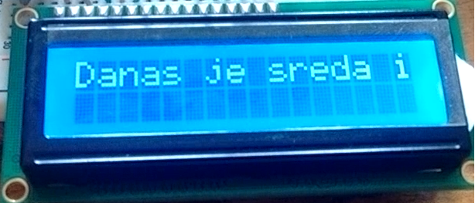
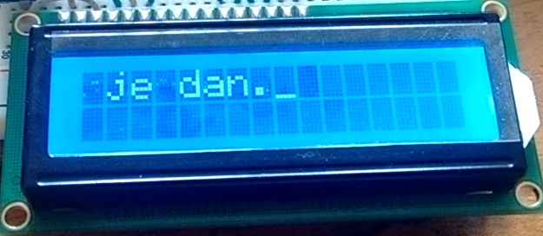
Primer 4.
// include the library code:
#include <LiquidCrystal.h>
// initialize the library with the numbers of the interface pins
LiquidCrystal lcd(12, 11, 5, 4, 3, 2);
void setup() {
// set up the number of columns and rows on the LCD
lcd.begin(16, 2);
}
void loop() {
lcd.clear();
lcd.cursor();
lcd.blink();
delay(5000);
lcd.print("Danas je sreda i lep je dan.");
delay(3000);
for (int i=1; i<38; i++){
lcd.scrollDisplayLeft();
delay(300);
}
while(true);
}
https://people.vts.su.ac.rs/~pmiki/_DALJINSKA_NASTAVA_MIKROKONTROLERI/29.04/p4.mp4

Slide 14
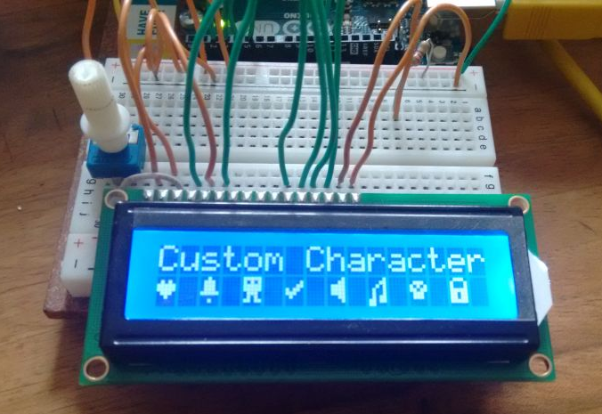
Primer 5.
/* Example sketch to create and display custom characters on character LCD with Arduino and LiquidCrystal library. For more info see www.makerguides.com */
#include <LiquidCrystal.h>
// Creates an LCD object. Parameters: (RS, E, D4, D5, D6, D7)
LiquidCrystal lcd = LiquidCrystal(12, 11, 5, 4, 3, 2);
// Make custom characters:
byte Heart[] = {
B00000,
B01010,
B11111,
B11111,
B01110,
B00100,
B00000,
B00000
};
byte Bell[] = {
B00100,
B01110,
B01110,
B01110,
B11111,
B00000,
B00100,
B00000
};
byte Alien[] = {
B11111,
B10101,
B11111,
B11111,
B01110,
B01010,
B11011,
B00000
};
byte Check[] = {
B00000,
B00001,
B00011,
B10110,
B11100,
B01000,
B00000,
B00000
};

Slide 15
Primer 5. (nastavak)
byte Speaker[] = {
B00001,
B00011,
B01111,
B01111,
B01111,
B00011,
B00001,
B00000
};
byte Sound[] = {
B00001,
B00011,
B00101,
B01001,
B01001,
B01011,
B11011,
B11000
};
byte Skull[] = {
B00000,
B01110,
B10101,
B11011,
B01110,
B01110,
B00000,
B00000
};
byte Lock[] = {
B01110,
B10001,
B10001,
B11111,
B11011,
B11011,
B11111,
B00000
};
void setup() {
lcd.begin(16, 2);
// Create a new characters:
lcd.createChar(0, Heart);
lcd.createChar(1, Bell);
lcd.createChar(2, Alien);
lcd.createChar(3, Check);
lcd.createChar(4, Speaker);
lcd.createChar(5, Sound);
lcd.createChar(6, Skull);
lcd.createChar(7, Lock);
// Clears the LCD screen:
lcd.clear();
// Print a message to the lcd:
lcd.print("Custom Character");
}
void loop() {
// Print all the custom characters:
lcd.setCursor(0, 1);
lcd.write(byte(0));
lcd.setCursor(2, 1);
lcd.write(byte(1));
lcd.setCursor(4, 1);
lcd.write(byte(2));
lcd.setCursor(6, 1);
lcd.write(byte(3));
lcd.setCursor(8, 1);
lcd.write(byte(4));
lcd.setCursor(10, 1);
lcd.write(byte(5));
lcd.setCursor(12, 1);
lcd.write(byte(6));
lcd.setCursor(14, 1);
lcd.write(byte(7));
}

Slide 16
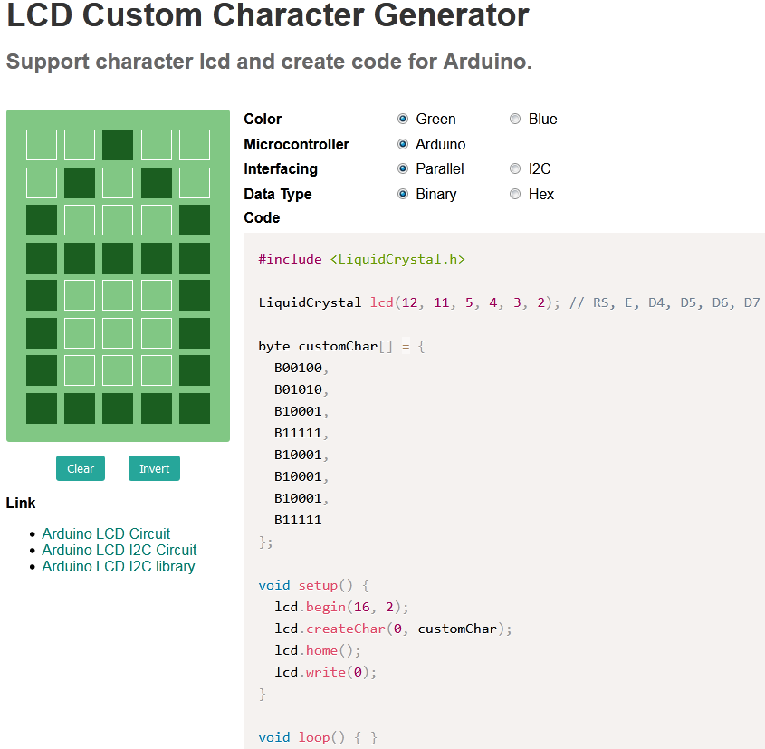
Generator karaktera

