Slide 1
Stringovi

Slide 2
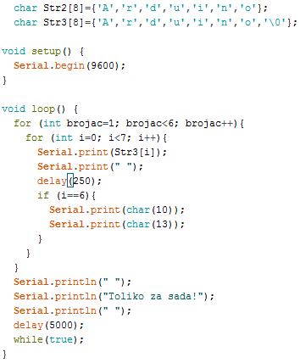
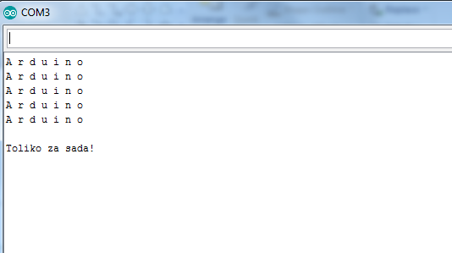
PlayString01

Slide 3
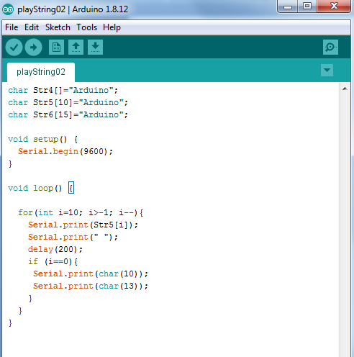
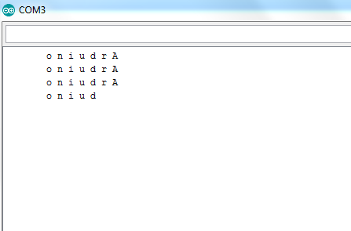
PlayString02

Slide 4
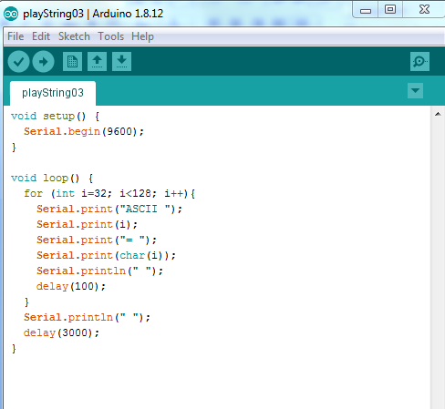
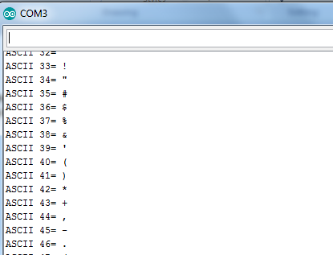
PlayString03

Slide 5
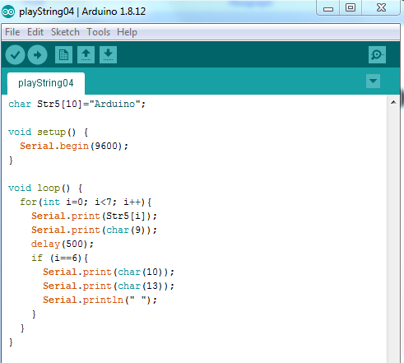
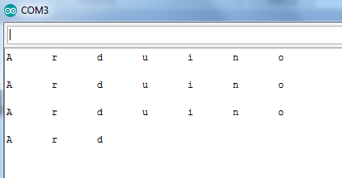
PlayString04

Slide 6
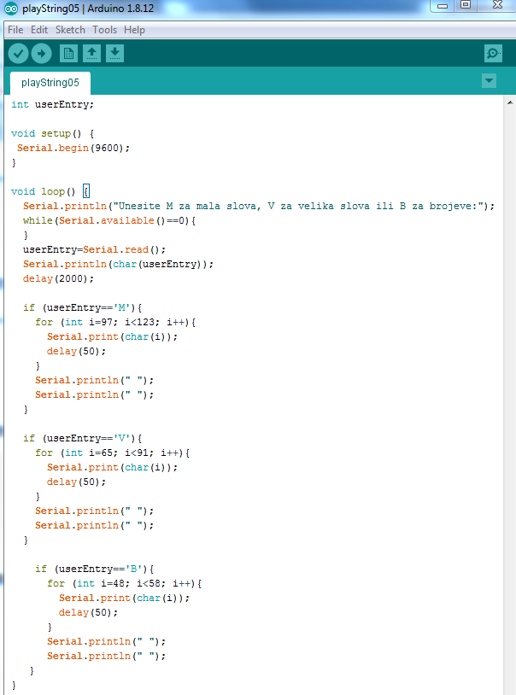
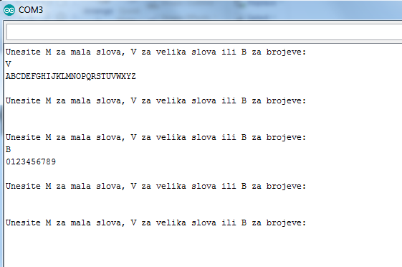
PlayString05

Slide 7
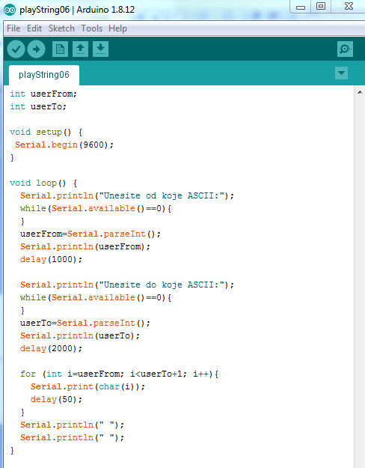
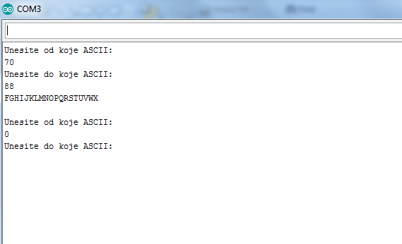
PlayString06

Slide 8
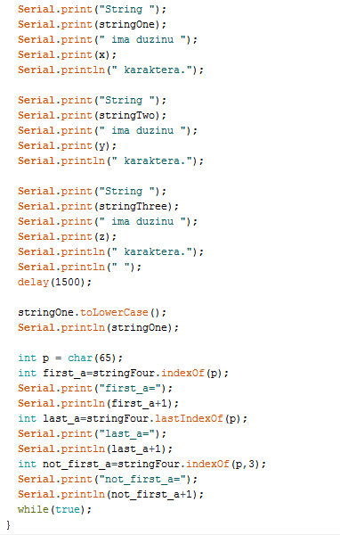
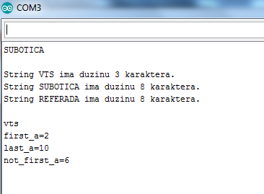
PlayString07
String stringOne = "VTS";
String stringTwo = "SUBOTICA";
String stringThree = "REFERADA";
String stringFour = "MATEMATIKA";
String q;
void setup() {
Serial.begin(9600);
}
void loop() {
int x = stringOne.length();
int y = stringTwo.length();
int z = stringThree.length();
if (stringOne.length()>stringTwo.length()){
Serial.println(stringOne);
}
if (stringOne.length()<stringTwo.length()){
Serial.println(stringTwo);
}
if (stringOne.length()==stringTwo.length()){
Serial.println("Ista duzina stringova");
}
Serial.println(" ");

Slide 9
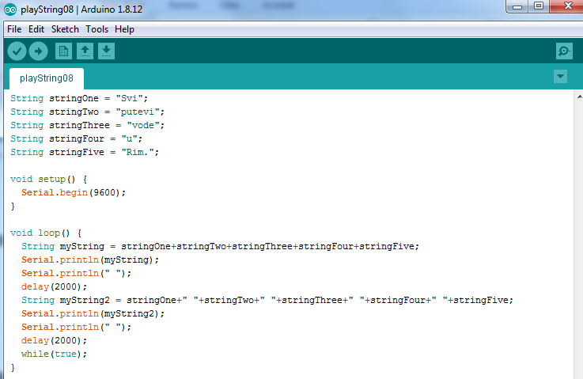
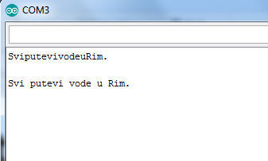
PlayString08

Slide 10
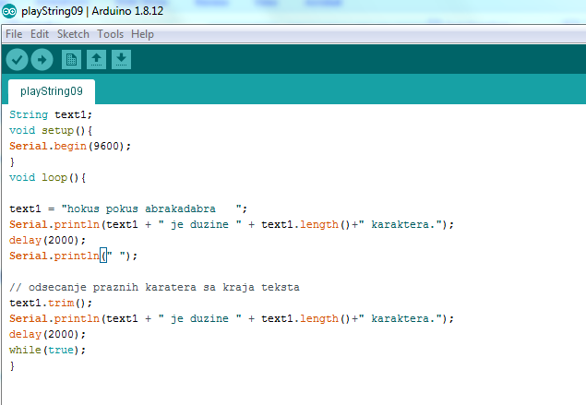
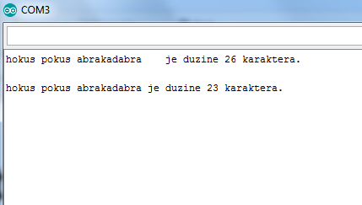
PlayString09

Slide 11
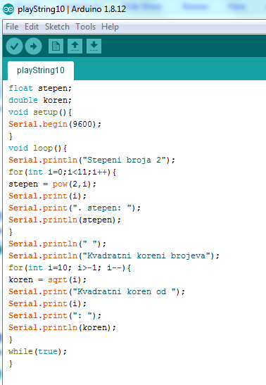
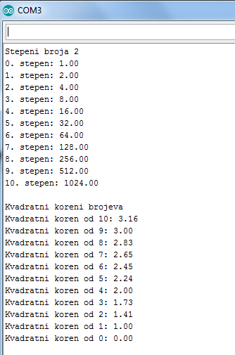
PlayString10

