Slide 1
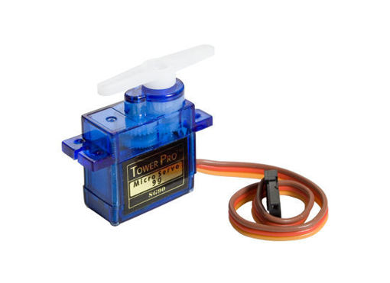
Servo motori

Slide 2
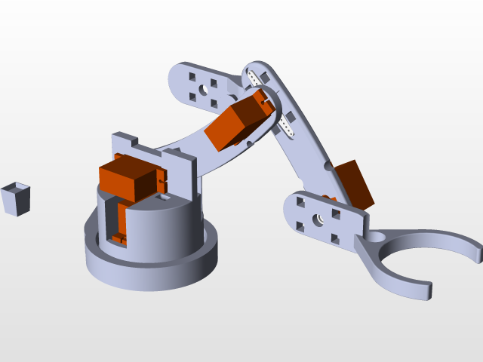
Servo motori - primena

Slide 3
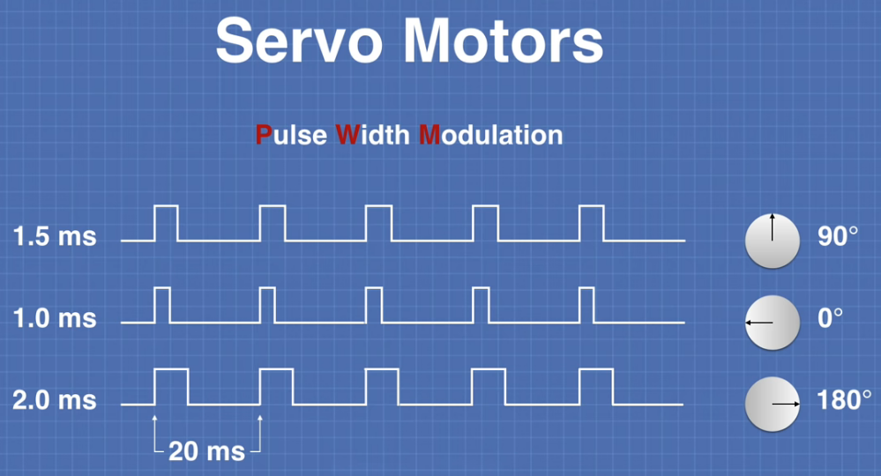
Servo

Slide 4
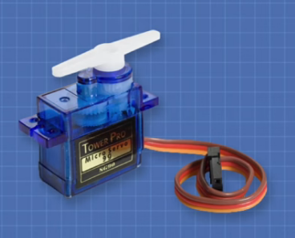
Specifikacije servo motora
Dve osnovne karakteristike servo motora su :
brzina
moment

Slide 5
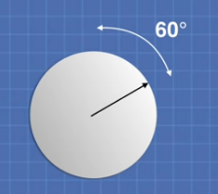
Brzina
Brzina se definiše kao vreme potrebno da se osovina
servo motora pomeri za 60 stepeni.
Na primer, 0.25s / 60°

Slide 6
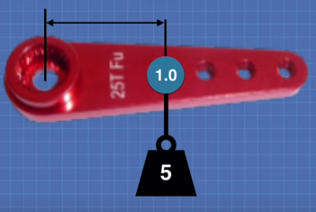
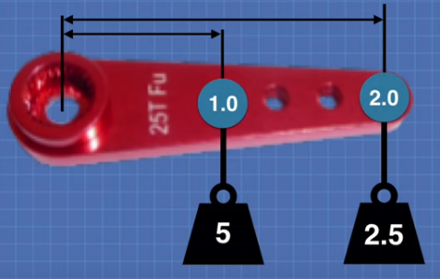
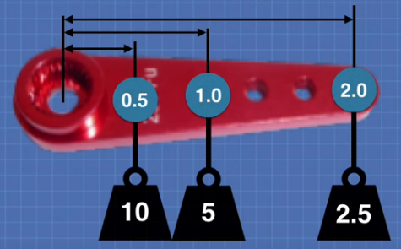
Moment
Moment se definiše kao intenzitet sile koju servo
motor može da primeni na polugu.
Meri se u kilogram-santimetrima (kg-cm).
Ili u unca-inčima (oz-in).
Primer: 5 kg-cm

Slide 7

Moment

Slide 8
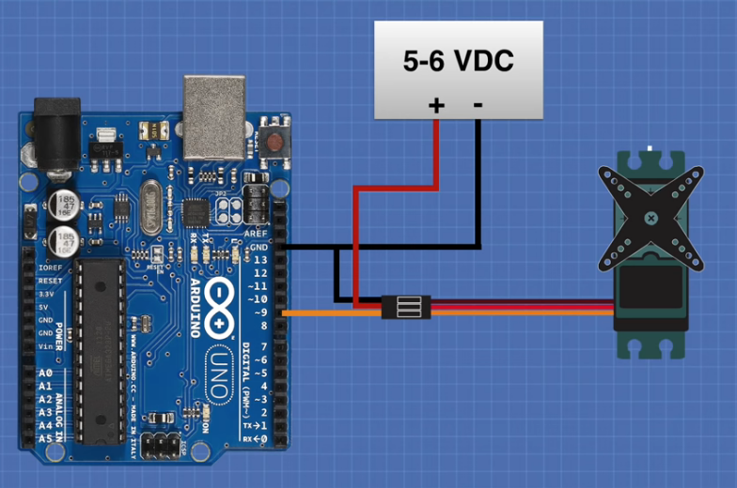
Primer 1. Povezivanje

Slide 9
Programski kod
#include <Servo.h>
Servo myservo; // create servo object to control a servo
// twelve servo objects can be created on most boards
int pos = 0; // variable to store the servo position
void setup() {
myservo.attach(9); // attaches the servo on pin 9 to the servo object
}
void loop() {
for (pos = 0; pos <= 180; pos += 1) { // goes from 0 degrees to 180 degrees
// in steps of 1 degree
myservo.write(pos); // tell servo to go to position in variable 'pos'
delay(15); // waits 15ms for the servo to reach the position
}
for (pos = 180; pos >= 0; pos -= 1) { // goes from 180 degrees to 0 degrees
myservo.write(pos); // tell servo to go to position in variable 'pos'
delay(15); // waits 15ms for the servo to reach the position
}
}

Slide 10
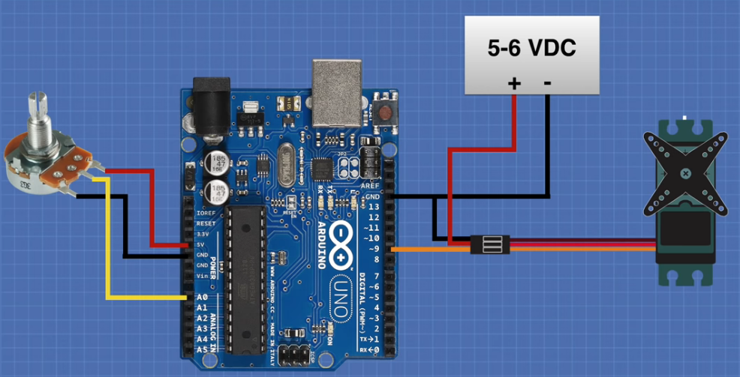
Primer 2. Potenciometar

Slide 11
Programski kod
#include <Servo.h>
Servo myservo; // create servo object to control a servo
int potpin = 0; // analog pin used to connect the potentiometer
int val; // variable to read the value from the analog pin
void setup() {
myservo.attach(9); // attaches the servo on pin 9 to the servo object
}
void loop() {
val = analogRead(potpin); // reads the value of the potentiometer (value // between 0 and 1023)
val = map(val, 0, 1023, 0, 180); // scale it to use it with the servo (value between 0 // and 180)
myservo.write(val); // sets the servo position according to the
// scaled value
delay(15); // waits for the servo to get there
}

Slide 13
Random servo
void loop() {
for (pos=0; pos<171; pos++){
myservo.write(pos);
delay(5);
}
for (pos=171; pos>1; pos--){
myservo.write(pos);
delay(5);
}
for (int i=1; i<20; i++){
myRandomNumber = random(0,180);
// tell servo to go to position in variable 'pos'
myservo.write(myRandomNumber);
// waits 250ms for the servo to reach the
// position
delay(250);
}
}
#include <Servo.h>
Servo myservo; // create servo object
// to control a servo
// variable to store the servo position
int pos, myRandomNumber = 0;
void setup() {
// attaches the servo on pin 9 to the servo object
myservo.attach(9);
}

Slide 14
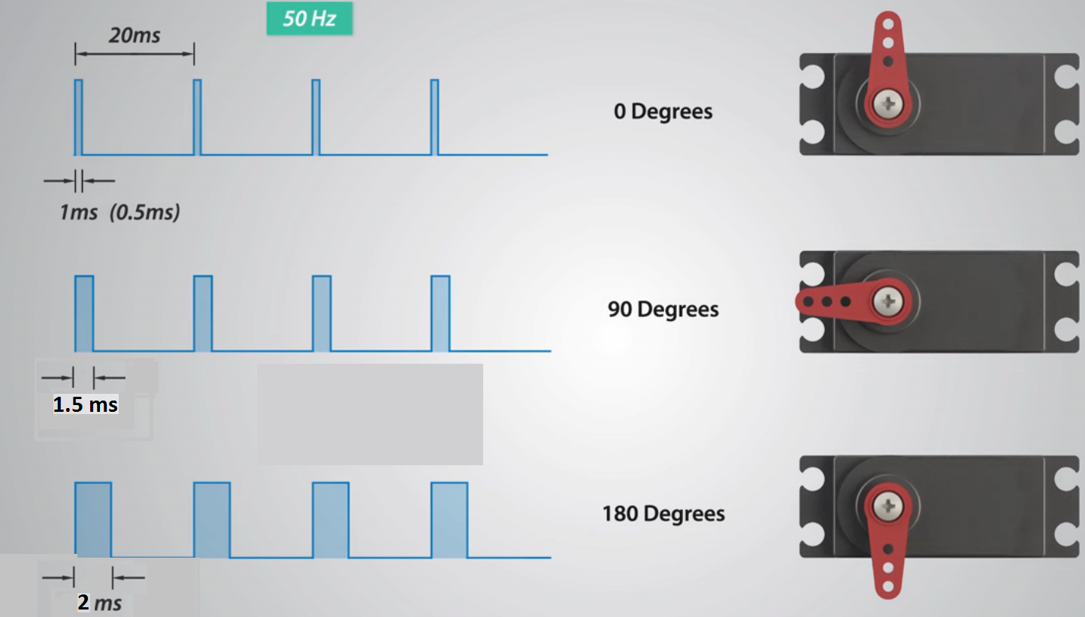
Servo

Slide 15
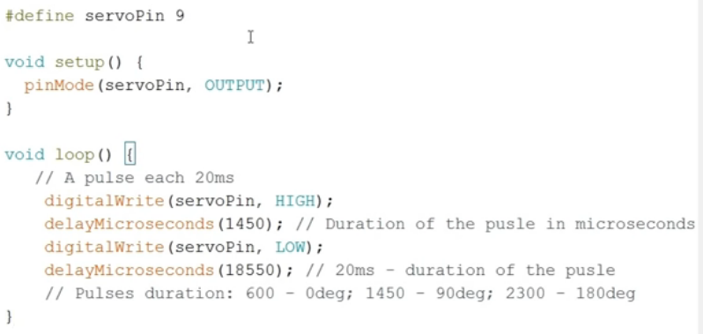
Prograsmki kod

Slide 16
Primer
void setup() {
pinMode(9, OUTPUT);
}
void loop() {
digitalWrite(9, HIGH);
delay(2);
digitalWrite(9, LOW);
delay(18);
}

Slide 17
Primer
#include <Servo.h>
Servo myservo; // create servo
// object to control a servo
// twelve servo objects can be
// created on most boards
int pos = 60;
// variable to store
// the servo position
void setup() {
myservo.attach(9);
// attaches the servo
// on pin 9 to the servo object
}
void loop() {
myservo.write(pos);
// tell servo to go to position in
// variable 'pos'
delay(10);
// waits 15ms for the servo to reach
// the position
while(true);
}

