Slide 1
TM1637

Slide 2
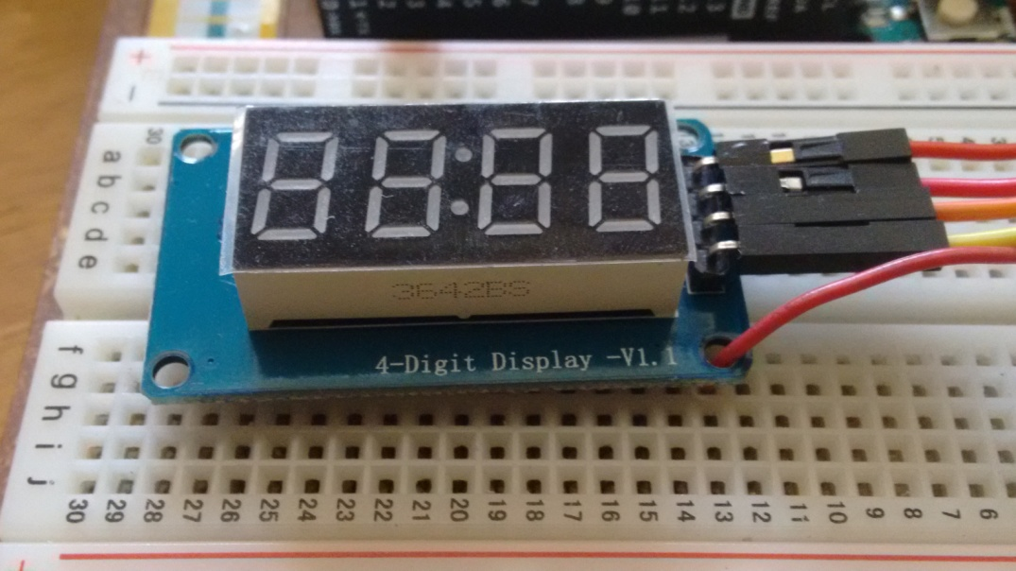
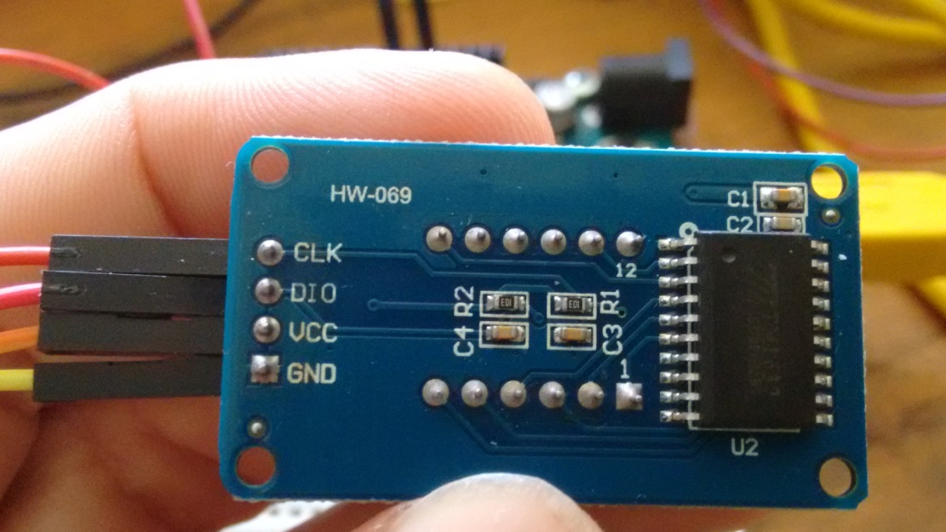
TM1637

Slide 3
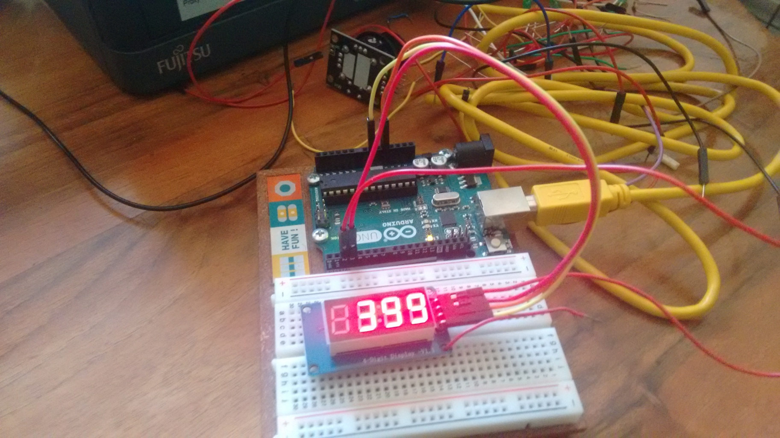
TM1637

Slide 4
Intenzitet displeja
// This program changes the brighness
// on the TM1637 diaplay.
// The current brightness is shown on the Serial Monitor.
#include <TM1637Display.h>
#define CLK 2
#define DIO 3
TM1637Display display(CLK, DIO);
void setup() {
Serial.begin(9600);
}
void loop() {
for (int i=0; i<8; i++){
display.setBrightness(i);
display.showNumberDec(99);
Serial.print("Current brightness of the display: ");
Serial.println(i);
Serial.println("");
delay(1000);
}
}

Slide 5
Brojevi na displeju
// This program sends numbers to the display.
// Numbers are shown on the Serial Monitor.
// Maximal numbers are tested.
#include <TM1637Display.h>
#define CLK 2
#define DIO 3
TM1637Display display(CLK, DIO);
void setup() {
display.setBrightness(1);
Serial.begin(9600);
}
void loop() {
display.showNumberDec(9999);
Serial.println("Number sent to diaplay: 9999");
Serial.println("Shown: 9999");
Serial.println("");
delay(500);
display.showNumberDec(10000);
Serial.println("Number sent to diaplay: 10000");
Serial.println("Shown: 0000");
Serial.println("");
delay(200);
display.showNumberDec(32767);
Serial.println("Number sent to diaplay: 32767");
Serial.println("Shown: 2767");
Serial.println("");
delay(200);
display.showNumberDec(32768);
Serial.println("Number sent to diaplay: 32768");
Serial.println("Shown: 2768");
Serial.println("");
delay(200);

Slide 6
Brojevi na displeju
display.showNumberDec(32769);
Serial.println("Number sent to diaplay: 32769");
Serial.println("Shown: 2767");
Serial.println("");
delay(200);
display.showNumberDec(32770);
Serial.println("Number sent to diaplay: 32770");
Serial.println("Shown: 2766");
Serial.println("");
delay(200);
display.showNumberDec(65535);
Serial.println("Number sent to diaplay: 65535");
Serial.println("Shown: -1");
Serial.println("");
delay(200);
display.showNumberDec(65536);
Serial.println("Number sent to diaplay: 65536");
Serial.println("Shown: 0");
Serial.println("");
delay(200);
display.showNumberDec(65537);
Serial.println("Number sent to diaplay: 65537");
Serial.println("Shown: 1");
Serial.println("");
delay(200);
while(true);
}

Slide 7
Brojač 0-10
void loop() {
for (int counter=0; counter<11; counter++){
display.showNumberDec(counter);
Serial.print("Display is ON. Number on the display is: ");
Serial.println(counter);
delay(800);
display.clear();
Serial.println("Display is OFF.");
Serial.println("");
delay(200);
}
while(true);
}
// This program counts from 0 to 10 on the
// display and between each count clears the
// display. Everything can be followed on the
// Serial Monitor.
#include <TM1637Display.h>
#define CLK 2
#define DIO 3
TM1637Display display(CLK, DIO);
void setup() {
display.setBrightness(1);
Serial.begin(9600);
}

Slide 8
Proizvoljni karakteri
// This program creates custom characters that turns on and off all segments.
// The display is programmed in a segment-by-segment fashion.
#include <TM1637Display.h>
#define CLK 2
#define DIO 3
TM1637Display display(CLK, DIO);
uint8_t all_on[] = {0xff, 0xff, 0xff, 0xff}; // uint8_t is the same as byte
uint8_t blank[] = {0x00, 0x00, 0x00, 0x00};
uint8_t degree[] = {SEG_A | SEG_B | SEG_F | SEG_G};
uint8_t celsius[] = {SEG_A | SEG_D | SEG_E | SEG_F};
uint8_t done[] = {
SEG_B | SEG_C | SEG_D | SEG_E | SEG_G, // d
SEG_A | SEG_B | SEG_C | SEG_D | SEG_E | SEG_F, // O
SEG_C | SEG_E | SEG_G, // n
SEG_A | SEG_D | SEG_E | SEG_F | SEG_G // E
};
void setup() {
display.setBrightness(1);
Serial.begin(9600);
}

Slide 9
Proizvoljni karakteri
void loop() {
for (int i=0; i<4; i++){
display.setSegments(degree,1,i);
delay(500);
display.setSegments(blank);
}
for (int i=3; i>-1; i--){
display.setSegments(degree,1,i);
delay(500);
display.setSegments(blank);
}
display.setSegments(done,4,0);
delay(1000);
display.setSegments(blank);
delay(1000);
}
https://people.vts.su.ac.rs/~pmiki/_DALJINSKA_NASTAVA_MIKROKONTROLERI/19.05/degreeC.mp4

Slide 10
Džojstik
#include <TM1637Display.h>
#define CLK 2
#define DIO 3
TM1637Display display(CLK, DIO);
const int SW_pin = 7; // digital pin connected to SW
const int X_pin = 0; // analog pin connected to VRx
const int Y_pin = 1; // analog pin connected to VRy
int currentNumber;
int timeDelay = 250;
void setup() {
display.setBrightness(1);
digitalWrite(SW_pin, HIGH);
Serial.begin(9600);
display.showNumberDec(currentNumber);
}
void loop() {
if (analogRead(Y_pin)>100 && analogRead(Y_pin)<500){
currentNumber++;
display.showNumberDec(currentNumber);
delay(timeDelay);
}
if (analogRead(Y_pin)<100){
currentNumber = currentNumber + 10;
display.showNumberDec(currentNumber);
delay(timeDelay);
}
if (analogRead(Y_pin)>550 && analogRead(Y_pin)<900){
currentNumber--;
display.showNumberDec(currentNumber);
delay(timeDelay);
}
if (analogRead(Y_pin)>900){
currentNumber = currentNumber - 10;
display.showNumberDec(currentNumber);
delay(timeDelay);
}

Slide 11
Džojstik
if (analogRead(X_pin)<100){
currentNumber = -999;
display.showNumberDec(currentNumber);
delay(timeDelay);
}
if (analogRead(X_pin)>900){
currentNumber = 999;
display.showNumberDec(currentNumber);
delay(timeDelay);
}
if (digitalRead(SW_pin)==LOW){
currentNumber = 0;
display.showNumberDec(0);
delay(timeDelay);
}
}
https://people.vts.su.ac.rs/~pmiki/_DALJINSKA_NASTAVA_MIKROKONTROLERI/19.05/joystick.mp4

Slide 12
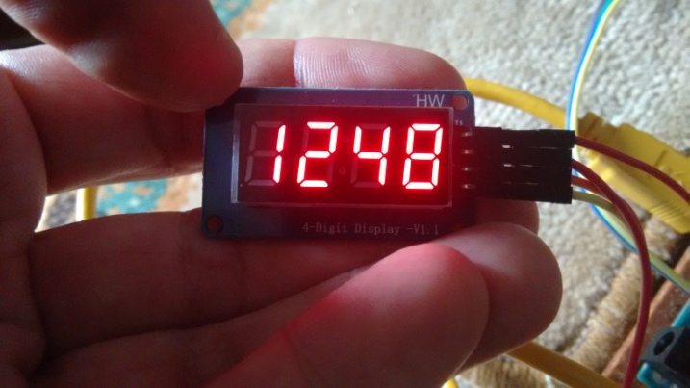
Prikaz 1248
// This program counts from 0 to 10 on the display and
// between each count clears the display.
// Everything can be followed on the serial Monitor.
#include <TM1637Display.h>
#define CLK 2
#define DIO 3
TM1637Display display(CLK, DIO);
uint8_t all_on[] = {0xff, 0xff, 0xff, 0xff};
uint8_t data[] = { 0xff, 0xff, 0xff, 0xff };
void setup() {
display.setBrightness(1);
display.setSegments(all_on);
delay(1000);
display.clear();
delay(1000);
Serial.begin(9600);
}
void loop() {
// Selectively set different digits
data[0] = display.encodeDigit(1);
data[1] = display.encodeDigit(2);
data[2] = display.encodeDigit(4);
data[3] = display.encodeDigit(8);
display.setSegments(data);
delay(1000);
Serial.println(data[0]);
Serial.println(data[1]);
Serial.println(data[2]);
Serial.println(data[3]);
while(true);
}
https://people.vts.su.ac.rs/~pmiki/_DALJINSKA_NASTAVA_MIKROKONTROLERI/19.05/1248.mp4

