Slide 1
TM1637

Slide 2
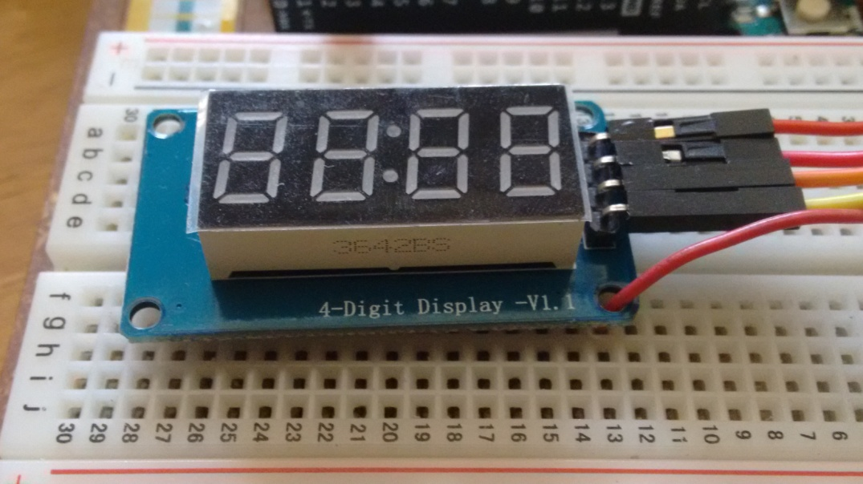
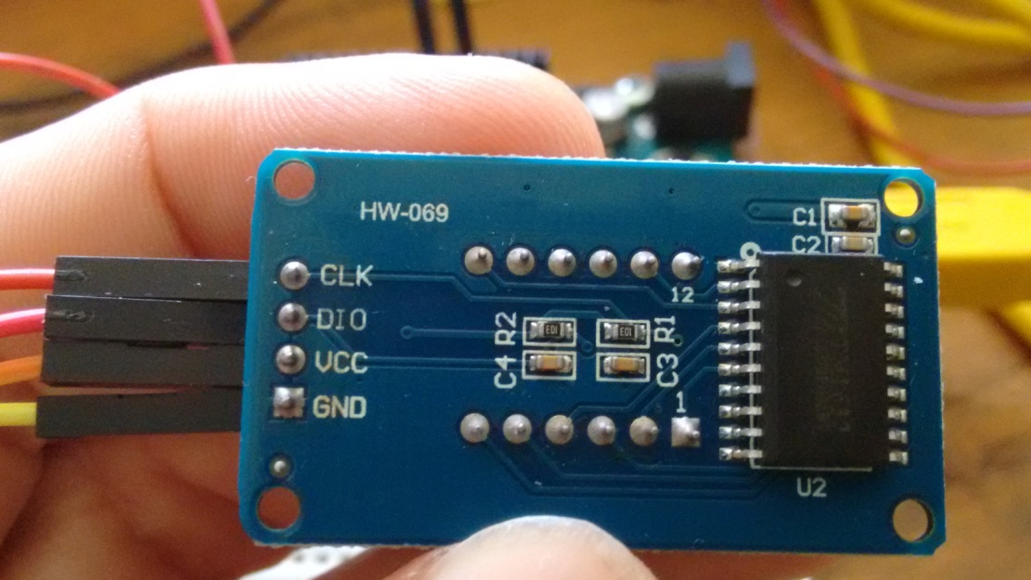
TM1637

Slide 3
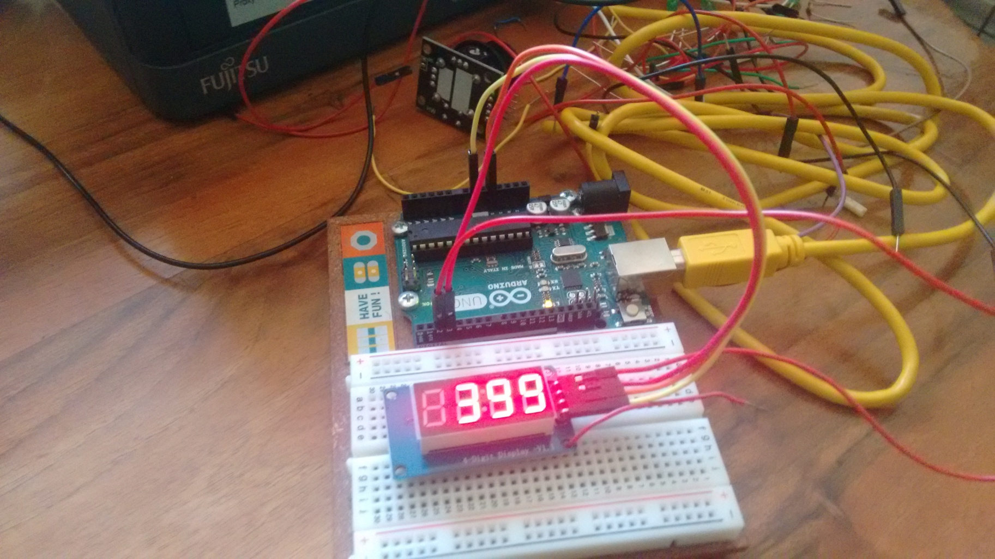
TM1637

Slide 4
Intenzitet displeja
// This program changes the brighness
// on the TM1637 diaplay.
// The current brightness is shown on the Serial Monitor.
#include <TM1637Display.h>
#define CLK 2
#define DIO 3
TM1637Display display(CLK, DIO);
void setup() {
Serial.begin(9600);
}
void loop() {
for (int i=0; i<8; i++){
display.setBrightness(i);
display.showNumberDec(99);
Serial.print("Current brightness of the display: ");
Serial.println(i);
Serial.println("");
delay(1000);
}
}

Slide 5
Brojevi na displeju
// This program sends numbers to the display.
// Numbers are shown on the Serial Monitor.
// Maximal numbers are tested.
#include <TM1637Display.h>
#define CLK 2
#define DIO 3
TM1637Display display(CLK, DIO);
void setup() {
display.setBrightness(1);
Serial.begin(9600);
}
void loop() {
display.showNumberDec(9999);
Serial.println("Number sent to diaplay: 9999");
Serial.println("Shown: 9999");
Serial.println("");
delay(500);
display.showNumberDec(10000);
Serial.println("Number sent to diaplay: 10000");
Serial.println("Shown: 0000");
Serial.println("");
delay(200);
display.showNumberDec(32767);
Serial.println("Number sent to diaplay: 32767");
Serial.println("Shown: 2767");
Serial.println("");
delay(200);
display.showNumberDec(32768);
Serial.println("Number sent to diaplay: 32768");
Serial.println("Shown: 2768");
Serial.println("");
delay(200);

Slide 6
Brojevi na displeju
display.showNumberDec(32769);
Serial.println("Number sent to diaplay: 32769");
Serial.println("Shown: 2767");
Serial.println("");
delay(200);
display.showNumberDec(32770);
Serial.println("Number sent to diaplay: 32770");
Serial.println("Shown: 2766");
Serial.println("");
delay(200);
display.showNumberDec(65535);
Serial.println("Number sent to diaplay: 65535");
Serial.println("Shown: -1");
Serial.println("");
delay(200);
display.showNumberDec(65536);
Serial.println("Number sent to diaplay: 65536");
Serial.println("Shown: 0");
Serial.println("");
delay(200);
display.showNumberDec(65537);
Serial.println("Number sent to diaplay: 65537");
Serial.println("Shown: 1");
Serial.println("");
delay(200);
while(true);
}

Slide 7
Brojač 0-10
void loop() {
for (int counter=0; counter<11; counter++){
display.showNumberDec(counter);
Serial.print("Display is ON. Number on the display is: ");
Serial.println(counter);
delay(800);
display.clear();
Serial.println("Display is OFF.");
Serial.println("");
delay(200);
}
while(true);
}
// This program counts from 0 to 10 on the
// display and between each count clears the
// display. Everything can be followed on the
// Serial Monitor.
#include <TM1637Display.h>
#define CLK 2
#define DIO 3
TM1637Display display(CLK, DIO);
void setup() {
display.setBrightness(1);
Serial.begin(9600);
}

Slide 8
Proizvoljni karakteri
// This program creates custom characters that turns on and off all segments.
// The display is programmed in a segment-by-segment fashion.
#include <TM1637Display.h>
#define CLK 2
#define DIO 3
TM1637Display display(CLK, DIO);
uint8_t all_on[] = {0xff, 0xff, 0xff, 0xff}; // uint8_t is the same as byte
uint8_t blank[] = {0x00, 0x00, 0x00, 0x00};
uint8_t degree[] = {SEG_A | SEG_B | SEG_F | SEG_G};
uint8_t celsius[] = {SEG_A | SEG_D | SEG_E | SEG_F};
uint8_t done[] = {
SEG_B | SEG_C | SEG_D | SEG_E | SEG_G, // d
SEG_A | SEG_B | SEG_C | SEG_D | SEG_E | SEG_F, // O
SEG_C | SEG_E | SEG_G, // n
SEG_A | SEG_D | SEG_E | SEG_F | SEG_G // E
};
void setup() {
display.setBrightness(1);
Serial.begin(9600);
}

Slide 9
Proizvoljni karakteri
void loop() {
for (int i=0; i<4; i++){
display.setSegments(degree,1,i);
delay(500);
display.setSegments(blank);
}
for (int i=3; i>-1; i--){
display.setSegments(degree,1,i);
delay(500);
display.setSegments(blank);
}
display.setSegments(done,4,0);
delay(1000);
display.setSegments(blank);
delay(1000);
}
https://people.vts.su.ac.rs/~pmiki/_DALJINSKA_NASTAVA_MIKROKONTROLERI/19.05/degreeC.mp4

Slide 10
Džojstik
#include <TM1637Display.h>
#define CLK 2
#define DIO 3
TM1637Display display(CLK, DIO);
const int SW_pin = 7; // digital pin connected to SW
const int X_pin = 0; // analog pin connected to VRx
const int Y_pin = 1; // analog pin connected to VRy
int currentNumber;
int timeDelay = 250;
void setup() {
display.setBrightness(1);
digitalWrite(SW_pin, HIGH);
Serial.begin(9600);
display.showNumberDec(currentNumber);
}
void loop() {
if (analogRead(Y_pin)>100 && analogRead(Y_pin)<500){
currentNumber++;
display.showNumberDec(currentNumber);
delay(timeDelay);
}
if (analogRead(Y_pin)<100){
currentNumber = currentNumber + 10;
display.showNumberDec(currentNumber);
delay(timeDelay);
}
if (analogRead(Y_pin)>550 && analogRead(Y_pin)<900){
currentNumber--;
display.showNumberDec(currentNumber);
delay(timeDelay);
}
if (analogRead(Y_pin)>900){
currentNumber = currentNumber - 10;
display.showNumberDec(currentNumber);
delay(timeDelay);
}

Slide 11
Džojstik
if (analogRead(X_pin)<100){
currentNumber = -999;
display.showNumberDec(currentNumber);
delay(timeDelay);
}
if (analogRead(X_pin)>900){
currentNumber = 999;
display.showNumberDec(currentNumber);
delay(timeDelay);
}
if (digitalRead(SW_pin)==LOW){
currentNumber = 0;
display.showNumberDec(0);
delay(timeDelay);
}
}
https://people.vts.su.ac.rs/~pmiki/_DALJINSKA_NASTAVA_MIKROKONTROLERI/19.05/joystick.mp4

Slide 12
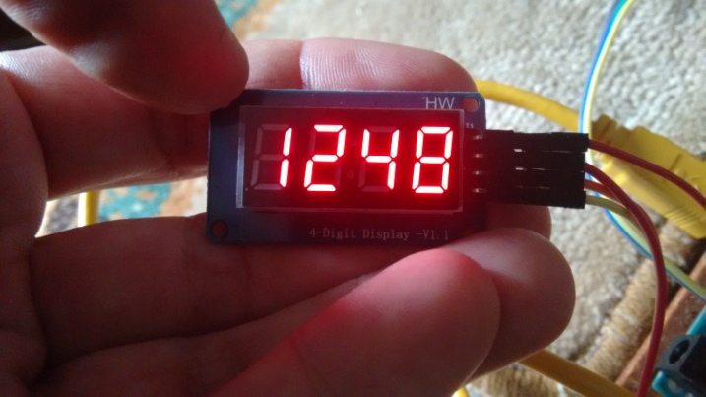
Prikaz 1248
// This program shows 1248 on the display and
// before that lights up all segments of the display.
// Everything can be followed on the serial Monitor.
#include <TM1637Display.h>
#define CLK 2
#define DIO 3
TM1637Display display(CLK, DIO);
uint8_t all_on[] = {0xff, 0xff, 0xff, 0xff};
uint8_t data[] = { 0xff, 0xff, 0xff, 0xff };
void setup() {
display.setBrightness(1);
display.setSegments(all_on);
delay(1000);
display.clear();
delay(1000);
Serial.begin(9600);
}
void loop() {
// Selectively set different digits
data[0] = display.encodeDigit(1);
data[1] = display.encodeDigit(2);
data[2] = display.encodeDigit(4);
data[3] = display.encodeDigit(8);
display.setSegments(data);
delay(1000);
Serial.println(data[0]);
Serial.println(data[1]);
Serial.println(data[2]);
Serial.println(data[3]);
while(true);
}
https://people.vts.su.ac.rs/~pmiki/_DALJINSKA_NASTAVA_MIKROKONTROLERI/19.05/1248.mp4

Slide 13
Brojač unazad 9999-0
#include <TM1637Display.h>
// Module connection pins (Digital Pins)
#define CLK 2
#define DIO 3
// The amount of time (in milliseconds)
// between tests
#define TEST_DELAY 100
TM1637Display display(CLK, DIO);
int count = 9999;
uint8_t data[] = {0, 0, 0, 0};
void setup() {
}
void loop() {
display.setBrightness(0x01);
// display organization
// data[0] data[1] data[2] data[3]
data[3] = display.encodeDigit(count/1 % 10);
data[2] = display.encodeDigit(count/10 % 10);
data[1] = display.encodeDigit(count/100 % 10);
data[0] = display.encodeDigit(count/1000 % 10);
display.setSegments(data);
//display.showNumberDec(count);
if(count <= 0) {
count = 9999;
} else {
count--;
}
delay(TEST_DELAY);
}

Slide 14
Play + brojač unazad 500-0
#include <TM1637Display.h>
const uint8_t OFF[] = {0, 0, 0, 0};
const uint8_t PLAY[] = {B01110011, B00111000, B01011111, B01101110};
TM1637Display display(2, 3);
void setup(){
display.setBrightness(1);
display.setSegments(OFF);
}
void countdown(){
for(int i=500; i>0; i--){
display.showNumberDec(i, false, 4, 0);
delay(40);
}
}
void displayText(){
display.setSegments(PLAY);
delay(2000);
}
void loop(){
displayText();
countdown();
}

Slide 15
Play + brojač unazad 09:59-00:00
// Mcros to retrieve the fractional seconds and minute parts
// of a time supplied inms
#define numberOfSeconds(_time_) ((_time_ / 1000) % 60)
#define numberOfMinutes(_time_) (((_time_ / 1000) / 60) % 60)
#include <TM1637Display.h>
// CONSTANTS
const uint8_t OFF[] = {0, 0, 0, 0};
// The byte order is .gfedcba
const uint8_t PLAY[] = {B01110011, B00111000, B01011111, B01101110};
TM1637Display display(2, 3);
// 1 hour in ms
unsigned long timeLimit = 600000;
void setup(){
Serial.begin(9600);
display.setBrightness(1);
display.setSegments(OFF);
}
void countdown(){
// Calculate the time remaining
unsigned long timeRemaining = timeLimit - millis();
while (timeRemaining > 0){
int seconds = numberOfSeconds(timeRemaining);
int minutes = numberOfMinutes(timeRemaining);
// Display seconds in the last two places
display.showNumberDecEx(seconds, 0, true, 2, 2);
// Display minutes in hte first two places with colon
display.showNumberDecEx(minutes, 0x80>>1, true, 2, 0);
// Update the time remaining
timeRemaining = timeLimit - millis();
}
}
void displayText(){
display.setSegments(PLAY);
delay(2000);
}
void loop(){
displayText();
countdown();
}

Slide 16
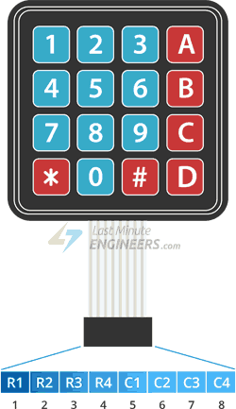
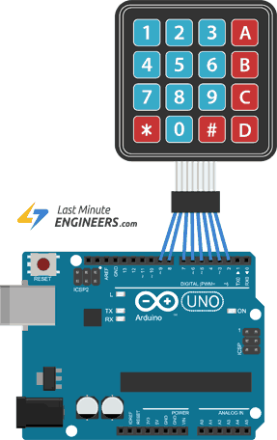
Matrična tastatura

Slide 17
Matrična tastatura

Slide 18
Matrična tastatura – Primer 1.
#include <Keypad.h>
const byte ROWS = 4; //four rows
const byte COLS = 4; //four columns
// Define the Keymap
char hexaKeys[ROWS][COLS] = {
{'1','2','3','A'},
{'4','5','6','B'},
{'7','8','9','C'},
{'*','0','#','D'}
};
byte rowPins[ROWS] = {13, 12, 11, 10};
byte colPins[COLS] = {8, 7, 6, 5};
//initialize an instance of class NewKeypad
Keypad customKeypad =
Keypad( makeKeymap(hexaKeys), rowPins, colPins, ROWS, COLS);
void setup(){
Serial.begin(9600);
}
void loop(){
char customKey = customKeypad.getKey();
if (customKey){
Serial.print("Key pressed: ");
Serial.println(customKey);
Serial.println("");
}
}

Slide 19
Matrična tastatura – Primer 2.
#include <Keypad.h>
int secretCode[]={1,2,3,4};
int myGuess[]={0,0,0,0};
int counter = 0;
int myGoodChoices=0;
const byte ROWS = 4; //four rows
const byte COLS = 4; //four columns
//define the cymbols on the buttons of the keypads
char hexaKeys[ROWS][COLS] = {
{'1','2','3','A'},
{'4','5','6','B'},
{'7','8','9','C'},
{'*','0','#','D'}
};
byte rowPins[ROWS] = {13, 12, 11, 10};
//connect to the row pinouts of the keypad
byte colPins[COLS] = {8, 7, 6, 5};
//connect to the column pinouts of the keypad
//initialize an instance of class NewKeypad
Keypad customKeypad = Keypad( makeKeymap(hexaKeys), rowPins, colPins, ROWS, COLS);
void setup(){
Serial.begin(9600);
}

Slide 20
Matrična tastatura – Primer 2.
for (int i=0; i<4; i++){
Serial.print("Secret: ");
Serial.print(secretCode[i]);
Serial.print(" ");
Serial.print("My guess: ");
Serial.print(myGuess[i]-48);
Serial.println("");
}
Serial.println("");
for (int j=0; j<4; j++){
if (secretCode[j]==myGuess[j]-48){
myGoodChoices++;
}
Serial.print("myGoodChoices= ");
Serial.println(myGoodChoices);
}
if (myGoodChoices==4){
Serial.println("");
Serial.println("Good!");
} else{
Serial.println("Miss!");
}
Serial.println("");
}
}
}
void loop(){
myGoodChoices = 0;
char customKey = customKeypad.getKey();
if (customKey != NO_KEY){
myGuess[counter]=customKey;
Serial.println(customKey);
counter++;
//Serial.print("Current counter value is: ");
//Serial.println(counter);
if (counter==4){
Serial.println("");
Serial.print("The four digit guess is: ");
for(int i=0; i<4; i++){
Serial.print(char(myGuess[i]));
//Serial.println(myGuess[i]);
Serial.print(" ");
}
Serial.println("");
Serial.println("");
counter=0;

Slide 21
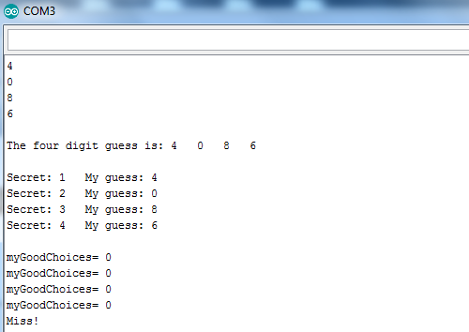
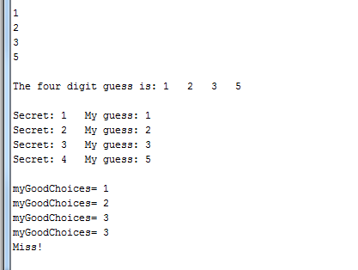
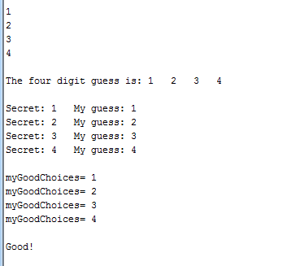
Matrična tastatura – Primer 2.

Slide 22
Matrična tastatura – Primer 3.
#include <Keypad.h>
int secretCode[]={1,2,3,4};
int myGuess[]={0,0,0,0};
boolean array_cmp;
int counter = 0;
int myGoodChoices=0;
const byte ROWS = 4; //four rows
const byte COLS = 4; //four columns
//define the symbols on the buttons of the keypads
char hexaKeys[ROWS][COLS] = {
{'1','2','3','A'},
{'4','5','6','B'},
{'7','8','9','C'},
{'*','0','#','D'}
};
byte rowPins[ROWS] = {13, 12, 11, 10};
//connect to the row pinouts of the keypad
byte colPins[COLS] = {8, 7, 6, 5};
//connect to the column pinouts of the keypad
//initialize an instance of class NewKeypad
Keypad customKeypad = Keypad( makeKeymap(hexaKeys), rowPins, colPins, ROWS, COLS);
void setup(){
Serial.begin(9600);
pinMode(2, OUTPUT);
pinMode(3, OUTPUT);
pinMode(4, OUTPUT);
}
void loop(){
char customKey = customKeypad.getKey();
if (customKey>='0' && customKey<='9'){
Serial.println(customKey);
Serial.println("Number");
Serial.println("");
digitalWrite(2, HIGH);
delay(200);
digitalWrite(2, LOW);
}

Slide 23
Matrična tastatura – Primer 3.
if (customKey>='A' && customKey<='D'){
Serial.println(customKey);
Serial.println("Letter");
Serial.println("");
digitalWrite(3, HIGH);
delay(200);
digitalWrite(3, LOW);
}
if (customKey=='*' || customKey=='#'){
Serial.println(customKey);
Serial.println("Special character");
Serial.println("");
digitalWrite(4, HIGH);
delay(200);
digitalWrite(4, LOW);
}
}

Slide 24
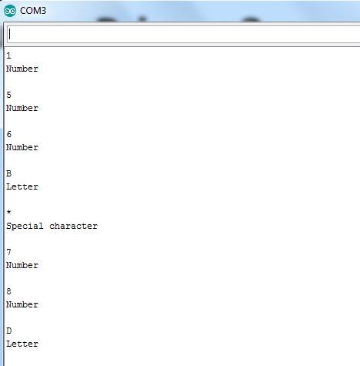
Matrična tastatura – Primer 3.

