Slide 1
Arduino Primeri

Slide 2
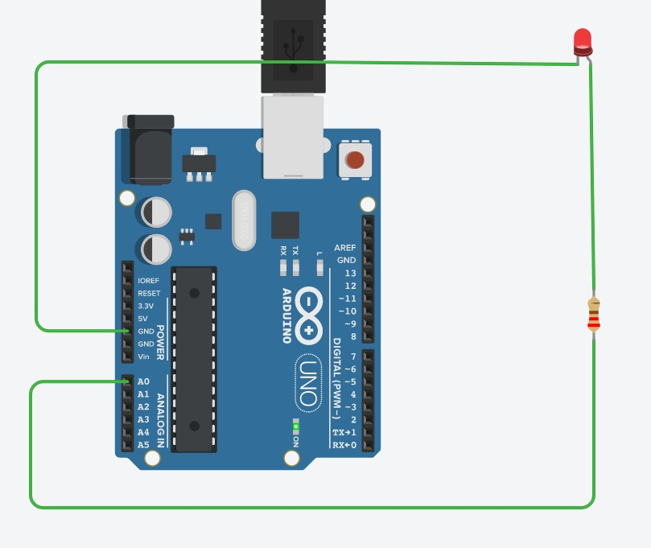
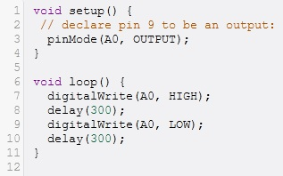
A0-A5 digitalni
Analogne nožice A0-A5 takođe mogu da se koriste kao digitalni I/O.

Slide 3
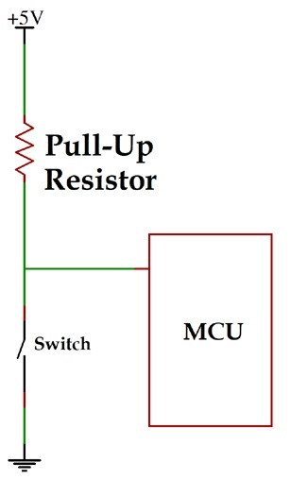
Pull-up otpornici

Slide 4
PWM modul
PWM – Pulse Width Modulation
(Impulsno Širinska Modulacija)
Simulacija analognih signala na digitalnim I/O nožicama
PWM nožice: Arduino Uno (3, 5, 6, 9, 10, 11): ~
PWM frekvencija: 490Hz, pins 5,6: 980Hz

Slide 5
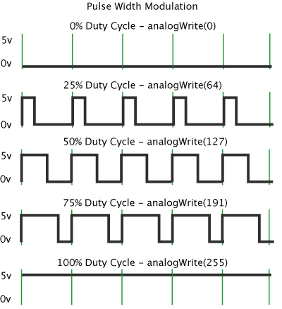
PWM modul
Duty cycle (faktor ispune)
Sintaksa:
analogWrite(pin, value)
value -> (0-255),
(0 – 0%, 255 – 100%)

Slide 6
VEŽBA
Promena intenziteta LED-a korišćenjem PWM modula

Slide 7
Zadatak
Sastaviti hardver i napisati softver za promenu intenziteta osvetljenja LED-a korišćenjem PWM modula.
Intenzitet LED-a menjati od 0% do 100% i nazad do 0%.
Svaki položaj držati po 30ms.

Slide 8
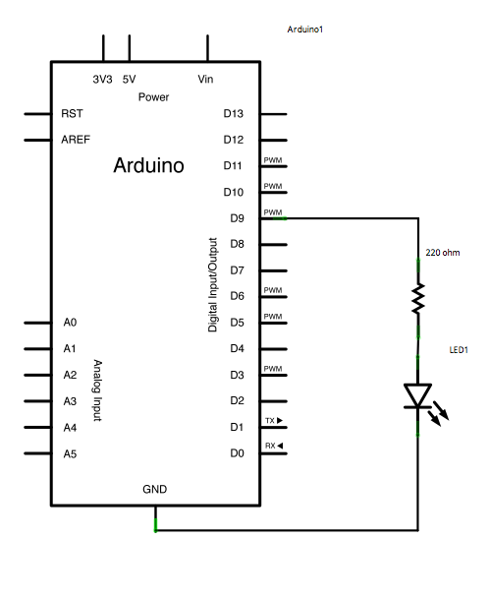
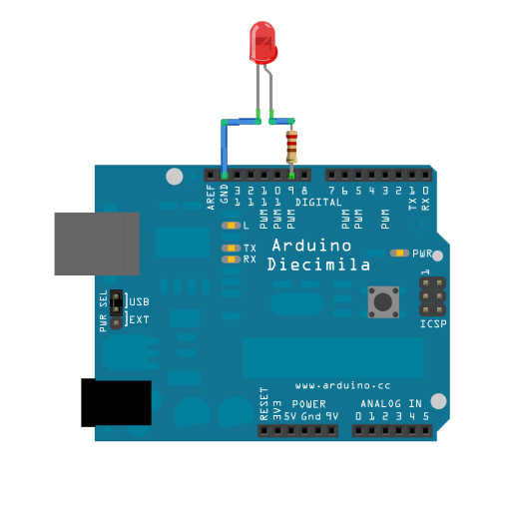
Hardver

Slide 9
Softver
int led = 9; // the PWM pin the LED is attached to
int brightness = 0; // how bright the LED is
int fadeAmount = 5; // how many points to fade the LED by
// the setup routine runs once when you press reset:
void setup() {
// declare pin 9 to be an output:
pinMode(led, OUTPUT);
}

Slide 10
Softver
void loop() {
// set the brightness of pin 9:
analogWrite(led, brightness);
// change the brightness for next time through the loop:
brightness = brightness + fadeAmount;
// reverse the direction of the fading at the ends of the fade:
if (brightness <= 0 || brightness >= 255) {
fadeAmount = -fadeAmount;
}
// wait for 30 milliseconds to see the dimming effect
delay(30);
}

Slide 11
Analiza programskog koda
U ovom primeru koristi se funkcija analogWrite().
analogWrite() koristi PWM, tako da treba biti pažljiv na koju nožicu se priključuje LED.
Nožice sa mogućnošću PWM-a obeležene su znakom “~”.
analogWrite(led, 0) pali LED minimalnim intenzitetom.
analogWrite(led, 255) pali LED maksimalnim intenzitetom.

Slide 12
Analiza programskog koda
int led = 9; // PWM nozica na koju je prikljucen LED
int brightness = 0; // osvetljaj LED-a na pocetku
int fadeAmount = 5; // za koliko da se promeni
//intenzitet LED-a u svakom koraku
// setup ce se izvrsiti jednom nakon reset-a
void setup() {
// deklaracija nozice 9 kao izlazne:
pinMode(led, OUTPUT);
}

Slide 13
Analiza programskog koda
void loop() {
// postavljanje pocetnog intenziteta LED-a:
analogWrite(led, brightness);
// promena intenziteta za sledeci prolazak kroz cilkus loop():
brightness = brightness + fadeAmount;
// na kraju intervala promena smera promene intenziteta:
if (brightness <= 0 || brightness >= 255) {
fadeAmount = -fadeAmount;
}
// cekanje 30ms kako bi se videla promena intenziteta
delay(30);
}

Slide 14
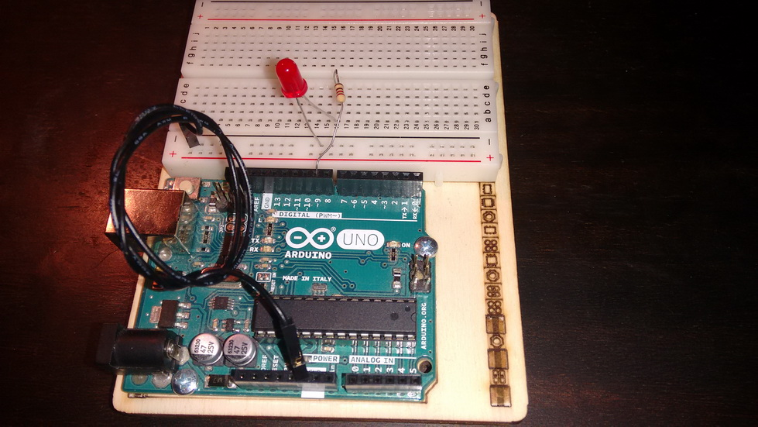
Izgled gotovog uredaja

Slide 15
Zadatak za samostalni rad
Promeniti vrednost promenljive fadeAmount i pratiti na koji način se menja izvršavanje programa.
Promeniti vreme čekanja između uzastopnih stanja (30ms) i pratiti kako se menja način izvršavanja programa.
Priključiti još jedan LED i paralelno povećavati i smanjivati intenzitete. LED-ovi treba da rade u kontrafazi (jedan svetli sve jače, dok drugi svetli sve slabije).

Slide 16
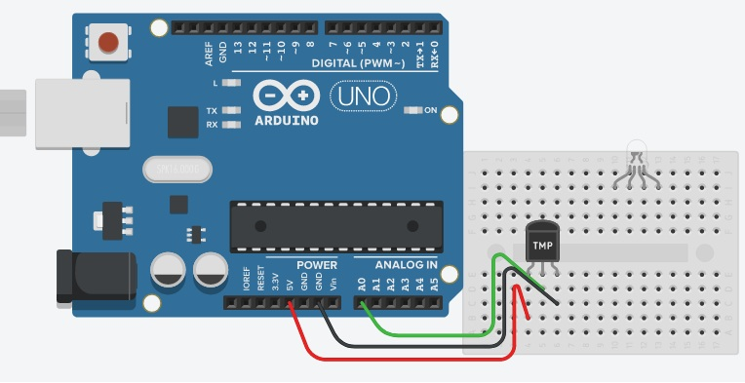
Merenje temperature

Slide 17
Merenje temperature
char degree = 176; //ASCI value of Degree
void setup()
{
pinMode(A0,INPUT);
Serial.begin(9600);
}
/*
The LM35 or TMP36 is an analog linear temperature sensor.
This means that the output voltage is proportional
to the temperature. The output voltage rises
by 10mv for every 1 degree Celsius rise in temperature.
The Arduino can read input from 0-5v.
The Arduino stores this as a 10bit number(0-1023).
Note that circuit configuration for TMP36 and LM35 both are same :)
*/
void loop()
{
int tmp = analogRead(A0); // Reading data from the sensor.This voltage is stored as a 10bit number.
float voltage = (tmp * 5.0)/1024; // (5*temp)/1024 is to convert the 10 bit number to a voltage reading.
float milliVolt = voltage * 1000; // This is multiplied by 1000 to convert it to millivolt.
float tmpCel = (milliVolt-500)/10 ; // For TMP36 sensor. Range(−40°C to +125°C)
// Important Note: use (tmpCel = milliVolt / 10;) For LM35 sensor. Range(−55°C to +150°C) with accury 0.5 and better then TMP36

Slide 18
Merenje temperature
/*
OR use this to direct convert 10 bit number to Celsius.
For LM35 sensor -> tmpCel = ((tmp/1024)*500);
For TMP36 sensor -> tmpCel = (((tmp/1024)*5)-0.5) *100;
*/
float tmpFer = (((tmpCel*9)/5)+32); // used to convert Celsius -> // Fahrenheit
Serial.print("10bit number(0-1023): ");
Serial.println(tmp);
Serial.print("voltage: ");
Serial.print(voltage);
Serial.println("V");
Serial.print("millivolt: ");
Serial.print(milliVolt);
Serial.println("mV");
Serial.print("Celsius: ");
Serial.print(tmpCel);
Serial.println(degree);
Serial.print("Fahrenheit: ");
Serial.println(tmpFer);
Serial.println("");
delay(1000);
}

